Slide 1
Berrien County Health Department – Performance Management Staff Training
Developed for BCHD by MPHI
Jessie Jones and Brittney Spitzley

Slide 2
Objectives
This training will:
Dive into an overview of Performance Management
Discover what this means for your work

Slide 3
First – A Question
What comes to your mind when you hear the term, “Performance Management?”

Slide 4
What is Performance Management?
Some Definitions:
A systematic process aimed at helping achieve an organization’s mission and strategic goals by improving effectiveness, empowering employees, and streamlining the decision-making progress.
-Public Health Foundation
A systematic process by which an agency involves employees…in improving organizational effectiveness in the accomplishment of agency mission and goals.
-US Office of Personnel Management
Notes:
What is performance management?
The two definitions on the screen have a few important things in common:
Systematic process
Involves employees
Seeks to improve effectiveness of agency activities
Aimed at measuring achievement of agency-level mission and goals

Slide 5
Performance Management Purpose
“…to move the field of public health from simply measuring performance of individual programs to actively measuring and managing performance of an entire agency system.”
Silos to Systems: Using Performance Management to Improve the Public’s Health.
Turning Point Performance Management National Excellence Collaborative:
Seattle, WA; Turning Point National Program, 2003
Notes:
You all are very familiar with the idea of accountability, setting objectives, evaluating your programs.
However, these activities tend to be linked to specific grants or funding streams, they rarely cross the agency, and they are not typically explicitly linked to the overall vision and mission of your agency.
Performance management isn’t about the performance of people or programs, its about managing the performance of the agency against agency wide objectives that are linked to the agency’s mission and vision

Slide 6
What is Performance Management?
Purpose:
Identifying Goals
Using Data
Driving Improvement
Notes:
The purpose of performance management is to determine whether your organization is reaching its goals. This involves regularly tracking data related to organizational goals, using data to determine whether the organization is making progress toward goals, and putting improvement activities in place when data indicate the need.

Slide 7
Why this?
The Importance of Performance Measurement:
A part of the foundation for decision making
Alignment of efforts with agency strategic direction
Shift in focus from individuals/activities to results
Meaningful feedback to employees
Helps identify improvement opportunities
Promotes learning and improvement culture
Notes:
There are many reasons why performance management is an important activity for public health agencies. These include:
It allows agencies to use data for decision making
It ensures strategic priorities are implemented and achievement is measured
It focuses on organizational-level results/outcomes
Employees have meaningful feedback about the outcomes of what they do
When data show that the agency isn’t making adequate progress toward a goal, it allows easy identification of opportunities for improvement
And finally, when an agency is regularly using its data to examine the outcomes of activities and uses the data to learn, this provides the basis for a learning organization and a culture of quality

Slide 8
Performance Management can be a powerful tool!
Notes:
Performance management can be a powerful tool. It allows for:
Communication
…of progress and accomplishments inside and outside the organization
Motivation
…for employees and partners
Illumination
…shedding light on what works and what doesn’t
Allocation
…informing decision about where to focus resources and efforts

Slide 9
Performance Management One Step at a Time
A fully functional performance management system should be created over time
Start with:
Communication
Planning
Existing resources
Notes:
It helps to think about performance management like you might think of working toward any other goal, like, for example, training for a race:
It takes planning, dedication, and time
It requires setting mini goals along the way
It can be painful at first, but the training eventually becomes its own reward
The payoff is great

Slide 10
Performance Management starts with a vision… and some data
Vision & Mission
Community Health Assessment
Where are we now?
Community Health Improvement Plan
Where do we need to go as a public health system?
Agency Strategic Plan
Where do we need to go as a public health agency?
Quality Improvement Plan
What are we working to improve?
Program Logic Models
What do we do & how do we do it?
Notes:
This work builds off of what you have – a vision & mission – and what you may have done or be working towards – an assessment of health status and a system wide plan to improve health status – and what that means for your agency.

Slide 11
A Model for Performance Management
Notes:
Based on the Turning Point model for quality improvement.
This system allows you to:
Know where you stand relative to organizational goals and standards for performance,
Measure progress toward your goals as a health department,
Regularly monitor and report performance, and
Inform opportunities for quality improvement.

Slide 12
A Brief Look into Each Component
Notes:
Next we will look into each component briefly.

Slide 13
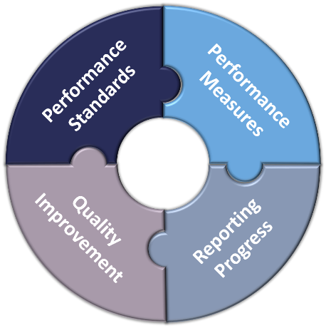
Performance Standards
Objective standards that are used to assess an organization’s performance
Steps:
Identify set goals/priorities
Set targets
Communicate expectations
Notes:
The steps for Performance standards include:
Identify relevant standards starting with agency goals as described in your vision, mission, and strategic plan, and looking to generally accepted standards for performance to find standards that align.
Set targets for the performance of your agency related to each indicator.
Communicate expectations for performance with agency staff and stakeholders to build awareness and gain buy-in.

Slide 14
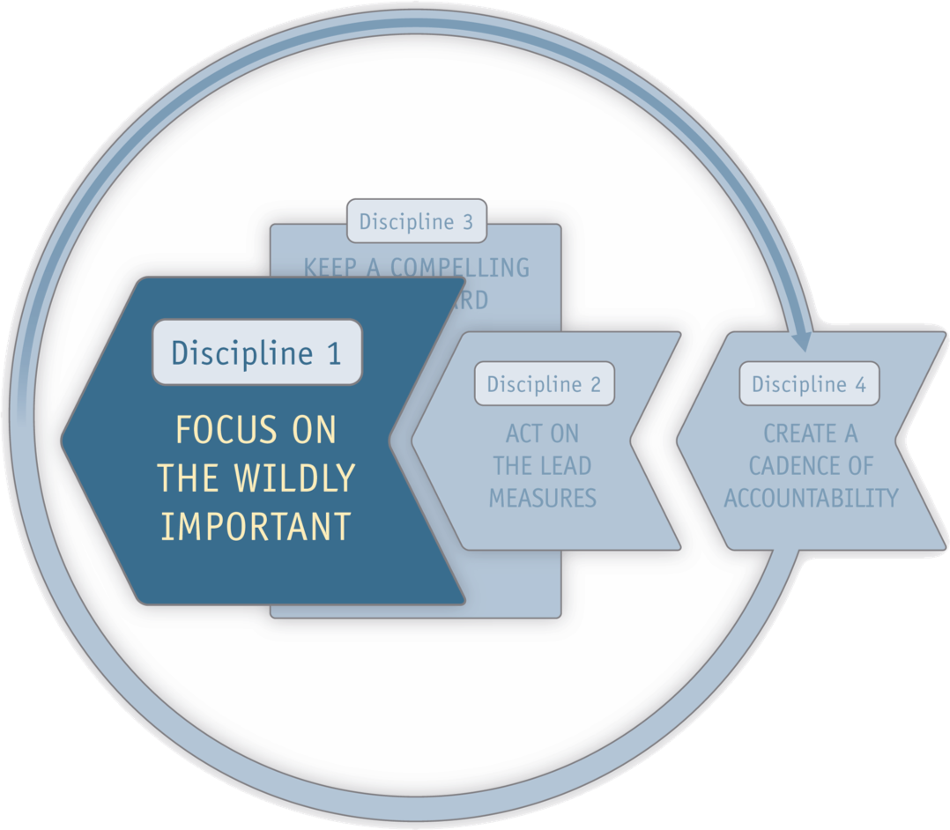
Performance Standards
Notes:
Berrien County Health Department is also incorporating the 4 Disciplines of Execution (or 4DX) into its performance management activities.
Discipline 1 is “Focus on the Wildly Important.” This involves narrowing your focus to a few highly important goals so the agency can manageably achieve them in the midst of the whirlwind of the day job.

Slide 15
Performance Measures
Performance measures are:
Quantitative
Related to identified goals/standards
Steps include:
Select measures
Create operational definitions for measures
Identify/develop data tracking tool
Collect data
Notes:
Your performance measures should be “quantitative measures of capacities, processes, or outcomes relevant to assessment of your performance indicators.”
– Turning Point Performance Management National Excellence Collaborative, 2004
Selected measures should let you know if you’re getting closer to achieving your performance standards.
Performance Measurement involves:
Selecting measures for each performance standard so you know what data are needed to tell if you are making progress,
Creating operational definitions for measures so staff understand how measures are defined and calculated, to ensure all are measuring the same thing in the same way;
Identifying or developing data tracking tools to make sure data are collected routinely and stored appropriately; and
Collecting data on a regular and ongoing basis.

Slide 16
Performance Measures
Notes:
4DX Discipline 2 is, “Act on the Lead Measures.”
While a lag measure tells you if you've achieved the goal, a lead measure tells you if you are likely to achieve the goal.
No matter what you are trying to achieve, your success will be based on two kinds of measures: Lag and Lead. Lag measures track the success of your wildly important goal. Lags are measures you spend time losing sleep over. They are things like revenue, profit, quality, and customer satisfaction. They are called lags because by the time you see them, the performance that drove them is already passed. You can’t do anything to fix them, they are history.
Lead measures are predictive of whether you will make progress toward your goal. They are process measures that your agency can act on to improve your ability to reach your goals. Lead measures are useful to include in your performance management system.

Slide 17
Reporting of Progress
Steps include:
Analyzing data
Reporting results
Develop a regular reporting cycle
A critical step!
Keeps you accountable
Provides you support
Notes:
After you have set in motion your system for performance measurement, you will need a system and timeline for reporting progress. This helps ensure that standards and measures are regularly reviewed and used. It also creates a system that is transparent, which helps drive monitoring and improvement.
Your system for reporting should include plans for:
Analyzing data on a set schedule and interpreting findings based on your standards and measures
Reporting results broadly through an established, routine mechanism that reaches all relevant stakeholders
Developing a regular reporting cycle so that staff know when to analyze data and create reports, and to ensure that managers and others are kept regularly apprised of progress.
Reports should compare performance measures with their target, and they should link measures to overall goals
They should provide context, and they should be targeted to a specific audience
They should also be routine – reports should be produced on a schedule – this means that they should also be straightforward, easy to produce, and easy to understand
This is a critical step!
Keeps you accountable to stakeholders who are expecting and review the reports
Provides you support for requests for resources

Slide 18
Reports of Progress
Keep a compelling scorecard
Notes:
4DX Discipline 3 is, “Keep a Compelling Scorecard.”
The lag and lead measures you include in your performance management system won’t have much meaning to the team unless they can see the progress in real time. Bowling through a curtain is not that much fun. Discipline 3 is the discipline of engagement. People perform best when they are emotionally engaged and the highest level of engagement comes when people who the score: whether they are winning or losing the game. It's that simple.
The best scoreboard is designed for, and often by the players. A player’s scoreboard is quite different from the complex scoreboard that coaches love to make. If players know the score, if they can influence the lead measure and if the lead measure moves the lag measures, you know you have a winnable game. Disciplines 1, 2 and 3 are nothing more than a formula for creating a winnable game. Discipline 4 is how we play that game.
The scoreboard is not just for the leaders. The scoreboard is for the whole team. To drive execution you need a players' scoreboard that has a few simple graphs on it indicating: Here's where we need to be and here's where we are right now.
With a successful scoreboard, anyone looking at it can determine in five seconds or less whether the team is winning or losing.

Slide 19
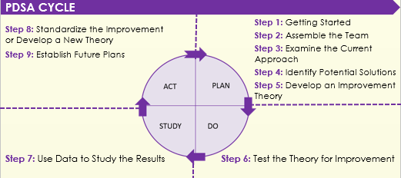
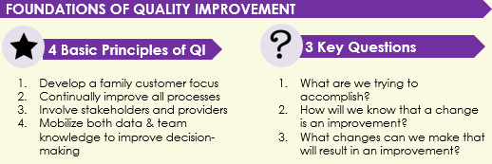
Quality Improvement
Notes:
Quality improvement is the final component of a performance management system.
Quality improvement is where a performance management system creates opportunity for meaningful improvement within your public health agency. It is about learning to use data on how you are performing to drive activities that lead to true improvement.
It involves:
Using data to:
Make decisions about where to focus your improvement efforts
Manage the changes that arise, and
Create a learning organization – one that uses data to learn about the processes, and experiences to constantly improve
As part of a Performance Management system, an established quality improvement process:
Brings consistency to the agency’s approach to managing performance
Motivates improvement
Helps capture lessons learned

Slide 20
Quality Improvement
Notes:
The 4th Discipline in the 4DX model is “Create a Cadence of Accountability.”
Each team engages in a simple regular process that highlights successes, analyzes failures, and course-corrects as necessary, creating the ultimate performance-management system.
‘What are the one or two most important things I can do this week that will have the biggest impact on the scoreboard?” In the meeting, each team member reports first if they met last week’s commitments, second if the commitments move the lead or lag measures on the scoreboard and finally which commitments they will make for the upcoming week.
With Discipline 4, accountability is shared. Commitments are not only made between leaders and their teams, they are made between individuals on the teams. By keeping weekly commitments, team members influence the lead measure, which in turn is predictive of success on the lag measure of the WIG.

Slide 21
Performance Management at BCHD: Everybody plays a part
HEALTH OFFICER
Provide visible leadership
Set the tone
Communicate plans and results with Board of Health
DEPUTY HEALTH OFFICER
Work with staff at all levels to develop objectives
Prepare summary and annual reports
Link with the QI team
Share staff development opportunities
Notes:
There is a role for everyone at BCHD in the performance management system. These three slides describe the different responsibilities for performance management based on role within the health department.

Slide 22
Performance Management at BCHD: Everybody plays a part
BCHD LEADERSHIP TEAM
Review data monthly
Identify opportunities for improvement
Provide feedback and guidance to teams
Guide and support data collection, analysis, and evaluation
Provide input on objectives and measures; solicit input from staff
Include performance management in staff meetings
Include relevant details on work plans of staff at all levels

Slide 23
Performance Management at BCHD: Everybody plays a part
ALL STAFF
Identify gaps and discuss with supervisor/manager
Be familiar with performance standards and measures
Actively participate to achieve objectives relevant to their program
Participate as asked on QI teams
BOARD OF HEALTH
Provide high-level oversight and accountability
Provide an outside perspective
Support Health officer in communicating plans, process, and results for improving performance with Board of Commissioners

Slide 24
Questions? Comments?
Notes:
What questions do you have?
What are you still working out?
What ideas came to mind?
What are you excited about?
Record these observations and share with your supervisor.

Slide 25
Thank you!
Notes:
Thank you for spending your time learning about BCHD’s performance management system. Together, we can work to make Berrien County a healthy place to live.

