Slide 1
“Leaders are visionaries with a poorly developed sense of fear and no concept of the odds against them. They make the impossible happen.” -Dr. Robert Jarvik

Slide 2
LESSON 15
Part I: "Use the formula P=40 to 70, in which P stands
for the probability of success and the numbers indicate
the percentage of information acquired.”
Part II: "Once the information is in the 40 to 70 range,
go with your gut."
Don't take action if you have only enough information to give you less than a
40 percent chance of being right, but don't wait until you have enough facts to
be 100 percent sure, because by then it is almost always too late. Today,
excessive delays in the name of information-gathering breeds "analysis paralysis." Procrastination in the name of reducing risk actually increases risk.

Slide 3
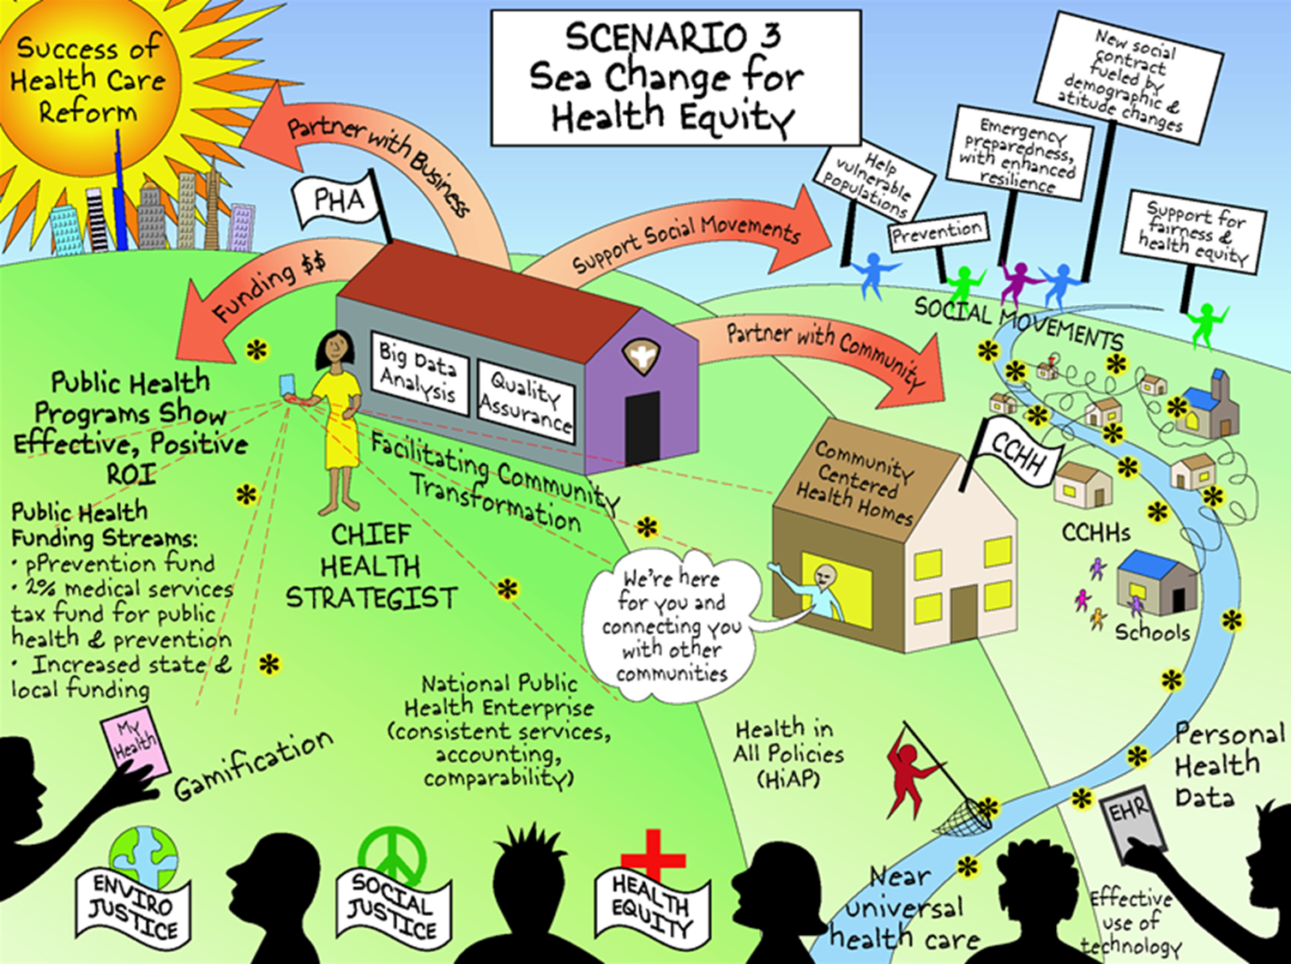
KCMO Health Dept.
http://www.altfutures.org/wp-content/uploads/2016/04/IAF-PublicHealth2030Scenarios.pdf
/LEAD
& Catalyst
Notes:
Pg 300 http://www.altfutures.org/wp-content/uploads/2016/04/IAF-PublicHealth2030Scenarios.pdf
Public Health 2030: A Scenario Exploration
What will be the greatest accomplishments for public health in the next two decades? What obstacles may prove insurmountable? What will public health look like in the U.S. in the year 2030? What should public health leaders be doing today? What do we want public health to be in the U.S. in 2030 that can inform today’s agenda?
Public health leaders have an opportunity to influence which future unfolds and how. IAF has developed alternative public health scenarios to invite readers to recognize that the future is uncertain, but can be bounded using the knowledge we have today. IAF’s Public Health 2030 project and report equips leaders with a broader awareness of the relevant trends and forces so that they can more adroitly shape the future of public health. The national report also offers “robust” strategies that were developed by leaders and experts from across the U.S. at a national workshop, and will be effective and advance the field no matter what the future holds.
Organizations and communities can use the scenarios as a living tool for strategy formulation by using them to:
Test whether current strategies will be effective in the different scenarios.
Formulate strategies to more effectively adapt to the changing environment.
Assure that strategic plans address the larger picture and longer-term futures for the public health community.
The Public Health 2030 project was supported by funding from the Robert Wood Johnson Foundation and the Kresge Foundation.
National Public Health 2030 Scenario Report
Scenarios for public health in 2030 and recommendations for working toward a preferred future
Local, state, and national organizations and leaders in public health can use Public Health 2030: A Scenario Exploration to consider uncertainties, trends, and forces that will shape public health and public health organizations.

Slide 4
“
It is the strength required to bring about social political, or economic changes.
In this sense power is not only desirable but necessary in order to implement the demands of love and justice. ”
-Martin Luther King, Jr
@RexArcherMD
http://grassrootspolicy.org/wp-content/uploads/2017/03/GPP_4FacesOfPower.pdf
Notes:
Health equity means social justice in health.
It means that we work toward community health and prevention to achieve the highest level of health for all people, meaning everyone has the same opportunity to live a long, healthy life.
B/c Violence is preventable and safety is possible….
Let us rise to meet this moment of urgency and opportunity, while working smarter and stronger, together.

Slide 5
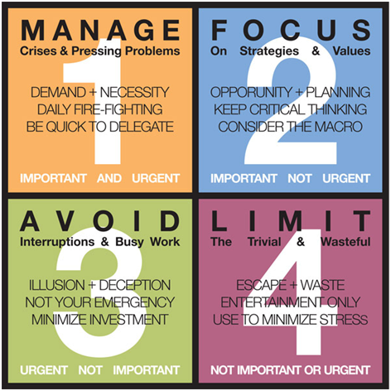
Relationship Building

Slide 6
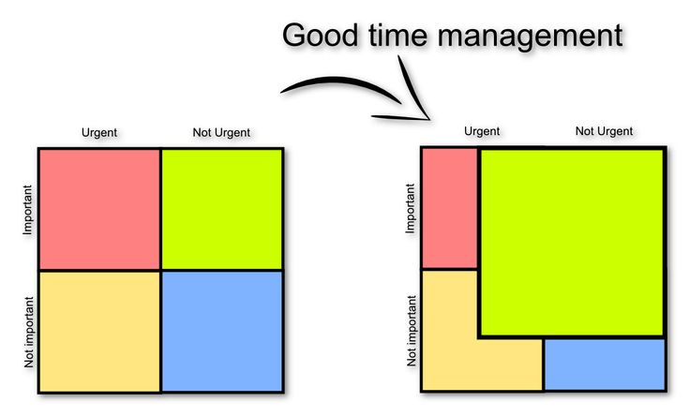
“What is important is seldom urgent and
What is urgent is seldom important.”
- Dwight Eisenhower, 34th U.S. President

Slide 7
Front Wall
“If not us, who? If not now, when?”
– John F. Kennedy
Back Wall
“Our lives begin to end the day we become silent about things that matter.”
- Dr. Martin Luther King, Jr.
West Wall
“All diseases have two causes, one pathological, the other political.”
-Rudolph Virchow
East Wall
“Public health is the constant redefinition of the unacceptable.”
-Geoffrey Vickers

Slide 8
“The greater danger for most of us is not that our aim is too high and we miss it, but that our aim is too low and we reach it.”
Michelangelo Di Lodovico Buonarroti Simoni,
Italian Renaissance sculptor, painter, architect, and poet, March 6, 1475, Caprese, Republic of Florence, Feb. 18, 1564, Rome

