Slide 1
What’s Working Right Now: Low-Cost Tools from Local Health Departments
July 7, 2026

Slide 2

Agenda
Welcome
Presentation
  Bend It Like REDCap: Leveraging REDCap to Build End-to-End Project Management Systems
  Mapmaking in R
Q&A
Closing

Slide 3
General Information
Recording: This webinar is being recorded. A link to the recording will be shared with participants.
Audio: All participant are muted to minimize background noise. Please remain muted and raise your hands to ask questions.
Questions: We encourage your questions! Use the Q&A feature to drop your questions or raise your hand to come off mute. Questions will be addressed during the designated Q&A portion.
Technical Issues: If you experience any technical difficulties, try refreshing your browser or exiting and rejoining the session. You can also reach out in the chat for assistance.

Slide 4





About NACCHO
NACCHO is comprised of nearly 3,300 local health departments (LHDs) across the United States. Our mission is to serve as a leader, partner, catalyst, and voice with local health departments.
Advocacy
Partnerships
Funding
Training and Education
Networking
Resources, tools, and technical assistance

Slide 5
Bend It Like REDCap: Leveraging REDCap to Build End-to-End Project Management Systems
Jennifer Lowe

Slide 6

BEND IT LIKE REDCAP:
LEVERAGING REDCAP TO BUILD AN END-TO-END PROJECT MANAGEMENT SYSTEM
Jennifer Lowe | 2026 NACCHO Webinar

Slide 7
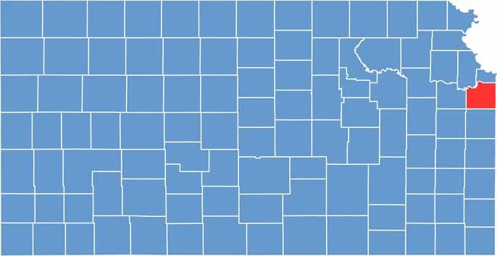

Johnson County, Kansas
Suburb of Kansas City
Most populous county in Kansas
  620,000 people

Slide 8
How did we get here?
Johnson County Epidemiology formed in 2020
  Result of COVID-19 Pandemic
Expansion from 2 to 8 population health epidemiology staff
After COVID – what now?

Slide 9
The Challenge

Slide 10

The Challenge
Multiple Channels,
No Single System
Requests arrived via email, phone, and informal conversations — with no centralized way to track them.

Slide 11

The Challenge
Multiple Channels,
No Single System
No Visibility
into Capacity
Requests arrived via email, phone, and informal conversations — with no centralized way to track them.
Staff had no shared view of workload, scope, or bandwidth, making prioritization reactive rather than planned.

Slide 12

The Challenge
Multiple Channels,
No Single System
No Visibility
into Capacity
Shifting Public Health
Priorities
Requests arrived via email, phone, and informal conversations — with no centralized way to track them.
Staff had no shared view of workload, scope, or bandwidth, making prioritization reactive rather than planned.
Greater emphasis on program evaluation increased request volume and complexity

Slide 13
The Challenge
Multiple Channels,
No Single System
No Visibility
into Capacity
Shifting Public Health
Priorities
Requests arrived via email, phone, and informal conversations — with no centralized way to track them.
Staff had no shared view of workload, scope, or bandwidth, making prioritization reactive rather than planned.
Greater emphasis on program evaluation increased request volume and complexity
These gaps underscored the need for clearer project assignments, roles, and workflow.

Slide 14
The Solution: A REDCap Project Management System
First utilized during COVID pandemic for case investigation and reporting
No new learning curve for project design
Free tool – hosted by Johnson County Department of Technology and Innovation
Notes:
Considered:
Excel: too many rogue spreadsheets; easier to break
Microsoft Forms: couldn’t connect project outcomes within the form itself. Not enough options/fields to build what we want without manual data connection

Slide 15
The Solution: A REDCap Project Management System
First utilized during COVID pandemic for case investigation and reporting
No new learning curve for project design
Free tool – hosted by Johnson County Department of Technology and Innovation
Standardization
Leverages Existing Infrastructure
No new software & free application.
Consistent forms and workflows mean every project is tracked the same way, regardless of who handles it.
Notes:
Considered:
Excel: too many rogue spreadsheets; easier to break
Microsoft Forms: couldn’t connect project outcomes within the form itself. Not enough options/fields to build what we want without manual data connection

Slide 16
Inside the Tool: Forms & Features
Request Form
Screening Assessment
Structured intake collects project type, requestor, purpose, and data needs; auto-sends communication to kick off screening.
Internal form to evaluate staff capacity, technical requirements, and feasibility before accepting a project.
Assignment & Scope
Timelines & Milestones
Assign projects based on screening results and auto-generate scope of work agreements between epi staff and requestors.
Staff log key milestones and deliverables; built-in date calculations flag overdue tasks and project pace.
Alerts & Notifications
KPIs
Automated alerts notify staff and supervisors of new requests, pending deadlines, drafts to review and status changes.
Calculates completion timelines, QA benchmarks, workload distribution, and project status.

Slide 17
Inside the Tool: Forms & Features
Request Form
Screening Assessment
Structured intake collects project type, requestor, purpose, and data needs; auto-sends communication to kick off screening.
Internal form to evaluate staff capacity, technical requirements, and feasibility before accepting a project.
Assignment & Scope
Timelines & Milestones
Assign projects based on screening results and auto-generate scope of work agreements between epi staff and requestors.
Staff log key milestones and deliverables; built-in date calculations flag overdue tasks and project pace.
Alerts & Notifications
KPIs
Automated alerts notify staff and supervisors of new requests, pending deadlines, drafts to review and status changes.
Calculates completion timelines, QA benchmarks, workload distribution, and project status.

Slide 18
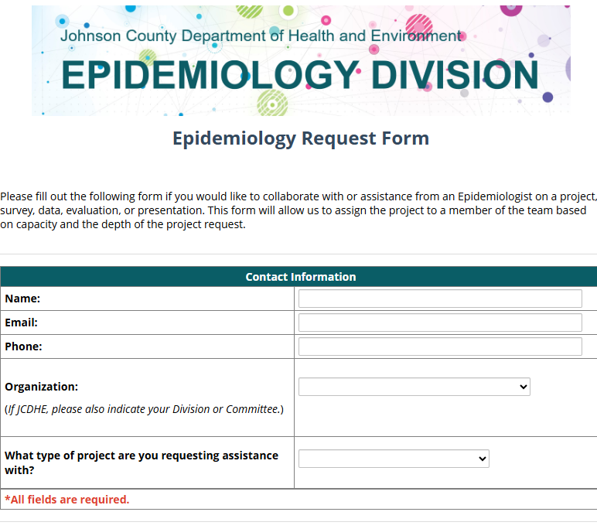

Slide 19
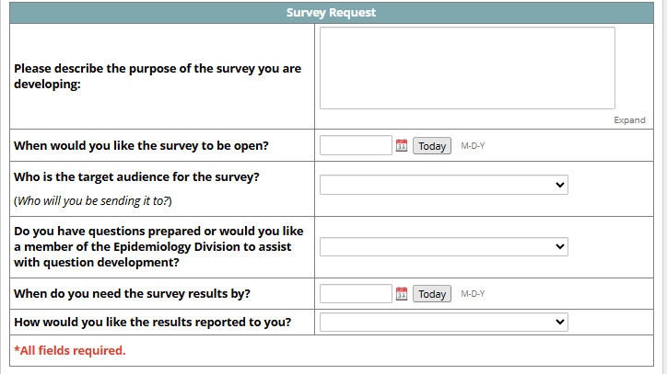

Slide 20
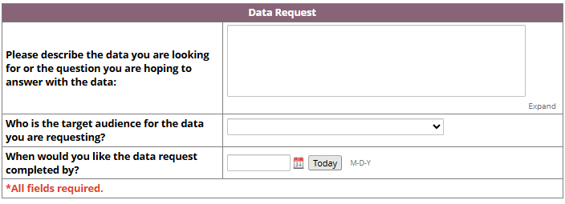

Slide 21
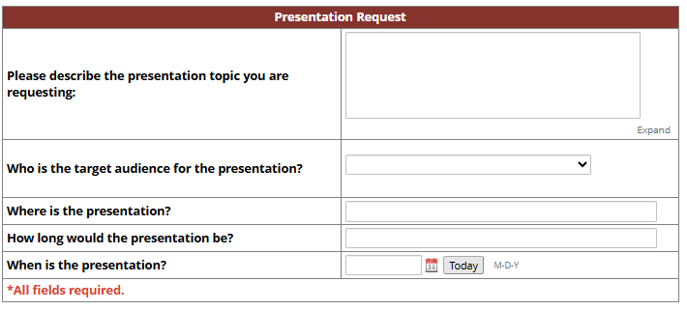

Slide 22
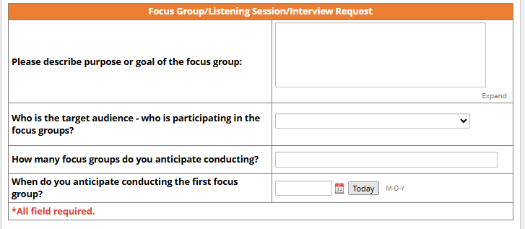

Slide 23
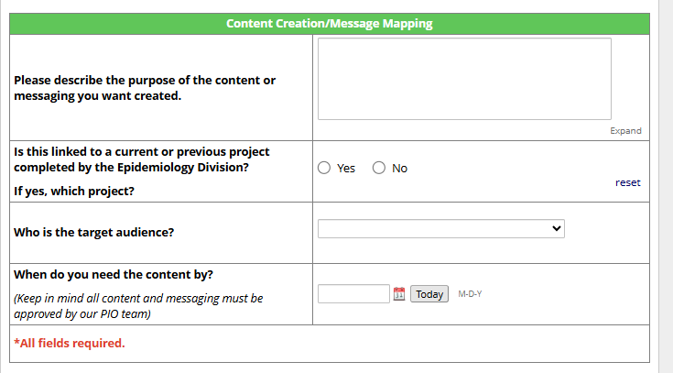

Slide 24
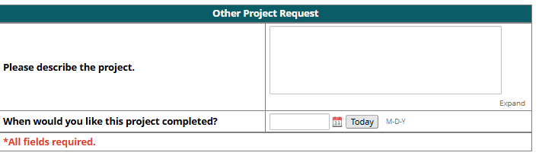

Slide 25
Inside the Tool: Forms & Features
Request Form
Screening Assessment
Structured intake collects project type, requestor, purpose, and data needs; auto-sends communication to kick off screening.
Internal form to evaluate staff capacity, technical requirements, and feasibility before accepting a project.
Assignment & Scope
Timelines & Milestones
Assign projects based on screening results and auto-generate scope of work agreements between epi staff and requestors.
Staff log key milestones and deliverables; built-in date calculations flag overdue tasks and project pace.
Alerts & Notifications
KPIs
Automated alerts notify staff and supervisors of new requests, pending deadlines, drafts to review and status changes.
Calculates completion timelines, QA benchmarks, workload distribution, and project status.

Slide 26
Inside the Tool: Forms & Features
Request Form
Screening Assessment
Structured intake collects project type, requestor, purpose, and data needs; auto-sends communication to kick off screening.
Internal form to evaluate staff capacity, technical requirements, and feasibility before accepting a project.
Assignment & Scope
Timelines & Milestones
Assign projects based on screening results and auto-generate scope of work agreements between epi staff and requestors.
Staff log key milestones and deliverables; built-in date calculations flag overdue tasks and project pace.
Alerts & Notifications
KPIs
Automated alerts notify staff and supervisors of new requests, pending deadlines, drafts to review and status changes.
Calculates completion timelines, QA benchmarks, workload distribution, and project status.

Slide 27
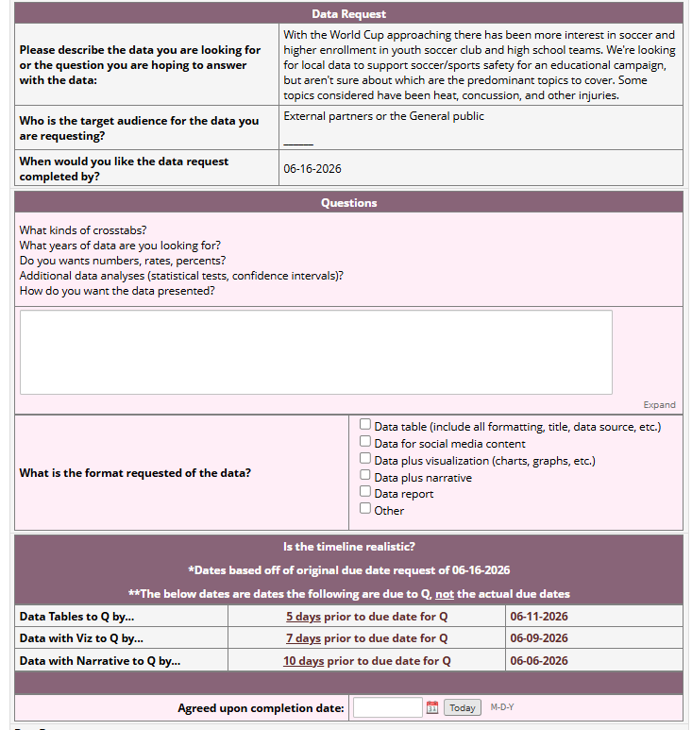
Screening

Slide 28
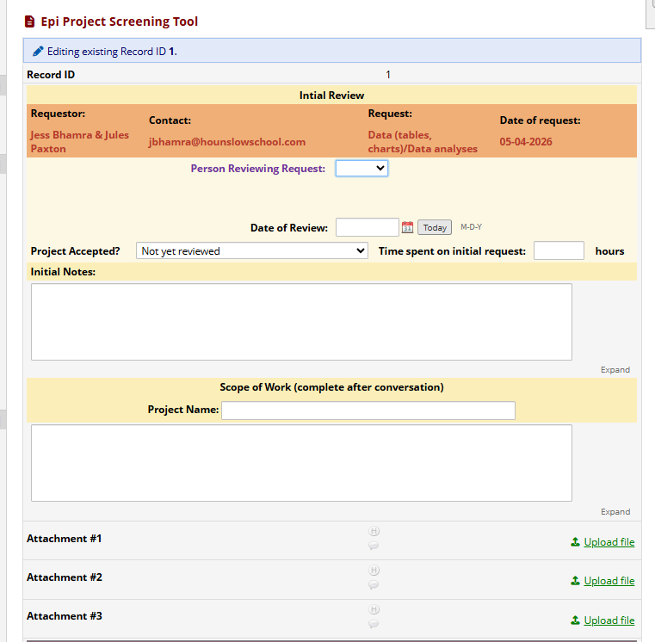
Screening

Slide 29
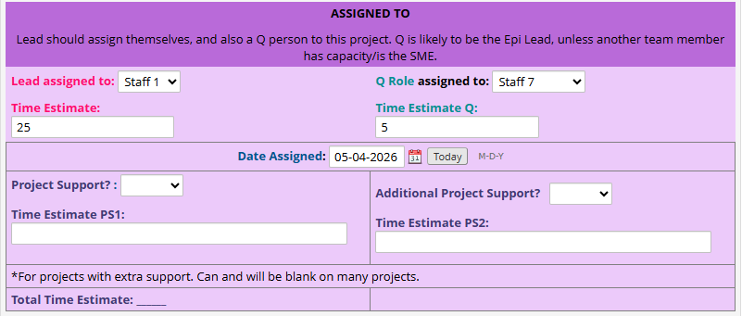
Assignment & Scope of Work

Slide 30
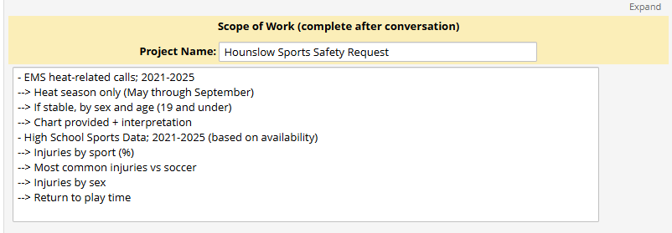
Assignment & Scope of Work

Slide 31
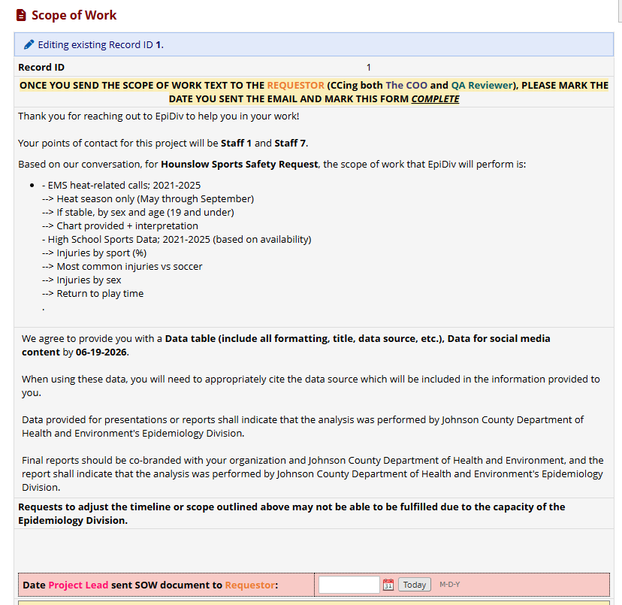
Assignment & Scope of Work

Slide 32
Inside the Tool: Forms & Features
Request Form
Screening Assessment
Structured intake collects project type, requestor, purpose, and data needs; auto-sends communication to kick off screening.
Internal form to evaluate staff capacity, technical requirements, and feasibility before accepting a project.
Assignment & Scope
Timelines & Milestones
Assign projects based on screening results and auto-generate scope of work agreements between epi staff and requestors.
Staff log key milestones and deliverables; built-in date calculations flag overdue tasks and project pace.
Alerts & Notifications
KPIs
Automated alerts notify staff and supervisors of new requests, pending deadlines, drafts to review and status changes.
Calculates completion timelines, QA benchmarks, workload distribution, and project status.

Slide 33
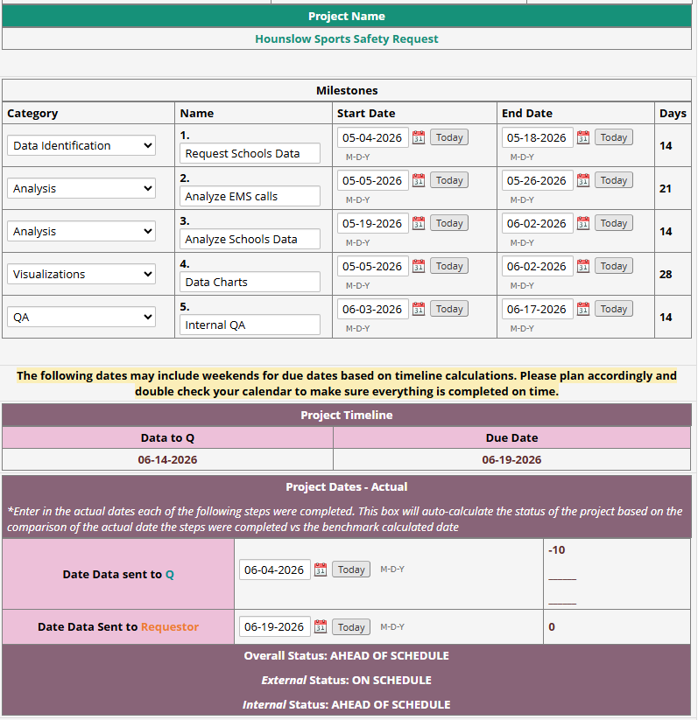
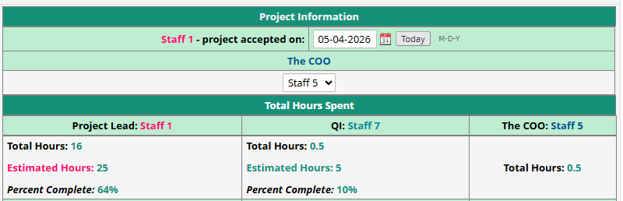
Timelines & Milestones

Slide 34
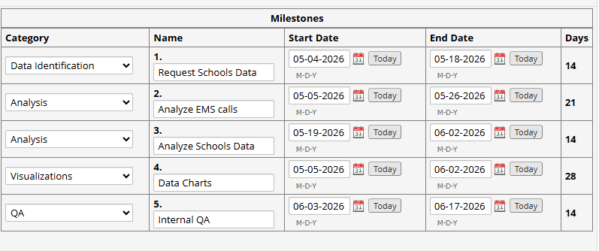
Timelines & Milestones

Slide 35
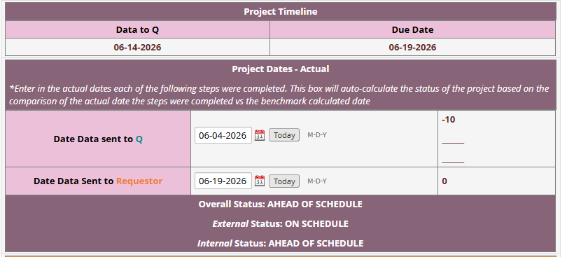
Timelines & Milestones

Slide 36
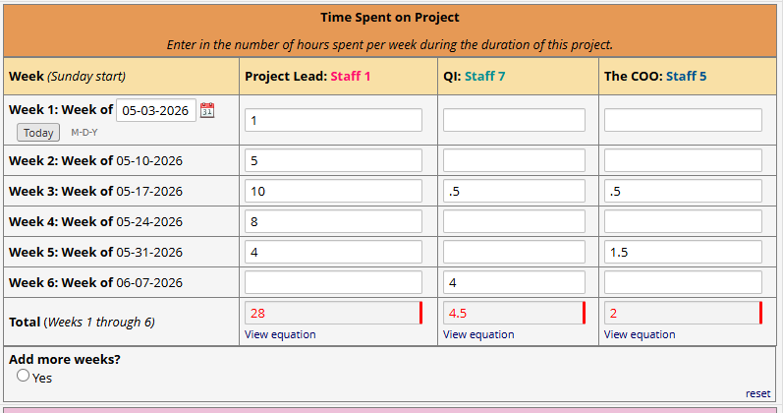
Timelines & Milestones

Slide 37
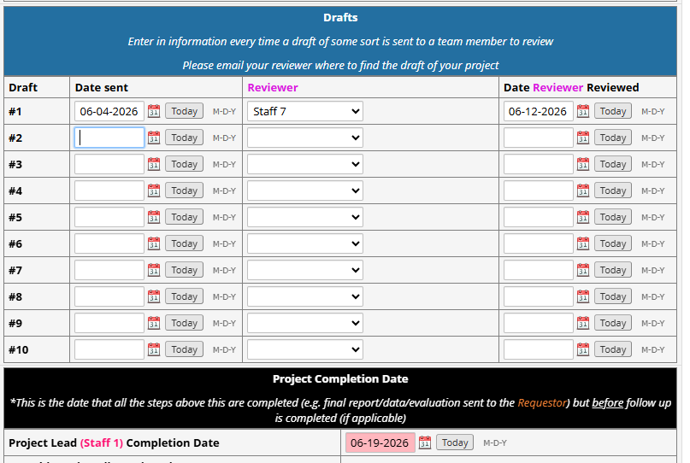
Timelines & Milestones

Slide 38
Inside the Tool: Forms & Features
Request Form
Screening Assessment
Structured intake collects project type, requestor, purpose, and data needs; auto-sends communication to kick off screening.
Internal form to evaluate staff capacity, technical requirements, and feasibility before accepting a project.
Assignment & Scope
Timelines & Milestones
Assign projects based on screening results and auto-generate scope of work agreements between epi staff and requestors.
Staff log key milestones and deliverables; built-in date calculations flag overdue tasks and project pace.
Alerts & Notifications
KPIs
Automated alerts notify staff and supervisors of new requests, pending deadlines, drafts to review and status changes.
Calculates completion timelines, QA benchmarks, workload distribution, and project status.

Slide 39
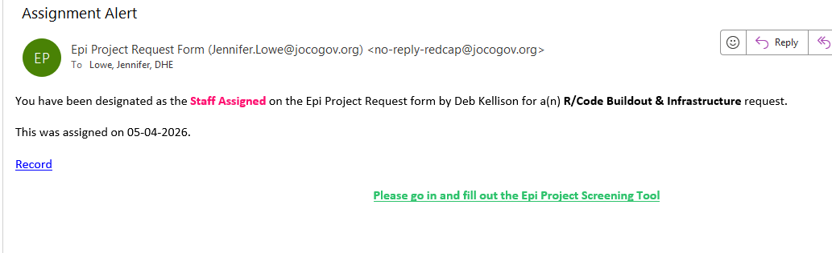

Alerts

Slide 40
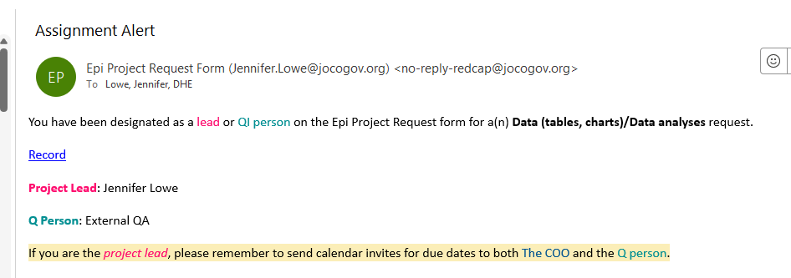
Alerts

Slide 41
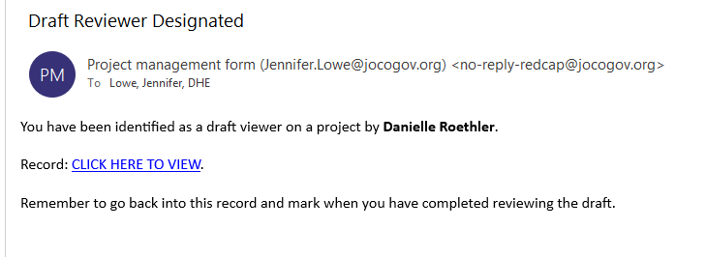
Alerts

Slide 42
Inside the Tool: Forms & Features
Request Form
Screening Assessment
Structured intake collects project type, requestor, purpose, and data needs; auto-sends communication to kick off screening.
Internal form to evaluate staff capacity, technical requirements, and feasibility before accepting a project.
Assignment & Scope
Timelines & Milestones
Assign projects based on screening results and auto-generate scope of work agreements between epi staff and requestors.
Staff log key milestones and deliverables; built-in date calculations flag overdue tasks and project pace.
Alerts & Notifications
KPIs
Automated alerts notify staff and supervisors of new requests, pending deadlines, drafts to review and status changes.
Calculates completion timelines, QA benchmarks, workload distribution, and project status.

Slide 43
KPIS
Limitation of REDCap
  Fields and calculations can be built into the form – not as dynamic if priorities change
  Reports are limited
  Visuals are limited
Utilize API in R to export data and run regular reports with visuals from REDCap data

Slide 44
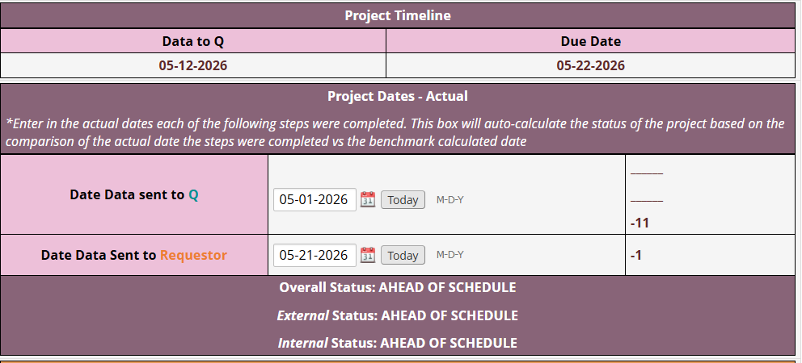
KPIS

Slide 45
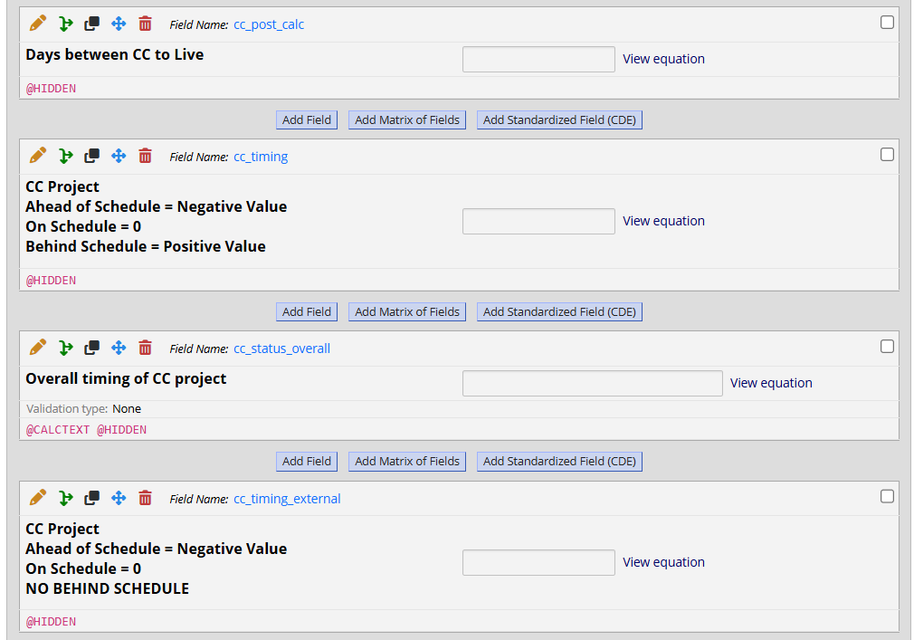
KPIS

Slide 46
Hours Tracking & Workload Visibility - 2025
178
4,800
~30%
60%
Total Project Requests
in 2025
Project Hours
Recorded
Data
Requests
Projects completed on time

Slide 47



Impact & Outcomes
Quantified Epi's Role
Transparency & Accountability
First time the division could put numbers to their workload, time, and contribution to the department; including previously “invisible” work
All staff see project status, assignments, and deadlines in one place — no hidden workloads.
Expanded to Other Programs
Success led to new REDCap forms for other JCDHE programs to track their own time, effort, and impact.

Slide 48
Other REDCap Tools
Community Health Programs Database
Environmental Complaints & Tracking
Translation & Interpretation Requests - Internal
Social Media and Communications Request - Internal
Community Outreach Requests
Office of the Medical Director Air Registry & Video Laryngoscopy QA

Slide 49
Other REDCap Tools
Community Health Programs Database
Environmental Complaints & Tracking
Database for community health programs such as diabetes prevention, community health workers, safe sleep, teen pregnancy case management. Operates like an EHR, records by client.
Translation & Interpretation Requests - Internal
Social Media and Communications Request - Internal
Community Outreach Requests
Office of the Medical Director Air Registry & Video Laryngoscopy QA

Slide 50
Other REDCap Tools
Community Health Programs Database
Environmental Complaints & Tracking
External complaint form for environmental complaints, and internal tracking for staff assignments, response to requests and outcomes.
Translation & Interpretation Requests - Internal
Social Media and Communications Request - Internal
Community Outreach Requests
Office of the Medical Director Air Registry & Video Laryngoscopy QA
Notes:
Enviromental form – stop gap until they can get a codes/permits system that connects them to other county departments. Has helped to develop a tool so they know what they need from a tool for programmatic metrics and tracking

Slide 51
Other REDCap Tools
Community Health Programs Database
Environmental Complaints & Tracking
Translation & Interpretation Requests - Internal
Social Media and Communications Request - Internal
Created a process for document translation process. Data used to support new county policies regarding certification and pay adjustments for staff providing translations in addition to regular job duties.
Community Outreach Requests
Office of the Medical Director Air Registry & Video Laryngoscopy QA

Slide 52
Other REDCap Tools
Community Health Programs Database
Environmental Complaints & Tracking
Translation & Interpretation Requests - Internal
Social Media and Communications Request - Internal
Database for PIO and communications staff to track staff requests for communications, as well as other tasks. Data compiled to support a role dedicated to communications, transitioning from split duties roles.
Community Outreach Requests
Office of the Medical Director Air Registry & Video Laryngoscopy QA

Slide 53
Other REDCap Tools
Community Health Programs Database
Environmental Complaints & Tracking
Translation & Interpretation Requests - Internal
Social Media and Communications Request - Internal
Community Outreach Requests
Office of the Medical Director Air Registry & Video Laryngoscopy QA
External request form for the community to request booths, education, presentations. This is tied to staff assignments and event follow up.

Slide 54
Other REDCap Tools
Community Health Programs Database
Environmental Complaints & Tracking
Translation & Interpretation Requests - Internal
Social Media and Communications Request - Internal
Community Outreach Requests
Office of the Medical Director Air Registry & Video Laryngoscopy QA
Logs airway attempts for emergency medical personnel. This allows for QA of video laryngoscopy and automates feedback.

Slide 55

Impact & Outcomes
Data-Driven Conversations
Most programs can now have data-driven conversations with real numbers on capacity and outcomes.

Slide 56
Lessons Learned & What's Next
Lessons Learned
What's Next
Build on free, pre-existing tools that have a range of uses
REDCap is free BUT it takes staff hours to design, analyze and update databases
Start with the request form first; it creates the data foundation everything else relies on.
Learning curve for staff using it – even if not designing the tools
Utilize project request data to measure capacity, forecast workload, and determine burnout risk based on current assignments
Continue rolling out program-specific forms to other JCDHE divisions.
Increase leadership’s comfortability with report building
Explore visualizations built from REDCap data for real-time reporting to managers

Slide 57
Thank you!
Jennifer Lowe| Jennifer.lowe@jocogov.org | 913-826-1266
Johnson County Department of Health and Environment

Slide 58
Mapmaking in R
Katherine Hathaway
Notes:
Thank you so much Tyler and Austin. We are now going to move into our next presentation from Washington County. Our presenter is Blanca Perez.
Blanca Pérez is an Environmental Health and Emergency Preparedness Data Scientist at Washington County Public Health. She holds a Master’s in Statistics and a Bachelor’s in Economics. Starting her public health career as a COVID-19 data analyst, she now focuses on GIS-based solutions for planning and resource allocation. She is passionate about using open-source tools to build scalable, cost-effective data systems for public health.

Slide 59


Mapmaking in R
Katherine Hathaway, MS, MPH Epidemiologic Methods Specialist and Statistician
Office of Epi Analytics and Informatics (EAI)
1

Slide 60

Agenda
Video
Critical comparison: R versus ArcGIS Pro
Live Demonstration
How to Make Maps Yourself
Wrap-Up
Metropolitan Health District
2

Slide 61

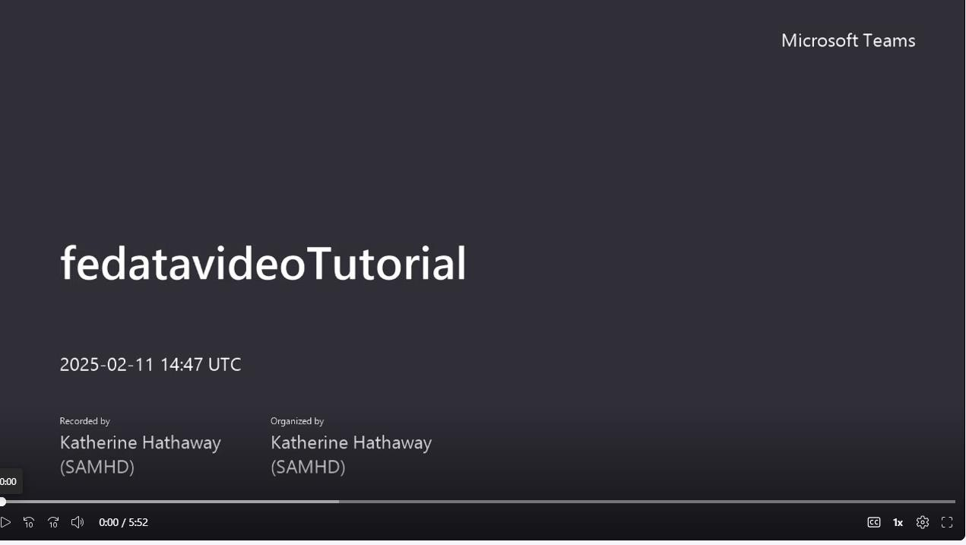

Video
Created for an interdepartmental, City of San Antonio (COSA) meeting addressing federal data changes initiated in early 2025
Due to broad audience, this video assumes:
  Little to no R exposure/previous coding experience
  Zero prior API use
  Little to no familiarity with Census data
Metropolitan Health District
3

Slide 62
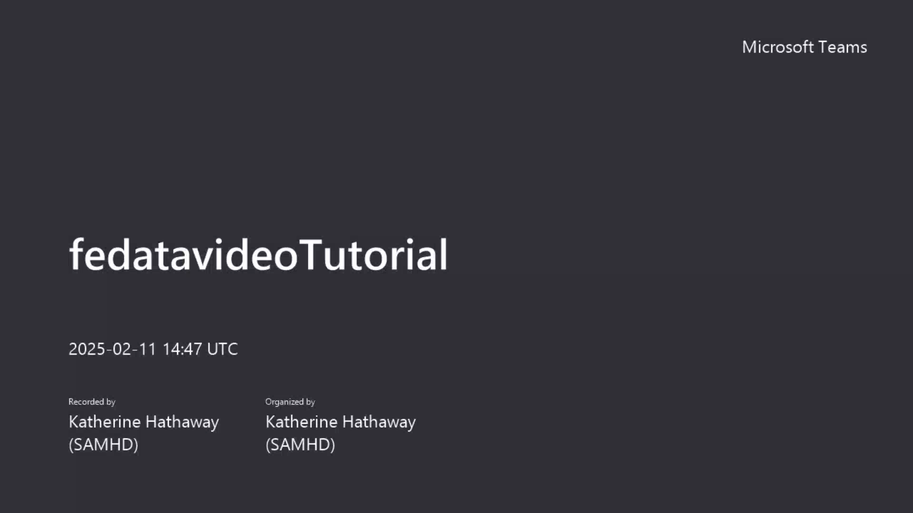

Slide 63
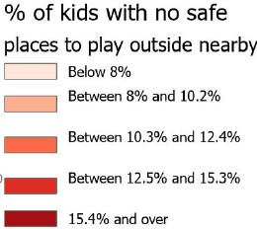

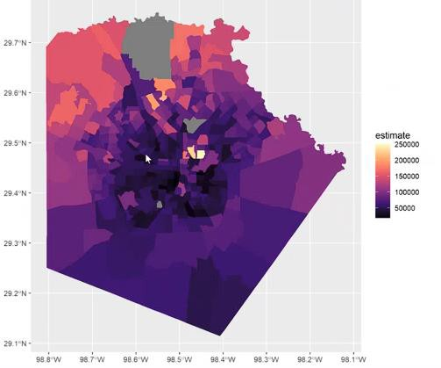
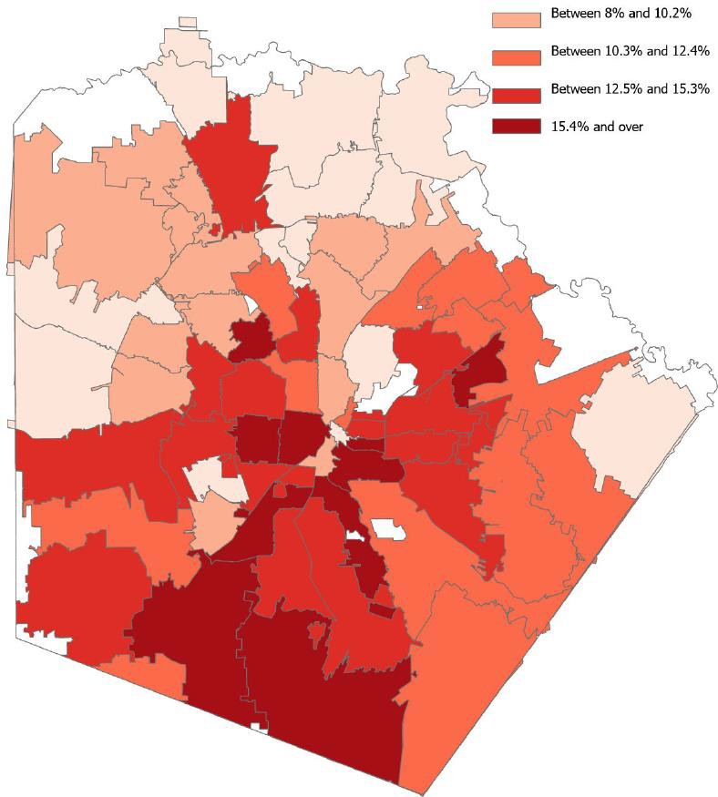




R Map
GIS Equivalent
lower
higher
Median income
higher
Metropolitan Health District
4

Slide 64

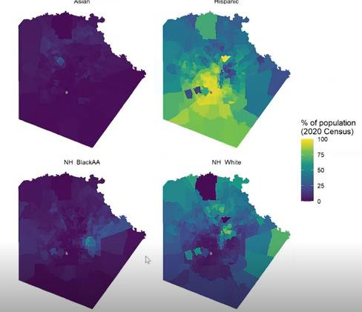
Bivariate maps live demonstration
Not from the video just shown.
While aligned with bivariate mapping conceptually, not as aligned with bivariate maps displayed by local health departments.
Join alternate data with data from tidycensus to acquire geocodes needed for mapping data not from the census
Metropolitan Health District
5

Slide 65
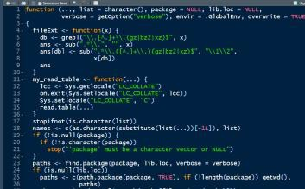




Everything you need to try this on your own
Patience
Base R
R Studio
Script
Time
Note the download will depend on the make and model of your computer
Note the download will depend on the make and model of your computer
Included in these slides at the end of the presentation
More than one hour at a time, and more than one day, as well.
Both Base R and R Studio software require updating several times annually.
Metropolitan Health District
6

Slide 66
New R packages are continuously coming out
Shiny is another package used for mapping and dashboard creation – it has become increasingly popular, but it is not a forgiving package.
While R and R Studio are free, the time commitment is NOT – and so that needs to be weighed in determining whether to go with an expensive ESRI license with many built in free trainings as well as little-to-no-coding versus using open-source options like these.
Fastest option for customized, reproducible, open-source maps might involve contracting with a R programmer to sit with you and tailor your maps just how you want them – and then see if you are able to adapt that code yourself.
Metropolitan Health District
7

Slide 67


THANK YOU!
Katherine Hathaway
katherine.hathaway@sanantonio.gov

Slide 68
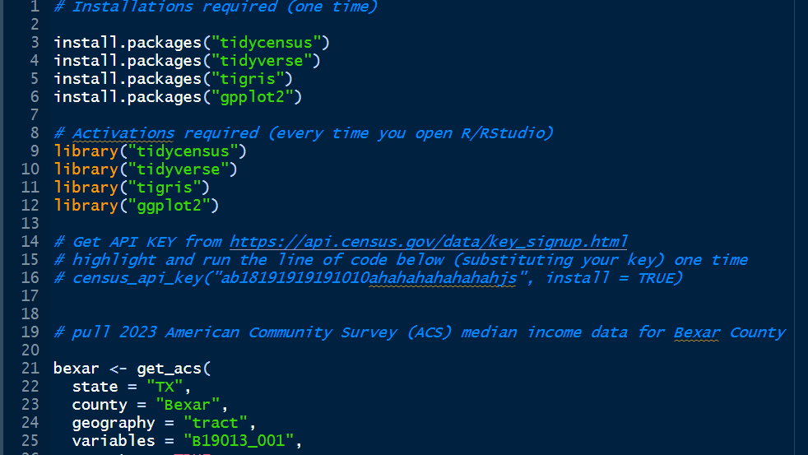

Slide 69
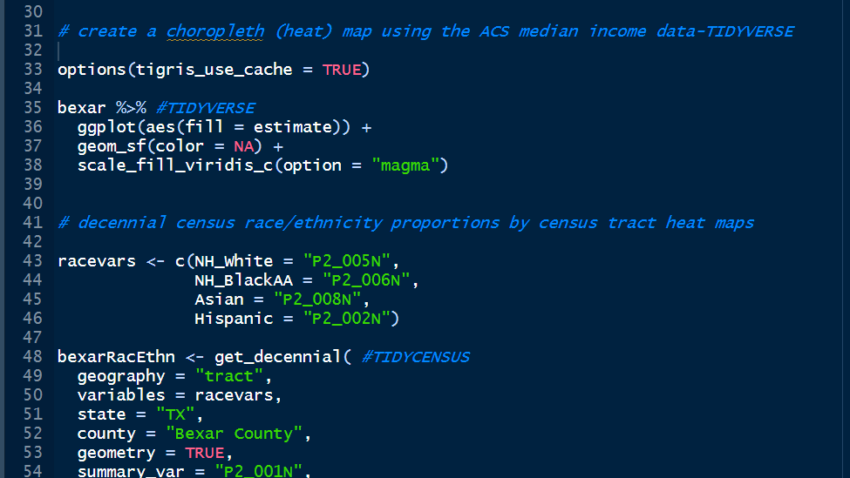

Slide 70
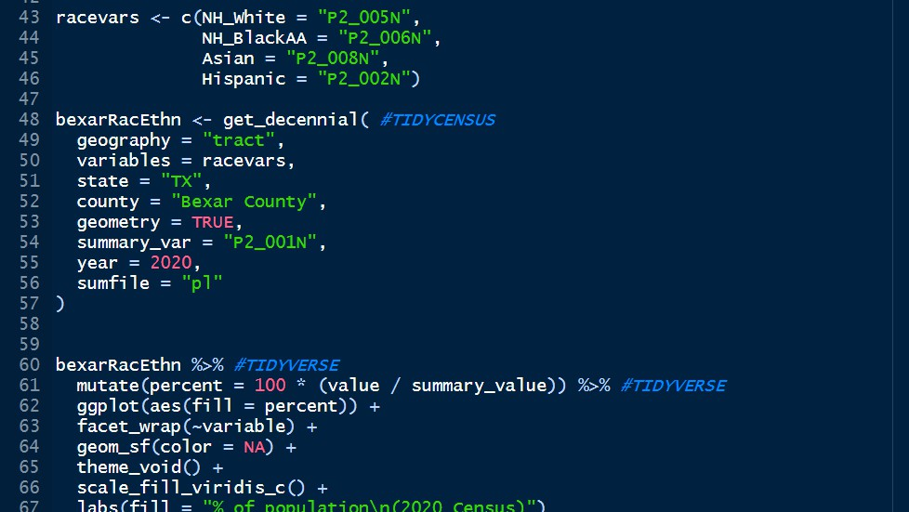

Slide 71
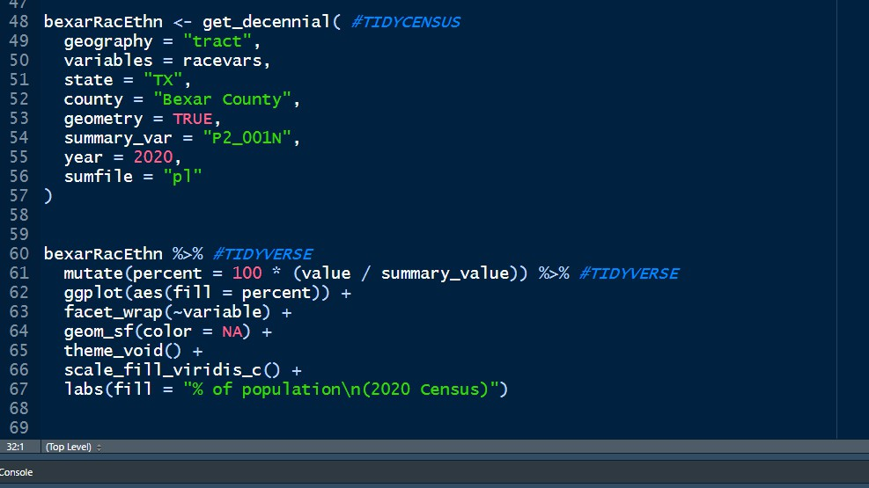

Slide 72
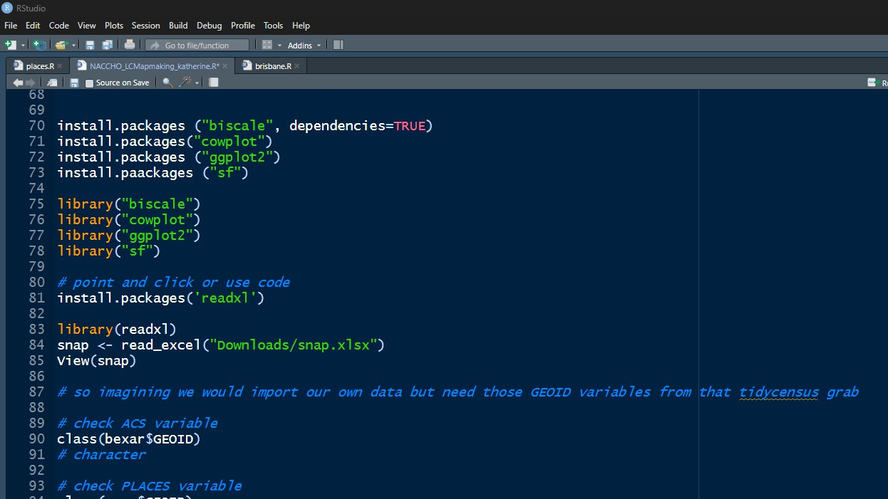

Slide 73
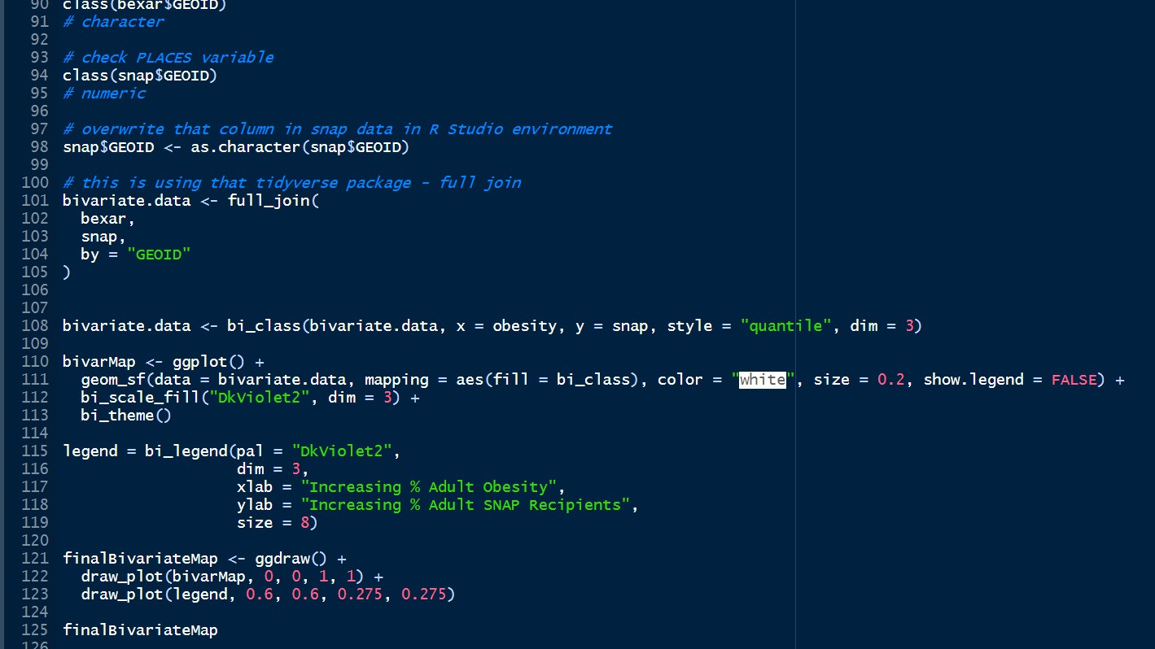

Slide 74


Slide 75

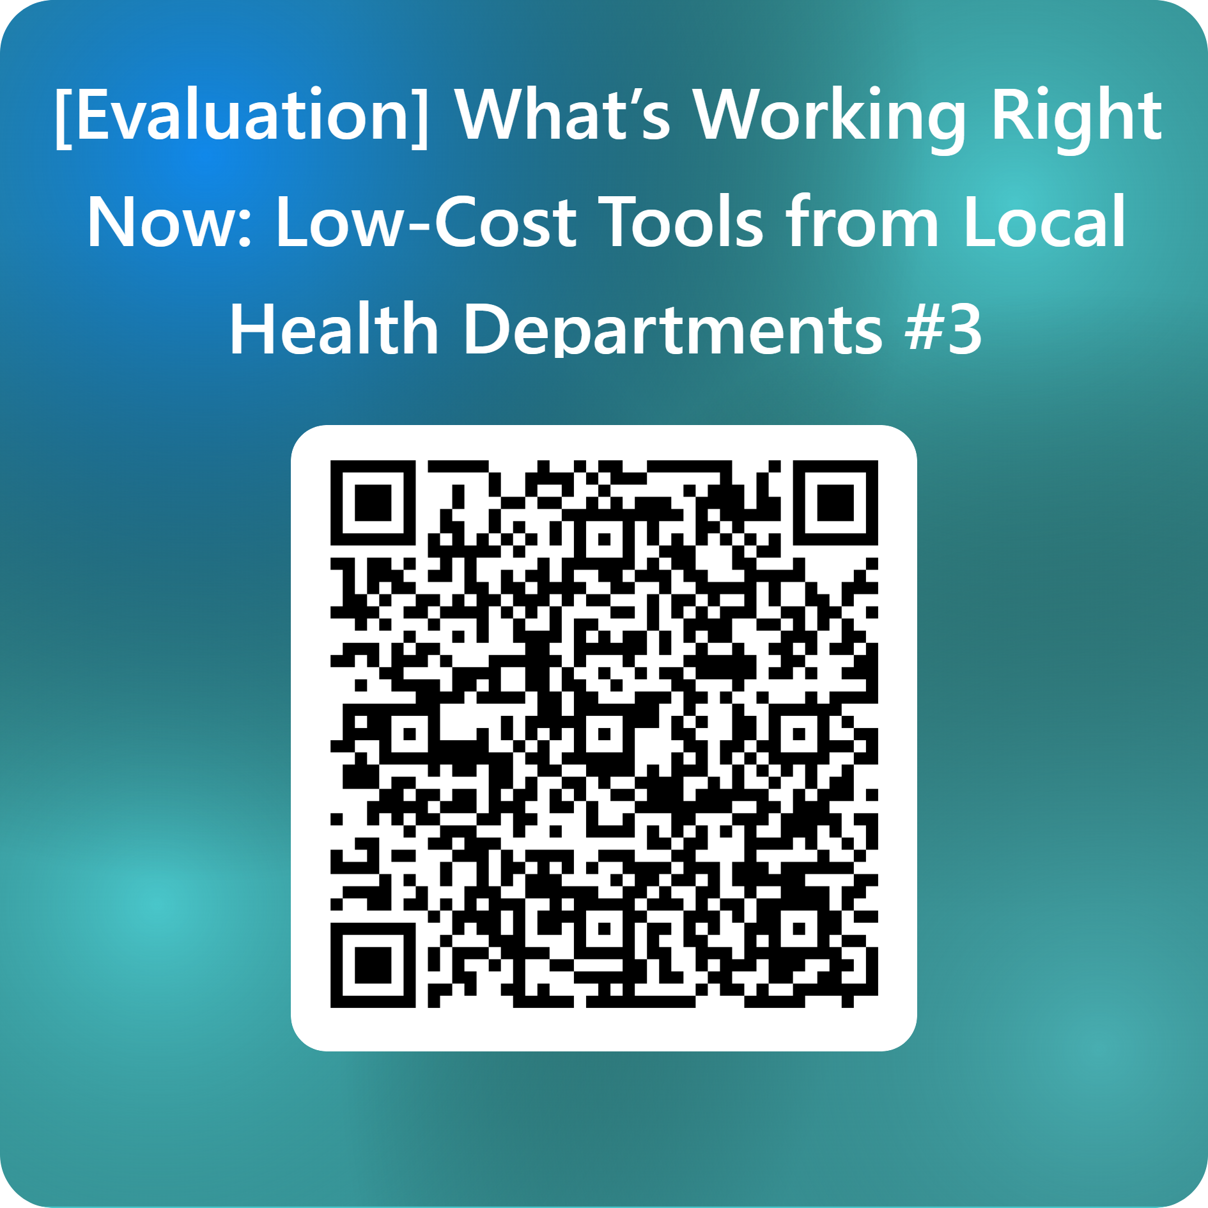
For any questions, please email phinformatics@naccho.org
Notes:
Before we close for the day. I want to thank our speakers for sharing their work and all of you for joining us. And lastly, we’d really appreciate your feedback. Please take a moment to scan the QR code or use the link in the chat to complete the evaluation—your input will help us shape and improve future informatics and data modernization activities.

