Slide 1
Webinar on Public Health IT Preparedness : What LHDs Need to Do Now and Plan for the Future
<?xml version="1.0"?><AllQuestions />
<?xml version="1.0"?><AllResponses />
<?xml version="1.0"?><Settings><answerBulletFormat>Numeric</answerBulletFormat><answerNowAutoInsert>No</answerNowAutoInsert><answerNowStyle>Explosion</answerNowStyle><answerNowText>Answer Now</answerNowText><chartColors>Use PowerPoint Color Scheme</chartColors><chartType>Horizontal</chartType><correctAnswerIndicator>Checkmark</correctAnswerIndicator><countdownAutoInsert>No</countdownAutoInsert><countdownSeconds>10</countdownSeconds><countdownSound>TicToc.wav</countdownSound><countdownStyle>Box</countdownStyle><gridAutoInsert>No</gridAutoInsert><gridFillStyle>Answered</gridFillStyle><gridFillColor>255,255,0</gridFillColor><gridOpacity>50%</gridOpacity><gridTextStyle>Keypad #</gridTextStyle><inputSource>Response Devices</inputSource><multipleResponseDivisor># of Responses</multipleResponseDivisor><participantsLeaderBoard>5</participantsLeaderBoard><percentageDecimalPlaces>0</percentageDecimalPlaces><responseCounterAutoInsert>No</responseCounterAutoInsert><responseCounterStyle>Oval</responseCounterStyle><responseCounterDisplayValue># of Votes Received</responseCounterDisplayValue><insertObjectUsingColor>Red</insertObjectUsingColor><showResults>Yes</showResults><teamColors>Use PowerPoint Color Scheme</teamColors><teamIdentificationType>None</teamIdentificationType><teamScoringType>Voting pads only</teamScoringType><teamScoringDecimalPlaces>1</teamScoringDecimalPlaces><teamIdentificationItem></teamIdentificationItem><teamsLeaderBoard>5</teamsLeaderBoard><teamName1></teamName1><teamName2></teamName2><teamName3></teamName3><teamName4></teamName4><teamName5></teamName5><teamName6></teamName6><teamName7></teamName7><teamName8></teamName8><teamName9></teamName9><teamName10></teamName10><showControlBar>All Slides</showControlBar><defaultCorrectPointValue>0</defaultCorrectPointValue><defaultIncorrectPointValue>0</defaultIncorrectPointValue><chartColor1>187,224,227</chartColor1><chartColor2>51,51,153</chartColor2><chartColor3>0,153,153</chartColor3><chartColor4>153,204,0</chartColor4><chartColor5>128,128,128</chartColor5><chartColor6>0,0,0</chartColor6><chartColor7>0,102,204</chartColor7><chartColor8>204,204,255</chartColor8><chartColor9>255,0,0</chartColor9><chartColor10>255,255,0</chartColor10><teamColor1>187,224,227</teamColor1><teamColor2>51,51,153</teamColor2><teamColor3>0,153,153</teamColor3><teamColor4>153,204,0</teamColor4><teamColor5>128,128,128</teamColor5><teamColor6>0,0,0</teamColor6><teamColor7>0,102,204</teamColor7><teamColor8>204,204,255</teamColor8><teamColor9>255,0,0</teamColor9><teamColor10>255,255,0</teamColor10><displayAnswerImagesDuringVote>Yes</displayAnswerImagesDuringVote><displayAnswerImagesWithResponses>Yes</displayAnswerImagesWithResponses><displayAnswerTextDuringVote>Yes</displayAnswerTextDuringVote><displayAnswerTextWithResponses>Yes</displayAnswerTextWithResponses><questionSlideID></questionSlideID><controlBarState>Expanded</controlBarState><isGridColorKnownColor>True</isGridColorKnownColor><gridColorName>Yellow</gridColorName></Settings>
<?xml version="1.0"?><AllAnswers />
James W Coates
Informatician
Cuyahoga County Board of Health

Slide 2
What exactly should LHDs be doing to advance ePublic Health & Informatics within their departments and in coordination with health care partners?
LHD Intent – Internal Q&A
To submit and contribute to the HIE
Certified EHR (Check HL7 version)
Qualify for MU?
Eligible Provider
Medicaid/Medicare threshold
Use HIE for Population Health data source
Direct Suite
Workforce Development
University Based Training
Community College Consortia
Free online classes

Slide 3
Big Data
Positives
Surveillance, trends, clusters
Information, knowledge
Targeted interventions
Negatives
Error prone (entry and coding)
Collected for clinical or billing not Public Health
Statistical problems (bias, confounding)

Slide 4
ODH Interoperability Initiative
Ohio Public Health Information Gateway - Dashboard Development and Enhancements
Enhance single portal through which all HL7 incoming and outgoing electronic health information will be exchanged.
Enhance Dashboard to address program needs such as; file and message level tracking, fail-point monitoring and reporting.
ODH – HIE Initiative
Continue partnership with HIEs (HealthBridge and CliniSync/OHIP) to create ongoing HL7 data exchange with ODH programs
Enhance Immunization Online Provider Enrollment and HL7 validation application to include additional ODH programs.
ODH Provider Management System
Work with programs to better understand how they manage customer relationships (CRM).
Immunization has developed a solution that might work for the enterprise.
ImpactSIIS Interoperability Project
Data Quality – Algorithm and data filtering reviews de-duplication
BizTalk enhancement
Bi-directional – real time messaging
*Slide provided by the Ohio Department of Health
Interoperability Initiative

Slide 5
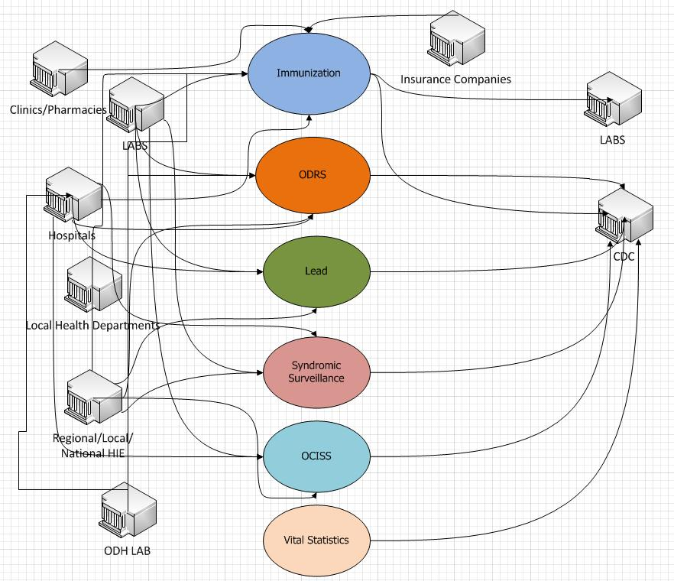
Current ODH Model
*Slide provided by the Ohio Department of Health
Interoperability Initiative

Slide 6
*Slide provided by the Ohio Department of Health
Interoperability Initiative

Slide 7
THE NOT
SO DISTANT FUTURE
*Slide provided by the Ohio Department of Health,
Interoperability Initiative

Slide 9
Where and how can LHDs become more involved and demonstrate leadership?
Local
Regional partnerships/coalitions
Immunizations
HIT
State
SACCHO Conferences/Trainings
State HIT Boards
TOPHIC
HIT Subcommittee
National
Standards and Interoperability Framework (S&I) Public Health Reporting Initiative (PHRI)

Slide 11
Once an LHD is at the table, what should they articulate?
How Local Public Health Functions
“Boots on the ground”
Lost in larger initiatives or institutions
Be well diverse with what is happening
State exemptions for MU
How Public Health can contribute
Functions Public Health can do or have done

Slide 12
What should LHDs be doing now and planning for later?
Inventory of where you are and what you have
Hardware
Software
Workforce
Plan for additional cost
Is there funding available, MU
Speaking with HIE/REC
Will you be going through HIE

Slide 13
How can LHDs measure their progress?
ODH LHD survey
2010 and 2011
Richard Thomas
2011 Key Findings
6 LHD have certified EHR (+2)
3 LHD looking at implementing
30% looking for a start up cost ~$1,000
50% annual maintenance of ~$1,000
Follow-up survey on clinical services and Electronic Health Record adoption by local health department, 2011.
Center for Public Health Statistics and Informatics, Ohio Department of Health, Richard Thomas, MPH

Slide 14
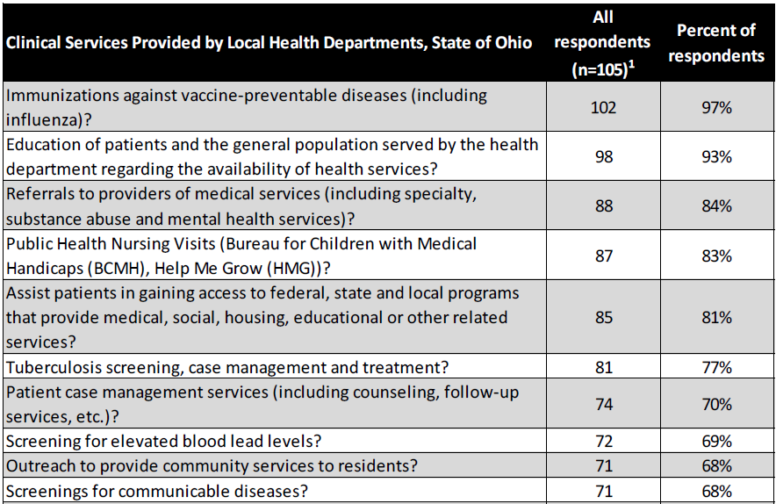
How can LHDs measure their progress?
ODH LHD survey
Follow-up survey on clinical services and Electronic Health Record adoption by local health department, 2011.
Center for Public Health Statistics and Informatics, Ohio Department of Health, Richard Thomas, MPH

Slide 15
Contact Information
James Coates, MS, RS
Informatician
Epidemiology, Surveillance and Informatics
Cuyahoga County Board Of Health
5550 Venture Drive
Parma, OH 44130
Phone: 216-201-2001 ext: 1617
Email: jcoates@ccbh.net

