Slide 1
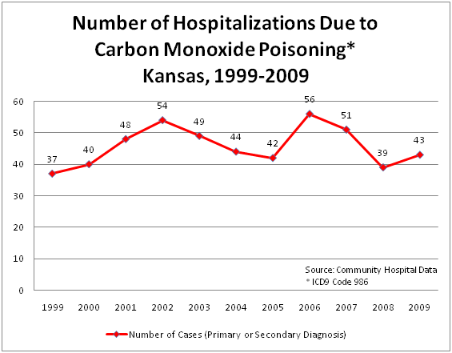
ENVIRONMENTAL HEALTH
Environmental Public Health is a segment of public health concerned with assessing, understanding, and controlling the impacts of people on their environment and the impacts of the environment on them.
AIR POLLUTION

Slide 2
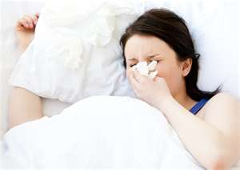
# of Poor Health Days Reported
MORBIDITY & MORTALITY
The percent of adults
reporting poor or fair
overall health ranges
between 9%-19% in
the East Central Kansas
Public Health Coalition
Counties
Years of Potential Life Lost
per 100,000 people
Premature death is represented by the years of potential life lost before age 75. Every death occurring before the age of 75 contributes to the total
number of years of potential life lost.
For example, a person dying at age 25 contributes 50 years of life lost and a person dying at age 65 contributes 10 years of life lost.
Range in Kansas (Min-Max): 3,846-11,727
Overall in Kansas: 7,084
National Benchmark: 5,564 (90th percentile)

Slide 3
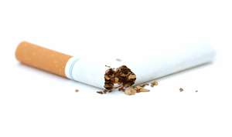
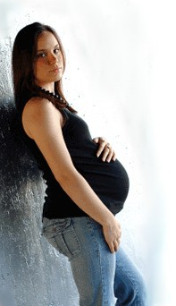
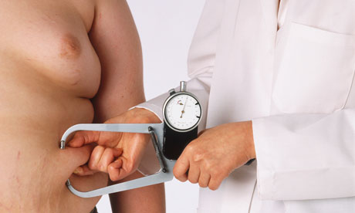
HEALTH BEHAVIORS
Percent of Adult Smoking & Excessive Drinking
Adult obesity rates range from 30%-32% for the East Central Kansas Public Health Coalition Counties
Teen Birth Rate per 1,000 female
population, ages 15-19

Slide 4
CLINICAL CARE
Access to Care
Quality of Care
Ratio of Primary Care Physicians to Population
Chase | No Physicians
Coffey | 1:1,407
Franklin | 1:1,650
Greenwood | 1:1,702
Lyon | 1:1,104
Osage | 1:2,711
Morris | 1:602
Wabaunsee | 1:2,293
The percent of population under age 65 without health insurance ranges between 13%-21% for the counties in the East Central Kansas Public Health Coalition

Slide 5
SOCIAL & ECONOMIC ISSUES
THAT AFFECT HEALTH
 | Chase | Coffey | Franklin | Greenwood | Lyon | Osage | Morris | Wabaunsee
% of 9th Graders That Graduate in 4 Years | 75% | 90% | 60% | 90% | 70% | 90 | No Data | 85%
% of Adults age 25-44 With some Post Secondary Education | 61% | 66% | 58% | 60% | 51% | 59% | 56% | 66%
% of Population 16+ That is seeking Employment | 5.5% | 5.7% | 8.7% | 6.6% | 6.1% | 7.6% | 6.9% | 7.1%
Percent of Children Under 18 in Poverty | 17% | 13% | 14% | 23% | 18% | 15% | 16% | 12%
% of Adults Without Adequate Social or Emotional Support | No Data | 14% | 15% | 15% | 21% | 15% | 14% | 15%
Children in Single Parent Households | 20% | 21% | 28% | 27% | 32% | 24% | 27% | 16%

Slide 6
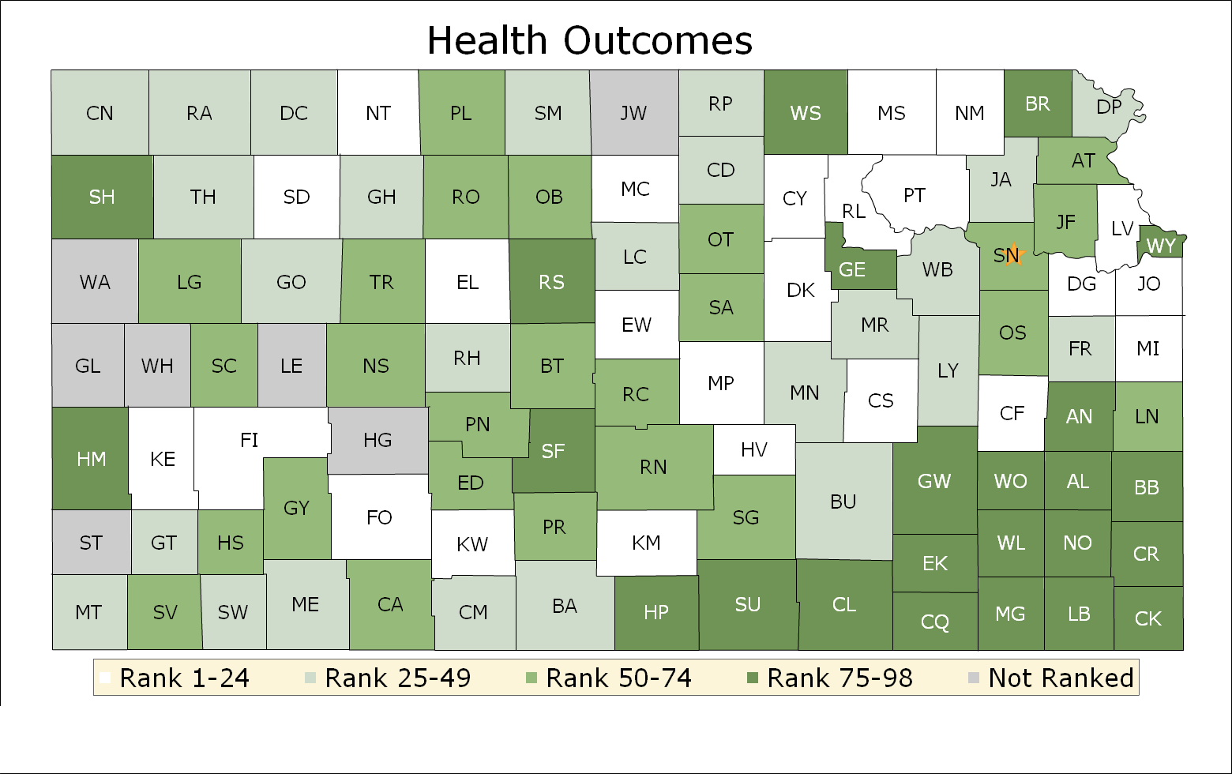
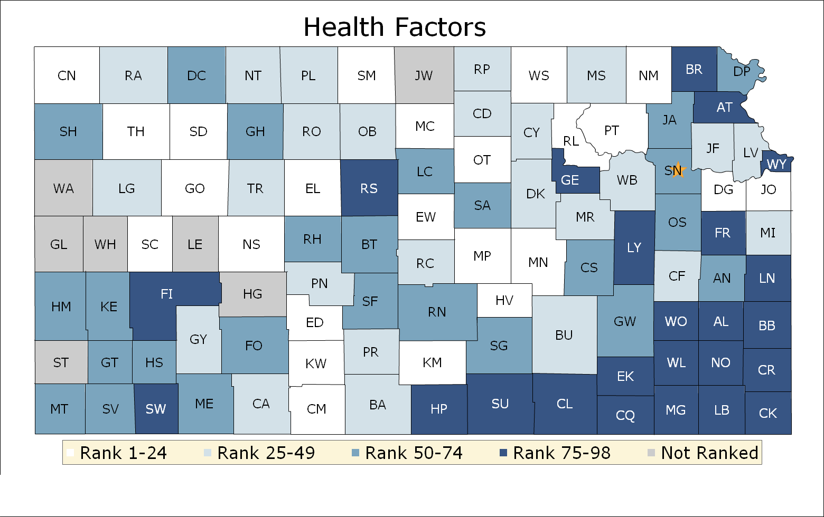
The County Health Rankings show us that where we live matters to our health. The health of a community depends on many different factors - ranging from health behaviors, education and jobs, to quality of health care, to the environment.
COUNTY HEALTH RANKINGS
County | Ranking
CS | 23
CF | 4
FR | 40
GW | 87
LY | 44
OS | 71
MR | 33
WB | 41
County | Ranking
CS | 51
CF | 40
FR | 77
GW | 74
LY | 80
OS | 73
MR | 43
WB | 29

