Slide 1
Guidance for Agricultural Workers and Employers and Testing Strategy for COVID-19 in High-Density Critical Infrastructure Workplaces
June 25, 2020
<?xml version="1.0"?><Settings><answerBulletFormat>Numeric</answerBulletFormat><answerNowAutoInsert>No</answerNowAutoInsert><answerNowStyle>Explosion</answerNowStyle><answerNowText>Answer Now</answerNowText><chartColors>Use PowerPoint Color Scheme</chartColors><chartType>Horizontal</chartType><correctAnswerIndicator>Checkmark</correctAnswerIndicator><countdownAutoInsert>No</countdownAutoInsert><countdownSeconds>10</countdownSeconds><countdownSound>TicToc.wav</countdownSound><countdownStyle>Box</countdownStyle><gridAutoInsert>No</gridAutoInsert><gridFillStyle>Answered</gridFillStyle><gridFillColor>255,255,0</gridFillColor><gridOpacity>50%</gridOpacity><gridTextStyle>Keypad #</gridTextStyle><inputSource>Response Devices</inputSource><multipleResponseDivisor># of Responses</multipleResponseDivisor><participantsLeaderBoard>5</participantsLeaderBoard><percentageDecimalPlaces>0</percentageDecimalPlaces><responseCounterAutoInsert>No</responseCounterAutoInsert><responseCounterStyle>Oval</responseCounterStyle><responseCounterDisplayValue># of Votes Received</responseCounterDisplayValue><insertObjectUsingColor>Red</insertObjectUsingColor><showResults>Yes</showResults><teamColors>Use PowerPoint Color Scheme</teamColors><teamIdentificationType>None</teamIdentificationType><teamScoringType>Voting pads only</teamScoringType><teamScoringDecimalPlaces>1</teamScoringDecimalPlaces><teamIdentificationItem></teamIdentificationItem><teamsLeaderBoard>5</teamsLeaderBoard><teamName1></teamName1><teamName2></teamName2><teamName3></teamName3><teamName4></teamName4><teamName5></teamName5><teamName6></teamName6><teamName7></teamName7><teamName8></teamName8><teamName9></teamName9><teamName10></teamName10><showControlBar>All Slides</showControlBar><defaultCorrectPointValue>0</defaultCorrectPointValue><defaultIncorrectPointValue>0</defaultIncorrectPointValue><chartColor1>187,224,227</chartColor1><chartColor2>51,51,153</chartColor2><chartColor3>0,153,153</chartColor3><chartColor4>153,204,0</chartColor4><chartColor5>128,128,128</chartColor5><chartColor6>0,0,0</chartColor6><chartColor7>0,102,204</chartColor7><chartColor8>204,204,255</chartColor8><chartColor9>255,0,0</chartColor9><chartColor10>255,255,0</chartColor10><teamColor1>187,224,227</teamColor1><teamColor2>51,51,153</teamColor2><teamColor3>0,153,153</teamColor3><teamColor4>153,204,0</teamColor4><teamColor5>128,128,128</teamColor5><teamColor6>0,0,0</teamColor6><teamColor7>0,102,204</teamColor7><teamColor8>204,204,255</teamColor8><teamColor9>255,0,0</teamColor9><teamColor10>255,255,0</teamColor10><displayAnswerImagesDuringVote>Yes</displayAnswerImagesDuringVote><displayAnswerImagesWithResponses>Yes</displayAnswerImagesWithResponses><displayAnswerTextDuringVote>Yes</displayAnswerTextDuringVote><displayAnswerTextWithResponses>Yes</displayAnswerTextWithResponses><questionSlideID></questionSlideID><controlBarState>Expanded</controlBarState><isGridColorKnownColor>True</isGridColorKnownColor><gridColorName>Yellow</gridColorName></Settings>
<?xml version="1.0"?><AllQuestions />
<?xml version="1.0"?><AllResponses />
<?xml version="1.0"?><AllAnswers />

Slide 2
Overview
Presentations
    Interim Guidance for Agricultural Workers and
    Employers
    Testing Strategy
Q&A Session

Slide 3
Housekeeping Items
Enter you questions in the Q&A box.
The moderator will pose your questions to the presenters during the Q&A session.

Slide 4
Recording
The recorded webinar will be emailed to all participants.
Past food safety sharing sessions are available on NACCHO’s Food Safety website:
http://www.naccho.org/programs/environmental-health/hazards/food-safety/

Slide 5




Jennifer Lincoln
National Institute for Occupational Safety and Health (NIOSH)
Christopher K. Brown, PhD, MPH, CPH
Occupational Safety & Health Administration (OSHA)
Megin Nichols, DVM, MPH, DACVPM
Centers for Disease Control and Prevention (CDC)
Caitlin Boon, PhD
Food and Drug Administration (FDA)

Slide 6
Interim Guidance for Agriculture Workers and Employers
Jennifer M. Lincoln PhD, CSP
Associate Director
Office of Agriculture Safety and Health
National Institute for Occupational Safety and Health

Slide 7
OSHA Updates on
Coronavirus Disease 2019 (COVID-19)
NACCHO Webinar
June 25, 2020
Chris Brown, PhD, MPH, CPH
Special Assistant, Office of the Assistant Secretary
Occupational Safety and Health Administration

Slide 8

OSHA guidance
OSHA has developed a variety of guidance materials for workers and employers on how to stay healthy during the pandemic.
OSHA.gov/coronavirus includes information on implementing the hierarchy of controls when workers have specific exposure risks.
www.osha.gov/coronavirus
Notes:
In addition to the COVID-19 Safety and Health Topics page, OSHA is also providing a number of alerts, a booklet produced jointly with the U.S. Department of Health and Human services, and other materials to help workers and employers, including in the sectors where exposure to the virus may be most likely. These materials are all available from the OSHA.gov/coronavirus page.
You can find additional resources from the Coronavirus Task Force at coronavirus.gov and the U.S. Department of Labor at dol.gov/coronavirus.

Slide 9

OSHA guidance
Joint HHS-DOL Guidance on Preparing Workplaces for COVID-19
OSHA Guidance on Returning to Work
OSHA Alert: Prevent Worker Exposure to Coronavirus (COVID-19)
www.osha.gov/coronavirus
Notes:
OSHA has issued alerts, available in both English and Spanish), for specific occupations, as well as a general alert on preventing worker exposure to COVID-19. Additional alerts are in the works.

Slide 10
Existing OSHA standards protect workers from exposure
Relevant OSHA requirements
Personal Protective Equipment (29 CFR 1910 subpart I), including:
  PPE General Requirements (1910.132)
  Eye and Face Protection (1910.133)
  Respiratory Protection (1910.134)
  Hand Protection (29 CFR 1910.138)
Bloodborne Pathogens (29 CFR 1910.1030)
Hazard Communication (29 CFR 1910.1200)
Recordkeeping (29 CFR part 1904)
Follow existing OSHA standards to help protect workers from exposure to SARS-CoV-2 and infection with COVID-19.
Employers should also remember that OSHA can use the General Duty Clause, Section 5(a)(1), of the Occupational Safety and Health Act to ensure that workers are protected from recognized safety and health hazards that may cause serious harm.
www.osha.gov/coronavirus

Slide 11
OSHA enforcement
OSHA:
Typically responds to emergencies, including disease outbreaks, in a technical assistance posture.
Provides compliance assistance to employers to help ensure workers are protected.
Provides technical assistance and support to other federal agencies, as well as state/local partners.
Implemented interim enforcement plan for investigating COVID complaints, while ensuring the safety of workers, employers, and inspectors.
OSHA enforcement authority
During emergency response operations, even when OSHA is operating in a technical assistance and support mode, OSHA standards remain in effect and OSHA retains its ability to enforce the OSHA standards under the OSH Act.
Enforcement of OSHA standards follows the jurisdiction in place before the emergency, such as in states operating OSHA-approved occupational safety and health programs called State Plans.
www.osha.gov/coronavirus

Slide 12
OSHA enforcement discretion
Memorandum | Effective
Enforcement Guidance for Respiratory Protection and the N95 Shortage Due to the 2019 Novel Coronavirus Disease (COVID-19) Pandemic | April 3, 2020 – present
Enforcement Guidance for Use of Respiratory Protection Equipment Certified Under Standards of Other Countries or Jurisdictions During the COVID-19 Pandemic | April 3, 2020 - present
Expanded Temporary Enforcement Guidance on Respiratory Protection Fit-Testing for N95 Filtering Facepieces in All Industries During the COVID-19 Pandemic | April 8, 2020 - present
Discretion in Enforcement when Considering an Employer's Good Faith Efforts During the Coronavirus Disease 2019 (COVID-19) Pandemic | April 16, 2020
Updated Interim Enforcement Response Plan for Coronavirus Disease 2019 (COVID-19) | May 19, 2020
Updated Enforcement Guidance for Recording Cases of Coronavirus Disease 2019 (COVID-19) | May 26, 2020 – present
OSHA has provided enforcement discretion for some of its requirements, including:
Respiratory Protection standard (29 CFR 1910.134)
Other health standards with respirator requirements
Recording and Reporting Occupational Injuries and Illness (29 CFR Part 1904)
www.osha.gov/coronavirus
Notes:
OSHA recognizes that employers in many sectors may experience challenges in complying with certain provisions of the agency’s standards as a result of the COVID-19 pandemic, including where those standards require the use of certain types of PPE (e.g., respirators) or provision of medical surveillance and training to workers. Accordingly, OSHA is providing enforcement flexibilities for specific provisions of certain standards to address these challenges and help ensure the continued protection of worker safety and health.
This enforcement guidance is intended to be time-limited to the current public health crisis. Please frequently check OSHA’s webpage at www.osha.gov/coronavirus for updates.

Slide 13
For continual updates
Visit OSHA’s website to sign up to receive OSHA information:
  QuickTakes biweekly newsletter
  Tip of the Day
  www.osha.gov/contactus
Follow OSHA on social media
  Twitter: @OSHA_DOL
  Facebook: Follow the Department of Labor page
www.osha.gov/coronavirus

Slide 14
Questions?
Chris Brown, PhD, MPH, CPH
Special Assistant
OSHA Office of the Assistant Secretary
brown.christopher.k@dol.gov
202-693-2368
OSHA Directorate of Technical Support and Emergency Management
202-693-2300
www.osha.gov/coronavirus

Slide 15
OSHA
www.osha.gov
1-800-321-OSHA (6742)

Slide 16
Testing in High-Density Critical Infrastructure Workplaces After a COVID-19 Case Is Identified
Megin Nichols, DVM, MPH
Food Systems Working Group
COVID-19 Response

Slide 17
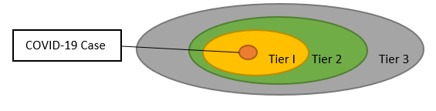
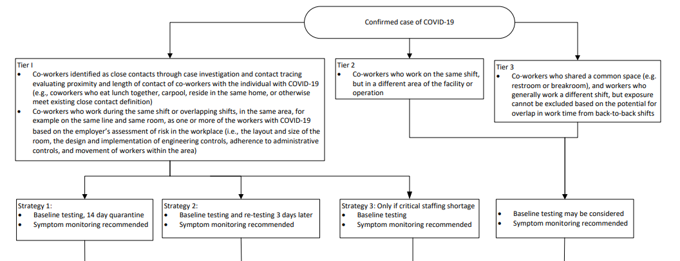
Testing in High-Density Critical Infrastructure Workplaces After a COVID-19 Case Is Identified
Published June 13
Testing strategy for exposed co-workers
Tier categorization is based on likelihood of exposure
A risk-based test strategy may be used to identify infectious workers and exclude them from the workplace
Working with public health agencies and industry partners to raise awareness and answer questions
Workers may be tiered by risk of exposure
Guidance includes a flowchart for tiered response
https://www.cdc.gov/coronavirus/2019-ncov/community/worker-safety-support/hd-testing.html

Slide 18
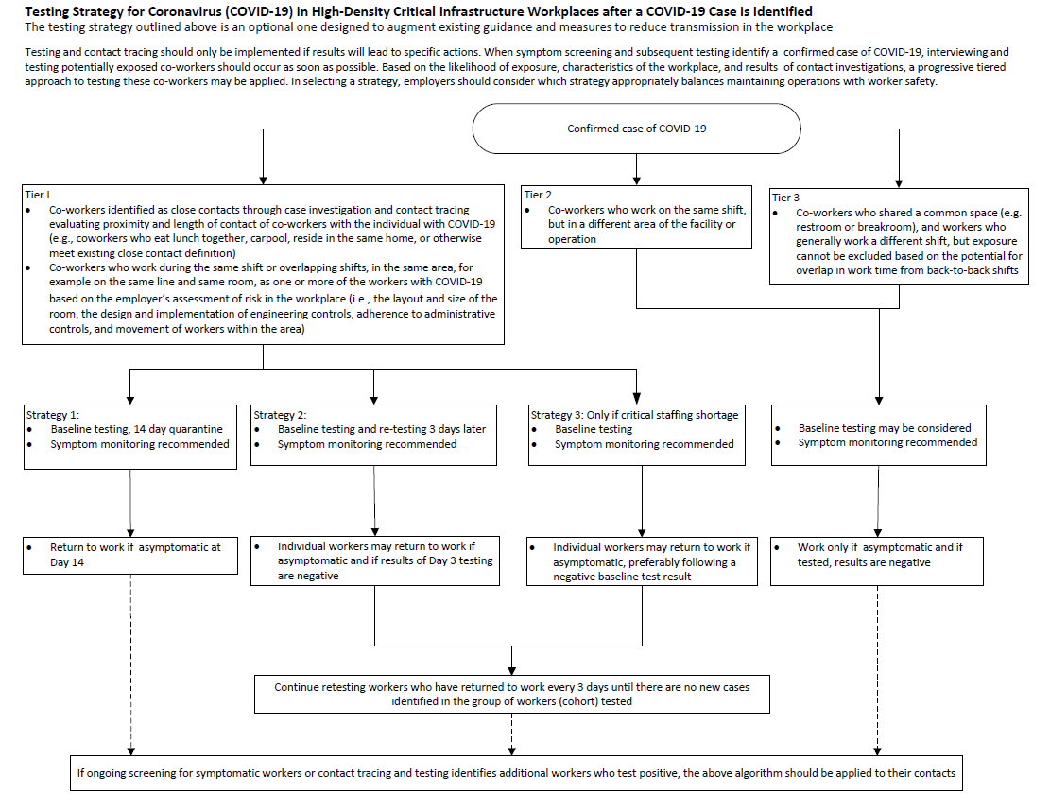
https://www.cdc.gov/coronavirus/2019-ncov/downloads/community/Testing-Strat-flow-diagram.pdf

Slide 19

Q&A Session

Slide 20

Thank you for your participation in today’s webinar!
Amy Chang, MS
Senior Program Analyst, NACCHO
achang@naccho.org
Tiara Smith
Program Analyst, NACCHO
tsmith@naccho.org
http://www.naccho.org/programs/environmental-health/hazards/food-safety

