Slide 1
Point of Care Blood Glucose Testing

Slide 2
What is Point of Care Blood Testing?
Medical testing that is performed outside of a laboratory setting. Point of Care (POC) is also known as bedside testing, near-patient testing, remote testing, mobile testing and rapid diagnostics.
It allows results to be received quickly without the need to send samples and specimens away to be processed at medical laboratories.
Examples are:
Blood glucose tests
Home pregnancy tests
Hemoglobin
Fecal occult blood
Rapid strep
Influenza tests
COVID-19 antigen testing
Prothrombin time/international normalized ratio (PT/INR)

Slide 3
Healthcare Worker Safety
When performing POC testing on residents, you are at risk of exposure to bloodborne pathogens and other illnesses.
Collecting samples from residents means you’re handling human specimens, biological material. This material can contain viruses that can cause influenza-like illness or bacteria that can cause sickness with strep throat or a staph infection.
There is also risk of getting harmful material on your hands that can be transferred to your mouth or directly into your body through exposed scratches and cuts on your skin.

Slide 4
Healthcare Worker Safety
Train and educate all staff who will be performing POC testing.
Document education and skills check competency and maintain records.
Validate competency on how to obtain the sample, how to use the testing device/equipment, how to properly clean, disinfect, and store reusable device/equipment, and how to dispose of one-time use device/equipment.
Follow the manufacturer’s instructions for use (IFU) on proper maintenance of the device/equipment.
Educate on Standard Precautions and appropriate PPE to use while performing POC blood glucose testing.
Educate on potential for bloodborne pathogen (BBP) exposure and proper handling of needles and other sharps

Slide 5
CDC and POC Blood Glucose Testing
There is risk of transmitting hepatitis B virus (HBV) and other infectious diseases during assisted blood glucose (blood sugar) monitoring.
Healthcare workers should follow these infection control requirements:
Don’t share fingerstick devices
Whenever possible, blood glucose meters should NOT be shared.

Slide 6
Unsafe Practices
Using fingerstick devices for more than one person
Using blood glucose meter for more than one person without cleaning and disinfecting after every use, per the manufacturer’s instructions.
Using insulin pens for more than one person
Failing to change gloves and perform hand hygiene between fingerstick procedures

Slide 7
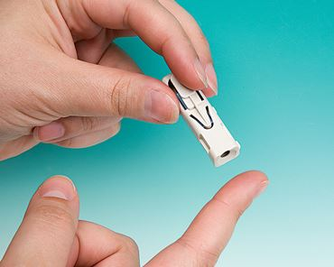
Fingerstick devices, also called lancing devices, are devices that are used to prick the skin and obtain drops of blood for testing
CDC Recommendations for POC Blood Glucose Testing for Long Term Care Facilities: Use single-use, auto-disabling fingerstick devices in long term care facilities. These are devices that are disposable and prevent reuse through an auto- disabling feature.

Slide 8
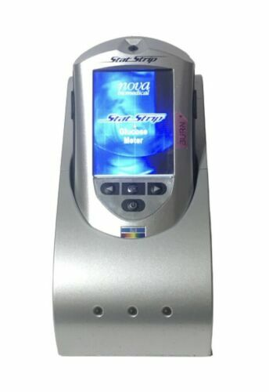
Blood glucose meters are devices that measure blood glucose levels
CDC Recommendations for POC Blood Glucose Testing for Long Term Care Facilities: Whenever possible, blood glucose meters should be assigned to an individual person and not be shared
If blood glucose meters must be shared, the device should be cleaned and disinfected after every use, per manufacturer’s instructions, to prevent carry-over of blood and infectious agents. If the manufacturer does not specify how the device should be cleaned and disinfected, then is should not be shared

Slide 9
Hand Hygiene
Wear gloves during blood glucose testing and during any other procedure that involves potential exposure to blood or body fluids
Change gloves between resident contacts. Change gloves that have touched potentially blood-contaminated objects or fingerstick wounds before touching clean surfaces. Discard gloves in appropriate receptacles.
Perform hand hygiene immediately after removal of gloves and before touching other medical supplies intended for use on other persons.

Slide 10
Training and Oversight
Review
New provider’s orders regularly for persons requiring assistance with blood glucose monitoring.
Provide
Provide and Recommend a full hepatitis B vaccination series to all previously unvaccinated staff persons whose activities involve contact with blood or body fluids.
Establish
Establish there is a designated infection preventionist (IP) overseeing infection control activities.
Assess
Assess adherence to infection control recommendations for blood glucose monitoring by routinely performing observation audits to walk through each step of cleaning, disinfection, usage, disposal, and storage.
Report
Report to public health authorities any suspected instances of a newly acquired bloodborne infection, such as hepatitis B, resident, or staff member.
Check
Check with State authorities for specific State and federal regulations regarding laboratory testing.

Slide 11
References
CDC. Injection Safety. Infection prevention during blood glucose monitoring and insulin administration. 2011. https://www.cdc.gov/injectionsafety/blood-glucose-monitoring.html
CDC. Division of Laboratory Systems (DLS). Point-of-care testing: risk assessment basics. 2021. https://www.cdc.gov/csels/dls/point-of-care-testing-risk-assessment-basics.html
CDC. Viral Hepatitis. Health care-associated hepatitis B and C outbreaks (> 2 cases) reported to the CDC 2008-2019. 2023. https://www.cdc.gov/hepatitis/outbreaks/healthcarehepoutbreaktable.htm
DotMed. Nova Biomedical. https://www.dotmed.com/listing/other/nova-biomedical/statstrip/glucose-meter-battery-docking-station-and-charger/3634849?utm_source=base&utm_medium=search&utm_campaign=Base&gclid=CjwKCAiAk9itBhASEiwA1my_65Qy_RmEcVJeXHgDuoUCxy6AafICgBBMQNxl_cxt9PLFAcquyb590xoC5XIQAvD_BwE
Yenice S. (2021). Training and Competency Strategies for Point-of-Care Testing. EJIFCC, 32(2), 167–178.

