Slide 1
Hepatitis C
An Overview for Healthcare Providers
Essential Information on Prevalence, Risk Factors, Testing, & Treatment

Slide 2
Why HCV? Why now?
Hepatitis C virus (HCV) kills more Americans than the 60 other reportable infectious diseases, including HIV, combined
Baby boomers (born between 1945 and 1965), especially African Americans, face high burdens of chronic HCV infection
People who inject drugs face rapidly rising rates of acute HCV infection as a result of the growing opioid epidemic
This is a pivotal moment in HCV treatment, because curative treatment regimens are now available
These treatments are significantly more effective, rapid, and tolerable than prior regimens
With curative treatment, eliminating HCV as a public health threat is a real possibility
1. Centers for Disease Control and Prevention (CDC). Hepatitis C FAQ for Health Professionals. http://www.cdc.gov/hepatitis/hcv/hcvfaq.htm#section1
2. CDC. Hepatitis C Kills More Americans than Any Other Infectious Disease. http://www.cdc.gov/media/releases/2016/p0504-hepc-mortality.html
3. National Academies of Sciences, Engineering, and Medicine. A National Strategy for the Elimination of Hepatitis B and C: Phase Two Report. http://www.nationalacademies.org/hmd/Reports/2017/national-strategy-for-the-elimination-of-hepatitis-b-and-c.aspx

Slide 3
Burden of HCV in the US
Current estimated US prevalence: 3.5 million (2.7-5 million)
2015 US incidence:
Nearly 2,500 acute cases were reported to CDC in 2015
However, CDC estimates that there were 33,900 new infections in 2015
Most impacted populations:
Young white non-urban people who inject drugs
Baby boomers, especially African Americans
HIV-positive men who have sex with men
CDC. Hepatitis C FAQ for Health Professionals. http://www.cdc.gov/hepatitis/hcv/hcvfaq.htm#section1

Slide 4
HCV-related Deaths
CDC. Surveillance for Viral Hepatitis – United States, 2013. http://www.cdc.gov/hepatitis/statistics/2013surveillance/index.htm#tabs-801919-5

Slide 5
Missed Opportunities Along the HCV Care Continuum
Yehia, B. The treatment cascade for chronic hepatitis C virus infection in the United States: A systematic review and meta analysis. PLoS One. 2014;9(7): e101554.
*Sustained virologic response (SVR) rates are based on data preceding the availability of curative direct-acting antivirals (DAAs).

Slide 6
HCV in [insert local jurisdiction]
Suggested Content:
HCV prevalence (statistics, charts, graphs)
HCV incidence (statistics, charts, graphs)
Most impacted populations locally
Changing trends

Slide 7
At-risk Populations

Slide 8
Baby Boomer Cohort
Individuals born 1945–1965 (aged 52-72 in 2017)
Adults born in these years:
Are 6 times more likely to be HCV-infected than adults born in other years
Are at the greatest risk for liver cancer and other HCV-related liver diseases
Account for 73% of deaths associated with HCV infection
77% of HCV-infected adults belong to the baby boomer birth cohort
African Americans have significantly higher rates of chronic HCV and HCV-related deaths compared to other ethnic groups
1. CDC. Recommendations for the Identification of Chronic Hepatitis C Virus Infection Among Persons Born During 1945–1965. http://www.cdc.gov/mmwr/preview/mmwrhtml/rr6104a1.htm?s_cid=rr6104a1_w
2. CDC: Viral Hepatitis Surveillance, United States, 2015. https://www.cdc.gov/hepatitis/statistics/2015surveillance/pdfs/2015HepSurveillanceRpt.pdf
3. CDC. Hepatitis C Disproportionately Affects the African American Community. https://www.cdc.gov/hepatitis/blackhistmnth-hepc.htm

Slide 9
Persons Who Inject Drugs
Individuals who inject drugs account for the greatest increases in new HCV infections in the US
Dramatic increases in new infections tied to the opioid epidemic
Exposure through injection drug use disproportionately impacts young people and those living in nonurban areas
HCV exposure occurs most often among new injectors
Acute HCV infection is often asymptomatic, and young injectors are unlikely to seek medical care
Heroin and opioid use occurring primarily among white males and females in suburban and rural settings
1. CDC: Viral Hepatitis Surveillance, United States, 2015. https://www.cdc.gov/hepatitis/statistics/2015surveillance/pdfs/2015HepSurveillanceRpt.pdf
2. Office of HIV/AIDS and Infectious Disease Policy. Hepatitis C Infection in Young Persons Who Injects Drugs. https://www.aids.gov/pdf/hcv-and-young-pwid-consultation-report.pdf

Slide 10
Rising Rates of New Infections among Persons Who Inject Drugs
Suryaprasad, et al. Emerging epidemic of hepatitis C virus infections among young nonurban persons who inject drugs in the United States, 2006-2012. Clinical Infectious Diseases, 2014;59(10):1411-1419.

Slide 11
Other Populations at Risk
HIV-positive persons
HCV is not routinely transmitted sexually, but is more likely to be among those infected with HIV
HIV-positive men who have sex with men are at a higher risk for HCV infection than HIV-negative men who have sex with men
HCV infection can negatively impact progression and management of HIV infection
25% of people with living with HIV in the US are coinfected with HCV
Individuals with occupational exposure to HCV through accidental needlesticks
Children born to HCV-positive mothers
Transmission occurs at birth, and no prophylaxis is available
1. CDC. Testing Recommendations for Hepatitis C Virus Infection. http://www.cdc.gov/hepatitis/hcv/guidelinesc.htm
2. Yaphe, et al. Incidence of acute hepatitis C virus infections among men who have sex with men with and without HIV infection: A systematic review. Sexually Transmitted Infections. 2012;88 (7):558-564.
3. CDC. Viral Hepatitis – CDC Recommendations for Specific Populations and Settings. http://www.cdc.gov/hepatitis/populations/hiv.htm
4. CDC. Hepatitis C FAQ for Health Professionals. http://www.cdc.gov/hepatitis/hcv/hcvfaq.htm#section1

Slide 12
Populations at Risk in [insert local jurisdiction]
Suggested Content:
Data on populations impacted by HCV in your jurisdiction (charts, maps of impacted areas, etc.)
Population-specific data
Overview of data sources available at local level (reference Department of Health and Human Services guidance for potential data sources on HCV incidence and impact, and injection drug and opioid use)

Slide 13
Testing Guidelines

Slide 14
Testing Recommendations by Risk
Baby boomer cohort (born between 1945-1965)
One-time screening for all members of baby boomer cohort
No prior HCV risk attainment recommended
People who inject drugs
Those currently injecting drugs
Those who have ever injected drugs, even once
HIV-positive persons
At initial HIV-related medical visit
Annually for all HIV-positive MSM
Children born to HCV-positive mothers
After 18 months if using an antibody screening
At 1–2 months if using an RNA test, and repeated subsequently to confirm
1. CDC. Testing Recommendations for Hepatitis C Virus Infection. http://www.cdc.gov/hepatitis/hcv/guidelinesc.htm
2. CDC. Screening Recommendations Referenced in Treatment Guidelines and Original Recommendation Sources. http://www.cdc.gov/std/tg2015/screening-recommendations.htm
3. CDC. Hepatitis C FAQ for Health Professionals. http://www.cdc.gov/hepatitis/hcv/hcvfaq.htm#section1

Slide 15
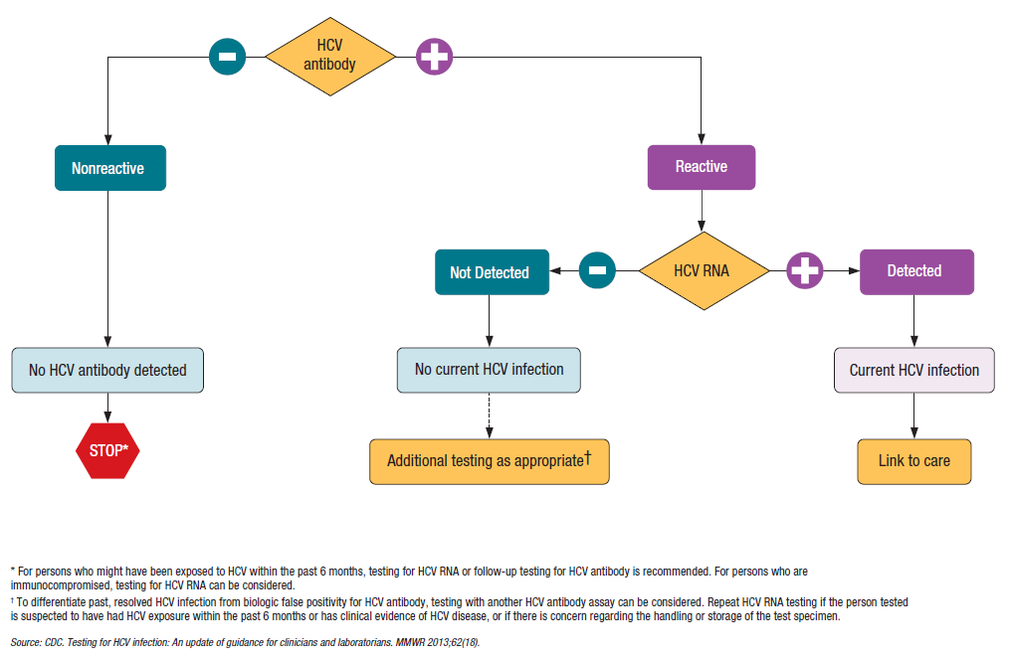
CDC Testing Algorithm
A two-part testing sequence (HCV antibody and HCV RNA confirmatory) is required to confirm an active HCV infection
CDC. Testing for HCV Infection: An Update of Guidance for Clinicians and Laboratorians. http://www.cdc.gov/mmwr/preview/mmwrhtml/mm6218a5.htm

Slide 16
Two-part Testing Sequence
Initial HCV antibody screening
Use CLIA-waived rapid test, or lab-based assay
Non-reactive indicates no presence of HCV antibodies
Reactive indicates:
Current HCV infection, or
Past HCV infection that has resolved, or
False positivity
Refer or Test for HCV RNA
If antibody screening test is reactive, conduct or refer to a specialist for an RNA test to detect active infection
RNA testing can be conducted using blood from:
A venipuncture sample subsequent to antibody screening, or
A single initial venipuncture in which two specimens are collected in separate tubes, or
A single initial venipuncture sample automatically directed to RNA testing after a reactive antibody screening (reflex-to-RNA), or
A separate venipuncture sample collected after reactive rapid test using a fingerstick sample
CDC. Testing for HCV Infection: An Update of Guidance for Clinicians and Laboratorians. http://www.cdc.gov/mmwr/preview/mmwrhtml/mm6218a5.htm

Slide 17
Treatment & Cure

Slide 18
Treatment Past & Present
Past
Interferon-based
Low efficacy against the most common HCV genotype (treatment often was not curative)
Patients often experienced significant side effects
Present
Direct-acting Antivirals (DAAs)
Curative (95%) for most patients and most genotypes
Provide improved patient quality of life: fewer side effects and shorter treatment duration (8-24 weeks)
Treatments are evolving with new medications, making it important to stay up-to-date with the latest guidelines
1. CDC. Hepatitis C FAQs for Health Professionals. http://www.cdc.gov/hepatitis/hcv/hcvfaq.htm
2. U.S. Food and Drug Administration (FDA). Harvoni (ledipasvir/sofosbuvir) Label Updated. http://content.govdelivery.com/accounts/USFDA/bulletins/125209b
3. FDA. FDA Hepatitis C Update – Approval of Zepatier for Treatment of Chronic Hepatitis C Genotypes 1 and 4. http://content.govdelivery.com/accounts/USFDA/bulletins/1333c51

Slide 19
Benefits of Treatment & Cure
Curative treatment reduces:
Risk of liver cancer by 75%
Risk of all-cause mortality by 50%
Curative treatment improves:
Cost-effectiveness compared to past treatment regimens
Cost-effectiveness compared to long-term treatment of HCV-associated conditions
Patient quality of life
Health outcomes for individuals co-infected with HIV
Curative treatment prevents future transmission of HCV
Rates of reinfection among persons who inject drugs are relatively low, especially with behavioral support, and should not be a justification for withholding curative treatment
1. CDC. CDC Fact Sheet: Viral Hepatitis and Liver Cancer. http://www.cdc.gov/nchhstp/newsroom/docs/factsheets/viral-hep-liver-cancer.pdf
2. Saab, et al. Cost-effectiveness Analysis of Sofosbuvir Plus Peginterferon/ribavirin in the Treatment of Chronic Hepatitis C Virus Genotype 1 Infection. Alimentary Pharmacology & Therapeutics. 2014;40(6):657-675.
3. Alcorn, K. Reinfection after hepatitis C cure: Prevention may require long-term support for people who have injected drugs. 2015. http://www.aidsmap.com/Reinfection-after-hepatitis-C-cure-prevention-may-require-long-term-support-for-people-who-have-injected-drugs/page/2973522/

Slide 20
Necessity of HCV Genotyping
Genotypes of HCV are distinct groups of the virus that impact different populations and require specific treatment protocols
Genotyping is often performed as part of RNA testing, and is necessary to optimize treatment
US Genotype Prevalence
1. U.S Department of Veterans Affairs. Hepatitis C Genotypes and Quasispecies. http://www.hepatitis.va.gov/provider/reviews/genotypes.asp#note2
2. University of Washington. Hepatitis C in the United States. http://www.hepatitisc.uw.edu/pdf/screening-diagnosis/epidemiology-us/core-concept/all

Slide 21
Accessing Treatment: Things to Consider
Suggested Content:
Locally-available insurance policies known to cover newer HCV treatment regimens
Assistance programs and compatible insurance plans
Known local barriers to coverage
Local patient navigation resources

Slide 22
Key Steps for Providers

Slide 23
Screen
Using a rapid or lab-based HCV antibody assay:
All persons born between 1945-1965 (baby boomers) once in their lifetime without attaining past risk
People who inject drugs who are currently injecting or who have ever injected
HIV-positive persons at their first medical visit, plus annually for all HIV-positive MSM
Confirm
With an HCV RNA test using reflex-to-RNA to streamline diagnosis and reduce loss-to-follow-up (or refer and link for confirmatory testing)

Slide 24
Refer and Link
To RNA confirmatory testing for antibody-positive patients
Or, to be assessed for treatment for RNA-confirmed patients
Counsel
HCV-positive persons on adherence for those receiving treatment, transmission prevention, and liver health
HCV-negative persons on harm reduction information
Follow Up
With antibody-positive patients in your practice to ensure they receive a confirmatory RNA test and are linked to care for treatment

Slide 25
Implement
Standing orders for nurses and medical assistants to nurses and medical assistants to screen for HCV
Electronic medical record enhancements, including alerts and prompts to screen 1945-65 birth cohort
Clinical decision support tools for confirmatory testing, risk-based testing, counseling and prevention for people who test positive, and referral coordination
Patient communication tools including email reminders and notifications
Consult
The most up-to-date HCV prevention and treatment guidelines at www.hcvguidelines.org

Slide 26
Local Contact Information
Suggested Content
Local health department contact information
State or regional viral hepatitis coordinator contact information
Information on local harm reduction services, including syringe service programs/exchanges

