Slide 1
Building Up Infection Prevention & Control in Local Departments in Healthcare-Associated Infections and Antimicrobial Resistance Project (BUILD HAIAR Project)
INFORMATIONAL WEBINAR
September 6, 2023

Slide 2
Webinar logistics
This webinar is being recorded. The recording will be shared.
Submit questions at any time during this webinar via the “Q&A Box.” Questions will be addressed at the end of the webinar.
If you need technical assistance, please use the “Q&A Box” or email infectiousdiseases@naccho.org.
Notes:
NACCHO will post the recording of this webinar on the blog posts announcing these opportunities. NACCHO will also email the recording to all webinar registrants.

Slide 3
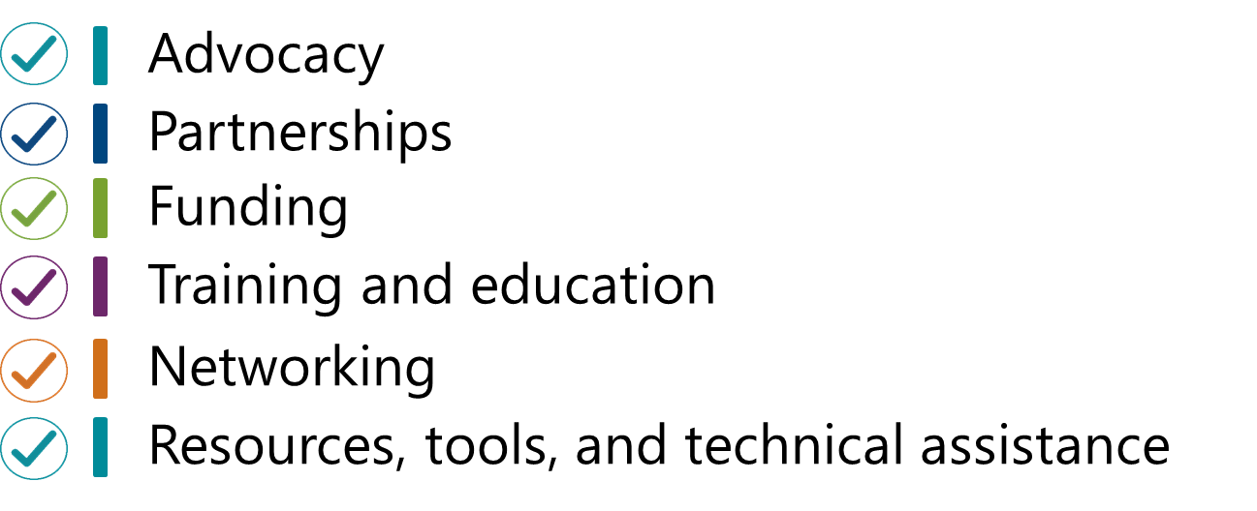
About NACCHO
NACCHO is comprised of nearly 3,000 local health departments (LHDs) across the United States. Our mission is to serve as a leader, partner, catalyst, and voice with local health departments.

Slide 4
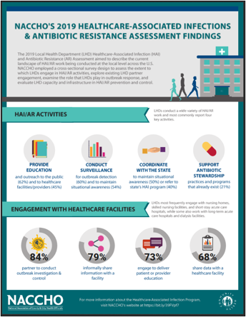
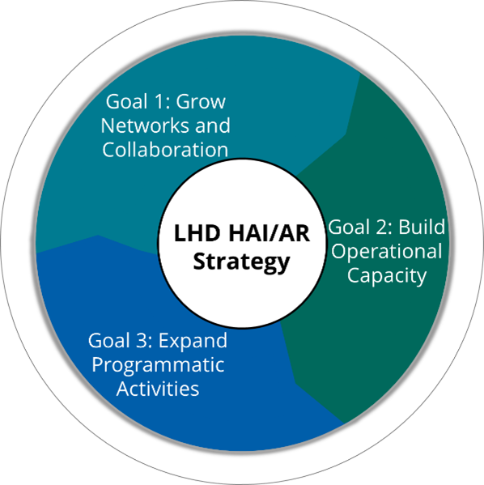
Background

Slide 6
Goals
This project aims to use the CDC (Interim) Local Health Department Strategy for HAI/AR as the foundation to increase LHD capacity in the following areas:
Support LHD capacity for HAI prevention and response;
Advance LHD engagement in AR-related initiatives and activities, including promoting antibiotic stewardship (AS);
Enhance coordination and connection with the State Health Department HAI/AR programs;
Develop and identify resources, lessons learned, and best practices for other LHDs; and
Build strategic approaches to HAI/AR, including addressing health equity.

Slide 7
Timeline
From page 4 of RFA
Application Project
August 25, 2023
Request for application opened
September 6, 2023
Informational webinar
September 22, 2023
Applications due by 11:59 PM PT
October 3, 2023
Anticipated award notification
October 17, 2023
Project period starts
June 30, 2024
Project period ends

Slide 8
Eligibility Criteria
From page 4 of RFA
The application is open to local health departments.
The applicant must express interest in strengthening their capacity in HAIs and AR prevention and response.
The applicant must have at least one staff member who will:
Participate in a monthly community of practice with other LHDs;
Coordinate with local, state, and regional partners;
Leverage the CDC LHD HAI/AR strategy; and
Attend at least one conference or NACCHO convening to share lessons learned.
Have the capacity to execute a contract and complete the project within the required time frames.

Slide 9
Funding Specifics
From page 3 of RFA
NACCHO will issue awards in the form of fixed priced contracts.
Award amounts:
Up to $60,000 to LHD demonstration sites that elect to complete the required activities.
Up to $80,000 to LHD demonstration sites that elect to conduct the required and up to 2 supplemental activities.
Notes:
Funding through this RFA ranges up to $50,000 for LHD demonstration sites that elect to complete the required/base activities and up to $100,000 for LHD demonstration sites that elect to conduct the required AND supplemental activities. Due to the range NACCHO projected at least 50 funded demonstration sites.
Selected LHDs will enter into a contract with NACCHO to complete the deliverables specified in the application.
NACCHO will pay each awarded LHD demonstration site in payments in exchange for completion of the assigned scope of work and accepted deliverables.
Deliverables will be priced as a percentage of the total award amount. For contracts up to $50,000, NACCHO will pay the first payment following the assigned percentage of completion of the deliverables and the second payment upon 100% completion of the deliverables (i.e. two payments). For contracts over $50,000, NACCHO will provide a payment schedule in accordance with the assigned completion percentage (estimated 3 to 4 payments).

Slide 10
Required activities
From page 5 of RFA
Attend project kickoff meeting
Completion of pre-assessment provided by NACCHO
Develop a project implementation plan leveraging the CDC LHD HAI Strategy that indicates HAI/AR goals and/or objectives and activities.
Share progress reports toward goals and/or objectives on the project implementation plan.

Slide 11
Required activities, cont.
From page 6 of RFA
Engage with NACCHO and other demonstration sites by:
Participating in monthly calls,
Participating in evaluation activities, and
Submission of end of project report and/or participation in an interview
Support of at least one communications product
Write at least 3 posts or responses on the BUILD HAIAR Virtual Community Page

Slide 12
Optional Supplemental Activities
From page 6 of RFA
Advance accreditation efforts through the Public Health Accreditation Board (PHAB) using HAI/AR program activities to fulfill accreditation objectives and strengthen crosscutting health department performance improvement efforts.
Explore the LHD role in a decolonization strategy implementation in long-term care facilities.
Obtain Certification in Infection Control (CIC) or Associate- Infection Prevention and Control (a-IPC) entry-level certification.

Slide 13
Submission Instructions
From pages 6-7 of RFA
Read NACCHO’s standard contract (Appendix A) and provide a copy to the individual with signing authority for the LHD.
Applications should be submitted through the online application system.
The link is provided in the RFA
Submissions after the deadline will not be considered.
The submitted application must include the following items to be deemed complete:
Local jurisdiction information (specific instructions provided);
Narrative (2,500- character limit) that addresses the three domains: need, implementation capacity, strategy and approach (specific instructions provided); and health equity
Anticipated budget (template provided) and budget narrative;
Completed Vendor Information Form (Appendix C), W-9, Certification of Non-Debarment, and FFATA data collection form (templates provided).

Slide 14
Selection criteria
From page 7 of RFA
Narrative (2,500-character limit):
Jurisdiction need (25%)
Capacity to implement project (30%)
Description of project activities (40%)
Health equity (5%)
Reviewers will consider geographic distribution, jurisdiction characteristics, population served, and health equity.
Supplemental activities (up to 300 words per additional task selected).
Notes:
Should we include a bullet point for supplement activities

Slide 15
Selection criteria, cont. BLOC COVID-19 +
Score has two components: a general application score and a health equity score.
Maximum total score = 6.00
5.00 general application + 1.00 health equity
Score section | Criteria | Weight
General application | Jurisdiction need Score based on responses in project narrative. | 25%
 | Capacity to implement the project Score based on responses in project narrative. | 30%
 | Description of project activities Score based on responses in project narrative. | 40%
Health equity | Medically Underserved Areas/Populations (MUA/P) designation Score based on MUA/P status for service areas within applicant’s jurisdiction. | 5%
 | CDC/ATSDR Minority Health Social Vulnerability Index (MH SVI) score Score based on composite MH SVI for counties within applicant’s jurisdiction. | 45%
 | Health Equity Inclusion Score based on whether applicant addressed health equity in application. | 10%

Slide 16
Q&A
Please enter your
questions or comments in to the
Q&A box

Slide 17
Thank you for joining today’s webinar! Please be on the lookout for additional opportunities soon.
Contact us with questions
Email: infectiousdiseases@naccho.org
An FAQ document for each opportunity and the recording of today’s webinar will be posted alongside both RFAs
Notes:
For any additional questions about this RFA, please e-mail: infectiousdiseases@naccho.org

