Slide 1


2018 Election Results & Opportunities for Public Health in 2019
NACCHO Government Affairs team:
Adriane Casalotti, MPH, MSW
Eli Briggs, MA
Ian Goldstein, MA
Notes:
Thank you for joining us today.
My name is Adriane Casalotti and I am the new Chief of Government and Public Affairs here at NACCHO. I am joined by my colleagues, Eli Briggs and Ian Goldstein, to give an overview of what happened in the election, our outlook for the lame duck session, and what we will be prioritizing during the next Congress, which starts in January.
We will also provide resources and avenues for how you can engage with us here in Government Affairs and how to build relationships with your elected representatives. We are focused on the federal landscape here, but these tools and skills are useful for any level of government engagement.
Just a quick note before we start: If you have any questions while we go through the presentation, feel free to type them in the fancy chat box in the bottom right corner of your screen. We will have time for questions at the end, and since we have so many participants, that is how we will field all questions.
In addition, we will have some poll questions being pushed out to you all while we speak—please let us know what you think!
We have a wide variety of participants on the line, so before we dive into the election coverage, let me quickly run through who we are here at NACCHO.

Slide 2


About NACCHO
OUR MISSION
To improve the health of communities by strengthening and advocating for local health departments
OUR VISION
Optimal health, equity, and security for all people in all communities
Notes:
Poll: how many have attended a NACCHO webinar previously?
NACCHO works to improve the health of communities by strengthening and advocating for local health departments – and we do this with an eye towards the ultimate vison of creating optimal health, equity, and security for all people in all communities.

Slide 3
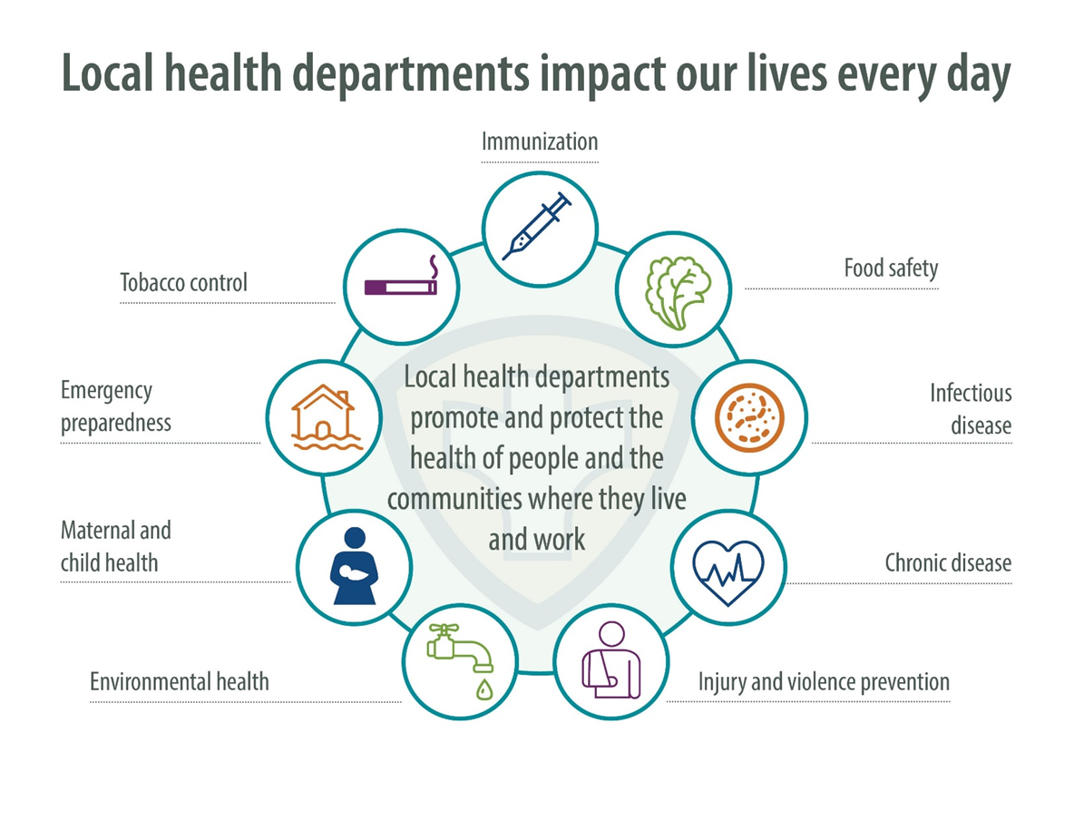
About Local Health Departments
Notes:
Poll: Are you with a LHD, State HD, community-based organization, university or other?

Slide 4
Who is NACCHO?
Local health departments and their staff
State public health department employees at the local level
Former local health officials (retirees)
Students
Non-profit organizations
For-profit organizations
While all local health departments are members, those that pay dues annually are considered active members and can vote in leadership elections.
NACCHO serves all sizes of local health departments
Notes:
There are all kinds of different size health departments including small (or those serving less than 50,000 people), medium (those serving 50-500K people) and then larger metropolitan-type departments serving a half million people or more. We serve all types and sizes of local health departments, including rural health departments.

Slide 5
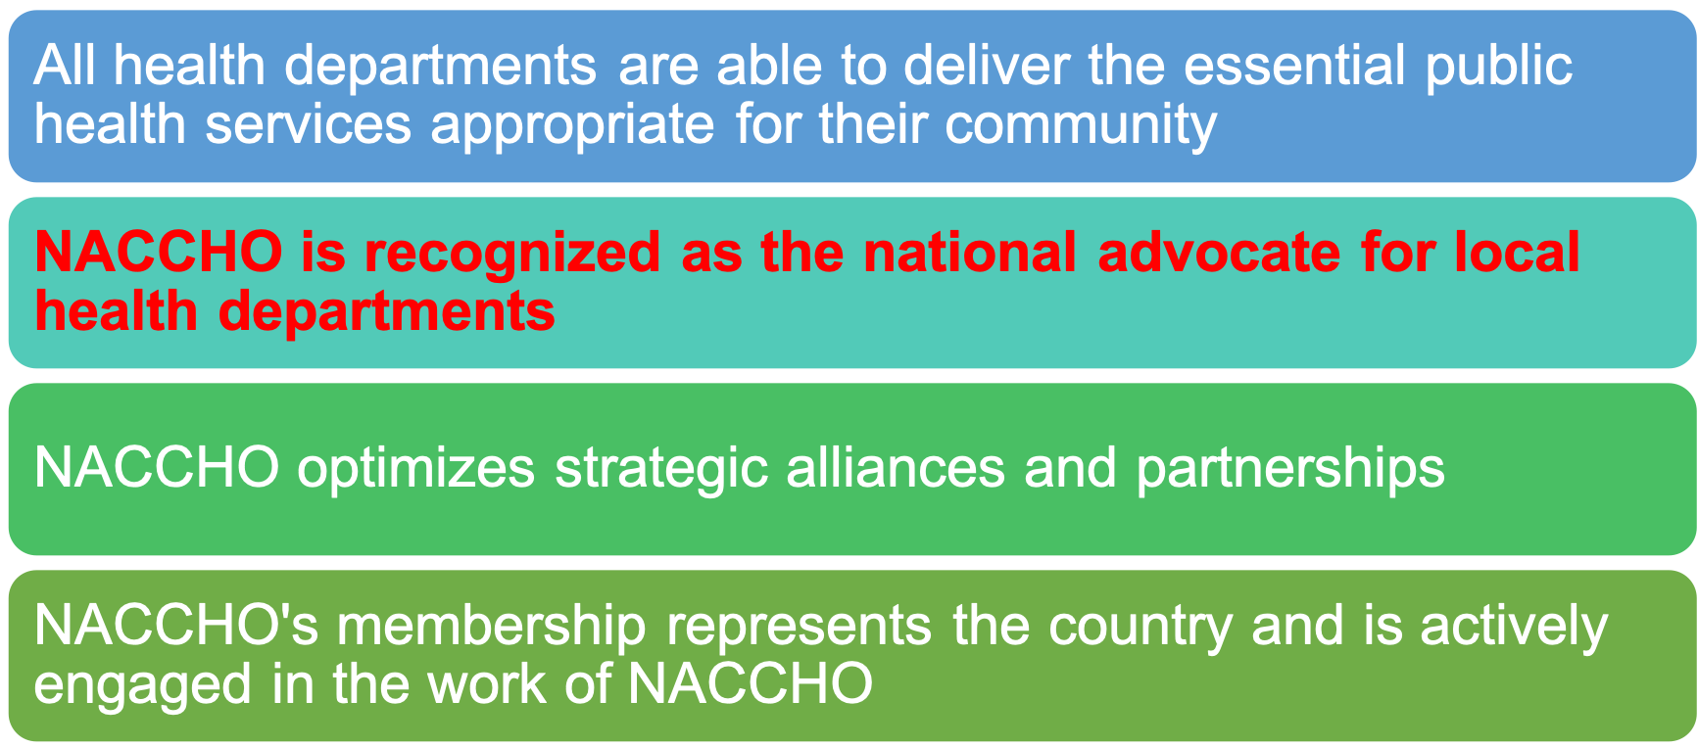
NACCHO Strategic Priorities
2018-2021
Notes:
Our current strategic priorities are:
All health departments are able to deliver the essential public health services appropriate for their community
NACCHO is recognized as the national advocate for local health departments
NACCHO optimizes strategic alliances and partnerships
NACCHO's membership represents the country and is actively engaged in the work of NACCHO

Slide 6
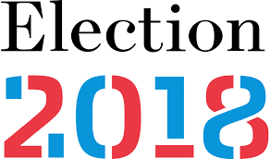
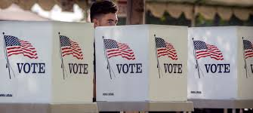
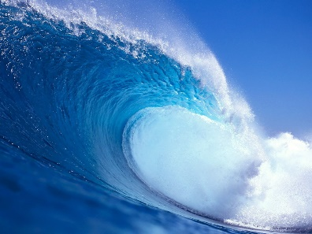
Election 2018
Blue
Wave?
This Photo by Unknown Author is licensed under CC BY-SA

Slide 7
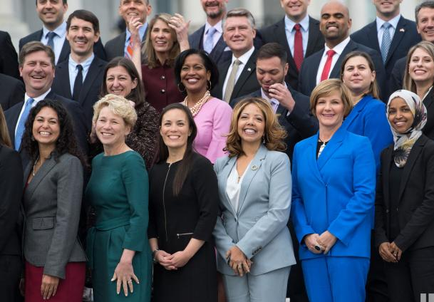
Election 2018
80+ new members in the House
5 new Senators
Diversity
First two Native American women in Congress
First two Muslim women in Congress
Health care focus
Lauren Underwood, nurse, elected in IL-14
Donna Shalala, former HHS Secretary, elected in FL-27
Kim Schrier, pediatrician, elected in WA-8
Several new Members focused on climate change/environment issues

Slide 8

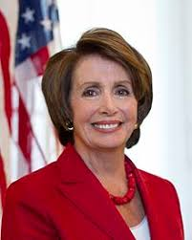
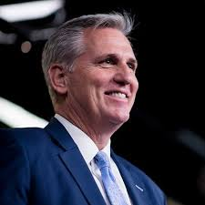
House of Representatives
What changes will Democratic control bring?
Speaker Nancy Pelosi (D-CA)
New Committee Chairs
Appropriations: Rep. Nita Lowey (D-NY)
Labor, HHS, Education Appropriations: Rep. Rosa DeLauro (D-CT)
Energy and Commerce: Rep. Frank Pallone, Jr. (D-NJ)
Ways and Means: Rep. Richard Neal (D-MA)
Speaker (expected)
Nancy Pelosi (D-CA)
Minority Leader
(Jan 2019)
Kevin McCarthy (R-CA)
Notes:
Other: Holding hearings/conducting oversight, Infrastructure, Shoring up Affordable Care Act, Addressing high drug prices, Legalizing cannabis?

Slide 9
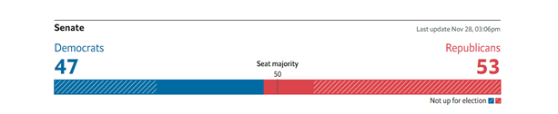
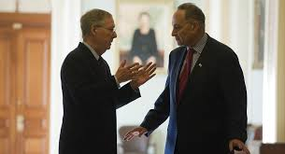
Senate
No change in leadership, but a strengthened Republican Majority
(53 Republicans to 47 Democrats)
Majority Leader Mitch McConnell (R-KY)
Minority Leader Chuck Schumer (D-NY)

Slide 10
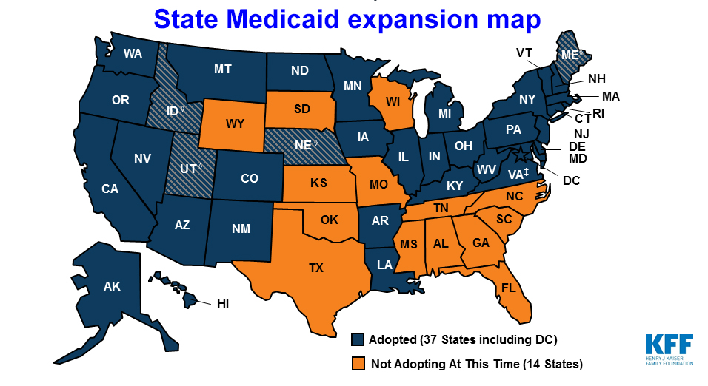
Public Health Ballot Initiatives
Medicaid Expansion passed in several states:
Idaho
Nebraska
Utah
Montana rejected a ballot measure to increase cigarettes by $2/pack to permanently expand Medicaid.
Cannabis Legalization: Medicinal and Recreational
Michigan approved recreational cannabis.
North Dakota rejected recreational cannabis.
Missouri approved medical cannabis.
Utah approved medical cannabis.

Slide 11

Public Health Ballot Initiatives
Abortion Rights
Alabama approved granting fetuses full “personhood” rights under the state Constitution.
Oregon rejected a measure to block abortion access for public employees and women covered by Medicaid.
West Virginia approved stripping the state Constitution of any right to an abortion or state Medicaid funding for abortions.

Slide 12

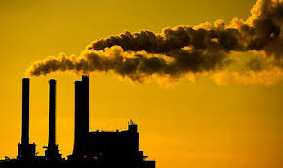
Public Health Ballot Initiatives
Sugar Sweetened Beverages
Oregon rejected a ballot measure that would have prevented local governments from taxing soda and sugary beverages.
Carbon Fee
Washington rejected a ballot measure to put a tax on carbon emissions to fund environmental health programs.

Slide 13
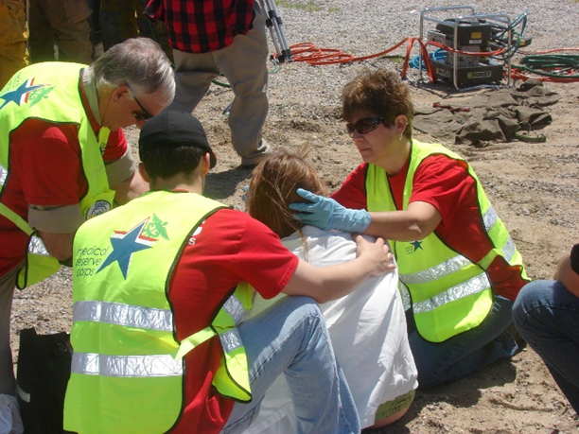

Lame Duck—What to Expect
FY2019 appropriations for most of the government including Agriculture, FDA
Labor HHS is already complete
Reauthorization of the Pandemic and All Hazards Preparedness Act
Includes Public Health Emergency Preparedness and Hospital Preparedness programs
Farm Bill Reauthorization
Supplemental Nutrition Assistance Program

Slide 14



NACCHO Legislative Agenda
Governmental Public Health Spending Accounts for Only 3% of the $2.9
Trillion Spent on Health Care in the United States
Health care spending
Public health spending

Slide 15
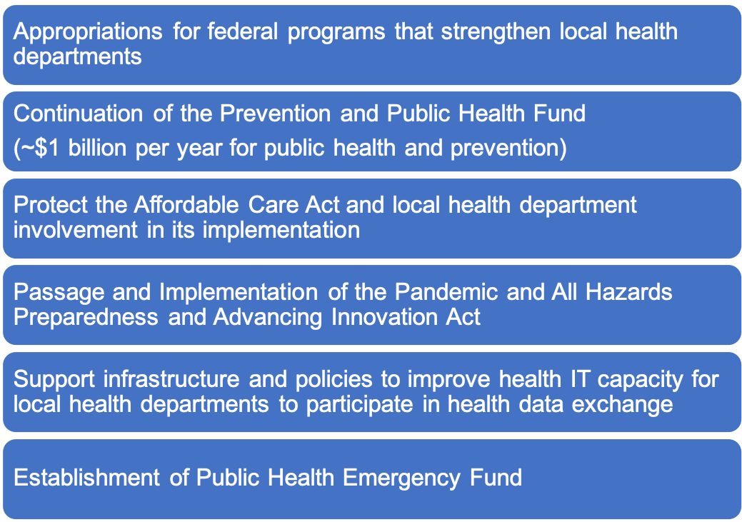
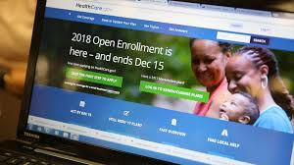

NACCHO Legislative Agenda

Slide 16

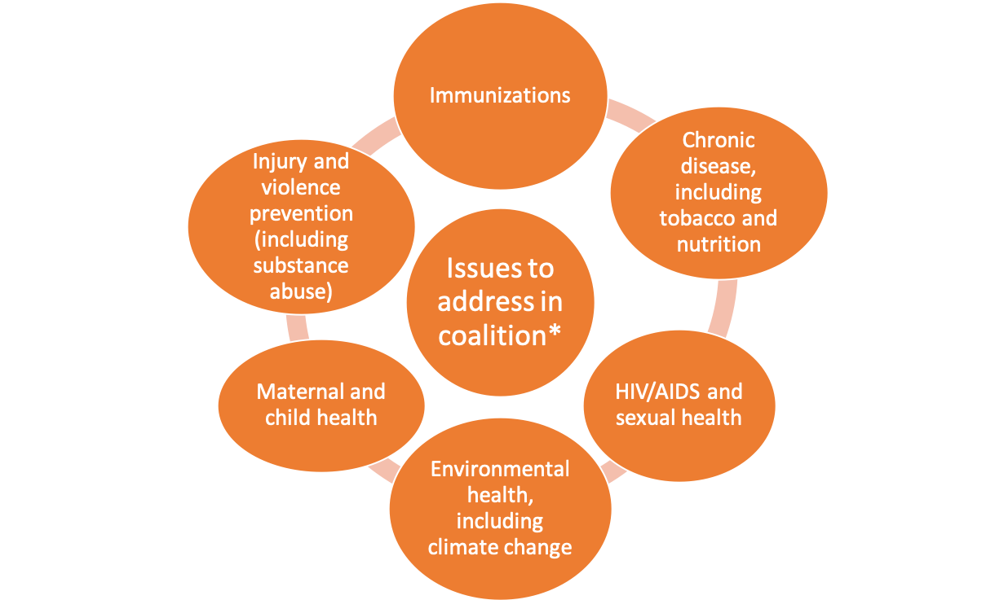
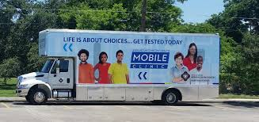

NACCHO Legislative Agenda
*Not an exhaustive list

Slide 17



The highest priority public health issues for
local health departments include…
substance use
chronic disease
mental/behavioral health
n=394
Notes:
substance use (opioids, tobacco, alcohol)
chronic disease (obesity, diabetes, cancer, CVD)
mental/behavioral health (depression, suicide, bullying)
Top three in 2014 were chronic disease, substance abuse, and community issues – such as access to care, transportation, etc -- (although coding schema likely differed between the two years so interpret with caution).

Slide 18
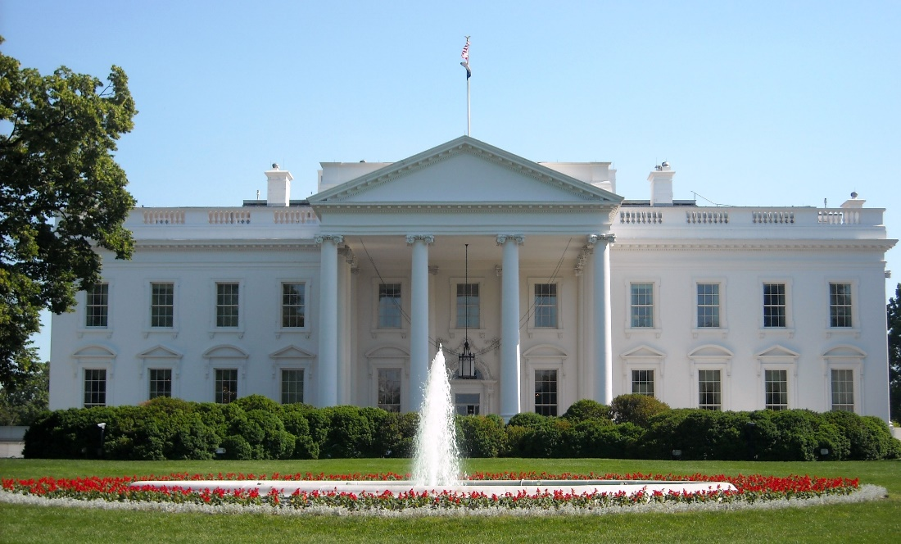
Outlook for 2019
2020 Election
697 days
until Tuesday, November 3, 2020
Bipartisanship may be in short supply with the Presidential election looming.
The House and Senate need to work together to get bills passed and to the President.
This Photo by Unknown Author is licensed under CC BY-SA
Notes:
Also, Democrats need to show they can lead, respond to new Members as well as legislate after years in the minority.
Oversight and messaging will be big push, but opportunity for education.
41% voters said HC was top issue in the election, lots of talk in this space, will see where there is bipar agreement to move forward to action

Slide 19










What You Can Do
Your Call to Action
Become a member
Join the Congressional Action Network
Apply for an award
Attend a conference
Serve on an advisory group or committee
@NACCHOAlerts
Notes:
There are variety of ways that you can actively participate in our organization.
By getting involved, you’ll strengthen the practice of local public health and help launch your career to the next level.
Become a member, if you aren’t already
Join our Congressional Action Network, which advocates for the issues critical to local health departments
Apply for an award like the LHD of the Year Award or the Model Practices Award Program
Attend a conference like NACCHO Annual, the Preparedness Summit, or the biannual informatics conference
Lend your expertise to a NACCHO advisory group or committee, which are responsible for shaping NACCHO’s priorities and directing NACCHO’s work on everything from food safety to accreditation.

Slide 20


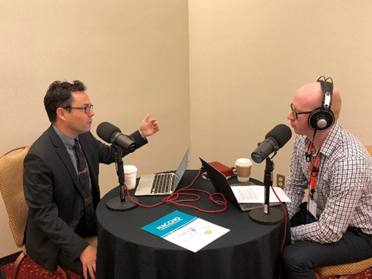
Get Involved
Sign up for NACCHO’s Congressional Action Network
TEXT “JOINCAN” to 50457 and click on the link to register
Subscribe to the NACCHO Podcast Series
Past guests include
Assistant Secretary for Preparedness and Response Dr. Robert Kadlec
Deputy Secretary for Rural Development at USDA Anne Hazlett
Search “NACCHO Podcast Series” in your Podcast App!
Notes:
There are many other ways you can get involved in advocacy as a private citizen or as a local public health official.
You can sign up for NACCHO’s Congressional Action Network (CAN) by taking out your phone and texting the word “JoinCAN” (one word!) to 50457. You will receive a text back with a link to register. You will receive action alerts from NACCHO Government Affairs staff on how you can take action on a particular issue.
I also encourage you to subscribe to NACCHO’s Podcast Series. Get the latest public health information out of Washington, DC in our weekly podcast that features great public health guests. You can find us by searching “NACCHO Podcast Series,” in any of the Podcast Apps.

Slide 21
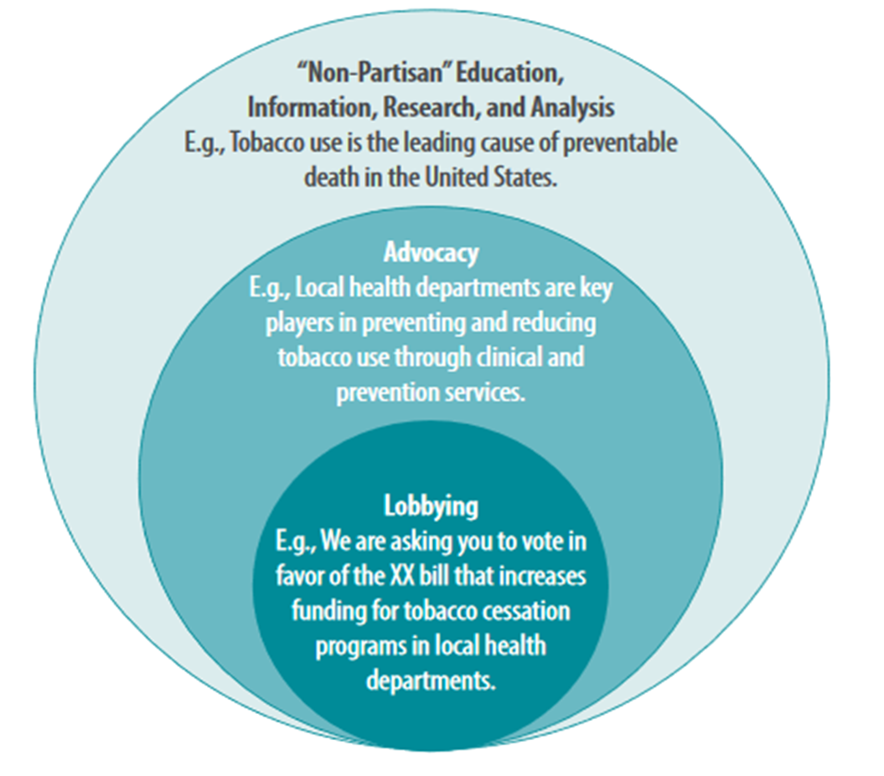
How to Engage
Whether you can lobby for a bill, advocate on an issue, or educate policymakers on the work of local health departments, everyone has a role to play.
Building a relationship with a Member of Congress or their staff and educating them about your health department is critical.
Call
Tweet
Send an email
Schedule a meeting
Invite for a visit or to a local event
However you want to get involved, NACCHO can help!
Notes:
"rules vary by jurisdiction" and "educating is not lobbying”

Slide 22
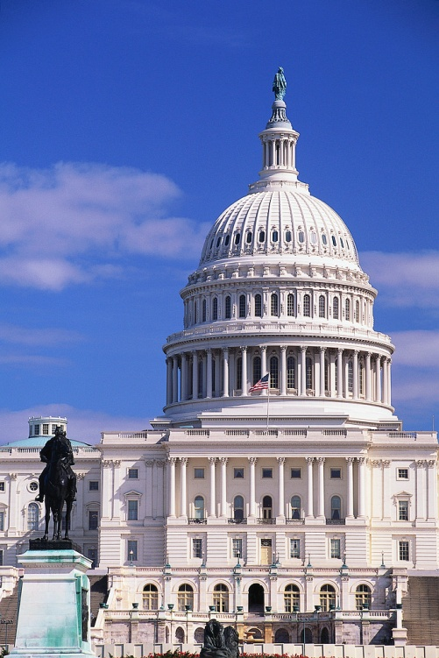

NACCHO Advocacy Resources
NACCHO Advocacy Toolkit:
http://www.naccho.org/advocacy/
New Member of Congress Packet
Federal Funding info, factsheets and guidance http://naccho.org/advocacy/funding-priorities
Notes:
We also have plenty of other resources – there’s no need whatsoever to reinvent the wheel or come up with something from scratch. That’s our job and we do it for you.
Our News from Washington e-newsletter is perhaps the single best email you might receive in a given week. It has EVERYTHING that has happened pertaining to public health and local health departments the CURRENT week. Sign up for it as soon as you can if you haven’t already done so.

Slide 23



Stay Connected
News from Washington
http://www.naccho.org/advocacy/news
@NACCHOAlerts
@NACCHOHQ
@NACCHOAlerts
@NACCHOAlerts
Notes:
It’s easy to stay on top of NACCHO’s news, information, and current happenings by using and participating in our social media accounts noted here.

Slide 24
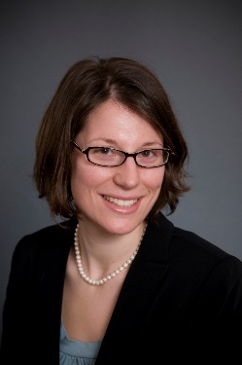
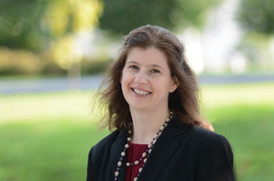
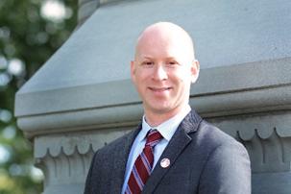
Contact NACCHO Government Affairs
Adriane Casalotti, MPH, MSW
Chief, Government and Public Affairs
acasalotti@naccho.org / 202-507-4255
Eli Briggs, MA
Senior Government Affairs Director
ebriggs@naccho.org / 202-507-4194
Ian Goldstein, MA
Government Affairs Specialist
igoldstein@naccho.org / 202-507-4273
@NACCHOAlerts

Slide 25

Questions?
Questions?
Discussion?
@NACCHOAlerts

