Slide 1
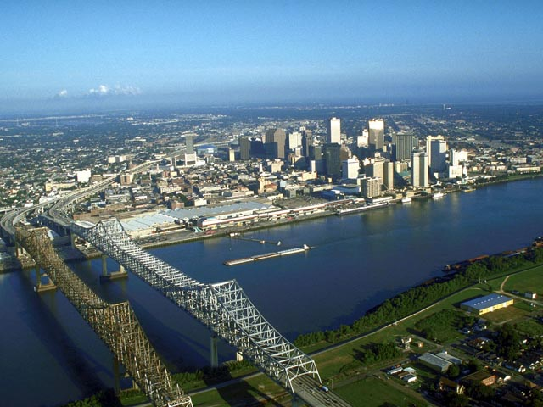
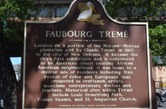
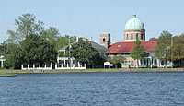
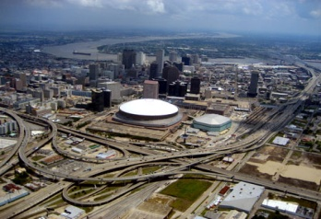
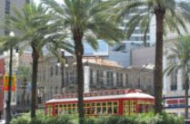
New Orleans Health Department Community Health Improvement Initiative Visioning Session and Forces of Change Assessment Thursday, February 2, 2012

Slide 2
Welcome
Karen Bollinger DeSalvo, MD, MPH, MSc
Health Commissioner
City of New Orleans
New Orleans Health Department
Community Health Improvement Initiative
Vision Session and Forces of Change Assessment
Thursday, February 2, 2012

Slide 3
Welcome
Introduction
Vision for Community Health Improvement
Break
Film: Unnatural Causes & Working Lunch
Forces of Change Assessment
Break
Forces of Change Assessment & Additional Capture
Vision Check
Next Steps
Adjourn
Agenda

Slide 4
Introduction
Yvette M. Wing, MPH
Community Health Improvement Coordinator
New Orleans Health Department
New Orleans Health Department
Community Health Improvement Initiative
Vision Session and Forces of Change Assessment
Thursday, February 2, 2012
Notes:
Address the purpose and importance of the vision session
Address the purpose of the FOCA
Outline the key things we should be walking away with

Slide 5
Objectives
Build consensus around the core elements that will help inform the vision for improving community health in New Orleans.
Identify and discuss the forces of change that affect our ability to carry out our vision for a healthy New Orleans.

Slide 6
“The purpose of the Vision Session is to guide the community through a collaborative, creative process that leads to a shared community vision and common values.” - NACCHO

Slide 7
Vision statements provide focus, purpose, and direction to the process so that participants collectively achieve a shared vision for the future.
Draft #1
Draft #2
A culture of generational health, equity, and civic engagement for all New Orleanians.
To promote health equity, access, safety, and empowerment for all New Orleanians.
Creating a Vision Statement to Drive Change
New Orleans Health Department Community Health Improvement Initiative- Vision Session and Forces of Change Assessment

Slide 8
Welcome
Introduction
Vision for Community Health Improvement
Break
Film: Unnatural Causes & Working Lunch
Forces of Change Assessment
Break
Forces of Change Assessment & Additional Capture
Vision Check
Next Steps
Adjourn
Agenda

Slide 9
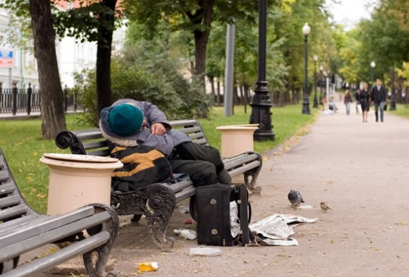
New Orleans Health Department Community Health Improvement Initiative- Vision Session and Forces of Change Assessment

Slide 10
New Orleans Health Department Community Health Improvement Initiative- Vision Session and Forces of Change Assessment

Slide 11
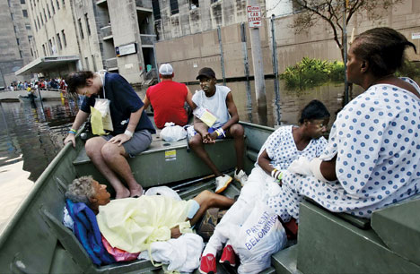
New Orleans Health Department Community Health Improvement Initiative- Vision Session and Forces of Change Assessment

Slide 12
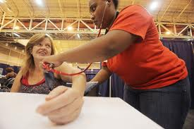
New Orleans Health Department Community Health Improvement Initiative- Vision Session and Forces of Change Assessment

Slide 13
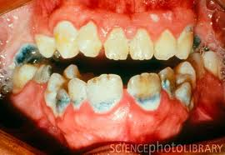
New Orleans Health Department Community Health Improvement Initiative- Vision Session and Forces of Change Assessment

Slide 14
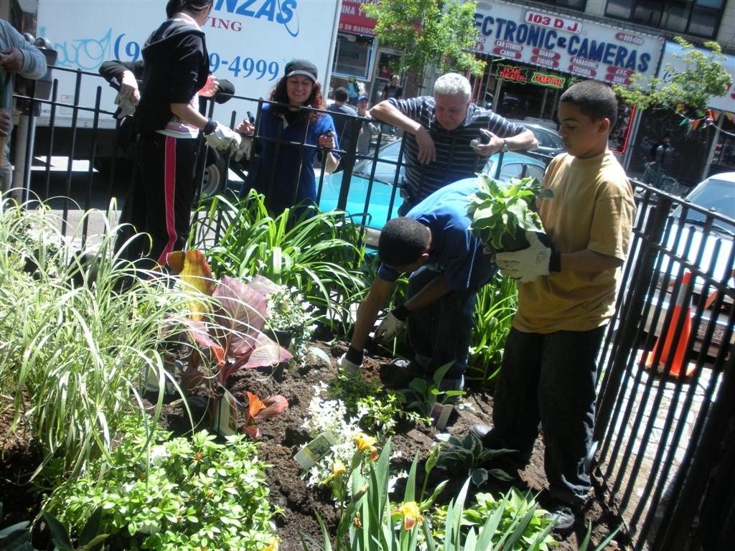
New Orleans Health Department Community Health Improvement Initiative- Vision Session and Forces of Change Assessment

Slide 15
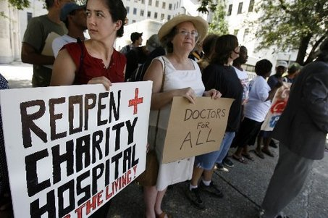
New Orleans Health Department Community Health Improvement Initiative- Vision Session and Forces of Change Assessment

Slide 16
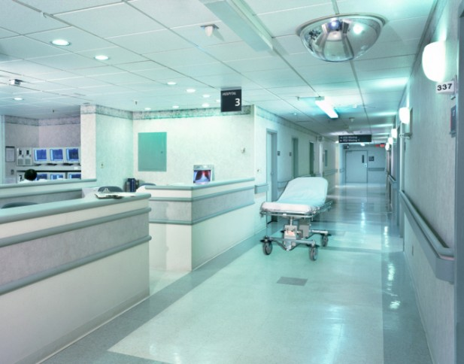
New Orleans Health Department Community Health Improvement Initiative- Vision Session and Forces of Change Assessment

Slide 17
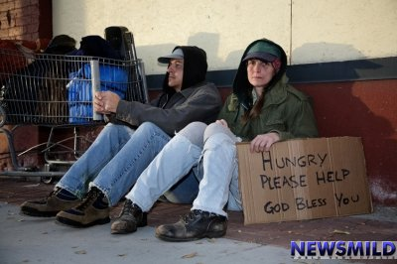
New Orleans Health Department Community Health Improvement Initiative- Vision Session and Forces of Change Assessment

Slide 18
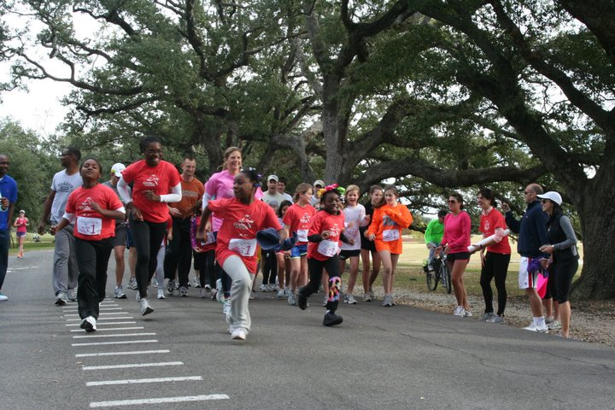
New Orleans Health Department Community Health Improvement Initiative- Vision Session and Forces of Change Assessment

Slide 19
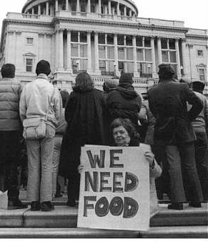
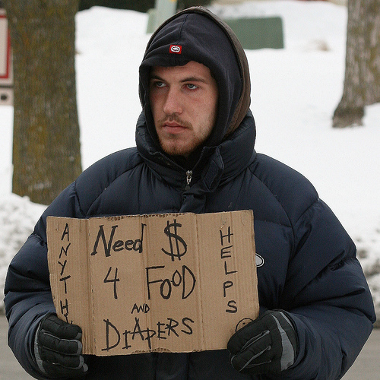
New Orleans Health Department Community Health Improvement Initiative- Vision Session and Forces of Change Assessment

Slide 20
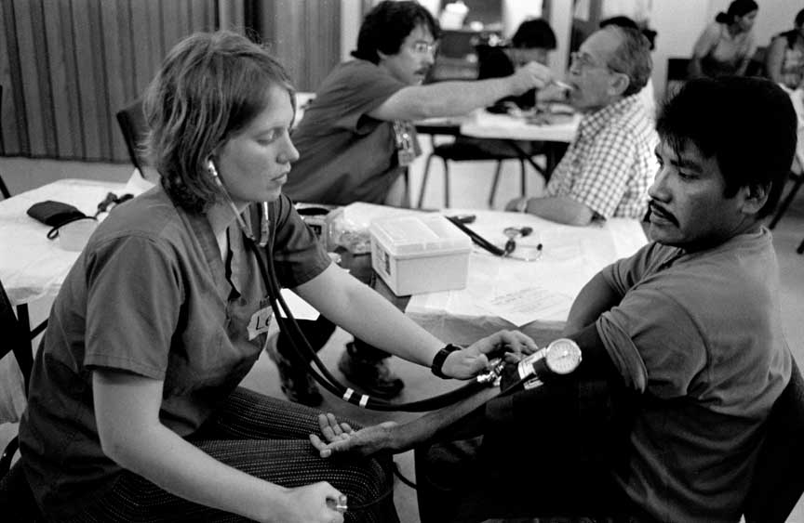
New Orleans Health Department Community Health Improvement Initiative- Vision Session and Forces of Change Assessment

Slide 21
New Orleans Health Department Community Health Improvement Initiative- Vision Session and Forces of Change Assessment

Slide 22
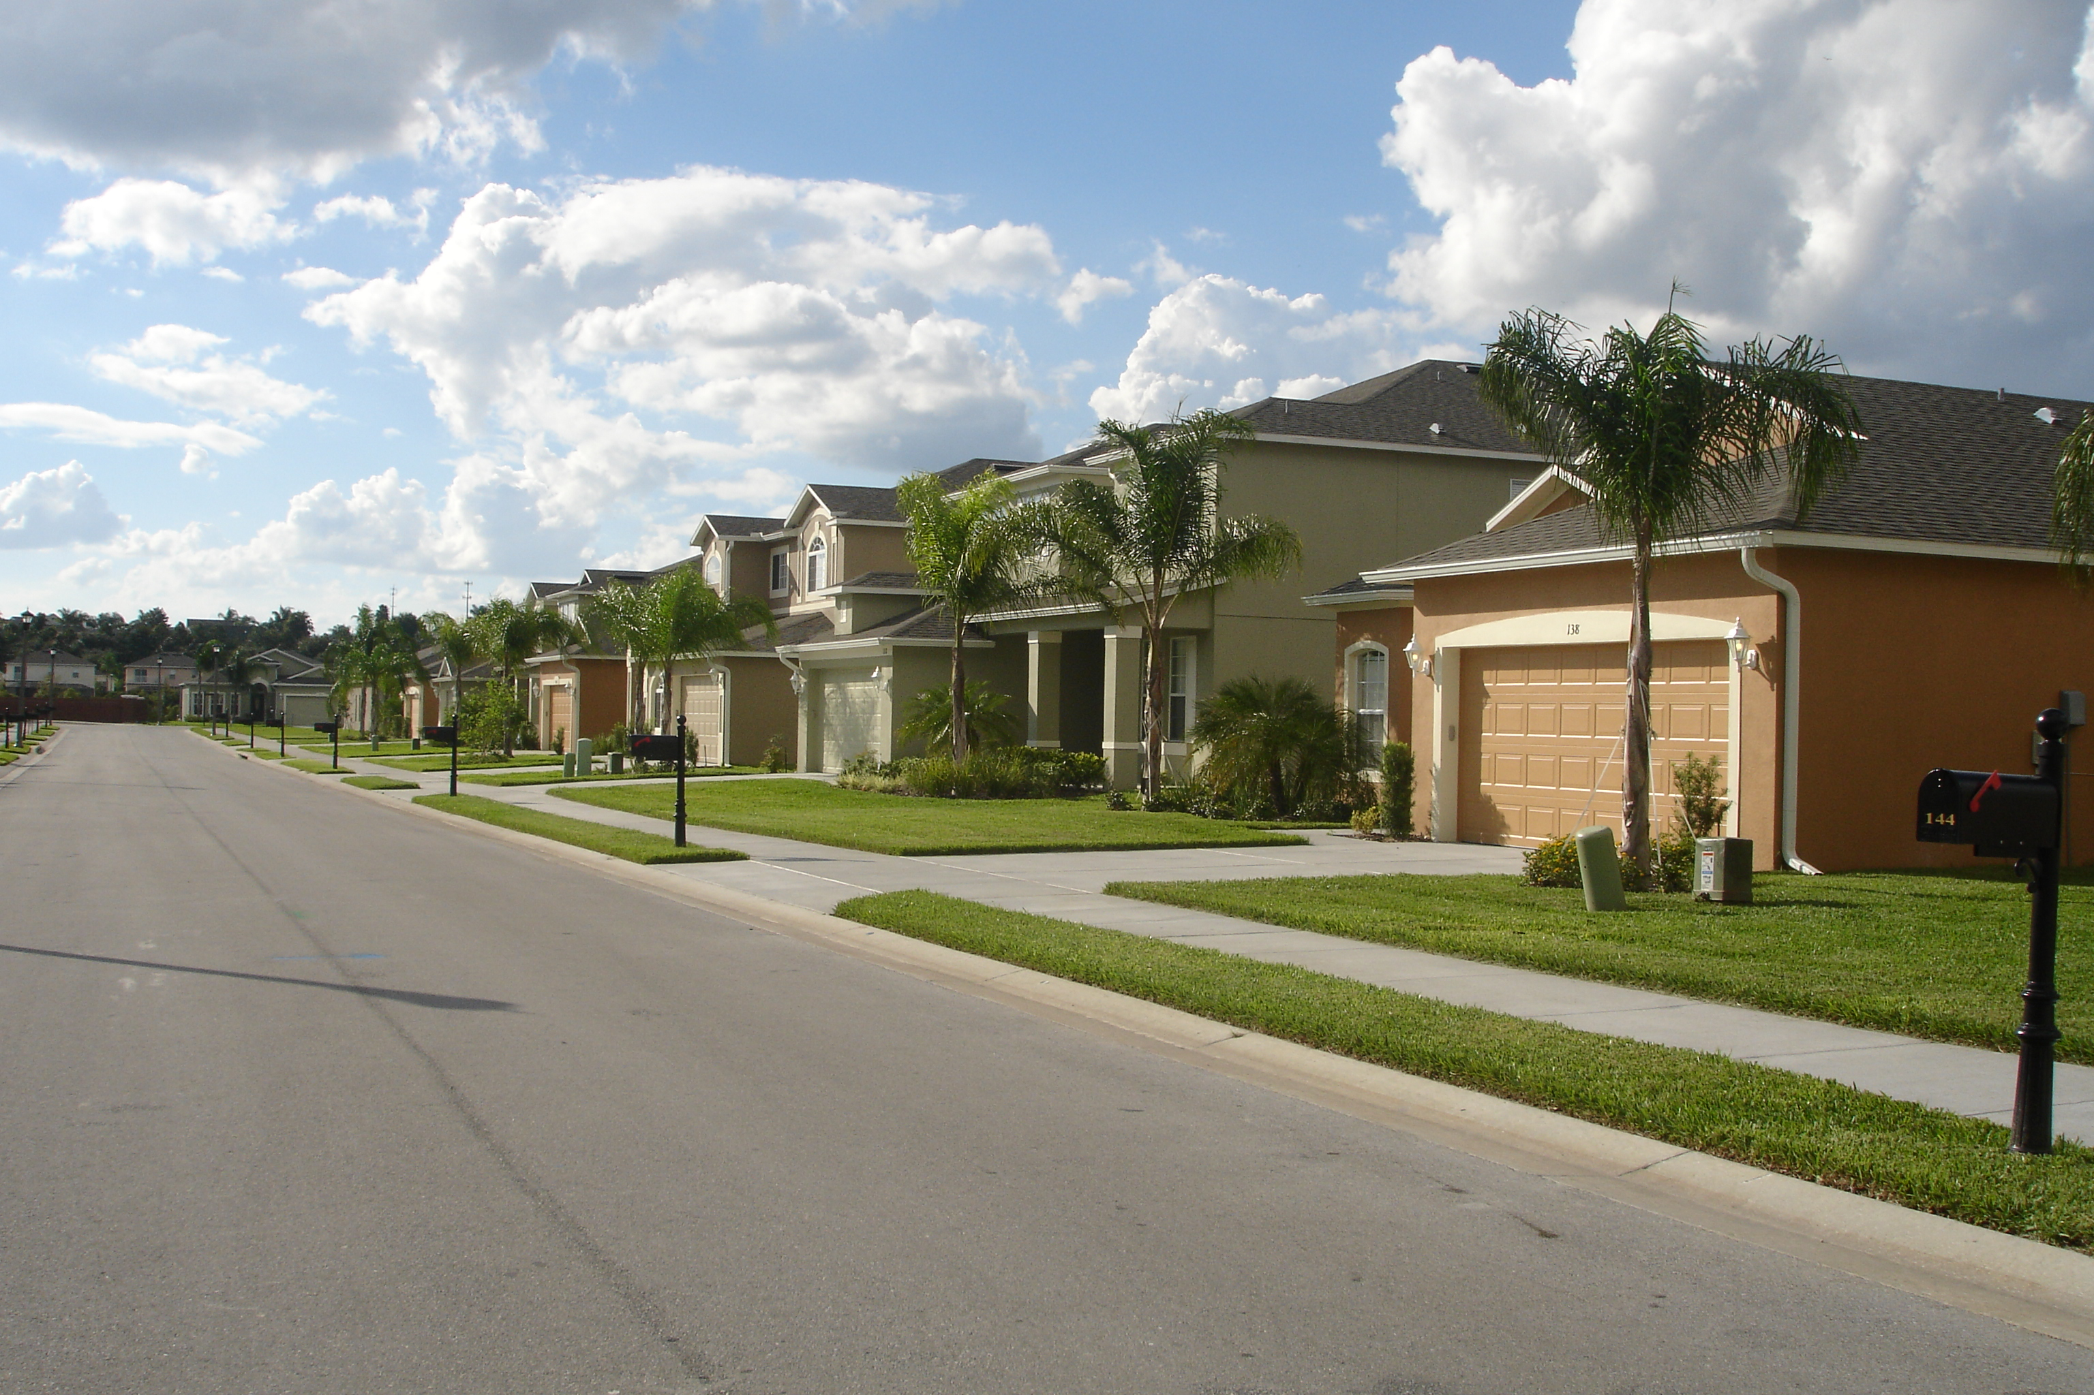
New Orleans Health Department Community Health Improvement Initiative- Vision Session and Forces of Change Assessment

Slide 23
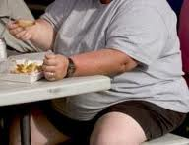
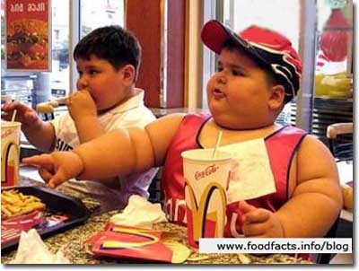
New Orleans Health Department Community Health Improvement Initiative- Vision Session and Forces of Change Assessment

Slide 24
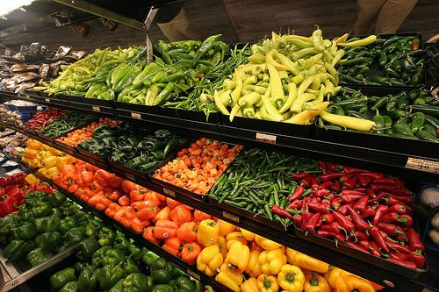
New Orleans Health Department Community Health Improvement Initiative- Vision Session and Forces of Change Assessment

Slide 25
New Orleans Health Department Community Health Improvement Initiative- Vision Session and Forces of Change Assessment

Slide 26
New Orleans Health Department Community Health Improvement Initiative- Vision Session and Forces of Change Assessment

Slide 27
Where do you see the state of community health in New Orleans 5 years from now? What about 10 years from now?
New Orleans Health Department Community Health Improvement Initiative- Vision Session and Forces of Change Assessment

Slide 28
Core principles and themes observed in sample vision statements:
✓
✓
Culture
Safety
✓
✓
Access
Mental and Physical Health
✓
✓
Education
Empowerment
✓
✓
Good Quality of Life
Equity
✓
Action
New Orleans Health Department Community Health Improvement Initiative- Vision Session and Forces of Change Assessment

Slide 29
Welcome
Introduction
Vision for Community Health Improvement
Break
Film: Unnatural Causes & Working Lunch
Forces of Change Assessment
Break
Forces of Change Assessment & Additional Capture
Vision Check
Next Steps
Adjourn
Agenda

Slide 30
Welcome
Introduction
Vision for Community Health Improvement
Break
Film: Unnatural Causes & Working Lunch
Forces of Change Assessment
Break
Forces of Change Assessment & Additional Capture
Vision Check
Next Steps
Adjourn
Agenda

Slide 31
Welcome
Introduction
Vision for Community Health Improvement
Break
Film: Unnatural Causes & Working Lunch
Forces of Change Assessment
Break
Forces of Change Assessment & Additional Capture
Vision Check
Next Steps
Adjourn
Agenda

Slide 32
Forces of Change Assessment
 | Trends (patterns over time) | Factors (discrete elements) | Events (one-time occurrences)
Social
Economic
Political/Legal
Environmental
Technological
Other
New Orleans Health Department Community Health Improvement Initiative- Vision Session and Forces of Change Assessment

Slide 33
Examples of Forces
Trends
Home foreclosures
Factors
Prevalence of teen pregnancy
Events
9/11 Attack on World Trade Center
Unemployment rate
Wealth and educational inequities
Latin American immigration
Aging population
Declining funding
Prevalence of obesity
Intergenerational issues
Hurricane Katrina
Enron
Housing Market Crash
Slow economy
New Orleans Health Department Community Health Improvement Initiative- Vision Session and Forces of Change Assessment

Slide 34
Welcome
Introduction
Vision for Community Health Improvement
Break
Film: Unnatural Causes & Working Lunch
Forces of Change Assessment
Break
Forces of Change Assessment & Additional Capture
Vision Check
Next Steps
Adjourn
Agenda

Slide 35
Welcome
Introduction
Vision for Community Health Improvement
Break
Film: Unnatural Causes & Working Lunch
Forces of Change Assessment
Break
Forces of Change Assessment & Additional Capture
Vision Check
Next Steps
Adjourn
Agenda

Slide 36
Forces of Change Assessment
 | Trends (patterns over time) | Factors (discrete elements) | Events (one-time occurrences)
Social
Economic
Political/Legal
Environmental
Technological
Other
New Orleans Health Department Community Health Improvement Initiative- Vision Session and Forces of Change Assessment

Slide 37
Welcome
Introduction
Vision for Community Health Improvement
Break
Film: Unnatural Causes & Working Lunch
Forces of Change Assessment
Break
Forces of Change Assessment & Additional Capture
Vision Check
Next Steps
Adjourn
Agenda

Slide 38
Draft Vision Statements
Draft #1
Draft #2
A culture of generational health, equity, and civic engagement for all New Orleanians.
To promote health equity, access, safety, and empowerment for all New Orleanians.
New Orleans Health Department Community Health Improvement Initiative- Vision Session and Forces of Change Assessment

Slide 39
Welcome
Introduction
Vision for Community Health Improvement
Break
Film: Unnatural Causes & Working Lunch
Forces of Change Assessment
Break
Forces of Change Assessment & Additional Capture
Vision Check
Next Steps
Adjourn
Agenda

Slide 40
Next Steps
Next steering committee meeting:
March 1, 2012 10am-11:30am
Next assessment:
Local Public Health Assessment April 2012
New Orleans Health Department Community Health Improvement Initiative- Vision Session and Forces of Change Assessment

Slide 41
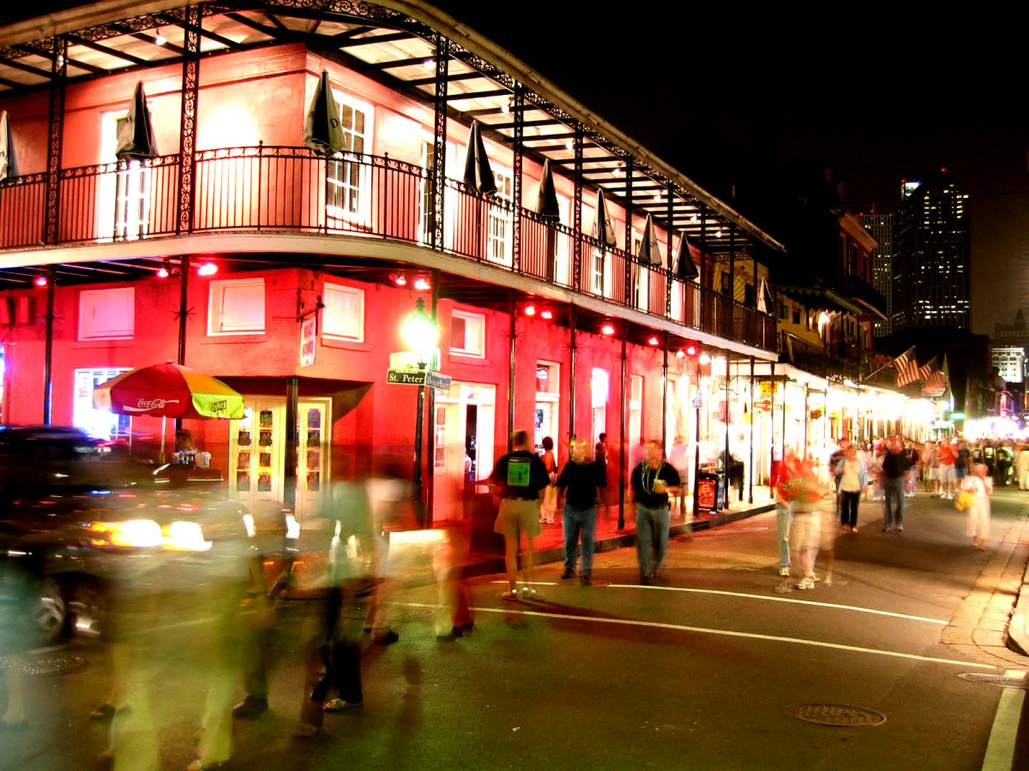
New Orleans Health Department Community Health Improvement Initiative Vision Session and Forces of Change Assessment
Thursday, February 2, 2012
New Orleans Health Department Community Health Improvement Initiative- Vision Session and Forces of Change Assessment

