Slide 1

Leveraging Cross-sectoral Partnerships to Advance the Implementation of Smoke-Free Public Housing
April 5, 2018 from 2 pm-3 pm ET

Slide 2


Logistics
Webinar audio will only be available through your computer speakers.
This webinar is being recorded and the recording will be shared.
Submit questions through the Q&A box to the right.

Slide 3
Poll Question #1
1) What is your organizational affiliation?
Local or Tribal Health Department
State or Territorial Health Department
Public Housing Authority or official
Federal Agency
National Organization
Community Based Organization
Other

Slide 4
Agenda
Welcome
Monroe County Health Department and Indiana University Health Bloomington
Cincinnati Health Department
Cook County Department of Public Health
Questions and Answers

Slide 5
Learning Objectives
Participants will have increased knowledge of how to leverage cross-sectoral partnerships to advance smoke-free public housing in their communities.
Participants will identify the facilitators and barriers local health departments may face in developing cross-sectoral partnerships to promote smoke-free public housing policies in their communities.

Slide 6

NACCHO Mission
NACCHO is comprised of nearly 3,000 local health departments across the United States. Our mission is to serve as a leader, partner, catalyst, and voice with local health departments.
There’s value in belonging
Learn more by viewing a short video available on our website.
Notes:
Local health departments are the backbone of the public health system in the United States. As a leader, partner, catalyst, and voice for LHDs, NACCHO advances the work of local health officials and their staffs to create healthy, thriving communities.

Slide 7








Values
Equity
Respect
Science
Excellence
Integrity
Innovation
Participation
Leadership
Notes:
The values of leadership, excellence, health equity, participation, respect, integrity, science, and innovation underpin all of NACCHO’s work. These values are reflected back in the important work of LHDs. Together, our collective commitment to local public health is improving the quality and length of all lives.

Slide 8





Our Work
Advocacy
Partnerships
Funding
Training and education
Networking
Resources, tools, and technical assistance
Notes:
NACCHO advocates for LHDs on Capitol Hill; hosts informative conferences; develops timely tools, resources, and publications; disseminates evidence-based practices; provides essential technical assistance, funding, and training; and cultivates important partnerships to move local public health forward.

Slide 9
Applying Community Engagement Principles to Cultivate Transdisciplinary Partnerships with Inter-governmental Agencies in Cook County, Illinois
NACCHO Webinar
Binion, A., Massuda Barnett, G., Durica, D.

Slide 10
Attribution
Funding for this project was made possible, in part, by the Centers for Disease Control and Prevention and the Illinois Department of Public Health. The views expressed in do not necessarily reflect the official policies of the Department of Health and Human Services, nor does the mention of trade names, commercial practices, or organizations imply endorsement by the U.S. Government.

Slide 11
Learning Objectives
Define community engagement and principles that can be applied to cultivate cross-sector, transdisciplinary partnerships.
Understand ways community engagement principles were employed to foster partnership with the public housing authority.
Apply challenges and lessons learned to improve collaborations and increase health impact.
Notes:
What I hope accomplish through today’s presentation

Slide 12
Transdisciplinary Partnership
Allows members from differing backgrounds to contribute their own knowledge and expertise, but efforts are collective in determining best ideas or approaches for solutions to a problem.
Oxford Dictionaries, 2017.
Notes:
What is Transdisciplinary Partnership?
The Oxford Dictonary defines transdisciplianary as relating to one or more branches of knowledge and partnership as the act of being partners.
‘Each member of a collaborative team has specific knowledge of his or her discipline, and transdisciplinary teams integrate these areas.’

Slide 13

Community Engagement
The process of working collaboratively with and through groups of people affiliated by geographic proximity, special interest, or similar situations to address issues affecting the well-being of those people.
Principles of Community Engagement (Second Edition), 2011.

Slide 14
Community Engagement Principles
Clear purpose/goals and who you want to engage
Become knowledgeable about the community
Establish relationships
Empowerment of community to “own” the issue
Cultivation value and need for partnership
Recognize and respect the diversity of the community.
Identify and mobilize community assets
Be prepared to release control and be flexible
Community collaboration requires long-term commitment
Notes:
There are 9 principles of community engagement, but its important to note that this is more of a continuum, that steps overlap and somethings are happing simultaneously. Today I’m going to pull out a few of the principles that were key to cultivating……

Slide 15


Transdisciplinary Partners
Certified health department for 124 municipalities, and 2.4 million people
No single overarching regulatory authority or coordinating entity
Health focused
2nd largest housing authority in Illinois
22 family, senior and high-rise properties, totaling 1,800 public housing units and 200 multi-family units
Business focused
Notes:
Now, lets talk about how these community engagement principles were used to cultivate a partnership between CCDPH and HAAC, two sister agencies serving suburban Cook County residents
CCDPH – focus on public health and prevention
HACC – business and housing

Slide 16
Purpose and Engagement Efforts Public Health and Housing Authority
Clarity: What were reasons for collaboration
Benefits of working together
HACC: Ease of integrating health
CCDPH: Promotion of HiAP
Resources that CCDPH can provide
Technical Assistance to support purpose
Notes:
Being clear about the purpose or goals of the engagement effort and the populations and/or communities you want to engage
Initial meetings to gain insight into each agency. Our collaboration had the possibility to build value for each agency.
HACC was interested in SFH and learned of CCDPH work in the area…..stated an interest in working together but wasn’t sure how

Slide 17
Relationship Building
Champion
and Leadership Team
Executive Director and Board Members
Resident Liaisons
Resident Advisory Boards
Building Managers
Involvement at all levels within HACC hierarchy
Notes:
Go to the community, establish relationships, build trust, work with the formal and informal leadership, and seek commitment from community organizations and leaders to create processes for mobilizing the community
The center of this process we had a champion, the relationship with champion was catalyzed by our flexibility, are responsiveness in requests, and overall open communication.
As a result our champion (asst to director) involved leadership (leadership team included Dir of Buildings, Dir of Compliance and Occupancy and champion) within other key departments in HACC and led to meetings with ED and Board of HACC, building managers (responsible for building maintenance and ensuring compliance once policy was implemented), resident liaisons (equivalent to peer health ed in the public health world), and resident advisory boards – involvement at all levels within the hierarchy of HACC

Slide 18
Empowerment to “Own” the Issue
Continued cultivation of relationship
Trust
Commitment and Engagement
Provision of technical assistance Development of resources | Seeking assistance on other health-related issues Tapping into our expertise | Commitment from leadership Engagement of residents via surveys
Notes:
When working with communities we have to remember and accept that collective self-determination is the responsibility and right of all people in a community. No external entity should assume it can bestow on a community the power to act in its own self-interest
Empowerment to own the not only the issue, but the process. Being business-focused HACC is used to implementation through mandates, but in order to garner buy-in and support from residents a formal survey was conducted.
We provided TA, offered resources, which then built the trust they needed to come to us for assistance on other health-related issues, which then built more commitment and engagement. the trust we built made them more comfortable taking our TA recommendations to even DO the survey. our expertise (giving them why this mattered, our feedback) led them to engage with the survey and the residents in a different way - instead of just "do this" we were able to have discussions with residents about the importance of doing it.

Slide 19
Cultivating Value and Need for Partnership
HACC needed to address health in their mission
CCDPH needed to address social determinants of health
Notes:
Step 4 Partnering with the community is necessary to create change and improve health
Both agencies needed each other to fulfill their missions. In order to provide safe and affordable housing and improve quality of life for residents, HACC needed to incorporate health, and in order for CCDPH to address social determinates of health (in this case housing), we needed to partner with the experts in that area.
Cultivating this partnership helped to build value for both agencies
"what's in it for me" - we first took advantage of HACC knowing they had to think about health (the HUD smoke free thing was coming, they knew, and so they were going to be compelled to do something) and how we need partners to really do PSE change, so the partnership had some value at the outset.
through cultivation and real partnership we built it beyond what HACC had to do and are now moving to other things - example - cessation isn't something that they had to do to go smoke free, but our work together built value for that
Co-Learning – CCDPH did not dictate the best way to implement policies, but instead learned what steps HACC wanted to take and supported them at that level. Leveraged funding from CDC and expertise of partners to develop needed supplemental materials, signage, and connections to cessation services

Slide 20
Identifying and Mobilizing Community Assets to Make Change
Capacity Building
Leadership
Staff
Residents
Education
Education
Education
Training
Notes:
The last principle I will address today is…..
Community engagement can only be sustained by identifying and empowering community assets and strengths and by developing the community’s capacity and resources to make decisions and take action
All HACC assets (actual HACC community: leadership, staff, residents) were educated on the benefits of SFH, but staff was all trained in a brief tobacco intervention.
Through increased capacity HACC staff are better able to assist residents and create sustainability for the implementation of SFH

Slide 21
Tools Used for Engagement and Technical Assistance
Surveys
Educational Presentations
Factsheets
Connection to Tobacco Cessation Services
Signage

Slide 22
Successes- Community Engagement
22 HACC owned properties are 100% smoke-free as of December 1, 2015
18 forums reaching over 250 residents emphasizing the importance of SFH
Expanded our relationship to include promotion of Healthy Homes within voucher housing program
Participation in Cook County community health and improvement plan process
Notes:
The synergies of all of those steps or processes led to ………..
the relationship cultivated a "growth mindset" where we were open to "what else" instead of limiting the work. other ex: healthy homes presentations with voucher folks, our partnering around lead. When opportunities arose, the relationships were there to make beginning the work a lot easier.

Slide 23
Expected Health Outcomes
More than 3,500 residents spared from exposure to secondhand smoke in their homes
88% reduction in indoor air pollution
20% reduction in asthma hospital admissions
4% increase in smoking cessation rates

Slide 24
Lessons Learned
Importance of relationship building
Meeting partners/community where they are
Ensuring partnership is a win-win
Expertise can be incentive
Notes:
Importance of relationship bldg.: flexible, responsive
Meeting community: listening to community needs
this relationship didn’t happen only because there was funding - we could buy some signs, but the real thing we offered was our expertise and "cover" - a lot of the times we wait for $$ to use as a carrot - this is a good example of our expertise being the carrot
Win-win includes transdisciplinary partners and community engagement effort affects
Expertise: Education and Outreach, Connection to cessation services, signage and supplemental materials, creation of success story

Slide 25




Acknowledgements
Notes:
Thank you for your time and thanks to SOPHE for opportunity to share our work

Slide 26
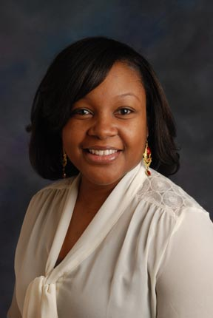


Contact Information
Aesha Binion, MPH
Health Educator III
Tobacco Prevention and Control Unit
aesha.binion@cookcountyhhs.org
cookcountypublichealth.org

Slide 27
Poll Question #2
2) Are you currently engaged in any cross-sectoral partnerships (ex. local housing authority, CBOs, LHDs, etc.) in your community related to smoke-free multi-unit housing?
Yes
No

Slide 28

NEIGHBORS HELPING NEIGHBORS QUIT TOBACCO
Cincinnati public housing residents lead smoking cessation classes for neighbors

Slide 29
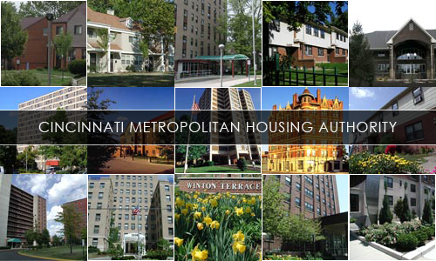

CMHA
Notes:
. CMHA provides affordable housing for low- to moderate-income families. CMHA owns and manages 4,800 asset management units in neighborhoods throughout Hamilton County, including Cincinnati. Most residents are elderly and working families. CMHA is the 17th largest housing authority in the United States

Slide 30
CINCINNATI METROPOLITAN HOUSING AUTHORITY (CMHA)
SMOKEFREE SINCE: JULY 1, 2016
13,000 RESIDENTS
18 MULTI-UNIT SITES / 274 SCATTERED SITES
RESIDENTS GENERALLY PAY 30% OF ADJUSTED GROSS INCOME IN RENT
Notes:
Planning began with CMHA in 2015. CHCC’s TFL Subcommittee at CHD
ODH’s Tobacco Control & Prevention Program has

Slide 31
33.6% of adults living in public housing smoke compared to 15.1% of the general public.
Half have attempted to quit and failed.
Notes:
… indicating need for adequate cessation support
Stats from study:
Prev Med. 2017 Jun;99:171-177. doi: 10.1016/j.ypmed.2017.02.001. Epub 2017 Feb 10.
Cigarette smoking and adverse health outcomes among adults receiving federal housing assistance.
Centers for Disease Control and Prevention (CDC) and the U.S. Department of Housing and Urban Development (HUD).

Slide 32
TOBACCO CESSATION
PROVIDE RESOURCES FOR RESIDENTS WHO WANT TO QUIT.
Group/Community-based Smoking Cessation
source of persuasion, stabilization, and support
reduce the sense of isolation
positive peer reinforcement
CMHA Residents to Facilitate On-Site Cessation Classes
Notes:
There are many options for smokers who want to quit (individual counseling, telephone, online, text) … using a combination of cessation options improves a smoker’s chance for success.
Some studies have shown that group/peer support can improve the likelihood of success for some.
- CDC’s “Quitting Smoking” Fact Sheet.
-Substance Abuse Treatment: Group Therapy
Treatment Improvement Protocol (TIP) Series, No. 41.
Center for Substance Abuse Treatment.
Rockville (MD): Substance Abuse and Mental Health Services Administration (US); 2005.

Slide 33
AMERICAN LUNG ASSOCIATION’S
FREEDOM FROM SMOKING PROGRAM
LED BY TRAINED FACILITATOR (plans, delivers, and evaluates program)
8 MEETINGS OVER 7 WEEKS
SESSIONS ARE 90 MINUTES – 2 HOUR
5 – 16 PARTICIPANTS OPTIMAL
Notes:
TFL Subcommittee partner ALA
uses techniques based on pharmacological and psychological principles and methods designed to help smokers gain control over their behavior
program includes a comprehensive variety of evidence-based cessation techniques
curriculum includes the latest research about nicotine replacement therapy (gum, inhalers, patches, lozenges and nasal spray) and other smoking cessation medications such as Zyban® and Chantix

Slide 34
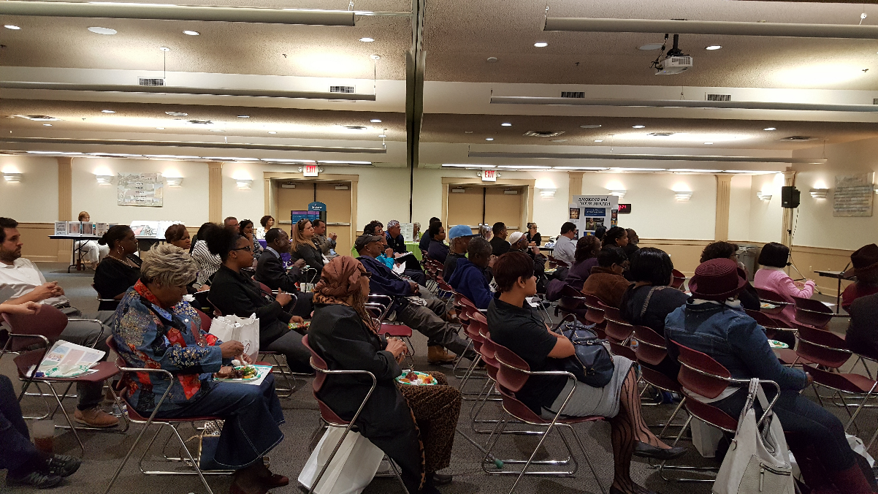
RESIDENT RECRUITMENT
Notes:
EFFECTIVE RECRUITMENT STRATEGY WILL MAKE OR BREAK THIS INITIATIVE.
Picture of May 5, 2016 CMHA Educational Symposium on SFMUH policy. Spoke about FFS Facilitator training and had a sign-in sheet for anyone interested … no one was!

Slide 35
RESIDENT RECRUITMENT: FREEDOM FROM SMOKING FACILITATOR TRAINING
TAKE ADVANTAGE OF EVERY OPPORTUNITY TO ENGAGE RESIDENTS
FOCUS GROUPS
POLICY COMMUNICATION MEETINGS
RESIDENT COUNCIL MEETINGS
HEALTH FAIRS
RESIDENT ADVISORY BOARD CONFERENCE
CHCC MEETINGS!
Notes:
Building a rapport with residents and continuing to talk about the training was an awesome recruitment strategy. Identify residents who are former smokers or who have recently quit for FFS Facilitator training as potential facilitator … requires more work, but can be very influential with other residents.

Slide 36
ENCOURAGING RESIDENTS TO PARTICIPATE
TRAINING AT NO COST TO RESIDENTS
THE TITLE “FFS FACILITATOR” IS THEIRS
ARRANGE WITH PHA FOR TRANSPORTATION TO TRAINING
PROVIDE LUNCH
Notes:
Residents can use this opportunity for training as a stepping stone for other opportunities

Slide 37
CONSIDERATIONS
FFS FACILITATORS MUST BE TOBACCO FREE
“CESSATION ADVOCATES” – TITLE GIVEN TO RESIDENTS WHO WANT TO BECOME FACILITATORS, BUT HAVE NOT BEEN TOBACCO-FREE FOR AT LEAST 1 YEAR
YOGA/MINDFULNESS TIE-IN CAN INCREASED PARTICIPATION IN FFS CLASSES
Notes:
Being an ex-smoker (not required) may give facilitator additional credibility with participants.
Many of trained residents were smokers, ALA partner co-facilitated the meetings
Facilitator training may be a longer process than anticipated, if additional attention is need for interested facilitators who are current smokers
Cessation advocates can be biggest champions
Yoga: FFS classes held immediately following a free community yoga class. Residents had already made one decision that day to do something healthy … “building healthy momentum”

Slide 38
LESSONS LEARNED
FIND A WAY TO INCLUDE RESIDENTS WHO ARE CURRENT SMOKERS IN FACILITATOR TRAINING
TRAIN PHA EMPLOYEE, LHD EMPLOYEE, AND/OR OTHER CHAMPION WHO CAN CO-FACILITATE MEETINGS INITIALLY
RECRUIT FFS PARTICIPANTS TO BECOME FACILITATORS
YOUTH ENGAGEMENT CAN BE USEFUL IN PROMOTING FACILITATOR TRAINING
Notes:
“cessation advocates” ..
Co-facilitator for residents who may be timid about leading a group initially or may not have met qualifications for training (tobacco user)
Recruit participants: keep them on a cessation path; will be very effective at engaging other smokers to go through FFS program (since we know that most smokers want to quit)
Stand group … kids can create posters promoting the training (and subsequent classes) and can share the opportunity with parents

Slide 39
OUR PARTNERS
CINCINNATI METROPOLITAN HOUSING AUTHORITY
AMERICAN LUNG ASSOCIATION
OHIO DEPARTMENT OF HEALTH
INTERACT FOR HEALTH
US ENVIRONMENTAL PROTECTION AGENCY
JURISDICTIONAL-WIDE RESIDENT ADVISORY BOARD (J-RAB)
CINCINNATI CHILDREN’S HOSPITAL MEDICAL CENTER
HAMILTON COUNTY PUBLIC HEALTH
AMERICAN CANCER SOCIETY
AMERICAN HEART ASSOCIATION
CRADLE CINCINNATI
m.Arch, Inc.

Slide 40

PUBLIC HOUSING IS GOING SMOKEFREE
Deadline:
July 30, 2018
Notes:
In case you haven’t heard … HUD has mandated that public housing agencies (PHA) administering public housing to implement a smoke-free policy by July 30, 2018 …

Slide 41
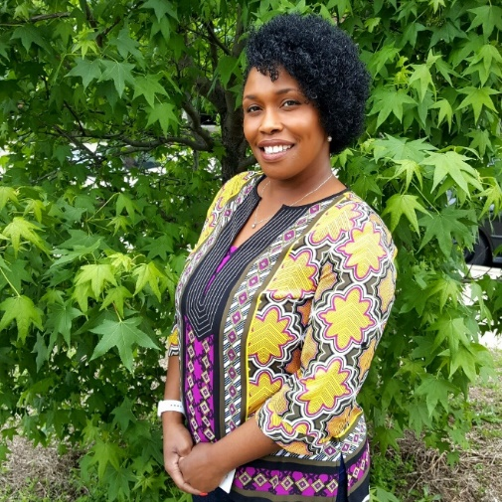
CONTACT INFORMATION
Tonia Smith RS, CHES, TTS
Tobacco Free Living Coordinator
Tonia.Smith@cincinnati-oh.gov
or
Denisha Porter MPH, HHS, RS
Director of Health Promotion and Worksite Wellness
Denisha.Porter@cincinnati-oh.gov
Notes:
questions?

Slide 42
Poll Question #3
3) Does your local housing authority have a smoke-free, multi-unit housing policy in place?
Yes, my organization is involved in the implementation
Yes, but my organization is not involved in the implementation
No

Slide 43


In Public Health, Partnership is everything!
Kathy Hewett,
Lead Health Educator, Accreditation Coordinator
Monroe County Health Department
Bloomington, Indiana
Carol Weiss-Kennedy
Director of Community Health
IU Health Bloomington Hospital
Bloomington, Indiana

Slide 44
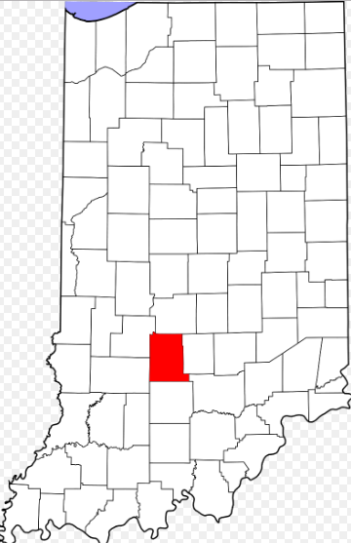


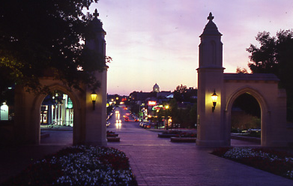
Monroe County Tobacco Coalition Bloomington, Indiana
Notes:
Monroe County is located in south central Indiana and is somewhat rural in nature. Our largest city, Bloomington, has a population of 145,496 and is the 7th largest city in Indiana, according to the 2010 census. We are home to Indiana University, whose 42,000 students helps to create a vibrant, multi-cultural environment and positive influence on our environment. Monroe County is also considered a hub for surrounding counties.

Slide 45
Partnering is a priority for us…
Monroe County
Health Department
Monroe County Pubic Health Nursing
&
Monroe County Public Health Clinic
Addressing Tobacco Control and Prevention Together
IU Health
Bloomington
Hospital

Slide 46

Partnering is a community priority
Examples:
Catalyst for collective action started in early 80’s for people living with HIV - CAAG
Tobacco Coalition began 2001
2004 - Active Living Coalition
2009 - ACHIEVE
2015 - Community Health Assessment and Community Health Improvement (CHIP) teams 2015-2018
Baby and Me, Tobacco Free 2016
Notes:
Bloomington Hospital supported the creation of program to provide social services to those diagnosed with HIV/AIDS. CAAG was one of these volunteer programs that served this population by supporting them with dignity during death. They sat with people so they did not die alone and they planned an supporting appropriate funerals . In many cases families had disowned the victim of HIV
The Active Living Coalition formed to work together to promote a healthy lifestyle to those who live, work and visit Monroe County. We received an ACHIEVE grant in 2009, which guided us in creating change through engaging people in workplaces, schools, healthcare and community organizations. The 2015-2018 Community Heath Assessment and Community Health Improvement teams is truly a community event. We have had individuals from over 50 organizations involved during the process.
When our groups meet, one of the first things we ask ourselves is “who can we partner with?”

Slide 47

What is the Monroe County Tobacco Coalition?
Started in 2001 with grant from Indiana State Department of Health
Core members
IU Health Bloomington Hospital
Indiana University
City of Bloomington
Monroe County Health Department
Notes:
Met monthly through 2015, then not as frequently. Still worked together to provide education and classes.

Slide 48
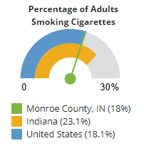
Smoking Risks
Indiana Challenges
Neonatal mortality
Smoking rates
Monroe County
Stats better
High numbers of students may sway data
Data Source: Community Commons, Age 18+ by County, BRFSS 2006-12
Notes:
Notes – give Indiana stats and compare to Monroe. Students sway data both ways… We do have a high number of lower income mom’s who smoke. We began a Baby and Me Tobacco Free program (on which we also partner) last year.

Slide 49

History and Achievements Smoking Bans
Bloomington first city in Indiana with comprehensive ban (2005)
All public places
Workplaces
Bars
Private clubs
Vaping included in ordinance in April, 2017
Indiana University – smoke free 2007
Smoking in Cars with children – County 2009
Notes:
Smoking Prohibited in Vehicles with Children Present Smoking is prohibited in a motor vehicle, either at rest or in motion, in which there is present a person thirteen (13) years of age or younger. A law enforcement officer shall not stop a vehicle for the sole purpose of determining whether there is a violation of this section.

Slide 50

Tobacco Coalition Classes Support…
Weekly classes
(multiple sites and times)
Instructors from all core coalition agencies
nicotine replacement therapy
Hospital foundation
Community Agencies
Classes done at non-profit, such as Housing Authority on and off
Local businesses
One-on-One

Slide 51

Lost funding, but…..
Kept cessation classes going
Coalition continued to meet
(not as frequently)
Educate ourselves and each other
Work on vaping, youth and smoking, other issues

Slide 52


Lost funding, but…..
Kept eyes on upcoming smoking requirements for public housing
Offered to reinitiate smoking cessation classes at the Bloomington Housing Authority
Housing staff showed interest in becoming facilitators
Facilitated attendance in beginning cessation training

Slide 53

“Community” Tobacco Cessation Facilitator Training
Coalition created in-depth training
Curriculum rebuilt
Different member agencies did training
IU Health Bloomington
Indiana University
City of Bloomington
Monroe County Health Department
Volunteers in Medicine

Slide 54

Sustainable Programs
Housing Authority staff members
trained to do tobacco facilitation
have complete curriculum
Tobacco Coalition
Provides Support
Will help as needed

Slide 55


Monroe County Tobacco Coalition
Funded for 2017-2019
Coordinator placed at IU Health Bloomington Hospital
Project examples
Educating public housing officials
Growing coalition
Monitoring points of sale for marketing to children
Other project
Coalition members continue cessation classes
(not funded by state)

Slide 56
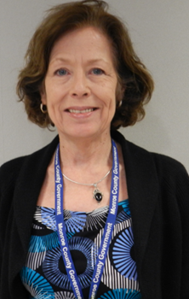
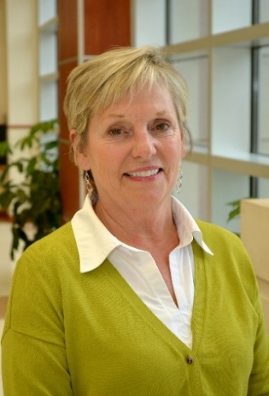
Thank you!
Kathy Hewett
Lead Health Educator and Accreditation Coordinator
Monroe County Health Department
119 W 7th St Bloomington, IN 47404
812-349-2722
khewett@co.monroe.in.us
Carol Weiss-Kennedy
Director of Community Health
IU Health Bloomington
333 E Miller Drive
Bloomington, IN 47401
812.353.9371
cweisskenned@iuhealth.org

Slide 57

Questions and Answers

Slide 58

Additional NACCHO Resources
Tobacco Webpage
http://www.naccho.org/programs/comunity-health/chronic-disease/tobacco
NACCHO Stories From the Field
http://www.nacchostories.org/
NACCHO Toolbox
http://naccho.org/resources/toolbox
Publications
Best Practices
Fact sheets
Tools
Stories from the Field
Contact us: chronicdisease@naccho.org
Notes:
There are variety of ways that you can actively participate in our organization. By getting involved, you’ll strengthen the practice of local public health and help launch your career to the next level. Become a member, if you aren’t already. Join our Congressional Action Network, which advocates for the issues critical to local health departments. Apply for an award like the LHD of the Year Award or the Model Practices Award Program. Attend a conference like NACCHO Annual, the Preparedness Summit, or the biannual informatics conference. Finally, lend your expertise to a NACCHO advisory group or committee, which are responsible for shaping NACCHO’s priorities and directing NACCHO’s work on everything from food safety to accreditation. Here some of the ways you can actively participate and strengthen our mission. You can learn more at www.naccho.org.

Slide 59
THANK YOU!
Thank you for participating in today’s webinar!
Please complete evaluation immediately following the webinar.
Evaluation Survey: http://naccho.co1.qualtrics.com/jfe/form/SV_4OWbCd2OrWaLoY5
Contact Information
Melanie Ruhe, MPH
Program Analyst, NACCHO
202-463-8154
mruhe@naccho.org

