Slide 1

Recognizing and Responding to Rashes in Healthcare settings
Project Firstline
Micro-Learn Discussion
Angelina County & Cities Health District
Facilitators:
Amanda Granger, BSN, RN
Marlene Brown, RN, MPH
Yolanda Parker, LVN

Slide 2
What is a Rash?³
• Abnormal skin—may be red, itchy, bumpy, flat, or blistered.
• Can be caused by:
– Infections (chickenpox, measles)
– Allergic reactions (poison ivy, bug bites)
– Non-infectious conditions

Slide 3
Why This Matters
Rashes are common in healthcare settings.
Some are harmless; others may indicate contagious illnesses.
Early recognition + proper precautions = reduced risk of outbreaks

Slide 4
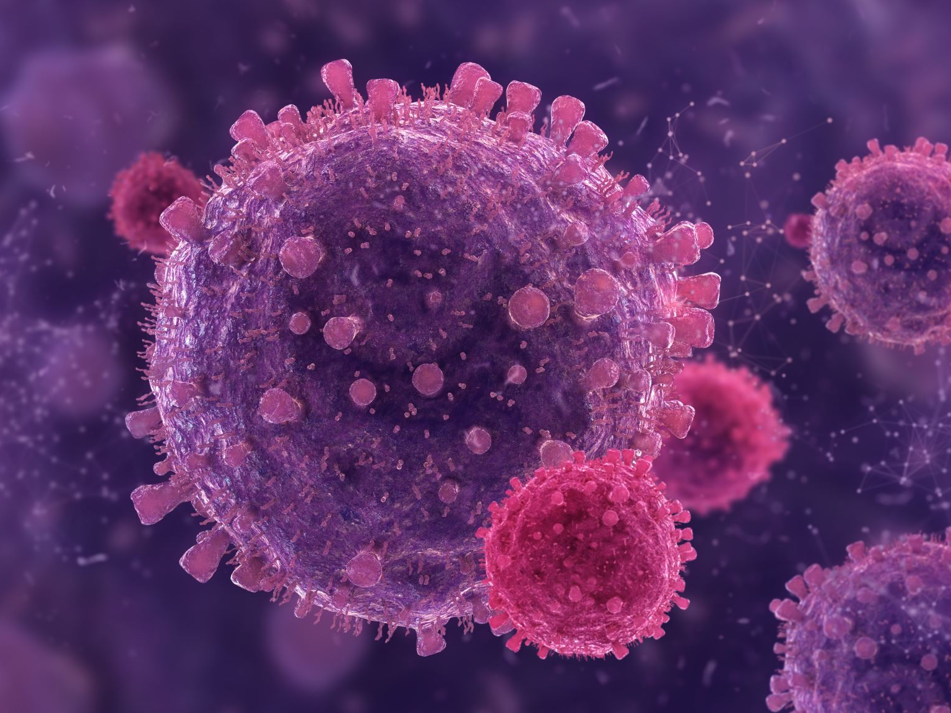
How rashes can spread
Some infections that cause rashes—like chickenpox or measles—are highly contagious. These infections can spread through the air or by direct contact³
Hands and skin often carry germs and can spread them to others¹
Scratching a rash can release germs into the air or onto surfaces³

Slide 5
Not All Rashes Are Infectious... But Treat Them Carefully³
• Even non-infectious rashes can allow germs to enter the body
• You can’t always tell what caused a rash just by looking

Slide 6
What To Do When You See a Rash³
• Avoid touching the rash if you don’t have to
• Always wear gloves if contact is necessary
• Cover the rash if appropriate
• Clean and disinfect surfaces and item
• Be cautious with exposed linens or clothing

Slide 7
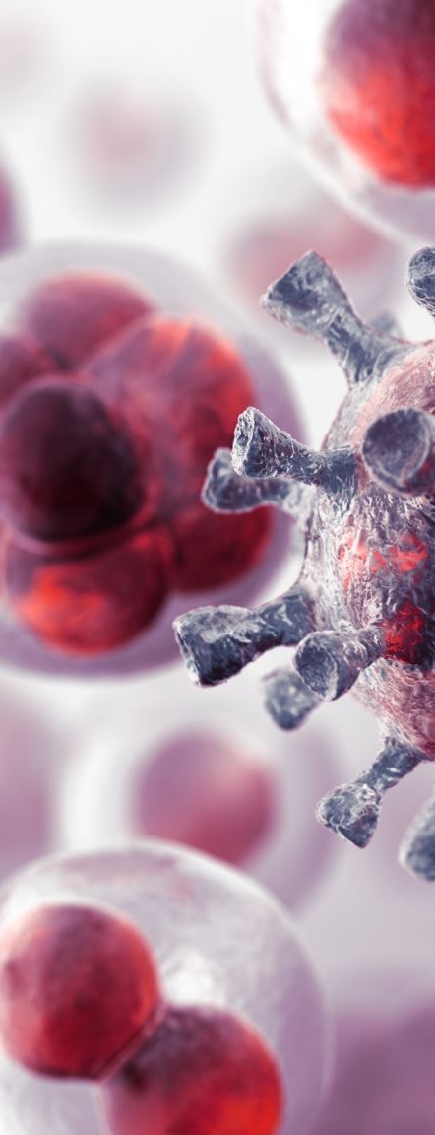
Respiratory Symptoms + Rash = Red Flag
• Rash + cough, congestion? Consider airborne virus³
• Separate the patient if possible
• Notify appropriate health officials

Slide 8
Protecting Yourself and Others³
• Treat any rash as a possible source of infection
• Broken or irritated skin is a vulnerable entry point for germs
• Take steps to prevent spread—even if the rash looks harmless

Slide 9
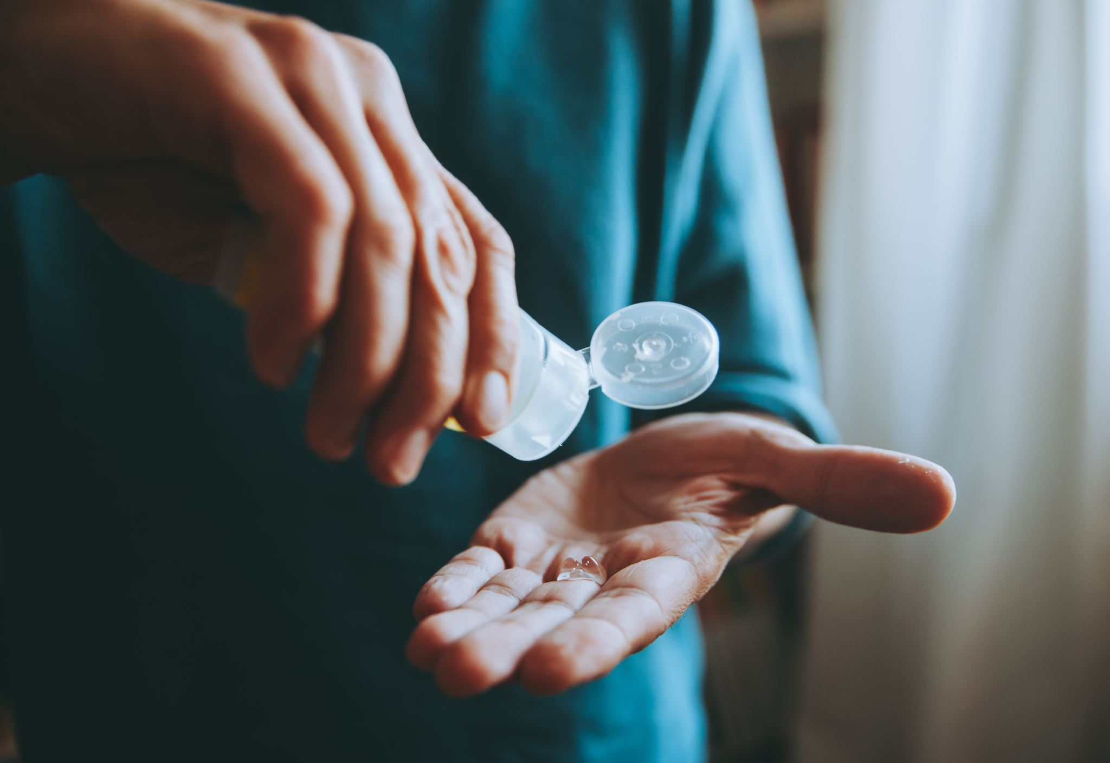
Key Takeaways
• You can't always tell if a rash is contagious
• Treat all rashes with caution
• Use PPE when needed
• Clean/disinfect affected areas²
• Communicate clearly and act quickly

Slide 10

Questions + Discussion
• Open the floor for sharing experiences and clarifying concerns.

Slide 11
Resources
Centers for Disease Control and Prevention. (n.d.). Skin infographic. U.S. Department of Health & Human Services. https://www.cdc.gov/project-firstline/media/pdfs/Healthcare-Germs-Body-Skin-508.pdf
Centers for Disease Control and Prevention. (n.d.). When and how to clean and disinfect a facility. U.S. Department of Health & Human Services. https://www.cdc.gov/hygiene/about/when-and-how-to-clean-and-disinfect-a-facility.html
Centers for Disease Control and Prevention. (n.d.). Rash Micro-Learn. U.S. Department of Health & Human Services. https://www.cdc.gov/project-firstline/media/pdfs/Micro-Learns-Rash-508.pdf

Slide 12

Thank You
• Thank you for your dedication to patient health!

