Slide 1
Enhanced Barrier Precautions
Faith Gandy & Alyssa Reed
Cabell-Huntington Health Department
Epidemiologist Infection Prevention Educators

Slide 2
What are Enhanced Barrier Precautions?
EBP expands the use of gown and gloves beyond anticipated blood and body fluid exposures.
They focus on use of gown and gloves during high-contact resident care activities that have been demonstrated to result in transfer of MDROs to hands and clothing of healthcare personnel, even if blood and body fluid exposure is not anticipated.
Notes:
Colonization means that the organism can be found in or on the body, but it is not causing any symptoms or disease. it is possible for the MDRO to be present on your body but not cause any illness. Such cases are called “colonization”. For example, Staphylococcus aureus is commonly found in various areas of the body including the skin and in the nose. Colonization rarely becomes an infection unless the bacteria spread to a part of the body where the bacteria are not usually found.

Slide 3
What are Multidrug-resistant Organisms?
Multidrug-resistant organisms are bacteria that have become resistant to certain antibiotics, and these antibiotics can no longer be used to control or kill the bacteria.
Multidrug-resistant organisms are found mainly in hospitals and long-term care facilities. They often affect people who are older or very ill and can cause bad infections.
Most often, MDROs spread from patient to patient on the hands of healthcare workers. They can also spread on objects such as medication cart handles, bed rails, bedside tables, IV poles, and catheters (soft tubes placed in the body), to name a few. They can also spread person-to-person through direct contact (touching oozing sores, for instance).

Slide 4

What are Standard Precautions?
Used with all resident care based on assessment of risk to protect healthcare providers and prevent spread of infections
Standard precaution practices:
  Hand hygiene
  Use of PPE
  Handling needles/sharps safely
  Safe injection practices
  Ensure appropriate patient placement, etc.

Slide 5
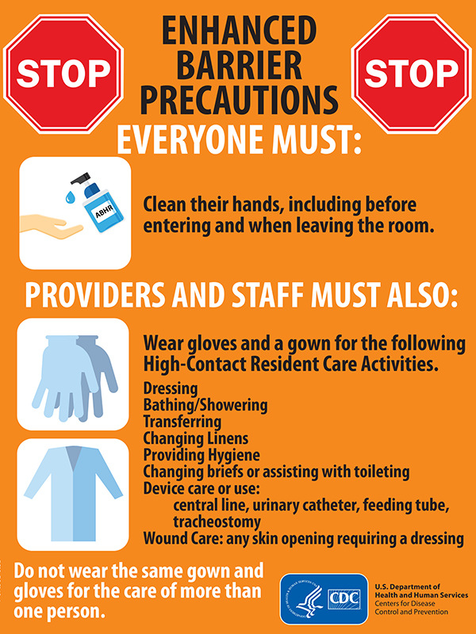
Enhanced Barrier Precautions (EBP)
Use EBP when performing high-contact resident care activities and for residents who meet criteria the use of EBP:
  Includes the use of gown and gloves
  Resident does not need a private room
  Resident may participate in communal activities and is not restricted to room
  Intended to be used for the resident’s entire length of stay in the facility

Slide 6
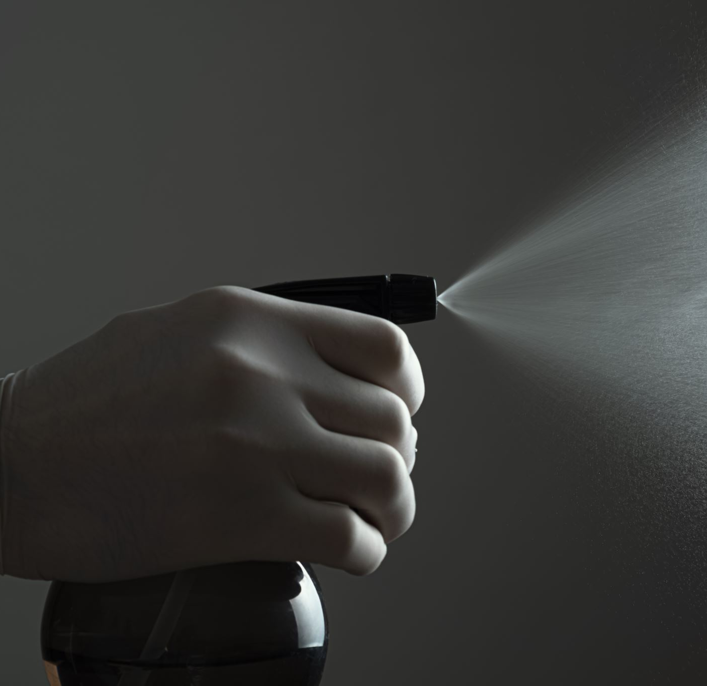
What are the differences between Enhanced Barrier Precautions and Standard Precautions?
Enhanced Barrier Precautions are recommended for residents known to be colonized or infected with a MDRO as well as those at increased risk of MDRO acquisition (e.g., residents with wounds or indwelling medical devices).
Standard Precautions still apply while using Enhanced Barrier Precautions.
Notes:
For example, if splashes and sprays are anticipated during the high-contact care activity, face protection should be used in addition to the gown and gloves

Slide 7
What are High-Contact Resident Care Activities?
Dressing
Bathing/Showering
Changing Linens
Transferring
Providing Hygiene
Changing Diapers or Assisting with The Bathroom
Wound Care
Device Care or Use
Notes:
Device Care of Use- indwelling catheter, trach/vent, central line, feeding tube

Slide 8
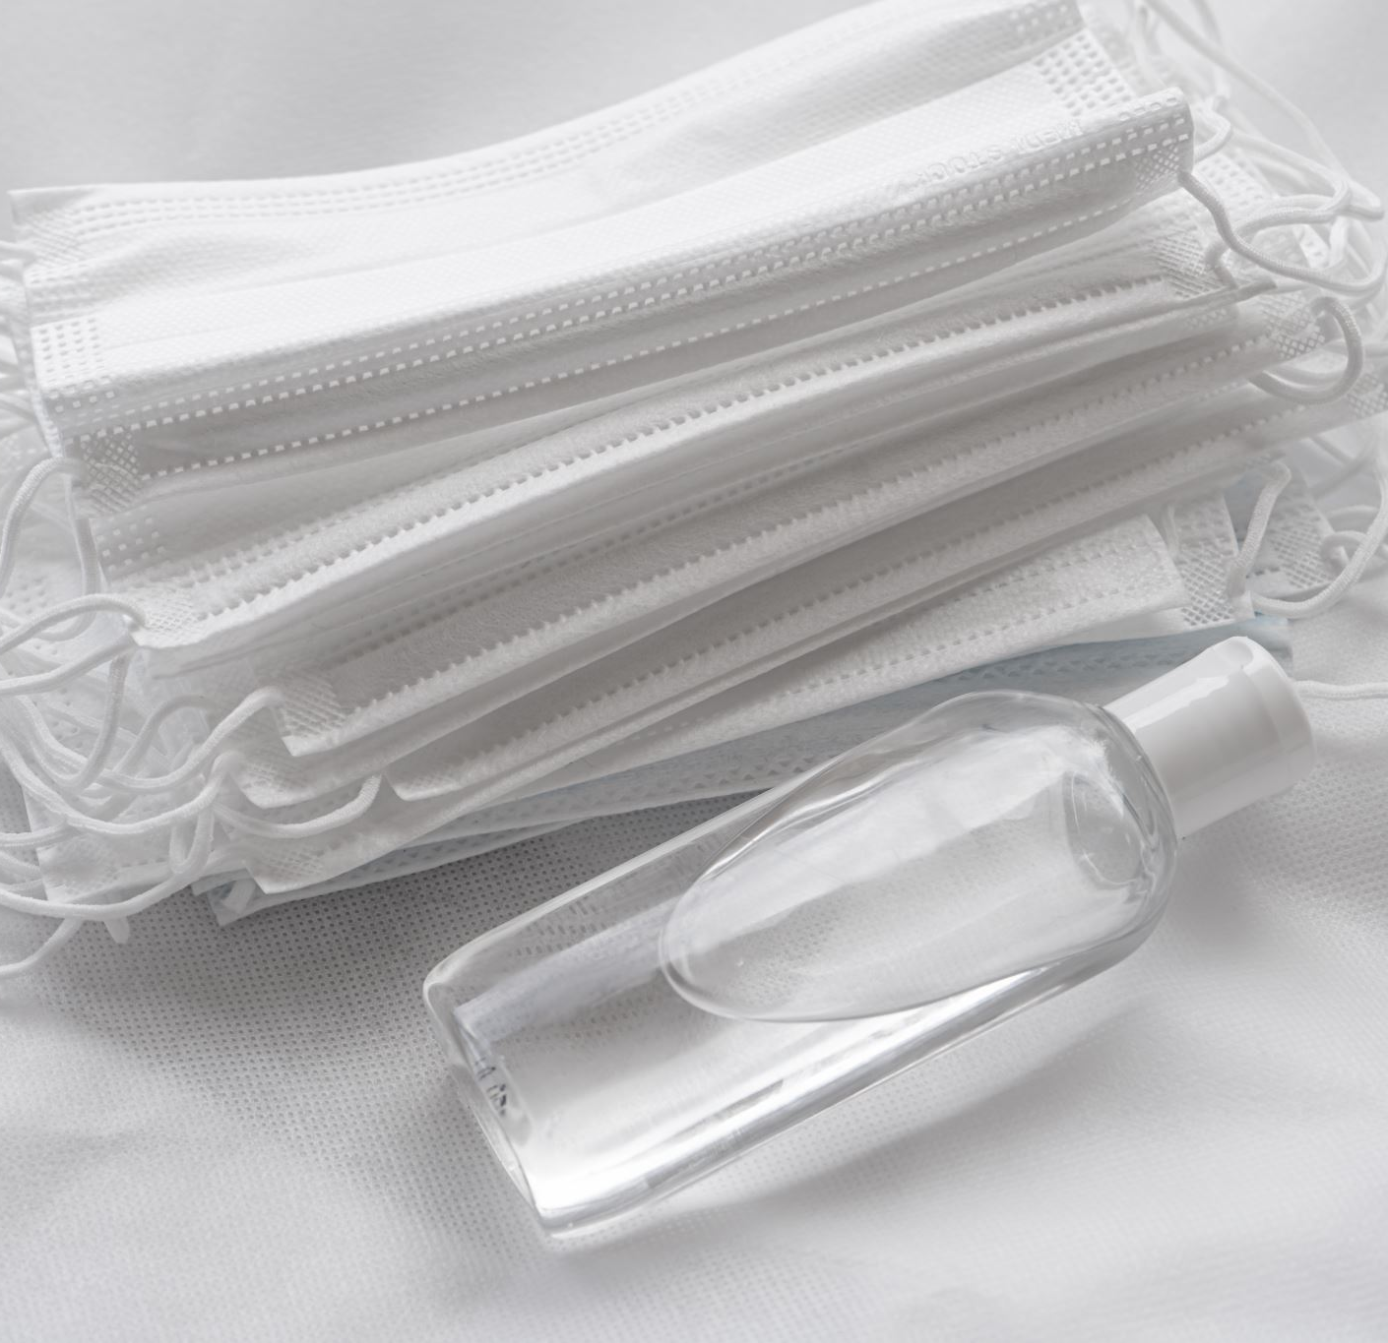
When Should I Use Enhanced Barrier Precautions?
Infection or colonization with an MDRO when contact precautions do not apply
Wounds
Indwelling medical devices (central line, urinary catheter, feeding tube, tracheostomy, ventilator)

Slide 9
When Should Staff use Contact Precautions vs Enhanced Barrier Precautions for a resident with a MDRO?
Contact Precautions should be used for all residents infected or colonized with an MDRO who also have:
  Presence of acute diarrhea
  Draining wounds or other sites of secretions or excretions that are unable to be covered or contained or for a limited period during a suspected or confirmed MDRO outbreak investigation

Slide 10
Differences Between Contact Precautions and Enhanced Barrier Precautions
Contact Precautions:
Gown and gloves for all room entries and for all activities
Private room is ideal
Room restriction except for medically necessary care
Recommended to be time limited
Enhanced Barrier Precautions:
Gown and gloves only for high-contact resident care activities
Recommended for duration of stay

Slide 11
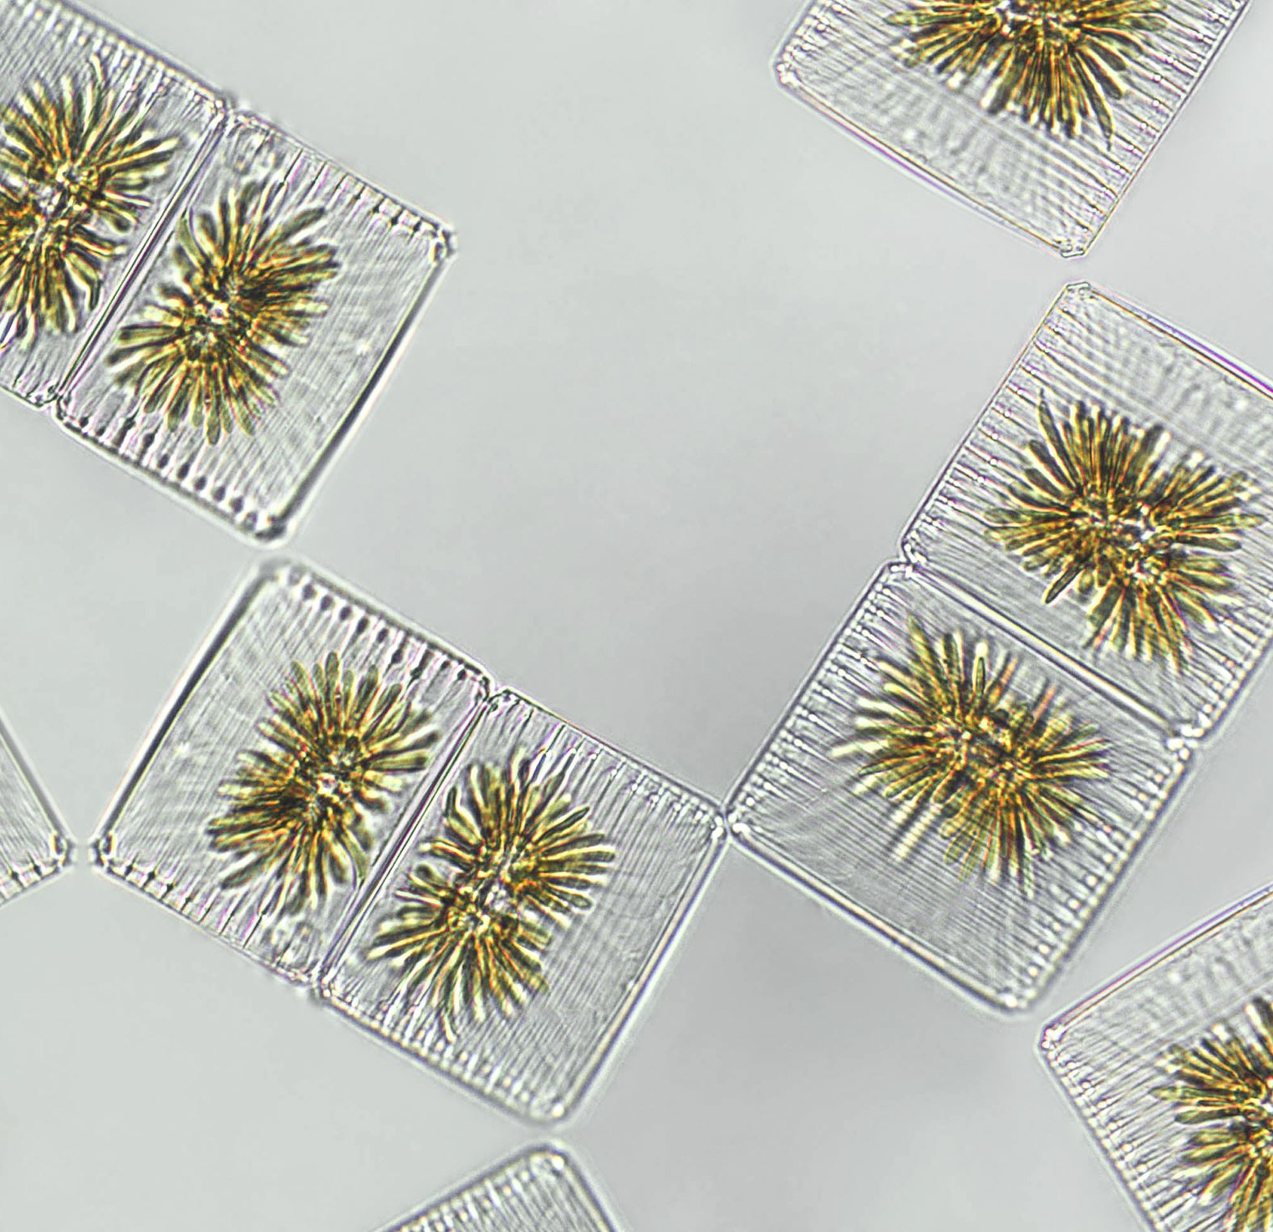
What MDROs are Included with EBP?
Pan-resistant organisms
  E. Coli
Carbapenemase-producing carbapenem-resistant Enterobacterales
Carbapenemase-producing carbapenem-resistant Pseudomonas species
Carbapenemase-producing carbapenem-resistant Acinetobacter baumannii
Candida auris

Slide 12
Why Nursing Homes?
Residents with complex medical needs are at higher risk for acquiring MDROs
Standard Precautions often have not been successfully implemented in nursing home settings
Allows for a more effective response to serious antibiotic-resistant threats
Reduce the necessity for Contact Precautions

Slide 13
Conclusion
Threats to nursing home residents; health are changing, and we must adapt to protect them.
Multidrug-resistant organisms (MDROs) are a known threat to nursing home residents, these germs can cause serious infections and are often hard to treat.
Enhanced Barrier Precautions (EBP) are infection prevention and control practices that can help reduce the spread of MDROs in nursing homes. Together, we can protect residents and stop the spread of germs.

Slide 14
Resources
https://www.cdc.gov/long-term-care-facilities/hcp/prevent-mdro/faqs.html
https://hqin.org/resource/enhanced-barrierprecautionstoolkit/#:~:text=This%20toolkit%20serves%20as%20a%20guide%20to%20assist,of%20Enhanced%20Barrier%20Precautions%20in%20Skilled%20Nursing%20Facilities.
https://www.train.org/cdctrain/training_plan/3814
https://www.cdc.gov/hai/videos/EBP-NH-Animated-English-LowRes.mp4
https://portal.ct.gov/dph/hai/multidrugresistant-organisms-mdros-what-are-they

Slide 15

Questions?

