Slide 1


Clostridioides difficile (C. diff)
Infection Prevention and Control
2025

Slide 2

What is Clostridioides difficile (C. diff)?

Slide 3
Clostridioides difficile (C. diff)
C. diff is a germ (bacterium) that causes diarrhea and colitis (an inflammation of the colon) and can be life-threatening.
C. diff can affect anyone. Most cases of C. diff occur when you've been taking antibiotics for something else or not long after you've finished.

Slide 4
Why is Infection Prevention and Control Important with C. diff cases?

Slide 5

C. diff is estimated to cause almost half a million infections in the United States each year.
About 1 in 6 patients who get C. diff will get it again in the subsequent 2-8 weeks.
One in 11 people over age 65 diagnosed with a healthcare-associated C. diff infection die within one month.

Slide 6
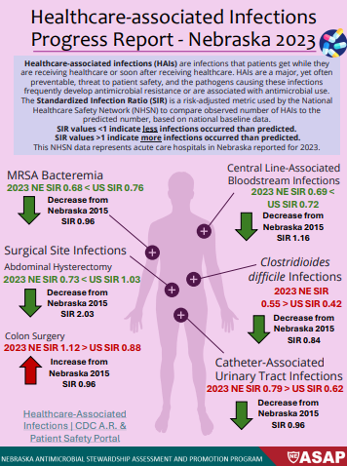

Notes:
Although Nebraska’s SIR has decreased –it is still higher than the US SIR average

Slide 7
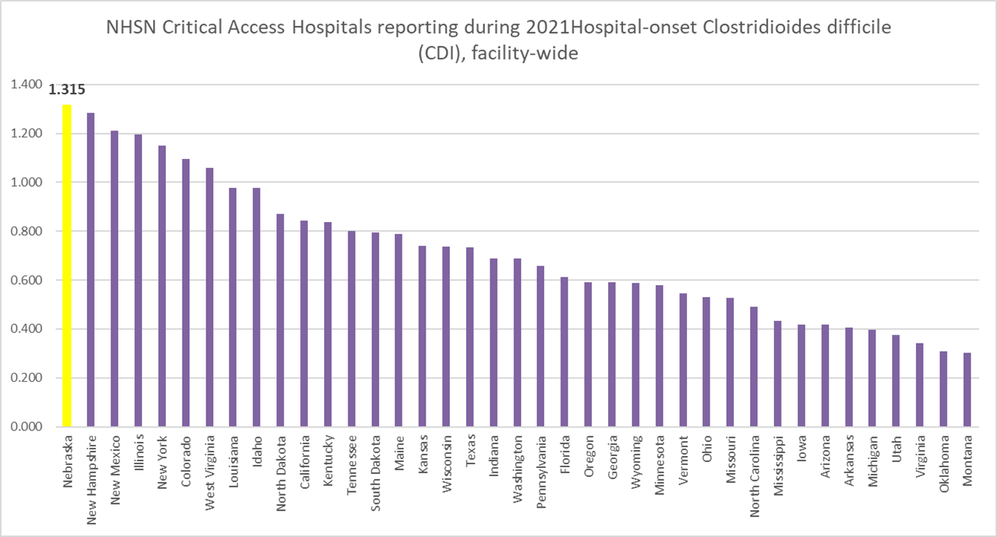
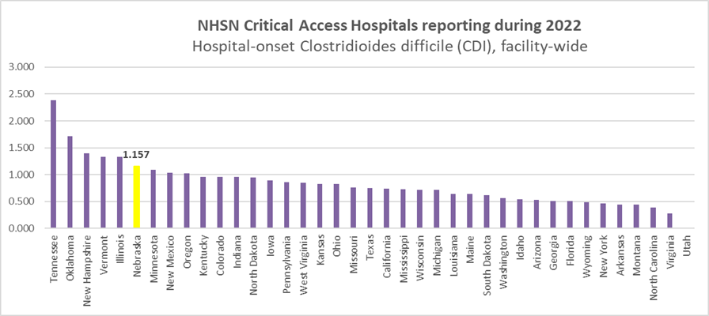


Notes:
In 2021 – Nebraska had the highest C. diff infection rate in the United States – we are making progress, but educating staff is crucial.

Slide 8
Why do C. diff germs live so long in the environment?

Slide 9
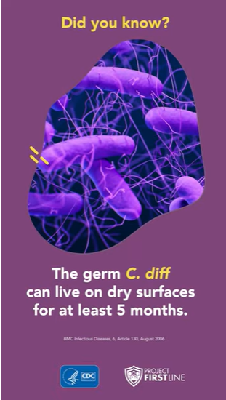

When C. diff germs are outside the body, they become spores.
These spores are an inactive form of the germ and have a protective coating allowing them to live for months or years on surfaces and in the soil.
The germs become active again when you swallow these spores and they reach the intestines.

Slide 10
How do C. diff germs spread to others?

Slide 11
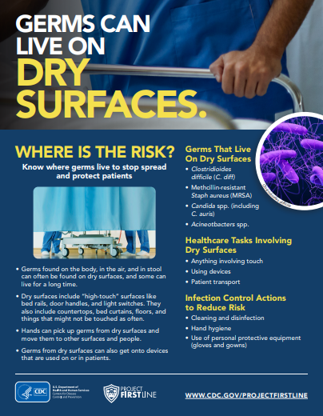
Patient environment plays an important role in the transmission of C. diff
WHERE IS THE RISK?
Equipment
Medical devices
Furniture
Telephone
Personal belongings
Bathroom
High touch surfaces: bedrails, door handles, and light switches
HCP clothes, belongings, and hands
Failing to notify other healthcare facilities when patient with C. diff is transferred.
Inter-Facility Infection Control Transfer Form for States Establishing HAI Prevention Collaboratives
Notes:
Concentration solely on cleaning high touch surfaces often prevents thorough and complete room decontamination https://www.ajicjournal.org/article/S0196-6553(22)00357-1/fulltext
Also includes staph, MRSA, Strep, C. auris, E. coli, klebsiella. Taking vital signs, weighing pts, transporting patients, lifting patients.

Slide 12
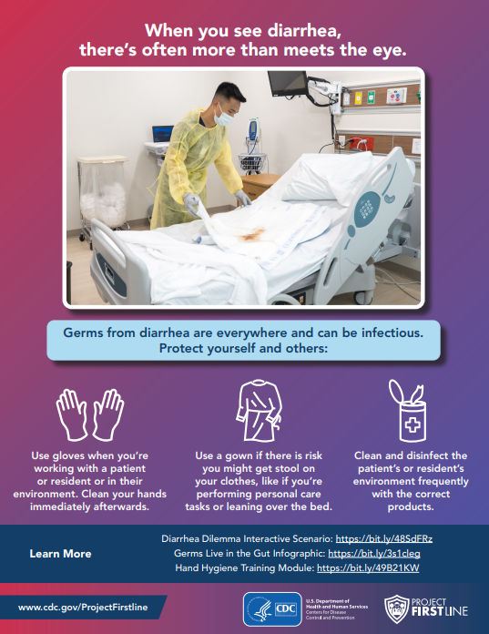

When you see diarrhea – assume it is always infectious!
Use gloves when you're working with a patient/resident or in their environment. Clean your hands immediately afterwards.
Use a gown – performing personal care tasks or leaning over the bed.
Clean and disinfect the environment frequently with the correct products.

Slide 13

Hand Hygiene
Hand Hygiene (HH) compliance among healthcare providers continues to be a significant challenge for many organizations.
Ineffective placement of dispensers or sinks
HH compliance data not collected or reported accurately
Lack of coaching
Not included as part of safety culture
Ineffective education
HCP distractions
https://www.ajicjournal.org/article/S0196-6553(22)00357-1/fulltext

Slide 14
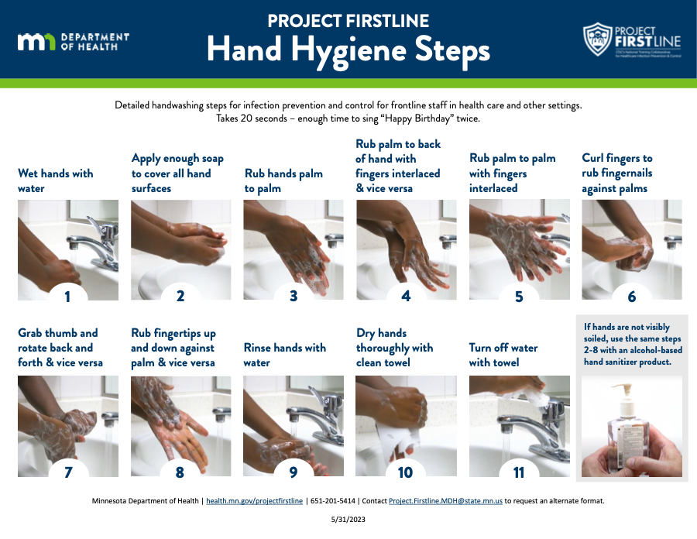

Slide 15
What precautions are recommended with C. diff?

Slide 16
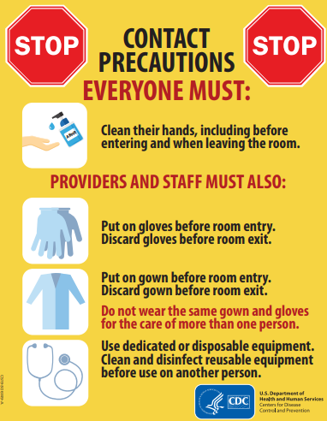

Clostridioides difficile (C. diff)
Initiate Contact
Precautions Promptly
Private room
Dedicated equipment
Frequent cleaning
Gloves and gown upon entry

Slide 17

Barrier: Poor compliance with Contact Isolation
Strategy: Multidisciplinary approach
Champions from multiple disciplines
Enlist frontline staff to better understand barriers
Use audits and feedback

Slide 18
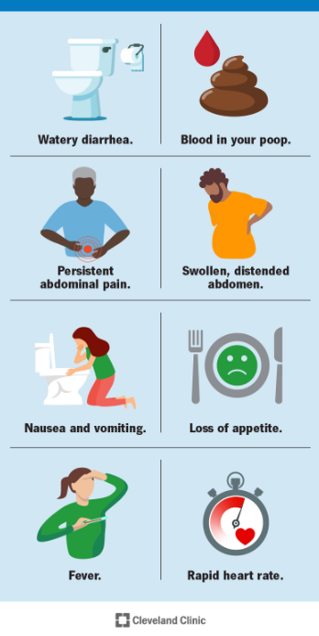
The most common symptom, and usually the first to appear, is watery diarrhea. A mild infection will cause diarrhea at least three times a day, often with some abdominal cramping.
As C. diff infection becomes more severe, diarrhea increases. It may occur as much as 10 to 15 times a day.
Notes:
C. diff Infection: What It Is, Symptoms & Treatment

Slide 19
How to clean and disinfect environment?

Slide 20
Surfaces should be clean and body substance spills should be managed promptly BEFORE disinfecting.

Slide 21
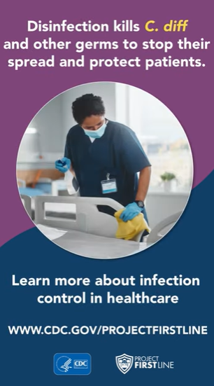
Disinfecting (after cleaning)
EPA - List K products kill Clostridioides difficile
(C. diff) spores.
How to Use Products on List K Effectively
A product’s effectiveness can change depending on how you use it.
Follow the label directions for Clostridioides difficile (C. diff) carefully including the contact time.
The contact time is the time the product must be applied to the surface for it to be effective.
EPA’s Registered Antimicrobial Products Effective Against Clostridioides difficile (C. diff) Spores [List K] | US EPA

Slide 22
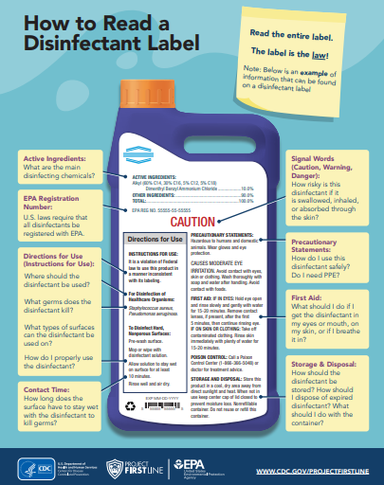
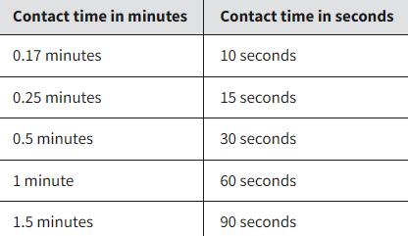
Disinfectant Label
EPA Registration Number
Active Ingredients
Directions for Use
Cautions and Warnings
First Aid
Storage and Disposal
Contact time
.

Slide 23
Barrier: Improper room and equipment cleaning and disinfection.
Strategy: Standardize and clearly define cleaning and disinfection procedures:
Who is responsible for what?
Educate those responsible
Use checklists
Use audits and feedback

Slide 24
Antibiotic Awareness

Slide 25
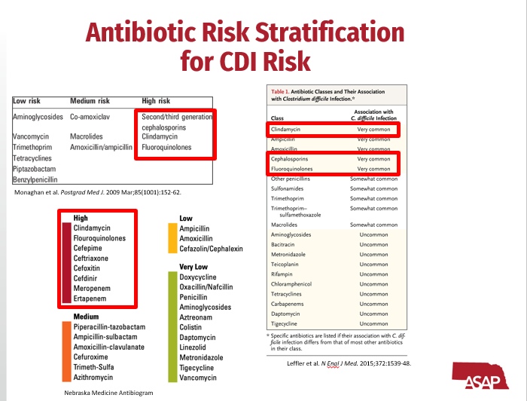

Slide 26
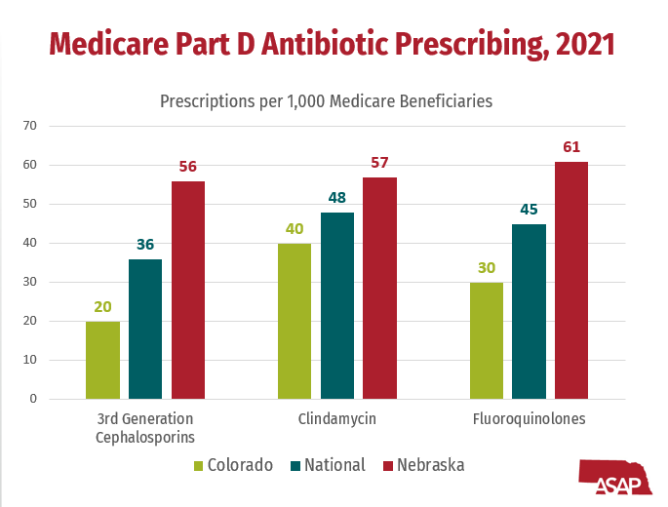
Notes:
Nebraska continues to prescribe more antibiotics than the national average – which increases the risk of C. diff

Slide 27
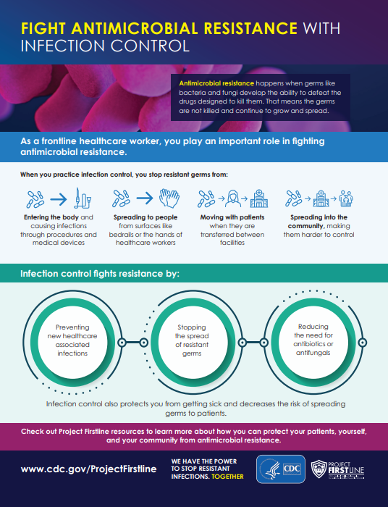

As a frontline healthcare worker, you play an important role in fighting antimicrobial resistance.
When you practice infection control, you stop resistant germs from:
Entering the body
Spreading to people
Moving with patients
Spreading into the community

Slide 28
Interactive Learning – Diarrhea Dilemma
Diarrhea Dilemma

