Slide 1
Cleaning and Disinfecting in Long Term Care Facilities (LTCFs)
Audience: all facility staff

Slide 2
Introduction
It is well documented that environmental contamination in healthcare settings plays a role in the spread of healthcare associated infections (HAIs).
Staff members of ALL types can help to address this and protect residents from infection.
We’ll start today by going over cleaning vs. disinfecting and then we’ll cover all the ways each type of staff are involved in cleaning and disinfecting.

Slide 3
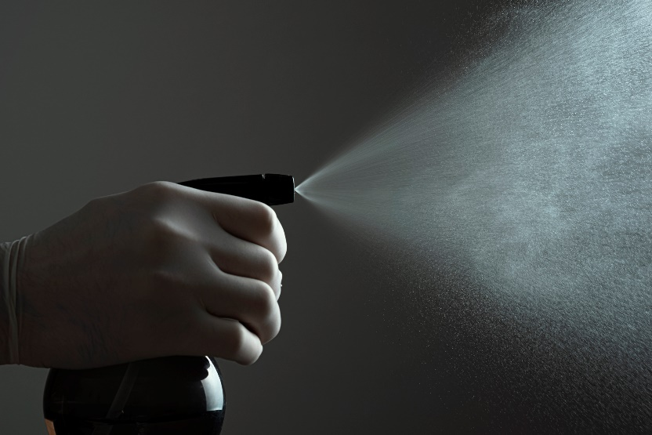
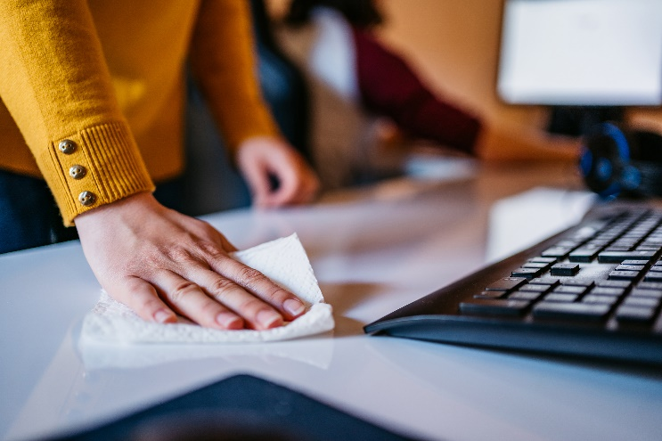
Cleaning vs. Disinfecting
Cleaning- physically removes germs, dirt, and impurities on the surface
Disinfecting- kills germs present on the surface (must stay wet for entire contact time to work)

Slide 4
Cleaning and Disinfecting
Cleaning and disinfecting are two separate steps.
You MUST clean a surface first before you can disinfect it.
Think about it this way…
If you spray a disinfectant on a bedside table with crumbs on it, the table is still dirty.
You have to clean it first to remove the crumbs. THEN you can disinfect the table.

Slide 5
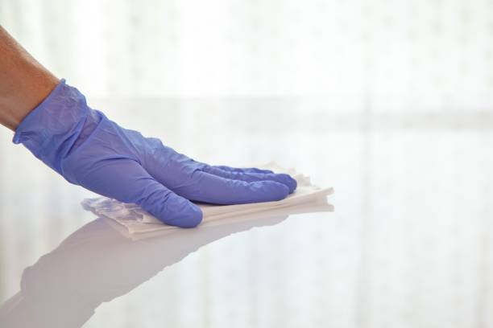
Cleaning and Disinfecting
Fortunately, many disinfectant wipes do both at the same time!
  As you wipe the surface, you are removing germs and dirt. Then the wipe leaves behind the disinfectant product that kills anything left.
  Just make sure the surface stays wet for the entire contact time for it to work.

Slide 6
How do YOU play a part?
For the rest of the slides, we have color coded types of staff so you can easily find the part you play in protecting residents.
Clinical staff- anything orange is relevant to you
Admin- anything yellow is for you
DON/Infection Preventionist- anything purple is for you
EVS/Housekeeping- anything green is for you
Line staff (dietary, laundry, etc.)- anything red is for you

Slide 7
Developing Policies
Decisions about cleaning and disinfection policies should be made with the following people at the table:
  Facility admin
  Infection preventionist (or whoever serves that role, in LTCFs it is of often the DON)
  EVS manager
Determining frequency, method, and process should be made with the following considerations:
  Probability of contamination
  Vulnerability of patients to infection
  Potential for exposure (ex. high touch vs low touch surfaces)

Slide 8
Developing Policies
Example: patient room cabinet surface and cabinet handle
Frequency, method, and process for cleaning these surfaces should vary slightly.
Cabinet surface-
Probability of contamination- low
Vulnerability of patients to infection- high
Potential for exposure- low touch surface
Cabinet handle-
Probability of contamination- high
Vulnerability of patients to infection- high
Potential for exposure- high touch surface

Slide 9
Upkeep and the Right Surfaces
Equipment and furniture should be:
Cleanable
Easy to maintain and repair
Resistant to microbial growth
Nonporous
Seamless
Clinical staff, admin, DON/IP, EVS, etc. should all keep an eye out for cracks/porous surfaces that need repair
Immediately notify DON/IP to put in a maintenance request

Slide 10
Routes of Transmission- Body Reservoirs
Skin
  Germs can be spread on the skin via touch or through equipment like a glucometer.
  Prevention: perform hand hygiene often, always ensure equipment has been cleaned and disinfected before using it on a resident, and handle sharps safely.
  Who needs to pay attention:
    Anyone touching a resident (usually clinical staff)
    Whoever is responsible for cleaning and disinfecting equipment (sometimes EVS, sometimes clinical staff)

Slide 11
Routes of Transmission- Body Reservoirs
Respiratory System
  Germs live in the nose, mouth and throat. Then they may enter the lungs, which can cause infections.
  Coughing spreads the germs into the air and on surrounding surfaces.
  Prevention: regularly clean and disinfect the patient care area, wear a mask when appropriate, ensure good ventilation (consider HEPA filters).
  Who needs to pay attention:
    Anyone around a sick resident, which includes clinical, EVS, dietary and laundry staff
    Facility admin and DON/IP can help improve ventilation and air quality when necessary (this will combat high contamination of surfaces)

Slide 12
Routes of Transmission- Body Reservoirs
Blood
  Germs from the blood can spread through touch, splashes and sprays.
  If it is not properly cleaned, then bacteria in the environment can use the blood to grow.
  Prevention: perform hand hygiene often, handle sharps carefully, immediately clean and disinfect all blood spills.
  Who needs to pay attention:
    When a blood spill occurs, clinical staff should immediately notify EVS staff to have it cleaned up.

Slide 13
Routes of Transmission- Body Reservoirs
GI System
  Germs can pass from the resident’s intestines, to the stool, and finally bathroom surfaces via touch or splashes.
  Prevention: perform hand hygiene often, use gloves/gowns, handle linens, textiles, and bedpans carefully, regularly clean and disinfect resident bathrooms and toileting equipment such as bedpans.
  Who needs to pay attention:
    Clinical staff who are changing a resident or assisting with toileting
    Clinical or laundry staff when handling linens, textiles, and/or bedpans
    EVS staff when cleaning a resident’s bathroom or contaminated surfaces

Slide 14
Routes of Transmission- Environmental Reservoirs
Water and Wet Surfaces
  Germs can thrive in wet surfaces, and spread via splashes, aerosolized droplets, or touch.
  Prevention: perform hand hygiene often, always ensure equipment has been cleaned and disinfected before using it on a resident, immediately clean and disinfect spills.
  Who needs to pay attention:
    Clinical staff who use the sinks or perform procedures with wet equipment
    EVS staff who clean sinks, bathrooms, and other spills

Slide 15
Routes of Transmission- Environmental Reservoirs
Dry Surfaces
  Germs can live on surfaces for a long time. They can be spread through hand contact and can be transferred to residents.
  Prevention: regularly disinfect of high-touch areas in resident rooms and everywhere in the facility (elevator buttons, nurse’s stations, WOWs, handrails, etc.), perform hand hygiene often.
  Who needs to pay attention:
    EVS staff when performing daily and terminal cleans
    Clinical staff when interacting in the patient care area or at workstations
    Anyone who touches anything in the facility (so everyone)

Slide 16
Routes of Transmission- Environmental Reservoirs
Dirt and Dust
  Dirt and dust from construction or renovation can carry airborne germs.
  These germs can be inhaled or transferred through touch, into wounds, or sterile equipment.
  Prevention: use barriers during construction to keep everything clean, maintain proper ventilation, thoroughly clean and disinfect any contaminated areas.
  Who needs to pay attention:
    DON/IP and admin staff should monitor for dirt and dust during construction
    Anyone should report dirt and dust from construction as soon as they notice it so that EVS staff can clean it immediately

Slide 17
Routes of Transmission- Environmental Reservoirs
Devices
  Medical devices can carry bacteria, especially if they are shared between patients.
  Infections can occur if contaminated devices are used on or inside the body (IVs, lancets, etc.).
  Prevention: always ensure equipment has been cleaned and disinfected before using it on a resident
  Who needs to pay attention:
    Whoever is responsible for cleaning and disinfecting equipment (sometimes EVS, sometimes clinical staff)
    Clinical staff when they use equipment on patients

Slide 18

Wrap Up
It is the responsibility of everyone in a facility to do their best to protect residents from infection.
Hopefully you feel ready to go back to work with a better understanding of the part you, and everyone else plays in cleaning and disinfecting.

Slide 19
Sources
www.cdc.gov/hygiene/pdf/331782-a_cleaning_sanitizing_disinfecting_508.pdf
www.cdc.gov/healthcare-associated-infections/media/pdfs/environmental-cleaning-rls-508.pdf

Slide 20
Questions?
Dallas County Health and Human Services
Healthcare Associated Infections (HAI) Team
HAI@dallascounty.org

