Slide 1

Examples:
EVS
PDI sani wipes
2 mins
Clinical
PDI sani wipes
2 mins
[type of staff]
[disinfectant]
[contact time]
[type of staff]
[disinfectant]
[contact time]
Clinical
Oxivir
4 mins
EVS
Virex II 256
4 mins
[type of staff]
[disinfectant]
[contact time]
Instructions for using templates:
Select which colors will indicate what type of staff (ex. EVS, clinical)
Select which shapes will indicate which disinfectants
Include the contact time of each disinfectant
You may choose to leave off the disinfectant and contact time if preferred
Use audit data to select what surfaces these sticker labels should go on

Slide 2
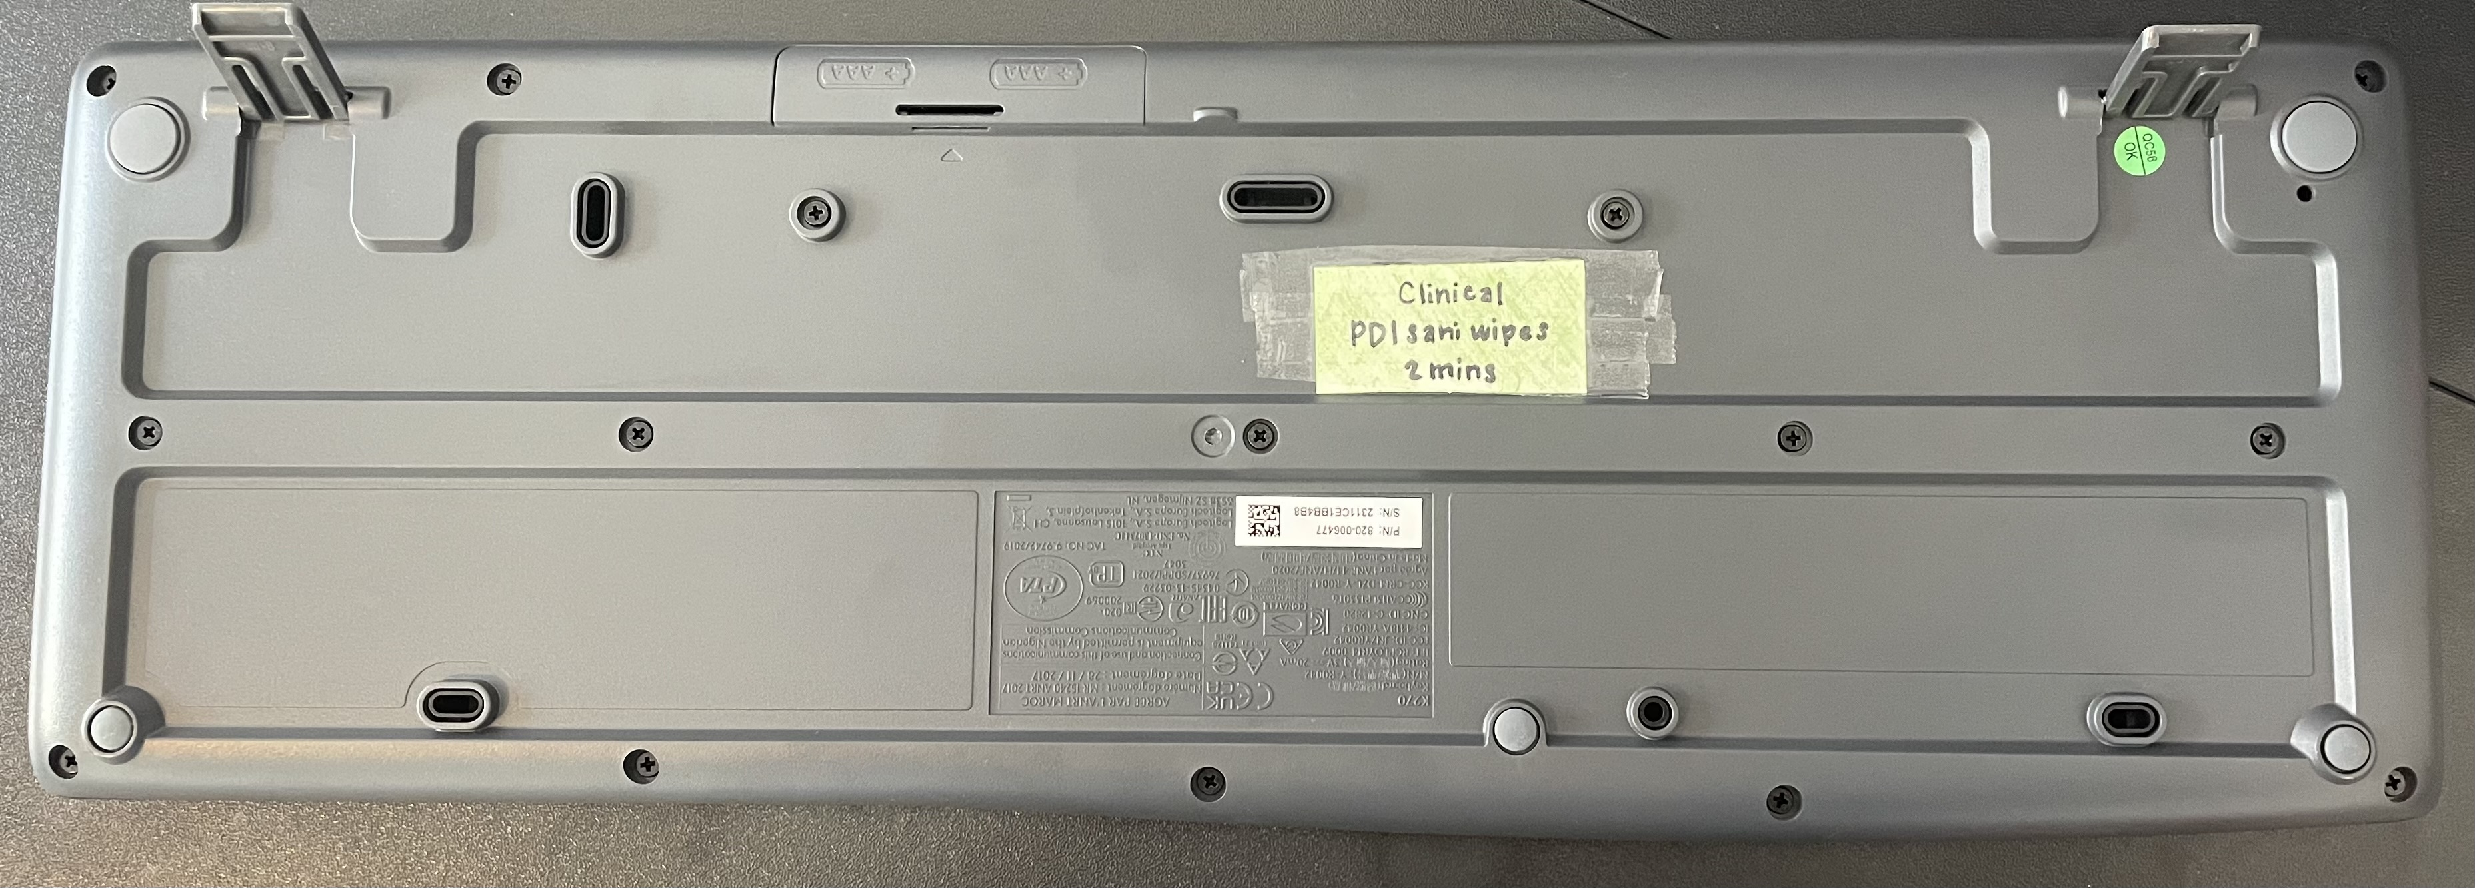
Example of sticker label on the back of a keyboard to serve as a quick reference that it is the responsibility of clinical staff to clean and disinfect keyboards.
Clinical
PDI sani wipes
2 mins

Slide 3
Customizable Templates
Fill these with your facility’s disinfectant information, print, laminate, and place on identified equipment.
[type of staff]
[disinfectant]
[contact time]
[type of staff]
[disinfectant]
[contact time]
[type of staff]
[disinfectant]
[contact time]
[type of staff]
[disinfectant]
[contact time]
[type of staff]
[disinfectant]
[contact time]
[type of staff]
[disinfectant]
[contact time]
[type of staff]
[disinfectant]
[contact time]
[type of staff]
[disinfectant]
[contact time]
[type of staff]
[disinfectant]
[contact time]
[type of staff]
[disinfectant]
[contact time]
[type of staff]
[disinfectant]
[contact time]
[type of staff]
[disinfectant]
[contact time]

