Slide 1

Healthcare Environment Reservoirs
Dupage county health department
Notes:
Facilitator Notes:
Participants log in and get settled.

Slide 2

Agenda
Welcome and Introductions
Four Healthcare Environment Reservoirs
Contact Time
UV Blacklight Auditing
Discussion
Bringing it Together
Conclusion
Notes:
Facilitator Notes:
Welcome the group and add a greeting to the chat box.
Announce housekeeping notes, either orally or via chat. If needed, provide additional notes specific to the platform you’re using (e.g., how to “raise your hand,” how to post questions).
Provide an overview of the agenda.
Adapt this section of the session as needed: for instance, you may choose to spend additional time on introductions if there are new faces, or if participants do not know each other.
Sample Script:
“We adapted this presentation from CDC’s Project Firstline. Thank you for joining us! Before we begin, a few housekeeping notes. We’ll meet today for about 20 minutes. Please keep your videos on, to the extent possible, and keep your microphone muted when you are not contributing to the discussion. It’s great to see you all here today!
“Today we’re going to talk about where germs live in the healthcare environment. We’ll also talk about how our understanding of these environmental reservoirs can be applied to infection control in healthcare, and how you can use your knowledge to anticipate when there could be risk for germs to spread – so you can take action to keep it from happening! We’ll have an opportunity to reflect before we wrap up for the day.”

Slide 3
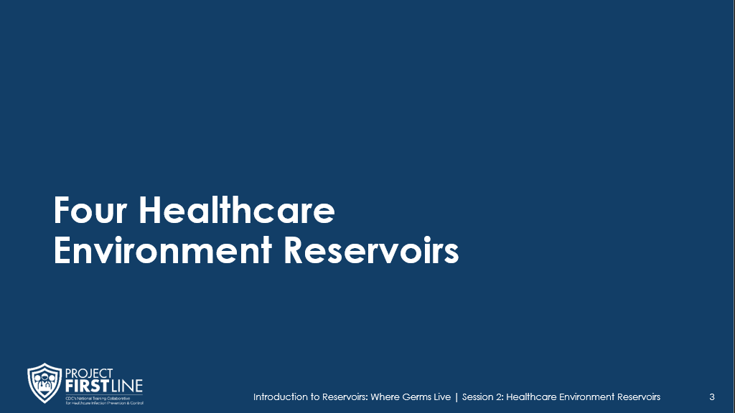
Four Healthcare Environment Reservoirs

Slide 4
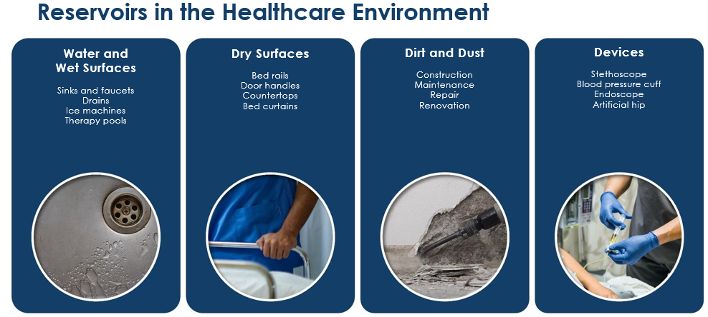
Four Healthcare Environment Reservoirs
Notes:
Facilitator Notes:
Briefly present and define four reservoirs in the healthcare environment: water and wet surfaces; dry surfaces; dirt and dust; and devices.
Note that these four reservoirs are not the only places in the healthcare environment where germs live, but they are important focus areas for infection control.
Explain to participants that this session will focus on why these reservoirs are important for infection control, and how healthcare workers can use their knowledge about them to recognize risks for germs to spread.
Define “reservoirs”
Sample Script:
“Germs are part of everyday life. The world is covered in germs, especially in healthcare. “Reservoirs” are the places on and in our bodies and in the environment where germs live. Germs frequently spread between and among these reservoirs. When we think about where germs live in the healthcare environment and the steps we can take to keep germs from spreading, we think of four core reservoirs: water and wet surfaces; dry surfaces; devices; and dirt and dust.
“These aren’t the only places where you can find germs in the healthcare environment, but we’ll focus on them for our discussions about infection control because they are common sources of spread. The definitions of these reservoirs are mostly self-explanatory, so today we’ll discuss why they’re so important, and how we can use our knowledge about them to recognize the risks for germs to spread.”

Slide 5
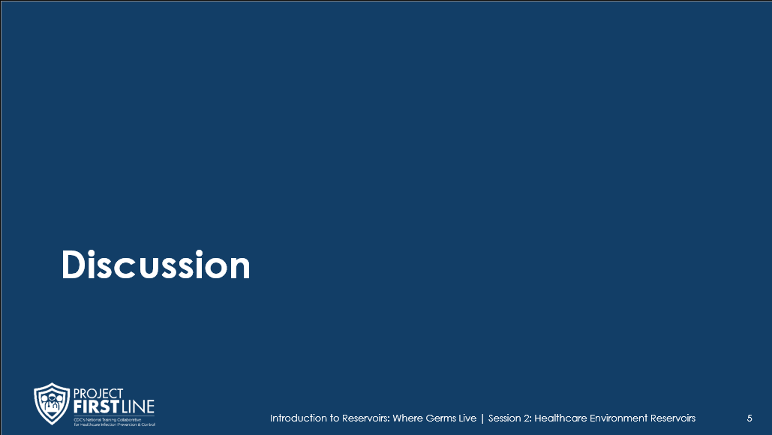
Discussion

Slide 6
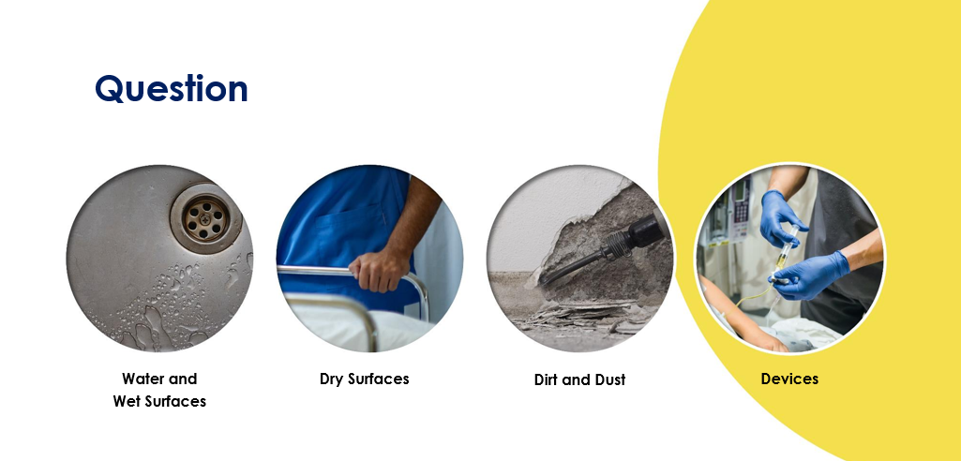
Notes:
Facilitator Notes:
This activity has two parts: (1) an “icebreaker” question; and (2) group discussions of each of the four environmental reservoirs, the risks for germs to spread from them, and infection control actions that can help stop germs from spreading.
The icebreaker should take approximately 1 to 2 minutes before you move to the discussion of individual reservoirs, which should take approximately 2 to 3 minutes each.
As you lead this activity, be aware that different audiences will have different experiences with the reservoirs. In some cases, the infection control actions that can control germ spread will not be part of your participants’ roles or responsibilities.
For instance:
Facility maintenance and engineering staff are responsible for making sure plumbing pipes are flushed, and for controlling dirt and dust during construction and renovation projects.
Dedicated, specialized staff are responsible for reprocessing certain medical devices.
When role-related issues such as these are raised, ask participants if they know what to do, or whom at their facility to ask, if they have questions.
Ask participants to reflect for a moment on which of these environmental reservoirs they interact with, or think about, most on a daily basis.
Acknowledge that although people will have more experience with some reservoirs than with others, everyone can recognize an infection risk.
If you choose, you can ask for volunteers to share their thoughts in the chat or by using the “raise your hand” function and unmuting when called on.
If there are no volunteers, affirm that there will be plenty of time to discuss each reservoir and strategies for recognizing risks for germ spread on the job.
If you have chosen to split discussions of the environment reservoirs into more than one session, modify the activity and script as needed.
Sample Script:
“You might have more experience with some reservoirs than others, based on your job, your daily tasks, and your interactions. It’s important to remember that everyone, no matter your training or role, can recognize an infection risk if you understand where germs live and the ways they spread!
“Before we start, I’d like to ask you a question. Based on your own work, are some reservoirs more ‘top of mind’ than others when you think about the risks for germs to spread? Why might that be? Please use the ‘raise your hand’ function or type a response into the chat if you have thoughts about any of the reservoirs on this slide.”
(Pause for responses.)

Slide 7
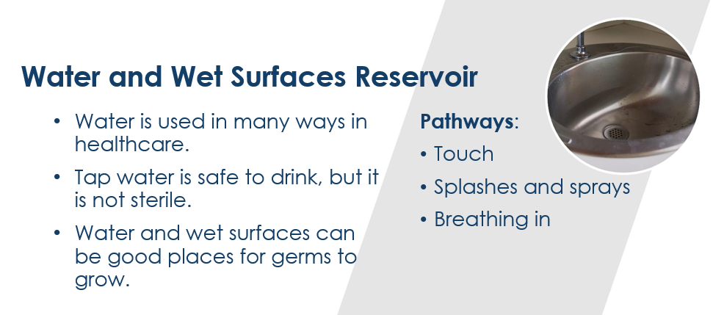
Water and Wet Surfaces
Notes:
Facilitator Notes:
Thank the group and emphasize that each of these reservoirs touches on healthcare workers’ daily work, regardless of their roles.
Transition to the second part of the learning activity, starting with a discussion of possible risks for germs to spread from the water and wet surfaces reservoir.
Briefly review the bullet points on the slide.
You may wish to refer to the Healthcare Environment informational tables in the participant booklet at: https://www.cdc.gov/project-firstline/media/pdfs/ReservoirsTK-S2-Booklet-508.pdf for additional discussion points.
Sample Script:
“Thank you for giving that some thought! Each of these environmental reservoirs has an impact on our daily work lives. We’ll explore some of the more obvious risks of each of these reservoirs, as well as some that might not be so obvious.
“Let’s start our discussion with water and wet surfaces. Water is used a lot in healthcare, and in many different ways. Although tap water is safe to drink for most people, it isn’t sterile. Because most water and wet surfaces are good places for germs to grow, it’s important to be careful with water in healthcare. Germs can spread by water in a few ways: by touch, like when you get germs from water on your hands, or when medical instruments get wet and can then grow germs that can spread to patients. Germs can also spread by splashes and sprays – not just into your eyes, nose, and mouth, but also onto skin or equipment. Breathing in is another way germs can be spread by water – when water gets into the air as very small droplets, it can be breathed in and carry germs to the lungs.”

Slide 8
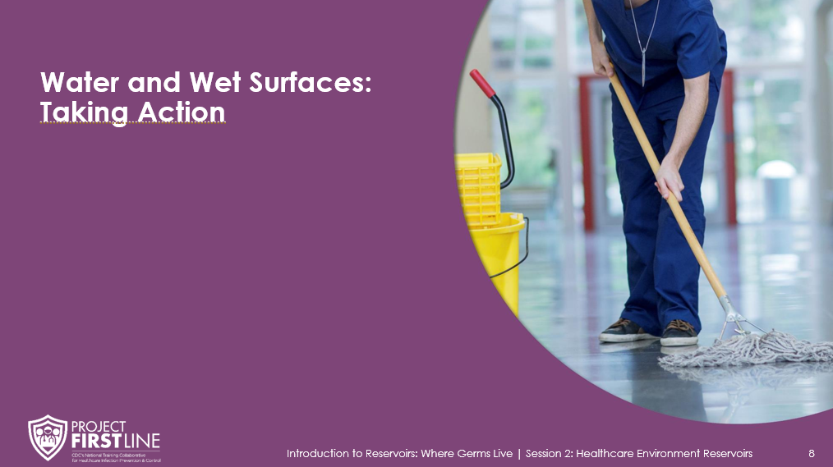
Water and Wet Surfaces: Discussion
Notes:
Facilitator Notes:
Ask participants to think about their profession and job duties, and to identify how they interact with this reservoir in their work.
Provide a moment for participants to jot down one or two of their day-to-day interactions with water and wet surfaces on the job in their participant booklets.
Next, ask them to each share one of the interactions they identified in the chat. As participants respond, acknowledge and affirm their ideas.
As a group, discuss the possible infection risks associated with the identified interactions with water and wet surfaces, and infection control actions to take to keep germs from spreading from this reservoir. Possible answers may include: getting rid of standing water; making sure surfaces like countertops are dry; not using tap water when you should use sterile water; and flushing plumbing pipes as part of routine maintenance. This list is not exhaustive: participants are likely to offer additional, different actions.
Time permitting, you can pose additional questions to prompt discussion, such as: which actions are unique to specific professions? Which actions apply to us all? Be sure to affirm that, regardless of their professional roles, everyone can take action to address infection risks.
Sample Script:
“Now that we’ve described why water and wet surfaces can pose risks for germs to spread, let’s discuss actions we can take to address those risks. Regardless of our professional roles in healthcare, we can also recognize risks with this reservoir. Please take a moment to jot down in your participant booklet how you interact with water and wet surfaces during your workday.”
(Pause for participants to reflect and write down ideas.)
“Now, let’s share some quick ideas. Please type into the chat one interaction that you wrote down.”
(Pause for responses. Acknowledge and affirm responses, as appropriate.)
“Thank you for the great examples. Now, let’s focus on actions we can take to keep germs from spreading from water and wet surfaces. Thinking about the potential risks associated with interactions you thought of, does anyone have ideas about infection control actions we can take to prevent germs from spreading from water and wet surfaces? Please feel free to unmute yourself, or type your ideas in the chat!”

Slide 9
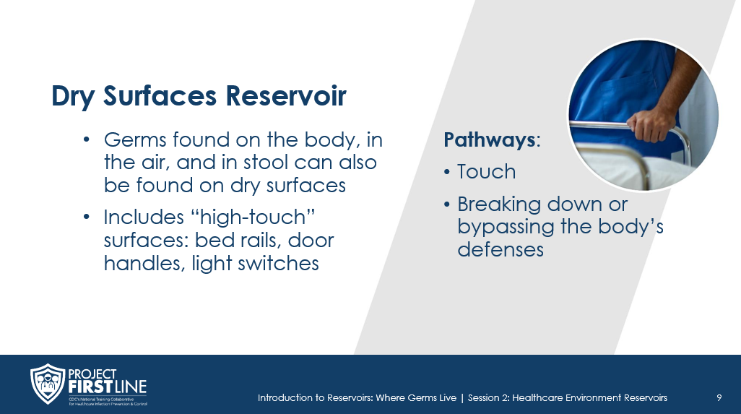
Dry Surfaces
Notes:
Facilitator Notes:
Briefly review the bullet points on the slide.
You may wish to refer to the Healthcare Environment informational tables in the participant booklet for additional discussion points.
Sample Script:
“That was great, thank you! Now let’s talk about dry surfaces. They include high-touch surfaces, like bed rails and door handles, as well as surfaces like countertops and bed curtains. Many germs found on the body, in the air, and in stool can end up on dry surfaces, and they can spread very easily! Hands can pick germs up and move them to other surfaces and people. Germs from dry surfaces can also get on devices and can be spread when those devices are used on or in patients.”

Slide 10
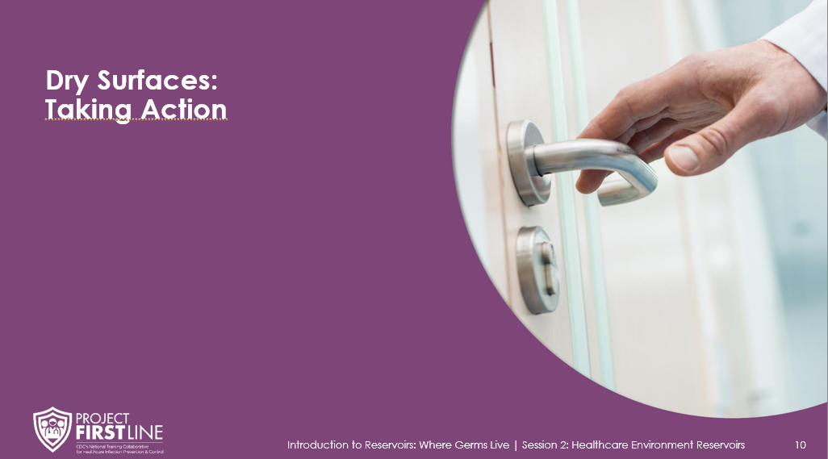
Dry Surfaces: Discussion
Notes:
Facilitator Notes:
Ask participants to think about their profession and job duties, and to identify how they interact with this reservoir in their work.
Provide a moment for participants to jot down one or two of their day-to-day interactions with dry surfaces on the job in their participant booklets.
Next, ask them to each share one of the interactions they identified in the chat. As participants respond, acknowledge and affirm their ideas.
As a group, discuss the possible infection risks associated with the identified interactions with water and dry surfaces, and infection control actions to take to keep germs from spreading from this reservoir. Possible answers may include: cleaning and disinfecting surfaces regularly, using gowns and gloves, and cleaning your hands regularly. This list is not exhaustive: participants are likely to offer additional, different actions.
Time permitting, you can pose additional questions to prompt discussion, such as: which actions are unique to specific professions? Which actions apply to us all? Be sure to affirm that, regardless of their professional roles, everyone can take action to address infection risks.

Slide 11
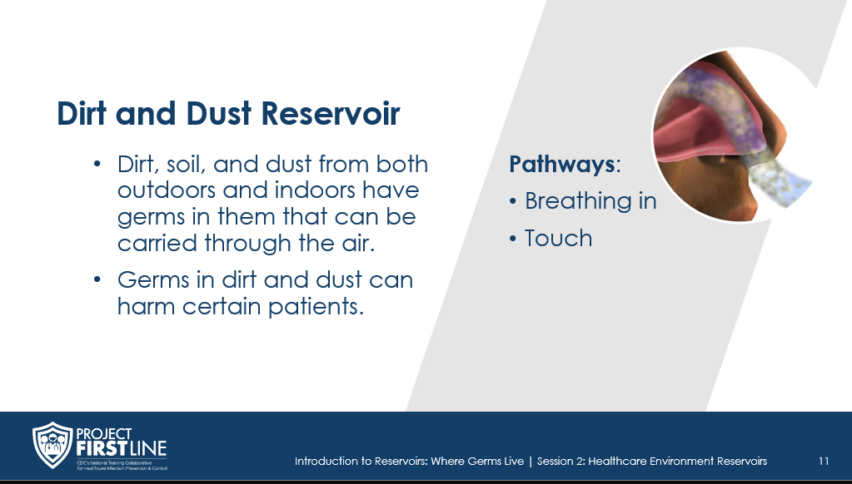
Dirt and Dust Reservoir
Notes:
Facilitator Notes:
Briefly review the bullet points on the slide.
You may wish to refer to the Healthcare Environment informational tables in the participant booklet for additional discussion points.
Sample Script:
“Now, we’ll move to dirt and dust. Outdoor construction projects near a healthcare facility, or indoor projects like building maintenance or renovation, can send dirt and dust into the air. The germs in that dirt and dust can harm certain patients if they’re breathed in. The germs can also spread by touch, especially by hands, when dirt and dust land on surfaces and devices. If the germs are spread to central lines or wounds, they can get into a patient’s body and cause infection.”

Slide 12
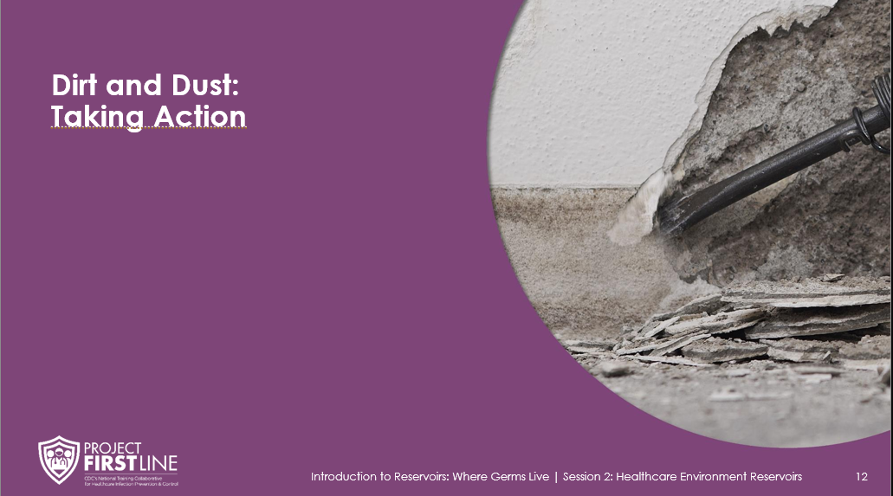
Notes:
Facilitator Notes:
Ask participants to think of their profession and job duties, and to identify how they interact with this reservoir in their work.
Provide a moment for participants to jot down one or two of their day-to-day interactions with dirt and dust on the job in their participant booklets.
Next, ask them to each share one of the interactions they identified in the chat. As participants respond, acknowledge and affirm their ideas.
As a group, discuss the possible infection risks associated with the identified interactions with dirt and dust, and infection control actions and strategies to keep germs from spreading from this reservoir. Possible answers include: good ventilation, construction barriers, and cleaning and disinfecting surfaces. This list is not exhaustive: participants are likely to offer additional, different actions.
Time permitting, you can pose additional questions to prompt discussion, such as: which actions are unique to specific professions? Which actions apply to us all? Be sure to affirm that, regardless of their professional roles, everyone can take action to address infection risks.
Sample Script:
“What are some instances at work when you encounter dirt and dust? Please jot down a few examples in your participant booklet.”
(Pause for participants to reflect and write down ideas.)
“Let’s share some of those thoughts. Please type into the chat one of the things that you thought of.”
(Pause for responses in the chat and acknowledge and affirm responses, as appropriate.)
“Great. Have you ever thought about the potential risks for germs to spread from dirt and dust? What might some of those risks be, and what actions will keep germs in dirt and dust from spreading? Please feel free to unmute yourself or type your ideas in the chat!”

Slide 13
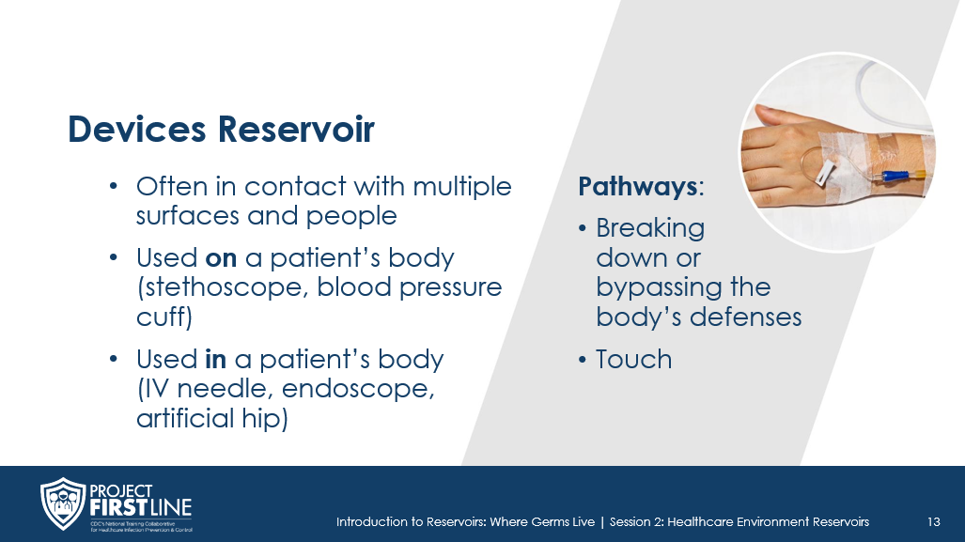
Devices Reservoir
Notes:
Facilitator Notes:
Briefly review the bullet points on the slide.
You may wish to refer to the Healthcare Environment informational tables in the participant booklet for additional discussion points.
Sample Script:
“Now, on to devices. Devices and equipment can have germs on them. Some devices are used on a patient’s body, like a stethoscope or a blood pressure cuff. Other kinds of devices are used in a patient’s body, like an IV needle, an endoscope, or an artificial hip. Germs can spread through devices by bypassing or breaking down the body’s defenses – in fact, devices can be the entryway into the body for germs. When they are used on or in a patient’s body to provide care, any germs on them can be spread to the patient. Touch is another important way that germs can be spread by devices, especially devices and equipment that are shared and used by multiple healthcare workers. They can spread germs between patients, and also pick up germs from a patient and carry them to other surfaces and people.”

Slide 14
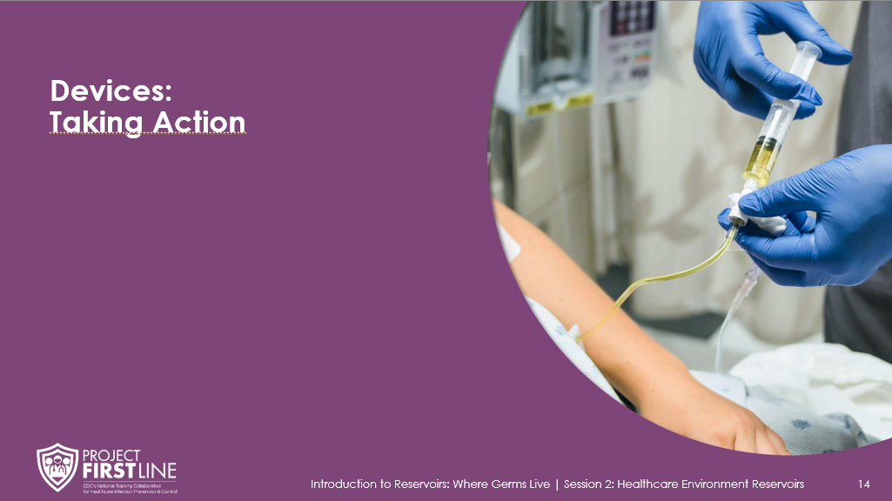
Devices: Discussion
Notes:
Facilitator Notes:
Ask participants to think of their profession and job duties, and to identify how they interact with this reservoir in their work.
Provide a moment for participants to jot down one or two of their day-to-day interactions with devices on the job in their participant booklets.
Next, ask them to each share one of the interactions they identified in the chat. As participants respond, acknowledge and affirm their ideas.
As a group, discuss the possible infection risks associated with the identified interactions with devices, and infection control actions and strategies to keep germs from spreading from this reservoir. Possible answers include: cleaning and disinfection, reprocessing or sterilizing devices, and practicing hand hygiene. This list is not exhaustive: participants are likely to offer additional, different actions.
Time permitting, you can pose additional questions to prompt discussion, such as: which actions are unique to specific professions? Which actions apply to us all? Be sure to affirm that, regardless of their professional roles, everyone can take action to address infection risks.
Sample Script:
“How do you use devices and equipment at work? Please note a few examples in your participant booklet.”
(Pause for participants to reflect and write down ideas.)
“Let’s share some of those thoughts. Please type into the chat one of the ways that you encounter devices.”
(Pause for responses in the chat and acknowledge and affirm, as appropriate.)
“Great, thank you! Now, think about your interactions with devices and the potential risks for germs to spread. What are some infection control actions that will keep that from happening? Please feel free to unmute yourself or type your ideas in the chat!”

Slide 15
Contact Time
Contact time: the time that a disinfectant must be in contact with a surface or device to ensure that appropriate disinfection has occurred. For most disinfectants, the surface should remain wet for the required contact time.
The amount of time will vary depending on the cleaning product being used
  Please refer to the product container to ensure that the manufacturer’s instructions are being followed
  The contact time may be different depending on which pathogens are present
    Always best to go with the longest time on the label
    Longer contact times can slow efficiency

Slide 16
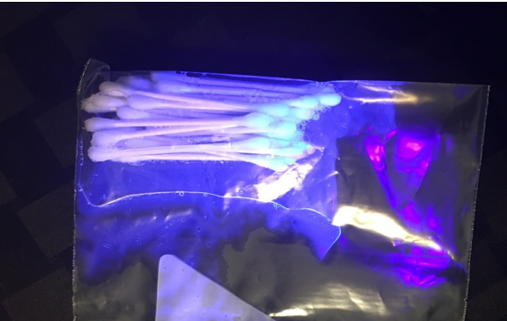
UV Blacklight Auditing
Materials Needed:
Tide laundry detergent
Q-Tips
Ziploc bag
UV Blacklight
  No specific kind is needed
  Inexpensive
Source: The images in these slides are adapted from an Illinois Department of Public Health (IDPH) presentation on EVS auditing

Slide 17
Process
Use the Tide and Q-tip to Mark 5-10 surfaces throughout a patient room
  High touch surfaces are ideal
    Bed rails, countertops, light switches, etc.
Document which surfaces were marked
Have the room cleaned per the normal routine
Go back with the UV light and see which areas were cleaned vs. missed
Keep track of data!
  Makes a great QAPI project

Slide 18
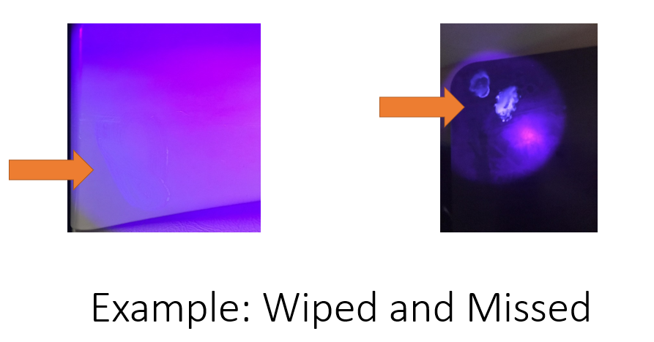
Example

Slide 19
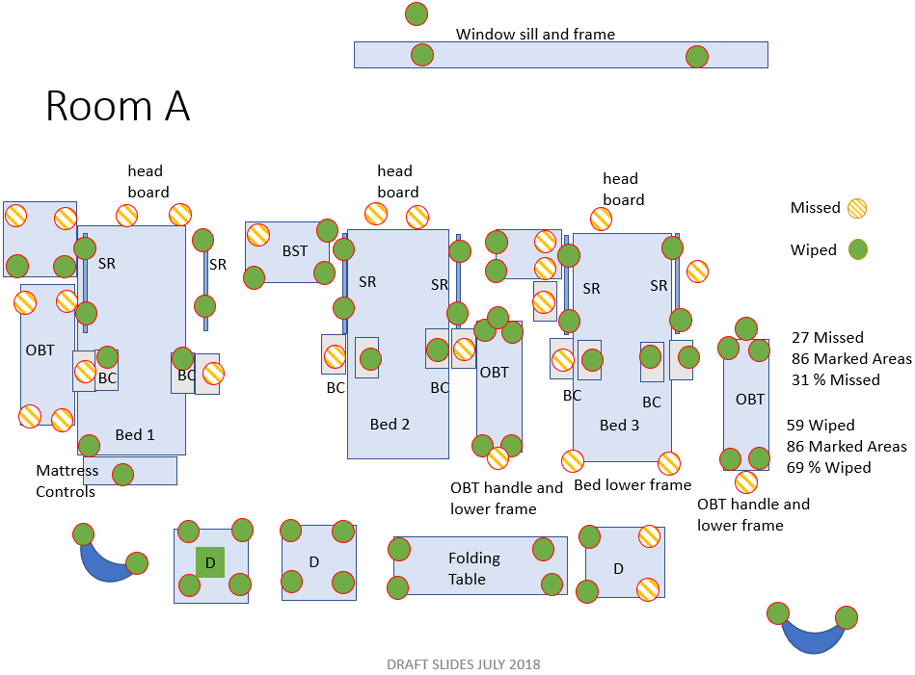
Room Map

Slide 20
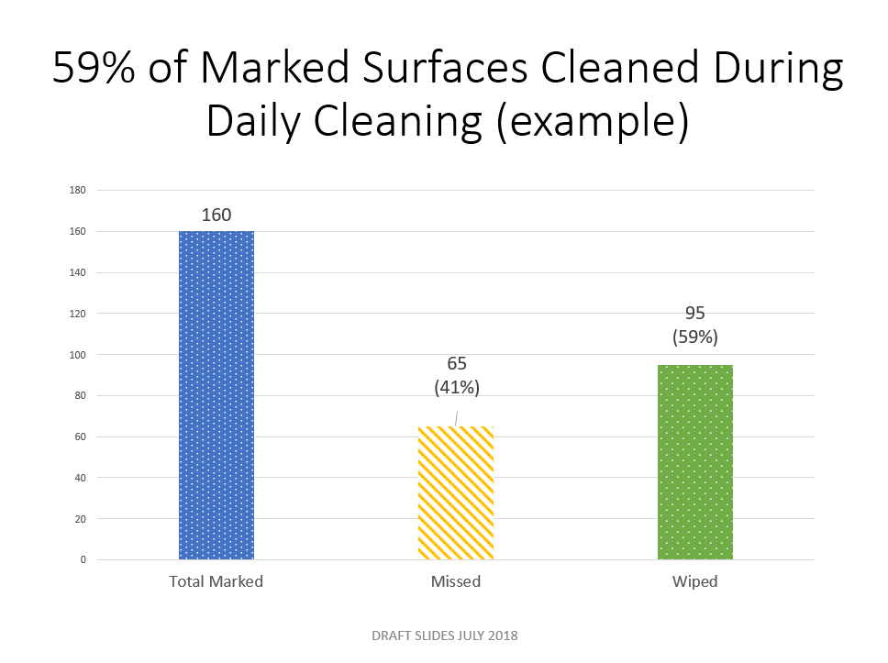
Data Example

Slide 21
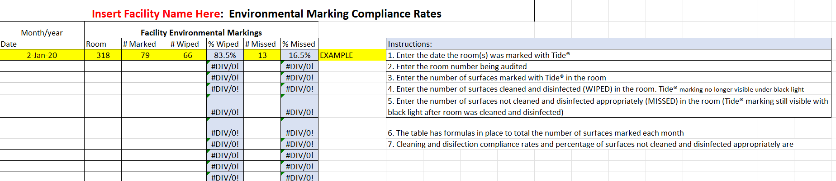
Spreadsheet Example

Slide 22
QAPI Project
Utilize the data to drive performance improvement
EVS manager can’t be everywhere at once
  Allows for passive quality control
Targeted intervention
  Specific floors, units, employees, most often missed areas of the room
Make it fun and competitive
Reward high performers and achieved benchmarks

Slide 23
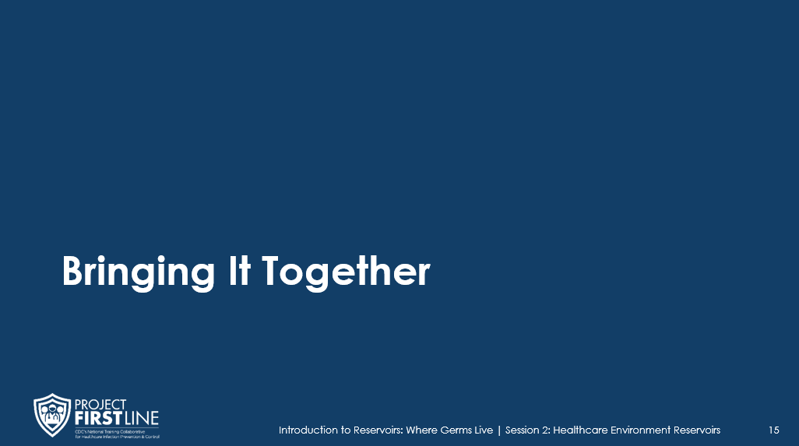

Slide 24
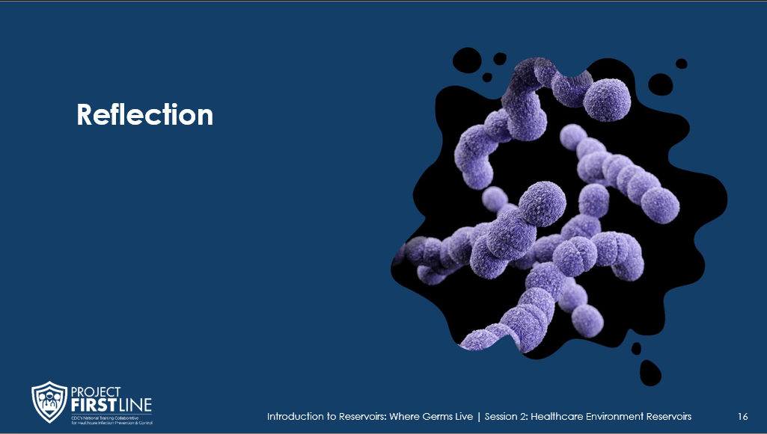
Reflection
Notes:
Facilitator Notes:
Explain that by using this approach of recognizing the risks for germs to spread from reservoirs in the healthcare environment, healthcare workers can better protect patients and others and keep their spaces healthy.
Remind participants of this session’s icebreaker, in which they were asked to identify an instance in which they encountered one of the environmental reservoirs and recognized the risk for germs to spread from it. Encourage participants to jot one to two strategies in their participant booklet that they can use at work to help them remember to recognize risks for germs to spread from reservoirs in the healthcare environment. If needed, you can prompt their thinking with examples, such as creating a mental checklist or a mnemonic device for remembering the environmental reservoirs. Invite participants to share their ideas verbally or in the chat.
Sample Script:
“That was a great discussion, thank you! By using this approach – thinking about the places where germs live in healthcare, and the risks for germs to be spread from them – we can understand the infection control actions to take to protect our patients, our colleagues, and ourselves.
“We started this session by thinking of examples of times when we have recognized risks for germs to spread from the environment at work. After our discussion, what are one or two new strategies you can use to apply this thinking? Please take a moment to jot down your ideas in your participant booklet.”
(Pause for participants to reflect and write down ideas.)
“Would anyone care to share their ideas? Please feel free to unmute yourself!”

Slide 25

Questions
Notes:
Facilitator Notes:
Invite additional remaining questions.
If the answers are information that is already included in this session, please respond.
If the questions address content that is not covered in this session, please do not attempt to answer. Instead, take note of the questions and consult with CDC resources to follow up with answers after the session.
Sample Script:
“We covered a lot today. Does anyone have any questions still remaining, or items I can clarify about the healthcare environment reservoirs?”

Slide 26

Conclusion

Slide 27
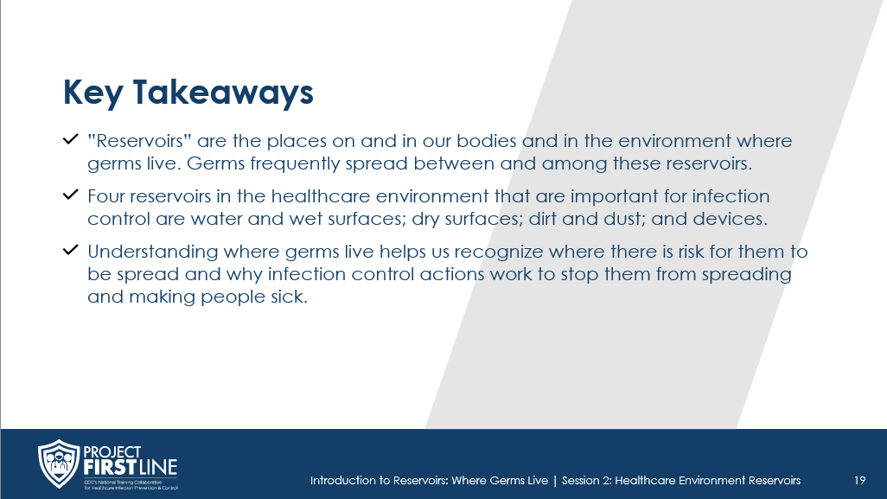
Key Takeaways
Notes:
Facilitator Notes:
Thank participants for their time and review the Key Takeaways from the session.
Sample Script:
“Thank you for your time and attention today. I hope that you can use these ideas in your work to help stop the spread of germs.”

Slide 28
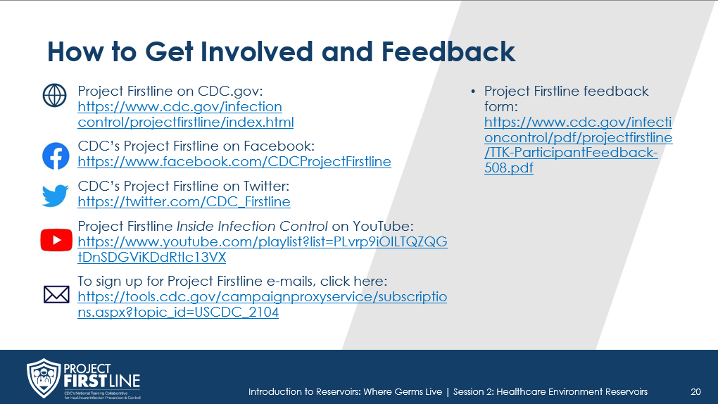
Additional Resources
Notes:
Facilitator Notes:
Share additional resources from Project Firstline and CDC.
Explain how participants can reach you, by the means of your choosing, and how they can reach Project Firstline.
If this session is part of a series, you may choose to describe the themes of upcoming sessions.
Direct participants to the feedback form.
Sample Script:
“Even though we covered a lot today, there is still much more to learn. You can keep exploring these topics on your own using the resources on this slide.
“Project Firstline has a suite of products to help you learn how to recognize infection control risks at work, and to help you learn more about where germs live in healthcare, and how they spread. You can also follow Project Firstline on social media!
“I will stay online for a few minutes after our session ends and will be happy to discuss any other questions!”
(If this session is part of a series) “Next time, we will cover [insert next training topic]. Finally, please let us know how you enjoyed today’s session by completing the following feedback form. Thanks again for joining us today.”

Slide 29
Text Here
Text here

Slide 30
Text Here
Text here

Slide 31
Text Here
Text here

