Slide 1

Transmission-Based Precautions
Dupage County Health Department
Notes:
Hello, and welcome to the second module of the Personal Protective Equipment course. This module will discuss Transmission-Based Precautions, which are infection prevention measures taken in addition to Standard Precautions to prevent the spread of disease. This module was developed by national infection prevention experts devoted to improving patient safety and infection prevention efforts.

Slide 2

Learning Objectives
Describe the different types of Transmission-Based Precautions
Determine what types of practices and personal protective equipment (PPE) are appropriate based on method of disease transmission
Apply this knowledge in patient care settings
Notes:
Upon viewing this module, you should be able to describe the different types of Transmission-Based Precautions; determine what types of practices and personal protective equipment or PPE would be appropriate based on the method of disease transmission; and apply this knowledge whether you work with patients at the bedside or support those who do.

Slide 3
Standard vs. Transmission-Based Precautions
Standard Precautions: apply to ALL care activities no matter if the patient is known to be sick or not
Transmission-Based Precautions: added measures to stop the spread of germs from patients who are sick or might be sick
Notes:
Before we go into more detail about Transmission-Based Precautions it’s important to recall the definition of Standard Precautions. Standard Precautions are infection prevention practices that apply to all care activities, regardless of suspected or confirmed infection status. In contrast, Transmission-Based Precautions are added measures for infection prevention strategies to prevent the spread of specific diseases. Patients who have confirmed or suspected disease that can be spread beyond what Standard Precautions can prevent, should have Transmission-Based Precautions in place. Remember that Standard Precautions will always be used. This means that a patient could have a diagnosis of influenza and be in Droplet Precautions, but health care personnel will continue to follow Standard Precautions when performing a blood draw. For additional information on Standard Precaution, please view Personal Protective Equipment module 1, The Basics of Standard Precautions.

Slide 4
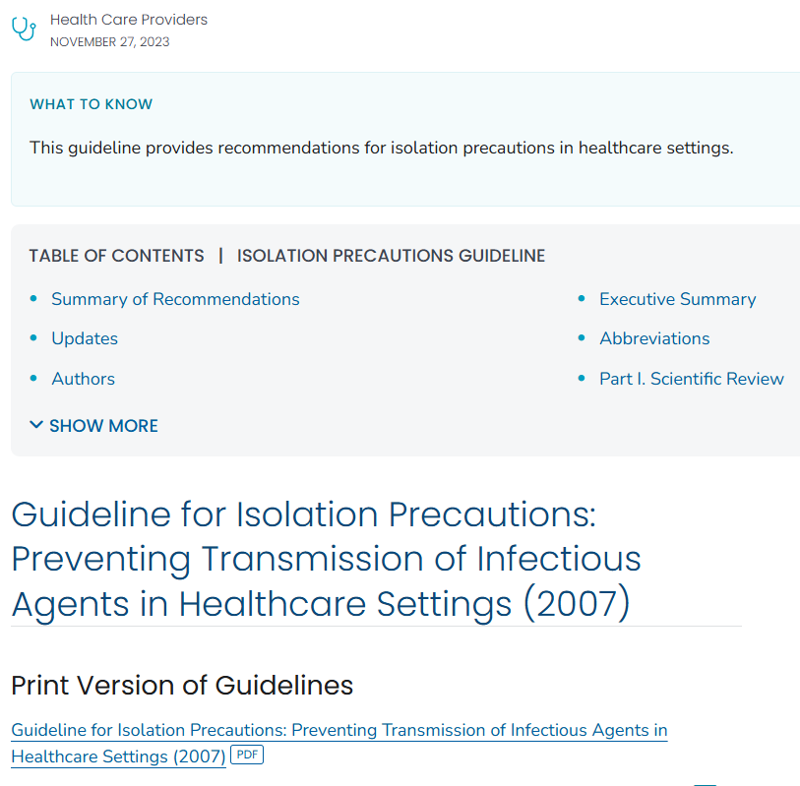
HICPAC Guidelines
Notes:
CDCs IPC guidelines are informed by the Healthcare Infection Control Practices Advisory Committee. Those guidelines inform policy and practices for infection control departments, health care epidemiologists, administrators, nurses and others who are responsible for developing, implementing and evaluating infection control programs for health care settings across the continuum of care. The 2007 HICPAC guidelines for Isolation Precautions can be accessed through the CDC website indicated on the slide shown.

Slide 5
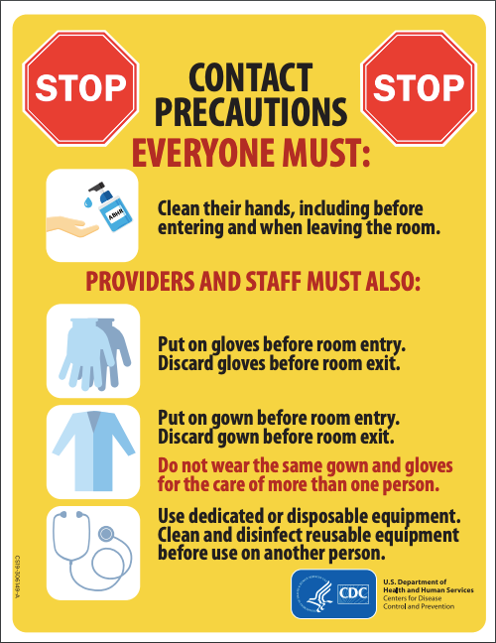
Types of Transmission-Based Precautions
Contact Precautions
Droplet Precautions
Airborne Infection Isolation
Enhanced Barrier Precautions
(CDC, Transmission-Based Precautions, https://www.cdc.gov/infection-control/hcp/basics/transmission-based-precautions.html
Notes:
The types of Transmission-Based Precautions are listed here. We will go into greater detail in following slides. The Chain of Infection was discussed in the Standard Precautions module; here we’ll talk more about how different types of pathogens spread, and why different types of TransmissionBased Precautions are important. Contact Precautions refers to precautions used for diseases that can be transmitted during contact with the patient or patient’s environment. Other harmful microbes can be passed along by large respiratory droplets, requiring Droplet Precautions. And still others are passed along through the air and require Airborne Precaution Isolation – pathogens are very small and remain suspended in the air. Patients should be placed into appropriate precautions as soon as possible (i.e. while awaiting confirmation of a suspected diagnosis) to prevent unintended exposure to health care personnel and other patients, families and visitors.

Slide 6

Contact Precautions
Methods used to contain diseases that are spread by
Direct Contact: Touching the patient
Indirect Contact: Touching the patient’s environment
Known or suspected infection or others that are “epidemiologically important”
Patients at risk of spreading germs to their surroundings
(Siegel JD et al., CDC Guidelines for Isolation Precaution, 2007 )
Notes:
Contact Precautions are used when patients have an infection that can be spread by contact with the patient’s skin including mucous membranes, feces, vomit, urine, wound drainage or other body fluids. These are examples of coming into direct contact with the patient. Indirect contact occurs when health care personnel are in the patient’s environment or surroundings that may be contaminated. Contact with a patient’s surroundings may be overlooked as a means of spreading infection. Health care facilities will have policies and protocols that describe which specific diseases or conditions warrant Contact Precautions.
Patients with known or suspected infections caused by pathogens that can be passed by contact are placed into Contact Precautions. An example is Clostridioides difficile. Epidemiologically important pathogens include organisms that have resistance to first line antimicrobial therapy or have unusual resistance patterns to antibiotics. They are often difficult to treat. The decision to include specific pathogens might be facility-specific and you should review which pathogens are of particular concern within your health care setting. Patients that are at high risk of contaminating their environment, e.g. with fecal incontinence, uncontrolled wound drainage or other excretions or secretions, should be placed into Contact Precautions.

Slide 7
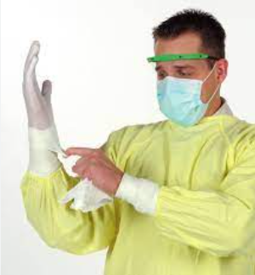
PPE for Contact Precautions
Wear a gown and gloves when you enter, before touching the patient or their surroundings
Things that might have germs:
Objects, such as tray tables and bedrails
Medical equipment (e.g. Blood Pressure cuff)
It is safest to use equipment for just one patient
Remove PPE when you exit the room and wash your hands right away
Notes:
Health care personnel caring for patients on Contact Precautions must wear a gown and gloves for all interactions that involve contact with the patient and the patient environment. PPE should be donned prior to room entry and doffed at the point of exit. For patients on Contact Precautions, a single-patient room is preferred. If two patients are being cohorted, or placed in a shared room with the same infection, this should be discussed with infection prevention and control personnel to understand potential risks. If patients are cohorted, PPE must be changed between the care of each patient. Donning and doffing of PPE was discussed in the Standard Precautions module; as a reminder, hand hygiene must always follow PPE removal.

Slide 8

Droplet Precautions
Stops the spread of diseases that travel in larger droplets from coughing, sneezing or talking
Examples of conditions requiring Droplet Precautions include:
    Seasonal Flu
    Whooping Cough (B. pertussis)
(Siegel JD et al., CDC Guidelines for Isolation Precaution, 2007; Image from CDC, Brian Judd, 2009)
Notes:
Droplet Precautions are used to prevent the spread of pathogens that are passed through respiratory secretions and do not survive for long in transit. These droplets are relatively large particles that cannot travel though the air very far. They are transmitted through coughing, sneezing, and talking. Although a single-patient room is preferred, patients may be cohorted after consulting with infection prevention and control personnel. Maintaining a spatial separation of three feet or more and keeping curtains drawn between patients is recommended.
You may have seen a similar photo of a sneeze to demonstrate the distance and amount of secretions. We as health care personnel certainly hope that others can contain sneezing and coughing to prevent distribution of these secretions. As described in PPE Module 1, respiratory hygiene should be part of Standard Precautions.

Slide 9
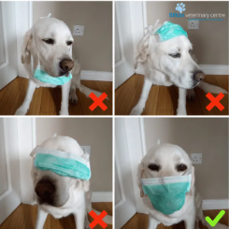
PPE for Droplet Precautions
Wear a face mask when you enter the patient’s room
Use Standard Precautions when touching items contaminated with respiratory fluids
Take off PPE at the point of exit; do not reuse face masks
Wash/Sanitize your hands after taking off your PPE
Notes:
Health care personnel caring for patients on Droplet Precautions must wear a face mask for close patient contact, considered to be within six feet or less or in the room of the patient. Taking a blood pressure, listening to lung sounds and administering medication would all require staff to wear a face mask. A respirator or N95 face mask is NOT necessary but can be used for the care of a patient on Droplet Precautions. Remember, that you should continue to use Standard Precautions during patient care in addition to Droplet Precautions.
This includes handling items contaminated with the patient’s respiratory secretions. PPE, including the face mask, should be removed at the point of exit and not worn in corridors or when caring for other patients. For some infections, eye protection might be necessary as well (e.g. Influenza). Lastly, remember to perform hand hygiene using soap and water or alcohol-based hand rub after removing all PPE.

Slide 10
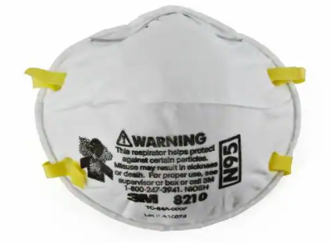
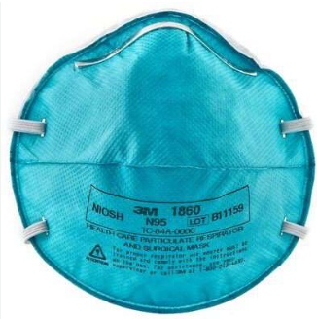
Airborne Infection Isolation
Stops the spread of germs that are very small and stay in the air for long periods of time
Examples include measles, M. tuberculosis, chicken pox
Patient should be placed in a negative pressure isolation room.
Notes:
Airborne infection isolation or Airborne Precautions prevent the transmission of infectious agents that remain viable and suspended in the air over long distances. Examples of these are rubeola virus or measles, varicella virus or chickenpox, and Mycobacterium tuberculosis. These patients should be promptly placed into an airborne isolation room that contains special air handling and ventilation. This air handling and ventilation capacity includes a monitored system that provides negative pressure relative to surrounding area (such as the hallway). The air is exchanged at a rate faster than other areas in the health care setting with exhaust directed to the outside and/or HEPA filtered.

Slide 11
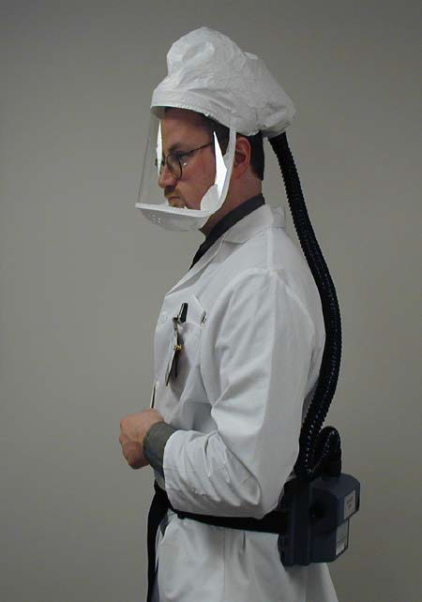
PPE for Airborne Isolation Infection
Wear a more protective mask (e.g. N95) or powered air purifying respirator (PAPR) before entering the room
With a particulate respirator, perform a fit-check before entering an area where there may be airborne infectious disease
(Siegel JD et al., CDC Guidelines for Isolation Precaution, 2007; National Institute for Occupational Safety and Health. Hospital Respiratory Protection Program Toolkit 2015; Image Credited to Martin Levesque)
Notes:
A particulate respirator must be worn by anyone entering the patient’s room that is on airborne precautions. This may be an N95 respirator or powered air purifying respirator or PAPR. Respirators are specifically designed to provide respiratory protection by efficiently filtering out airborne particles. An N95 respirator requires appropriate fit-testing done by trained personnel. A fit-test will ensure the face mask has a tight seal against the face. A PAPR consists of a battery operated blower and HEPA filter, connected by a tube to a covered face piece, as in the photo.
PAPRs may be selected if an N95 respirator does not fit, or the employee has facial hair or a facial shape that would interfere with mask-to-face seal. Occupational health services will be able to provide details on what types of respiratory protection they have available, how employees obtain fit testing and proper use of the respirator.

Slide 12
Patient Transport
For all isolation types:
Limit patient movement: Try to keep patients in their room as much as possible.
Cover infected areas: Make sure any infected areas are covered.
No PPE in the hallway: Healthcare staff should not wear PPE (gowns) when moving patients.
Good communication: Make sure staff communicate when patients need to leave their room
Notes:
Moving patients out of their isolation room should only occur when necessary. For patients on Contact Precautions, any infected areas must be covered or contained. PPE should not be worn by health care providers or transporters while moving the patient. Clean PPE should be used at the destination point.
n Droplet Precautions, the patient should wear a surgicaltype face mask and follow cough etiquette when outside of their room. For patients in airborne infection isolation, the patient should also wear a surgical face mask and follow cough etiquette. Patients and transport personnel do not need to wear respirators when transporting patients. When patients must leave their room and travel to another department or area, there must be good hand-off communication among staff about the type of isolation precautions. This may include verbal, written and/or electronic notifications.

Slide 13
Enhanced Barrier Precautions
Use of gown and gloves during “high-contact” resident care activities. These are activities that increase the chance of germ transmission:
  Dressing
  Bathing/showering
  Transferring
  Providing hygiene
  Changing linens
  Changing briefs or assisting with toileting
  Device care or use: central line, urinary catheter, feeding tube, tracheostomy/ventilator
  Wound care: any skin opening requiring a dressing

Slide 14
Enhanced Barrier Precautions
Who does this apply to?
All residents who have any of the following:
  An infection or colonization with a drug-resistant germ when Contact Precautions aren't needed
  Wounds or medical devices like a central line, urinary catheter, feeding tube, or tracheostomy/ventilator, no matter if they have a drug-resistant germ or not

Slide 15
Enhanced Barrier Precautions
Enhanced Barrier Precautions do NOT replace normal contact precautions
If the resident has any of the following, they should remain on contact precautions until they are cleared from isolation:
  Acute diarrhea, draining wounds, or other places where bodily fluid leaking can’t be contained/covered
Residents on Enhanced Barrier Precautions are allowed to leave the room and join group activities and dining
Improves the quality of life for residents while keeping others safe

Slide 16
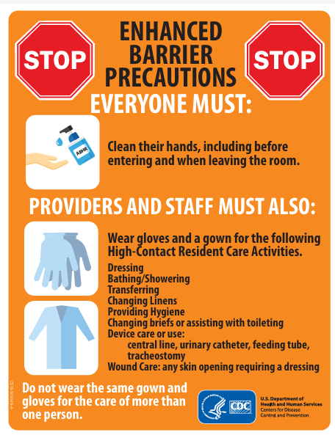
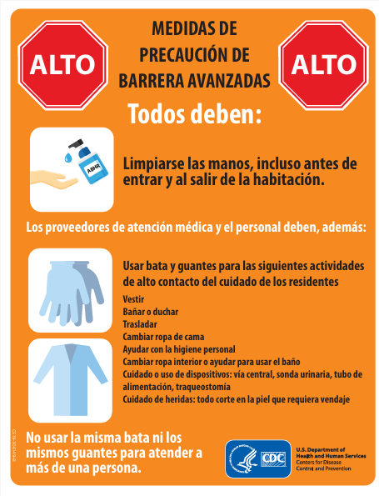
CDC Signage

Slide 17
Scenario 1
You are a nurse working the evening shift at a long-term care facility. A new resident reports a cough with blood-streaked sputum for almost two months with night sweats and an unintended 20-lb weight loss. You suspect tuberculosis (TB). What type of precautions would be appropriate?
Contact
Droplet
Airborne
Contact & Droplet
Notes:
Now we’ll do a couple of case scenarios to test your knowledge. You are a nurse working the evening shift at a long-term care facility. A new resident reports a cough with blood-streaked sputum for almost two months with night sweats and an unintended 20-lb weight loss. You suspect tuberculosis (TB). What type of precautions would be appropriate?
The correct answer is C, Airborne Isolation Precautions. A surgical type face mask should be placed on the patient and he should be moved to a negative-pressure room as soon as possible. If an AIIR is not immediately available, you should be promptly placed in a private room while awaiting the AIIR. Staff caring for the patient must wear appropriate respiratory protection such as an N95 respirator or PAPR.

Slide 18
Scenario 2
A resident has become symptomatic with fever, cough, and body aches for two days. She tests positive for seasonal influenza. What type of precautions would be appropriate?
Contact
Droplet
Airborne
Standard
Notes:
In this next example, A resident has become symptomatic with fever, cough, and body aches for two days. She tests positive for seasonal influenza. What type of precautions would be appropriate?
The correct answer is B, Droplet Precautions. These precautions need to be instituted before lab confirmation of illness. Some facilities have enhanced or extended Droplet Precautions, but all should be based on the Droplet Precautions concepts we covered in this module. This includes health care personnel wearing a surgical-type face mask when coming into close contact with the patient, use of a private room and limiting movement within the facility.

Slide 19
Scenario 3
You are assisting in the admissions process for a patient being admitted to your skilled nursing facility. You notice that the resident has a large draining wound on his hip that’s difficult to keep covered and is draining onto his bed sheets. You confirm this and suggest to the nurse the patient be placed into:
Contact Precautions
Enhanced Barrier Precautions
Droplet Precautions
Airborne Isolation Precautions
Notes:
In our last example, You are assisting in the admissions process for a patient being admitted to your skilled nursing facility. You notice that the resident has a large draining wound on his hip that’s difficult to keep covered and is draining onto his bed sheets. You confirm this and suggest to the nurse the patient be placed into:
The correct answer is A, Contact Precautions. Contact Precautions should be considered when a patient has a draining, wound. It should also be considered for patients with uncontrollable diarrhea and other instances when the environment may become contaminated.

Slide 20
Key Messages
Transmission-Based Precautions include Contact, Droplet, Airborne and Enhanced Barrier Precautions
PPE (Personal Protective Equipment) should be chosen based on how germs spread.
Standard Precautions should be used for all patients, along with their specific Transmission-Based Precautions
Notes:
Transmission-Based Precautions are used when a patient has a known infection, such as one that’s been laboratory-diagnosed, or a suspected infection while awaiting confirmation. Patients should be placed into precautions as soon as possible to prevent exposure to health care personnel and other patients. All health care personnel caring for patients in Transmission-Based Precautions should be aware of the correct PPE and work practices needed to provide care safely. Awareness of how diseases are spread is important for health care personnel. Finally, don’t forget to always use Standard Precautions along with any Transmission-Based Precautions needed for a patient.

Slide 21
References
Berends C, Walesa B. Isolation Precautions (Transmission-based Precautions). Association of Infection Control and Epidemiology Text. 2013.
Hospital Respiratory Protection Program Toolkit 2015. National Institute for Occupational Safety and Health. https://www.osha.gov/Publications/OSHA3767.pdf
Sequencing for Personal Protective Equipment (PPE). Centers for Disease Control and Prevention; CS250672-E. Available at http://www.cdc.gov/hai/pdfs/ppe/ppe- sequence.pdf
Siegel JD, Rhinehart E, Jackson M, et al. 2007 Guideline for Isolation Precautions: Preventing Transmission of Infectious Agents in Healthcare Settings. Centers for Disease Control and Prevention. Available at http://www.cdc.gov/hicpac/pdf/isolation/isolation2007.pdf
IDPH: A Toolkit for Implementing Personal Protective Equipment in Nursing Homes to Prevent the Spread of Multidrug-and Extensively Drug-Resistant Organisms: https://dph.illinois.gov/content/dam/soi/en/web/idph/publications/idph/topics-and-services/prevention-wellness/patient-safety-quality/toolkit-for-implementing-ppe-mdros-092024.pdf

Slide 22
Text Here
Text here

Slide 23
Text Here
Text here

Slide 24
Text Here
Text here

