Slide 1


BREAKING THE CHAIN: Infection Control and You
Presented by
Notes:
Hello everyone! My name is _____ And my name is _________. We are from the Freehold Area Health Department, your local health department here in the community!
We are so excited to be here with you today to present our newest infection control training series, Breaking the Chain, Infection Control and You. Today will be all about empowering you to be able to recognize risks for germs to spread in the healthcare setting, and having the confidence to take specific infection control steps to stop the spread of these germs.
Our presentation is split into four sections and we will be doing three different interactive activities throughout our session today. We’ll be asking for volunteers for these activities and there are prizes up for grabs! We encourage your interaction and participation throughout our presentation today as well.

Slide 2
Agenda
Welcome!
Recognizing Risk
Personal Protective Equipment
Hand Hygiene
Cleaning and Disinfection
Notes:
So with that, here is our basic agenda. We will start by discussing recognizing risks in healthcare settings including where germs live and how they spread. We will then spend some time reviewing three tools in our infection control toolbox to help stop the spread of germs in our healthcare facilities.

Slide 3
Section 1
Recognizing Risk

Slide 4
Risk Recognition:
Seeing the potential for a problem to happen
Seeing a potential problem doesn’t mean the problem will definitely happen!
We take action to keep something bad from happening.
Notes:
Our first section is all about recognizing risk. So, what does exactly that mean? A simple definition is seeing the potential for a problem to happen. In our case is seeing the potential for germs to spread.
The benefit of recognizing a risk is that you have the ability to take action to keep something bad from happening. For purposes of our presentation today, taking action means using infection control practices to stop germs from spreading.

Slide 5
Risks of Germs in Healthcare
Higher chance residents will have an infection
Residents likely to be more vulnerable to infection
Things we do as part of care can put people at risk of infection
The work we do presents many opportunities for germs to spread
Notes:
When we think about germs spreading in healthcare, it's helpful to remember what makes healthcare a unique setting for germs to spread.
Why do we think about germs and their risks differently in facilities like this than in other places like in our home or out in the community?
The residents in this facility are here to receive care, and there is a higher chance that they may already have an infection.
Many of the residents in long-term care facilities can be ill, weak, or elderly. They are going to be more vulnerable to or at risk for infection.
There are things done as part of resident care that can put people at risk of infection.
The work that we do in these types of facilities also bring opportunity for germs to spread. Examples include close interaction with residents, shared equipment, common areas and high touch surfaces.
This is why infection control is so important in these types of settings. It’s important to be able to recognize the risk for germs to spread throughout your work day so you can prevent it from happening, just like you would do for any other type of risk in your normal everyday life.

Slide 6
Where is the risk for germs to spread in healthcare?
Notes:
We’ve talked about recognizing risk in general, and about higher risks for germs to spread in healthcare. Now let’s work together to identify exactly where and why these risks exist in the healthcare setting.

Slide 7
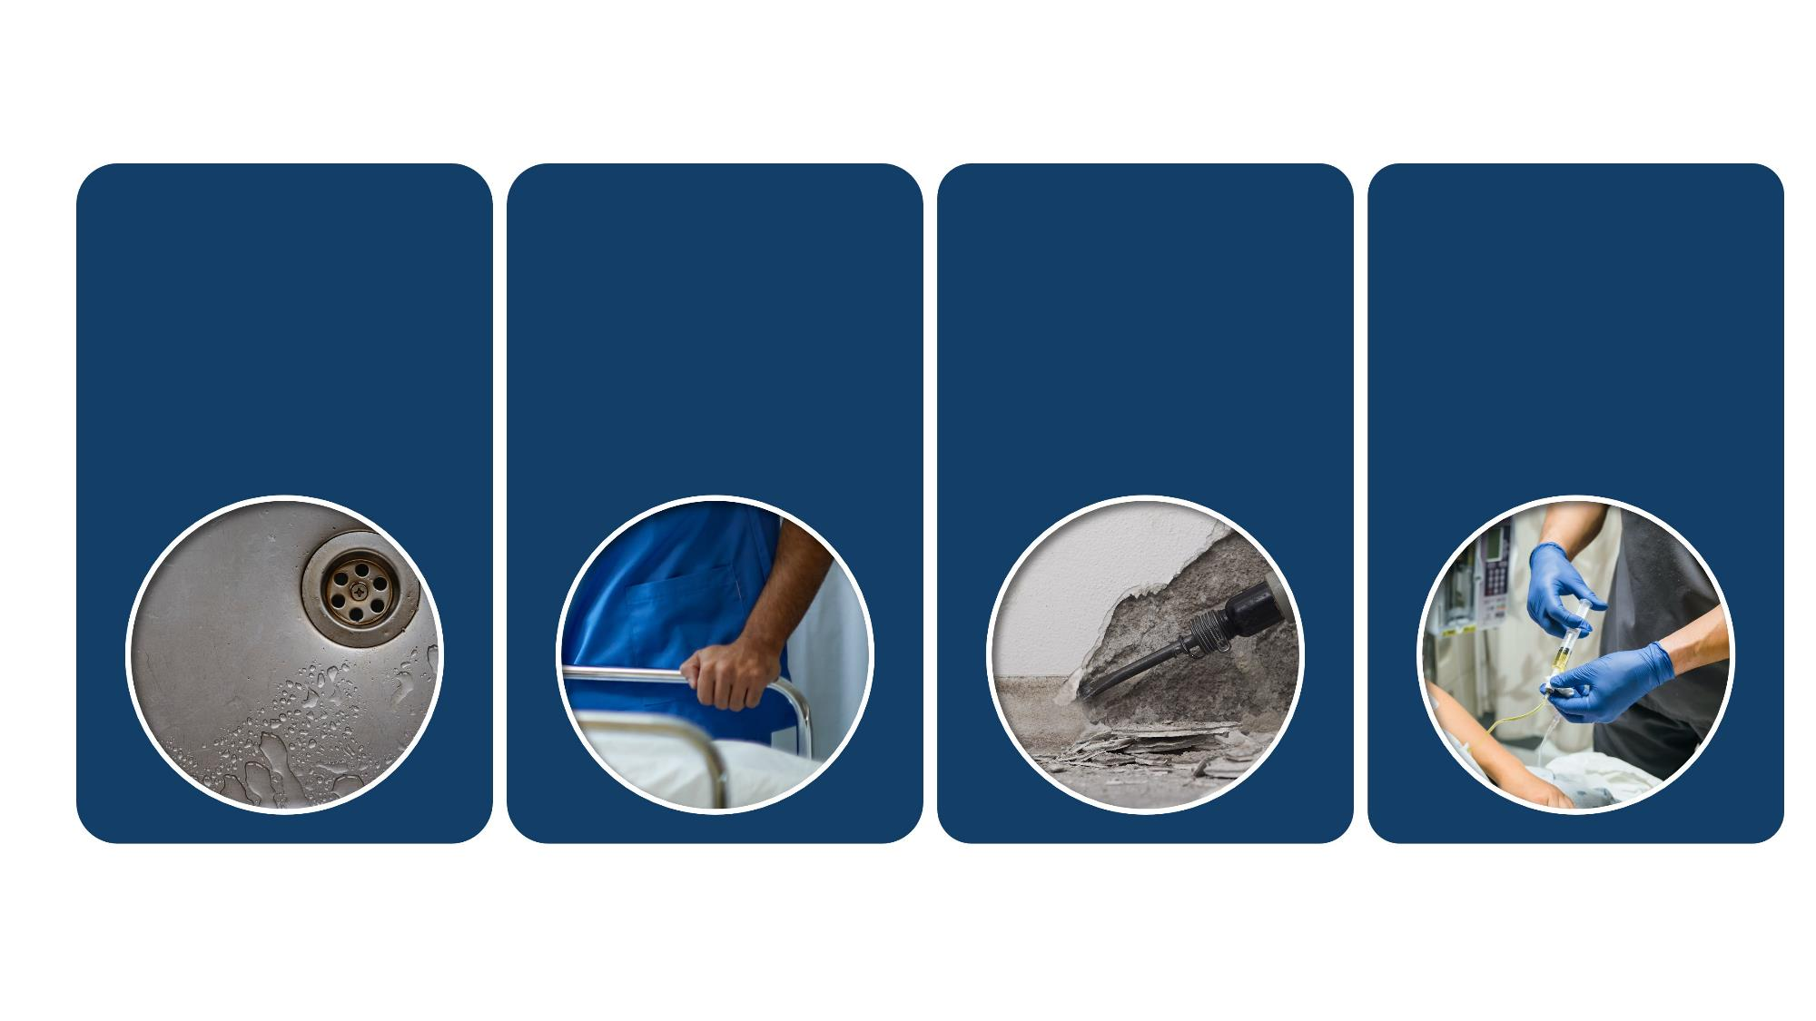
Reservoirs in the Healthcare Environment
Water and
Wet Surfaces
Sinks and faucets
Drains
Ice machines
Pools
Dry Surfaces
Bed rails
Door handles
Countertops
Bed curtains
Dirt and Dust
Construction
Maintenance
Repair
Renovation
Devices
Stethoscope
Blood pressure cuff
Glucometer
Pulse Oximeter
Notes:
For us to be able to recognize the risk of germs spreading and be able to stop it, we first need to know where germs live. So, we’ll begin by discussing germ reservoirs in the healthcare environment, or where germs live.
There are four main reservoirs - or four main places where germs live in healthcare settings: water and wet surfaces; dry surfaces; dirt and dust, and devices
In terms of water and wet surfaces, germs can live in sinks and faucets, drains, ice machines, and pools.
Dry surfaces are all around us in the healthcare setting, and can include “high touch surfaces” like bed rails and door handles, or things that aren’t touched as often like countertops and bed curtains.
Germs can also live in dirt and dust from things like major construction, general maintenance, minor repairs, or renovation.
Last but not least, medical devices can harbor germs. Some common devices that you might see in this type of setting include stethoscopes, blood pressure cuffs, glucometers, and pulse oximeters.
Now, these are not the only places where you can find germs in the healthcare environment, but these some of the main areas that we will focus on today.

Slide 8
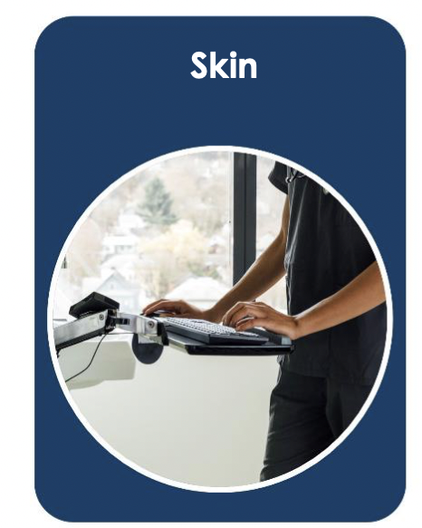
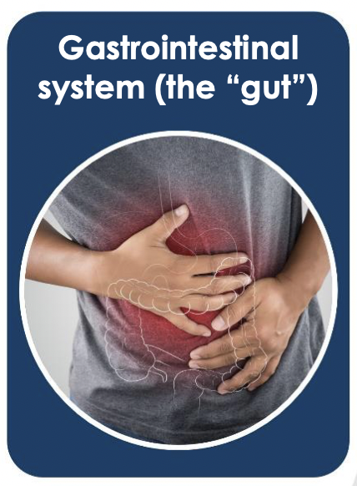
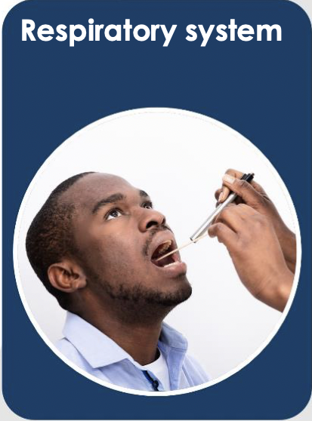
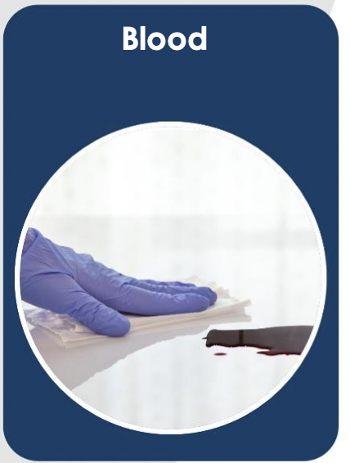
Reservoirs in the Body
Gastrointestinal
system (the “gut”)
Respiratory system
Blood
Skin
Notes:
In addition to germs living in the environment, they can also live in and on the body.
There are four main reservoirs - or four main places where germs live in and on the body: the skin, gut, respiratory system and blood.
Skin, especially hands, carry many germs and spread them easily.
Germs on skin can spread to other people, surfaces, and shared items.
This is why hand hygiene is such an important step of infection control, which we will discuss later.
The gut is filled with bacteria. Most germs in our gut do not cause problems in healthy people but can cause infection when spread among people with weak immune systems.
Germs found in residents stool (poop) can spread to our hands, surfaces, or other people during activities like direct patient care or cleaning a bathroom.
If proper hand hygiene or cleaning and disinfection is not done, these germs can spread further.
Germs can live in our respiratory system, like our nose, throat and lungs.
When an infected person talks, breaths, sneezes or coughs, their respiratory droplets can spread these germs
Germs can also live in our blood and spread when blood from an infected person gets onto a sharp item or device.
For example, reusing needles or not cleaning and disinfecting multi use medical devices like glucometers can cause germs to spread.
Knowing where germs live can help you recognize the risk for them to spread. It also helps you understand why infection control actions work to stop germs from spreading and making people sick.

Slide 9
How Germs Spread and Make People Sick
Notes:
Christa
Now that we know where germs live, let’s talk about how they spread and make people sick.

Slide 10
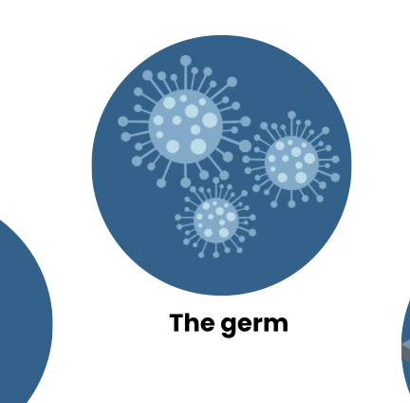

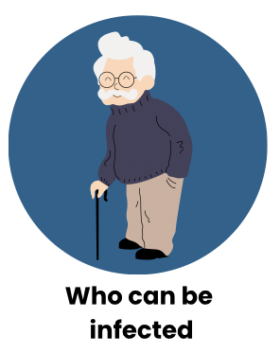
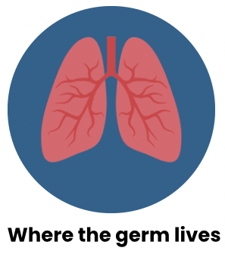

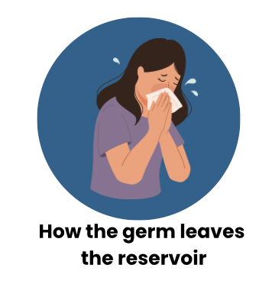
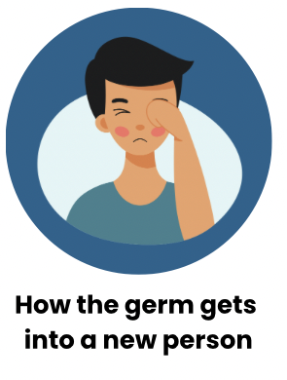
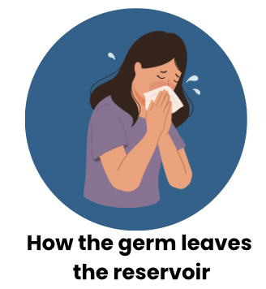
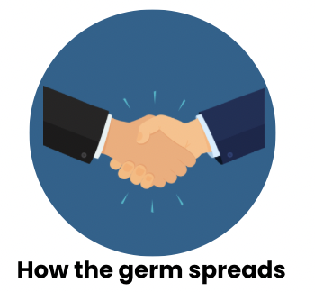
How Germs Make People Sick: Chain of Infection
Infectious Agent
Susceptible Host
Reservoir
Portal of Exit
Portal of Entry
Portal of Exit
Mode of Transmission
Notes:
Christa
We like to use the chain of infection to show exactly how germs can spread. Germs are inevitable, but there are several things that have to happen for them to actually infect a person and cause illness.
(Click 1x for animation) First we have the infectious agent which is the germ.
(Click 2x) Next, we have a reservoir. The reservoir is where the germ lives. Like we just learned, a reservoir can be in the body like in the respiratory tract or the blood. Or it can be in the environment, like in water or on a surface.
(Click 3x) Then we have the portal of exit. The portal of exit is how the germ gets out of that reservoir where it’s living. An example would be if someone coughs and the germ living in their respiratory tract exits their lungs.
(Click 4x) Now that the germ has exited the reservoir it needs a way to travel. Mode of transmission is how the germ moves from one place to another. There’s direct transmission where the germ is transmitted directly from person to person, like by direct contact with a sick person’s skin or respiratory droplets. There’s also indirect transmission where transmission can happen through a contaminated object. Like if a person coughs all over the bed rail, and then someone comes and touches that bedrail.
(Click 5x) The germ now needs an entry point. Portal of entry is how that germ gets into a new person to make them sick. This could be through a cut on someone’s skin, or through mucous membranes like their eyes, nose or mouth.
(Click 6x) Finally, we need a susceptible host and this is the person who ultimately gets sick. This could be one of your residents. But it could also be a co-worker or visitor to the facility.
To summarize: There is a germ that is living somewhere, it exits the reservoir where it’s living and it travels to a person where it enters their body and make them sick.

Slide 11
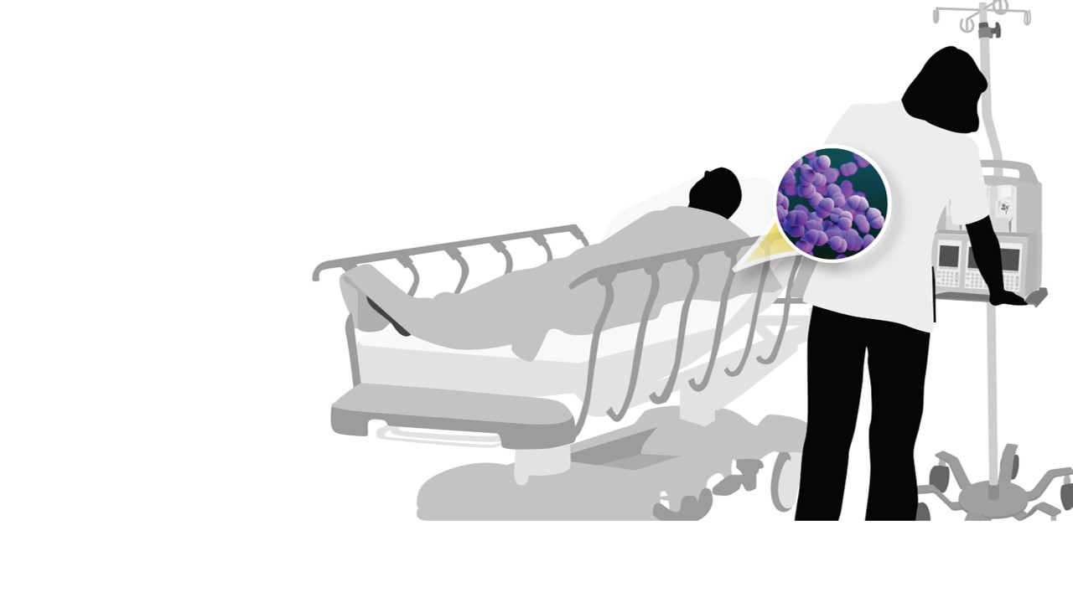
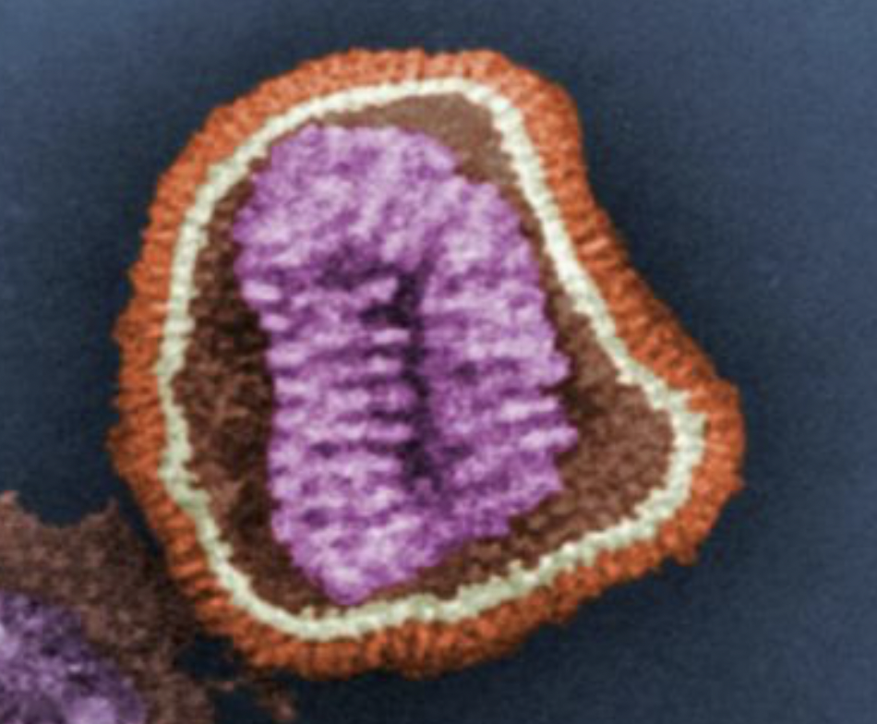
How Germs Spread and Make People Sick Example
Example Scenario - Influenza
Infectious Agent
Portal of Exit
Mode of Transmission
Portal of Entry
Susceptible Host
Reservoir
Respiratory system of a sick resident or staff
member
Another resident or staff member
Influenza
Sneezing or coughing
Respiratory droplets
Mouth, nose, or eyes
Notes:
Christa
Let’s go through an example of how a germ may actually spread in your facility. By understanding how a germ spreads, we can understand where the risks for transmission exist and take steps to prevent that transmission from happening.
For this example, we’ll talk about the flu virus. Let’s pretend you have a resident who is already sick with the flu and they are eating lunch with another resident who is not sick. How could that flu germ spread and make the other resident sick as well?
(Click 1x) So the flu virus is our germ. Flu is a respiratory virus, so where would the flu germ be living in an infected resident?
(Allow staff to answer)
(Click 2x) Yes, it lives in our respiratory tract. And what is a way that it could exit that sick person’s respiratory tract?
(Allow staff to answer)
(Click 3x) Yes, coughing, sneezing, even talking could give that virus a portal of exit. And how does it spread?
(Allows staff to answer)
(Click 4x) It spreads through respiratory droplets, and there’s a few way this could happen. First, if the sick person coughs or sneezes and the other resident inhales those droplets, that would be an example of direct transmission. Another mode of transmission would be if the sick resident coughs and their respiratory droplets get all over the salt and pepper shakers at the table and then the non-sick resident uses the salt and pepper before they eat their meal. This would be an example of indirect transmission. So what is our portal of entry for our non-sck resident?
(Allow to staff to answer)
(Click 5x) Yes, it would be their mouth, nose, or eyes. If those respiratory droplets get into any of those areas they will have the ability to make that resident sick with the flu.
(Click 6x) And in this example our susceptible host was another resident, but it could also have been a staff member or visitor to the facility.
Question for audience: In this specific example where one resident who is sick with flu gives it to another resident, what could we have done to prevent that spread from happening?
Answer: We could have isolated the sick resident so they can’t expose others. Other infection control measures could include using masks (although this is hard when you’re eating), promoting vaccination of staff and residents, cleaning and disinfecting shared items at the table between use, etc.

Slide 12

Challenge: Break the Chain!
Help us identify infection control strategies you do everyday to break the chain of infection
Notes:
Christa
Sticky note activity with chain of infection
You all take steps everyday to break the chain of infection. To protect yourselves, your residents, your co-workers and other people in the facility. There are sticky notes and markers on your table. Can you write down one infection prevention step you take and come put it on the board where you think it breaks the chain of infection. And keep in mind, many of the things we do break the chain at multiple points so you can just pick one place to put your sticky note.
(Give participants 5 minutes for activity) Review answers with group. Point out any that may have been missed.
Great work. We have identified infection control steps we take in our jobs everyday to reduce the risk of spreading germs. Now we’re going to take some time to dive deeper into a few of them.
One important thing to remember as we talk about infection control actions is that they all have to happen together to truly protect you and your patients. Germs are sneaky. If we only break the chain in one spot, they may find a way around it. We want to disrupt the chain of transmission at as many points as possible to make sure people don’t get sick.
We also want to make sure we’re taking these infection control actions all the time because the risk for infection always exists in the healthcare setting. These actions become even more important when there is an outbreak in your facility or someone is already sick. But, if we consistently engage in these practices everyday we can prevent illness from occurring and that really is our ultimate goal.

Slide 13
Section 2
Personal Protective Equipment (PPE)
Notes:
Christa
The first infection control topic we are going to highlight is Personal Protective Equipment or PPE. We’re going to talk about each infection control measure individually, but remember that they always need to happen together to be effective.
We all wear PPE everyday throughout the course of our jobs because it reduces the risk of transmitting germs. But let’s talk more about why we wear it and considerations we have to take into account to make sure it’s working the way it’s supposed to.

Slide 14
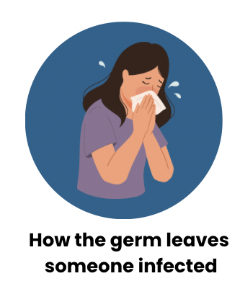
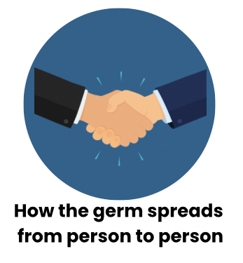
Personal Protective Equipment
PPE: equipment worn to minimize exposure to a variety of hazards
Protects you and your patient
PPE doesn’t have a brain!
Infectious Agent
Susceptible Host
Reservoir
Portal of Entry
Portal of Exit
Mode of Transmission
Notes:
Christa
Personal protective equipment, or PPE, is equipment you wear to minimize your exposure to different risks. It offers protection to both the person who wears it and the resident.
PPE is actually one of the least effective infection control tools we have for a few reasons. First, it doesn’t actually remove the risk. It doesn’t remove the germ from the environment, it just provides a layer of protection between you and the germ. So the risk still exists, but PPE helps minimize risk. Second, it doesn’t have a brain. PPE only works when used correctly and that relies on you doing all of the right things. Selecting the right PPE, putting it on correctly, wearing it correctly, taking it off correctly, and performing the right actions when there’s a breach in your PPE.
PPE breaks the chain of infection at multiple points. Let’s think about the flu germ. If you put a mask on a patient who is sick, you prevent those germs from exiting their respiratory tract. So you’ve blocked the portal of exit. And by preventing respiratory droplets from getting into the air you removed the mode of transmission. And if you as the staff member wear a mask when around a resident who is sick with a respiratory virus like flu, it blocks the portal of entry by preventing those germs from getting into your respiratory tract.

Slide 15
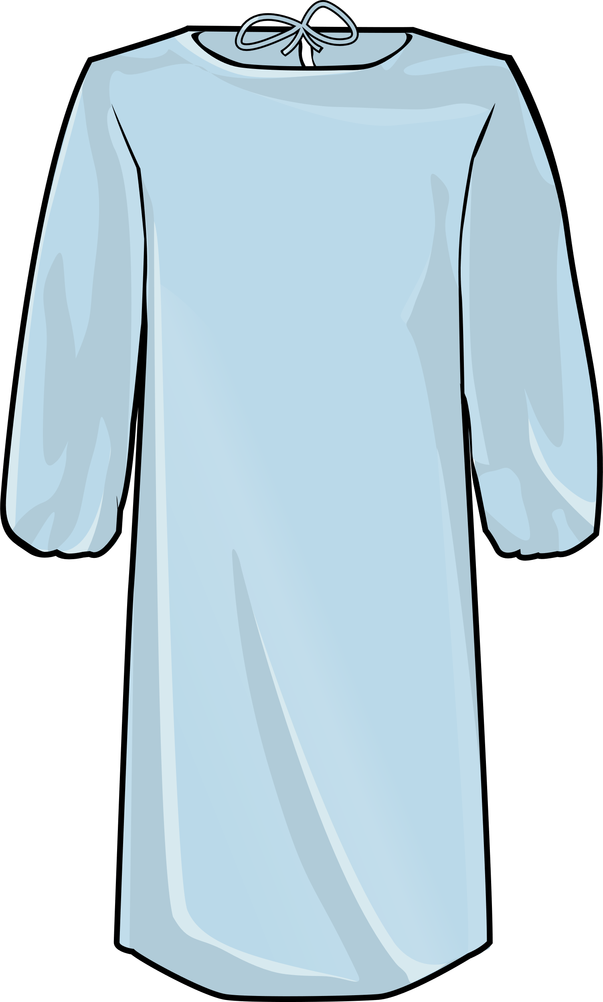

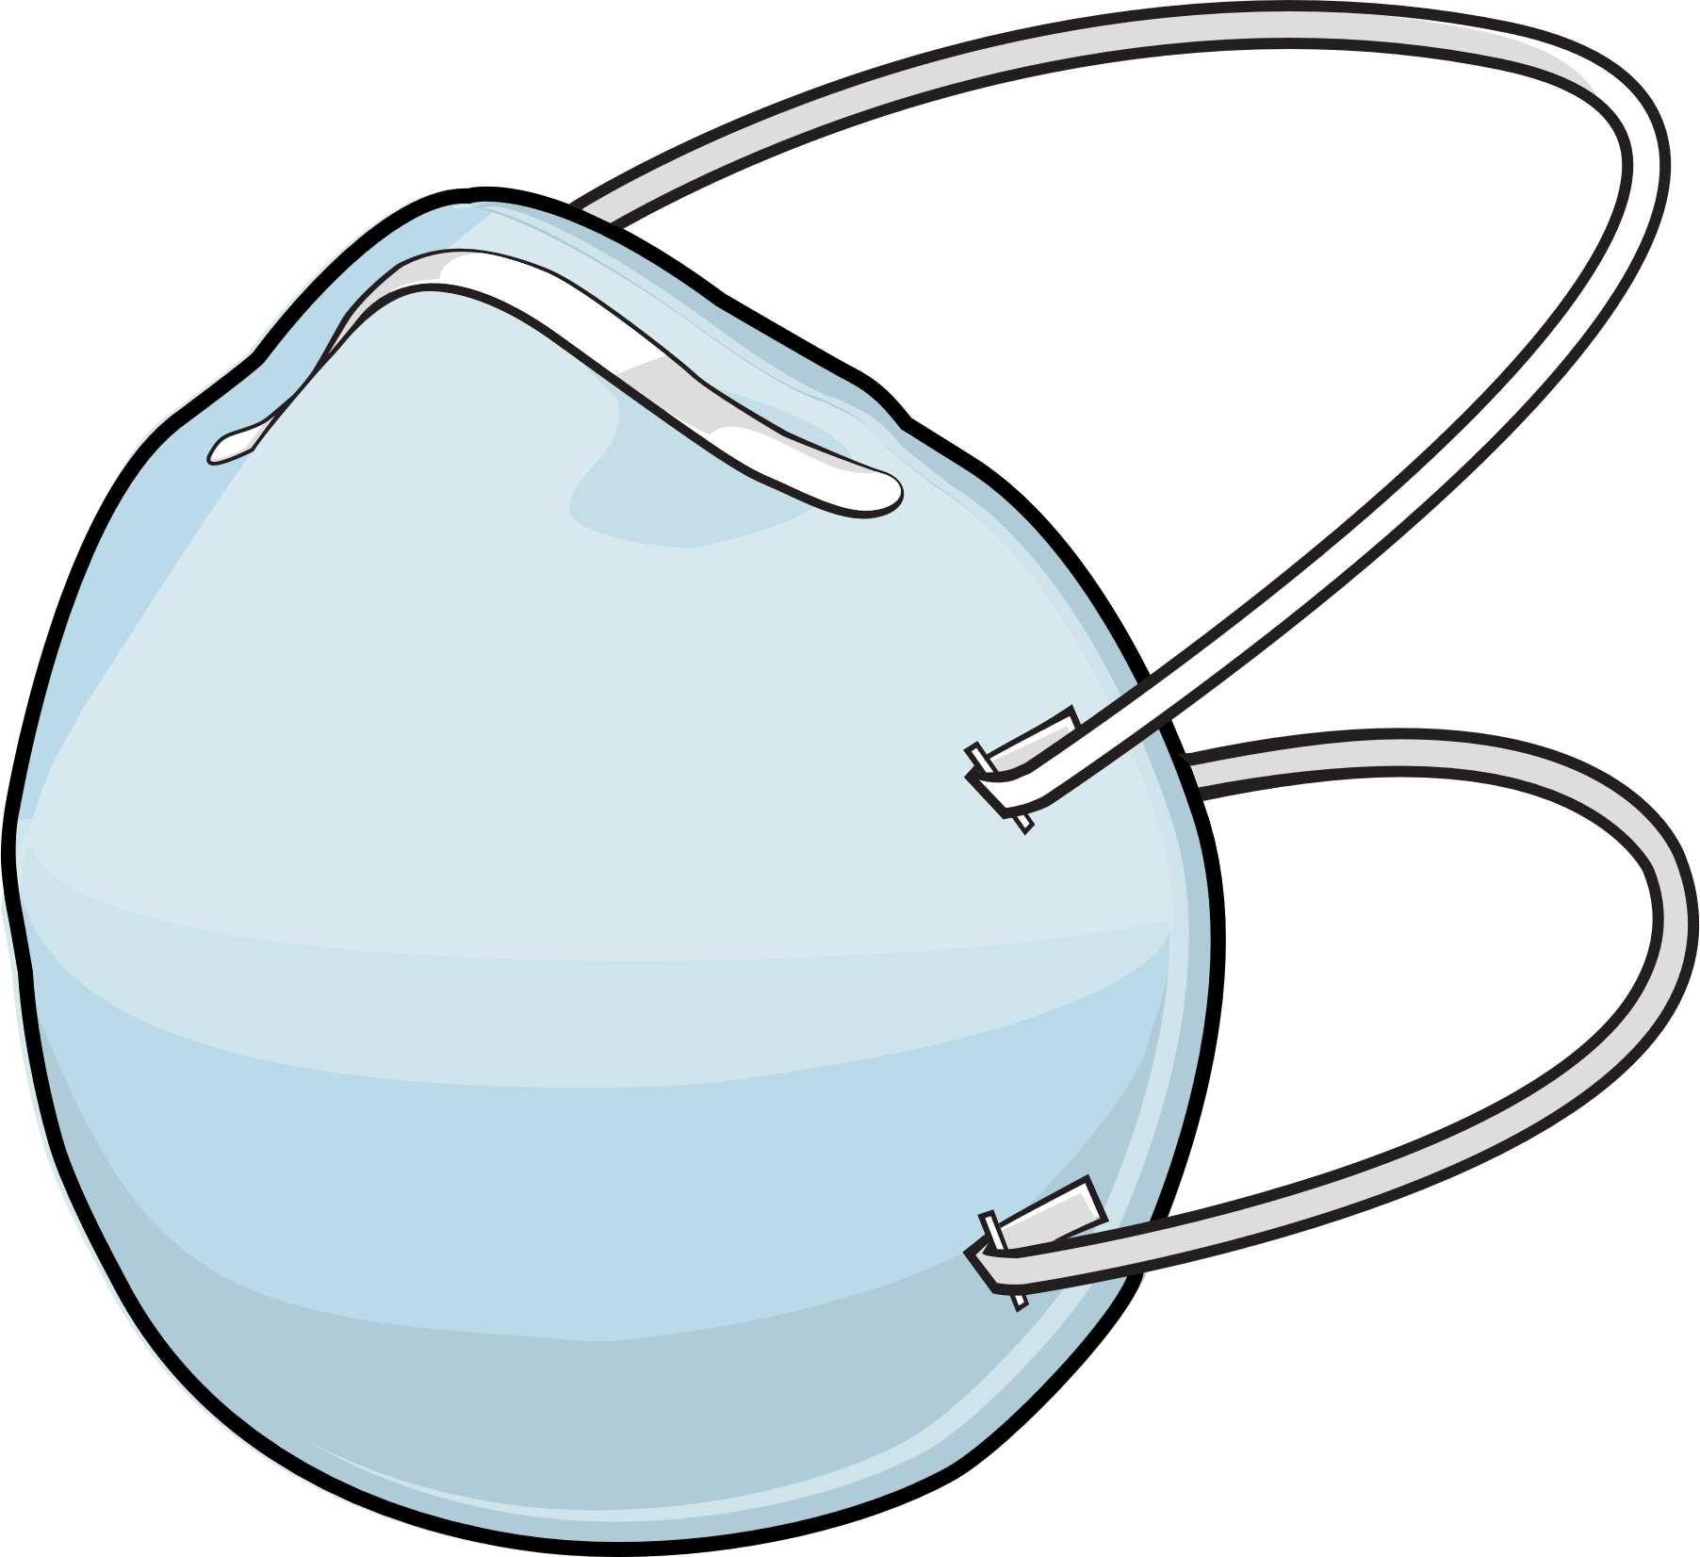
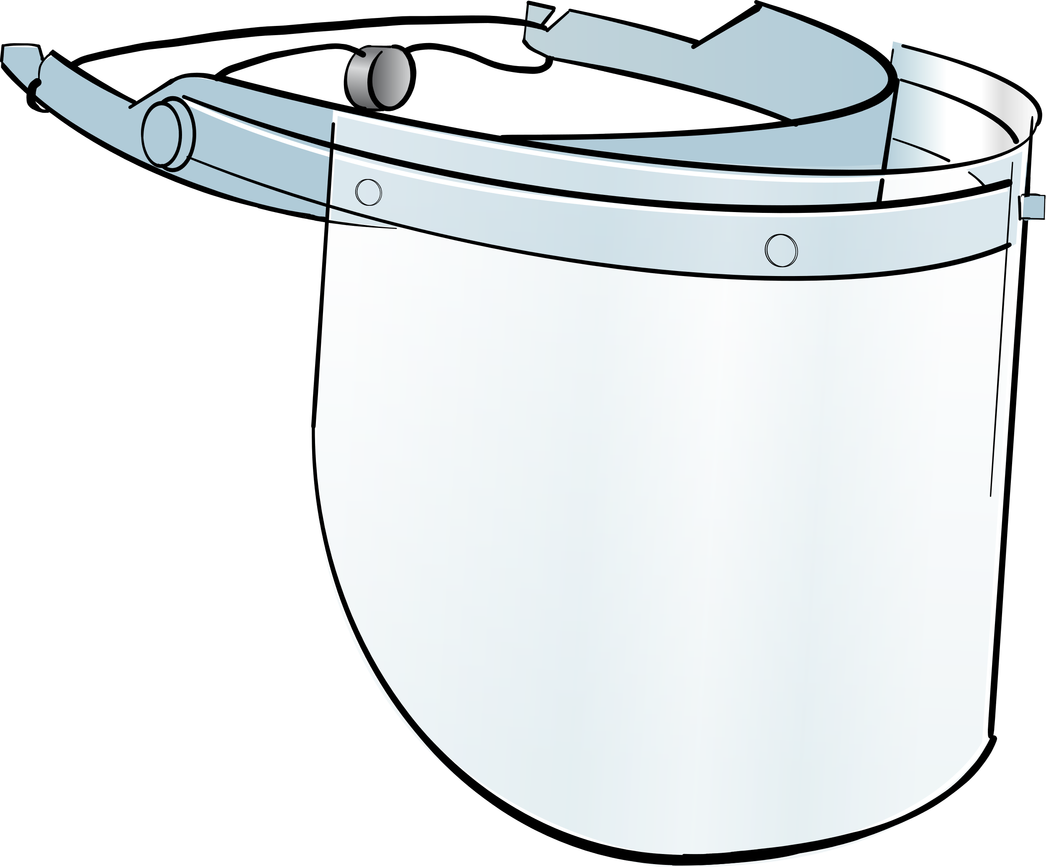

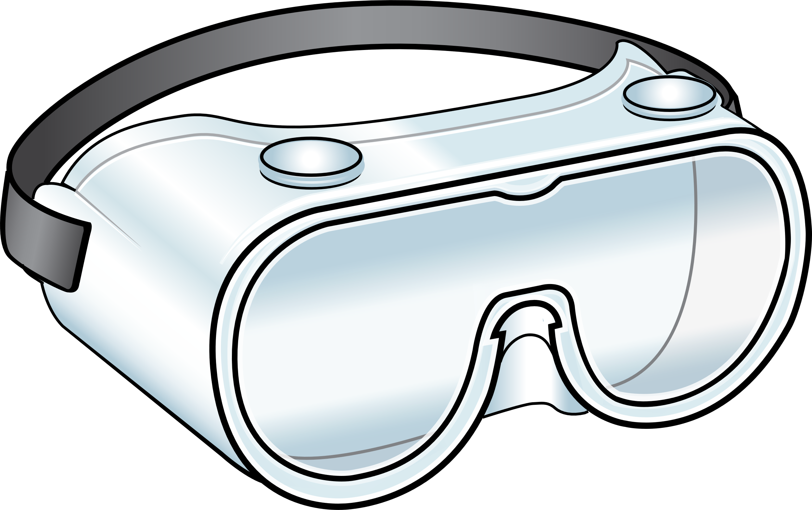
Type of PPE | Why it Protects You | Why it Protects the Patient
Gloves and Gowns | Prevents germs from getting on your hands, skin, or clothing | Get thrown out after use so the germs are not carried to the next patient
Mask or Respirator | Prevents you from breathing in germs | Prevents you from exhaling your own germs onto the patient
Eye Protection | Prevents germs from getting into your eyes (and potentially your respiratory tract) | Prevents you from touching your eye and spreading germs
Notes:
Christa
These are the most common types of PPE you’re going to use in a healthcare setting.
Gloves and gowns prevent germs from getting directly on your hands, skin or clothing. They protect the patient because when you dispose of those gloves and gowns before you leave the room, you leave those germs behind. Gowns and gloves need to fit properly and we need to change them when they become contaminated, even it we are still interacting with the same patient.
Masks or respirators like N95’s offer protection for your respiratory tract because they prevent you from breathing in germs. They also prevent you from exhaling your own germs onto the patient.
Just like the name implies, eye protection prevents germs from getting into your eyes. This is important because if germs get into your eyes they can cause an eye infection, but they can also get into your respiratory tract through your tear ducts and potentially cause a respiratory infection. This is why we wear eye protection for respiratory illnesses like flu and COVID. Eye protection also prevents you from touching your eyes while caring for a patient and potentially spreading your own germs.

Slide 16
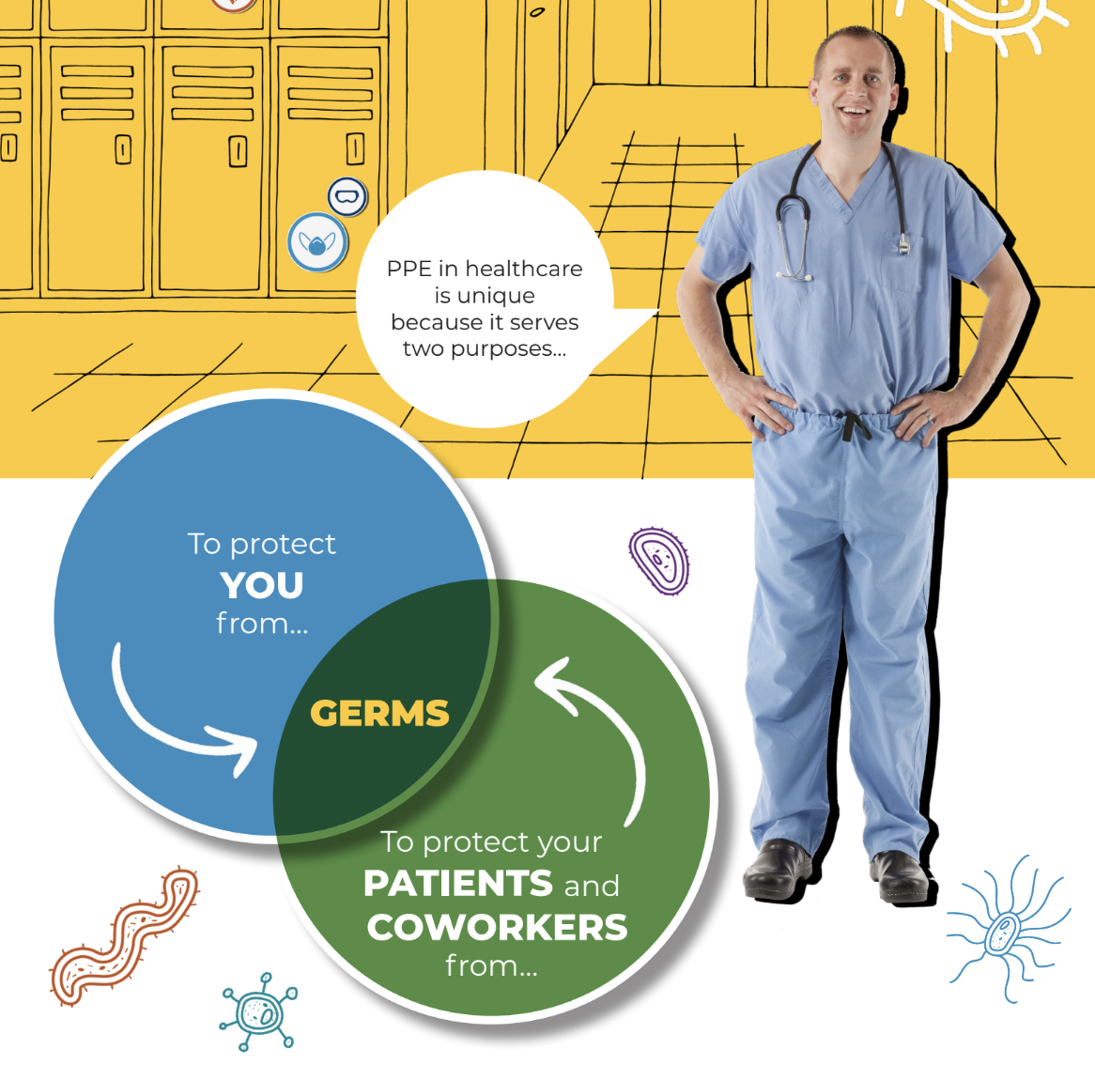
When do you wear PPE throughout the day and how do you choose what to wear?
Notes:
Christa
Ask question and allow time for responses.

Slide 17
Choosing the right PPE
Based on what type of isolation the patient is on - check the signage on the door
Standard Precautions- assess the risk of the activity or task you are about to do
Facility policy
When in doubt - ask your supervisor!
Notes:
Christa
Thank you for those answers. There’s a few in particular I want to highlight.
We know that we need to wear certain PPE when a patient is on isolation. The easiest way to identify what PPE to wear is to review the signage on the door. If your signage does not indicate which PPE to wear, make sure you know your facility policy. It is your responsibility to make sure you have the right PPE on before you enter the room.
Even if you are not entering an isolation room, there may be times where you need to wear certain PPE based on the task you are about to perform. That’s why we always practice standard precautions. Standard Precautions are a common-sense, risk based approach to infection control. It means we assess the risk of what we are about to do and select the right PPE for the task. For example, if you’re about to do an activity that may result in splashes, such as cleaning vomit, you should wear PPE that will protect you from those splashes. This could include a gown, gloves, and possibly eye protection.
Finally, always follow your facility policy and when in doubt, ask your supervisor.

Slide 18
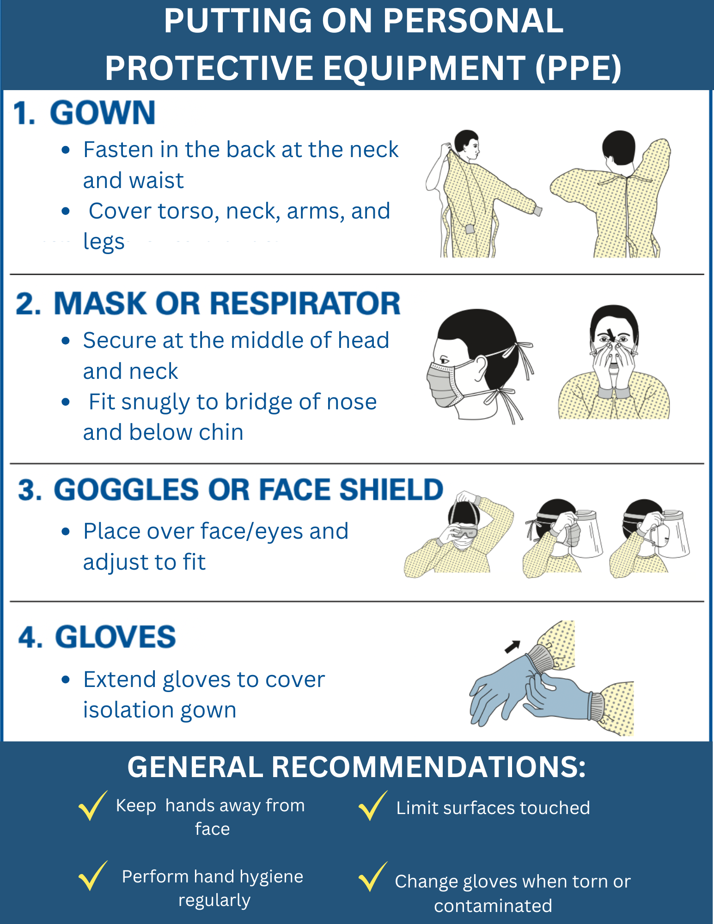
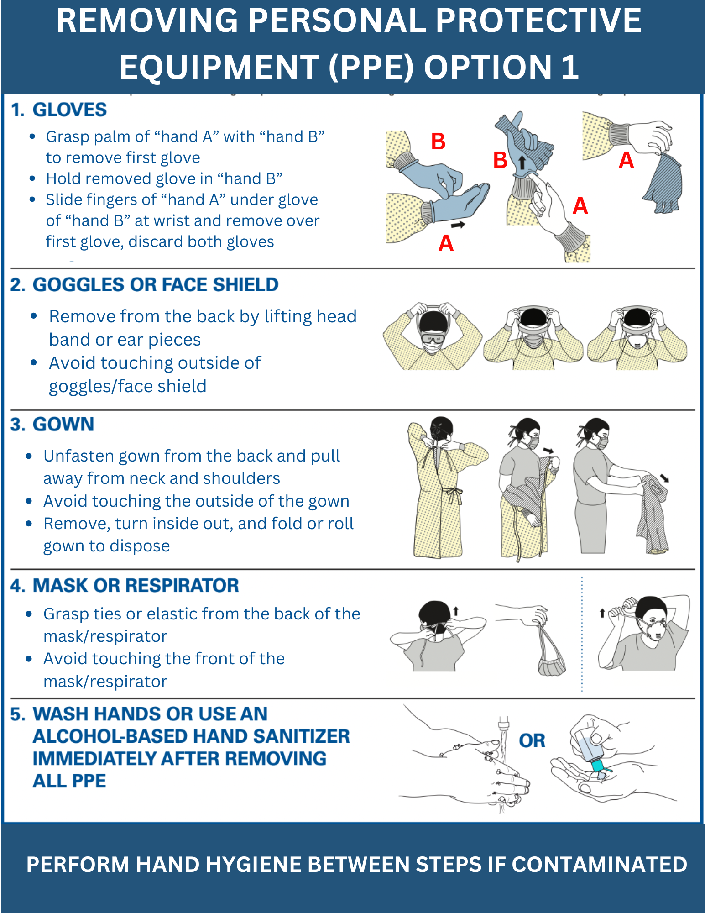
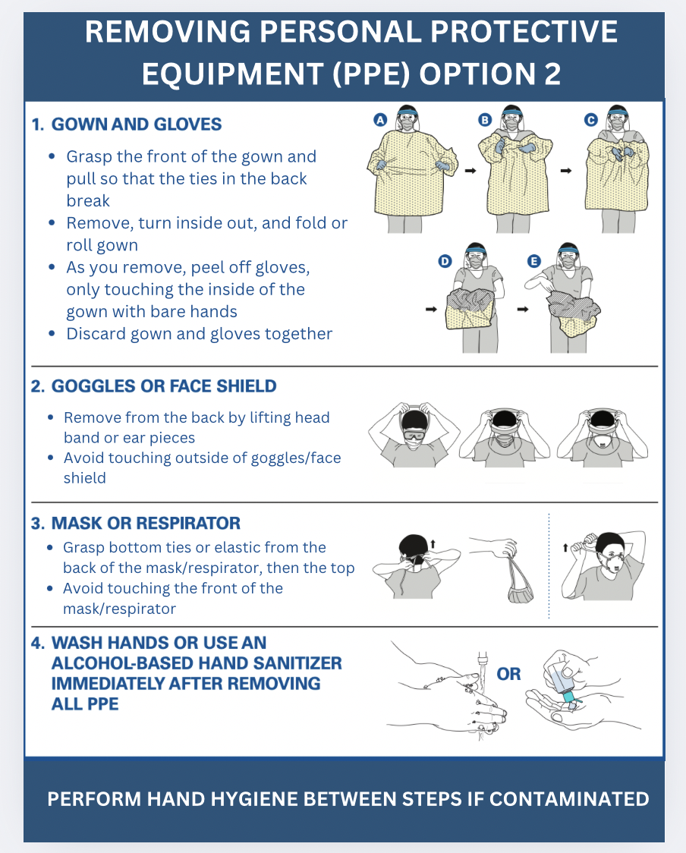
Challenge: Properly Donning and Doffing PPE
Notes:
Christa
Let’s put our PPE skills to the test.
Activity: Ask one staff member to come to the front of the room and practice properly donning and doffing all PPE. The facilitator will guide the participant through each step and the rest of the students can offer feedback and advice.
(Give participants 5 minutes for activity)

Slide 19
Section 3
Hand Hygiene
Notes:
Brett

Slide 20
What is hand hygiene?
 | Hand hygiene refers to the act of cleaning hands and includes the use of water, soaps, or alcohol-based hand sanitizer.
Infectious Agent
Susceptible Host
Reservoir
Germs can be found on the hands or gloves of staff members, on surfaces in the facility and on medical devices.
Portal of Entry
Portal of Exit
One of the main ways germs spread is by touching other people or surfaces and not properly cleaning your hands.
Mode of Transmission
Notes:
Brett
The most common way for germs to spread in the healthcare setting is from hands. Germs can be found on the hands or gloves of staff members, on surfaces in the facility and on medical equipment. One of the main ways germs spread is by touching other people or surfaces and not properly cleaning your hands.
Hand hygiene is the act of cleaning hands and includes the use of water, soaps or alcohol-based hand sanitizer. Hand hygiene is a core infection control practice because it helps break the chain of infection at so many different points.
The skin on your hands can be a reservoir for germs. Performing hand hygiene can remove those germs from your skin and prevent those germs from spreading to surfaces, objects or other people.
Additionally, performing hand hygiene after touching an infected person or a contaminated surface or object can protect you by ensuring that those germs do not make their way into your eyes, nose, mouth, or breaks in your skin that would cause you to become infected.

Slide 21
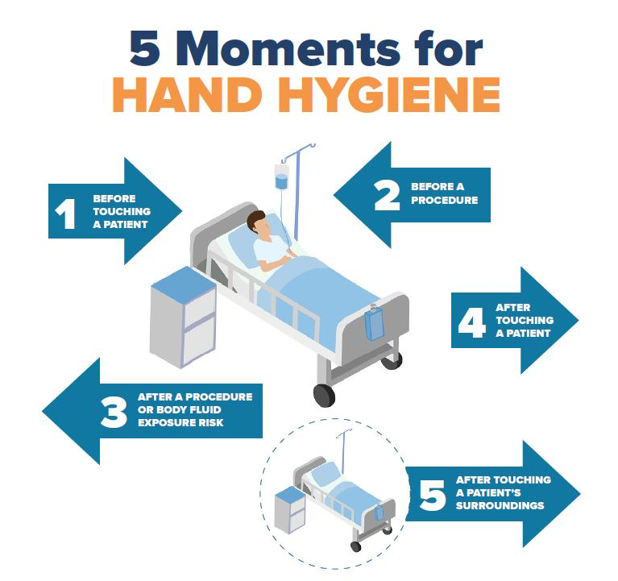
When should I use soap and water to wash for 20 seconds?
If hands are visibly soiled
Before eating
After using the restroom
During the care of patients with known or suspected norovirus or C. difficile
Notes:
Brett
Hand hygiene requires knowing when to perform it - your ability to recognize the risk for germs to spread - and requires that you perform hand hygiene properly.
So let’s break this down - knowing when to perform hand hygiene. Many of the hand washing infographics that we see, including the one on this slide, are specific to clinical staff. We want to highlight the important role that YOU all play in stopping the spread of germs in your facility beyond direct patient care.
Can you share some other moments when you should wash your hands?
(give time for participants to respond)
After using the bathroom
After cleaning up bodily fluids including vomit, feces, etc
After coughing, sneezing, blowing your nose
Before preparing food or feeding someone
Before eating
After handling linens
In between cleaning (room to room)
After touching a high touch surface (door knobs, handrails, light switches, bathrooms)
Before and after cleaning a bathroom
Before and after handling raw foods like chicken, meat, or other poultry or preparing ready to eat foods like salad
Excellent. Now on the topic of performing hand hygiene properly, can anyone tell us how long you are supposed to be washing your hands for?
(give time for participants to respond)
There are also times when should only be washing your hands using soap and water instead of relying on hand sanitizer - what are some of those situations?
Bringing this back to recognizing risks…If you can identify the risks for germs to spread throughout your day to day work, you can take action by implementing infection control practices, like knowing when to perform hand hygiene.

Slide 22

Notes:
Brett
(Give participants 5 minutes for activity)

Slide 23
Section 4
Environmental Cleaning
& Disinfection
Notes:
Brett

Slide 24
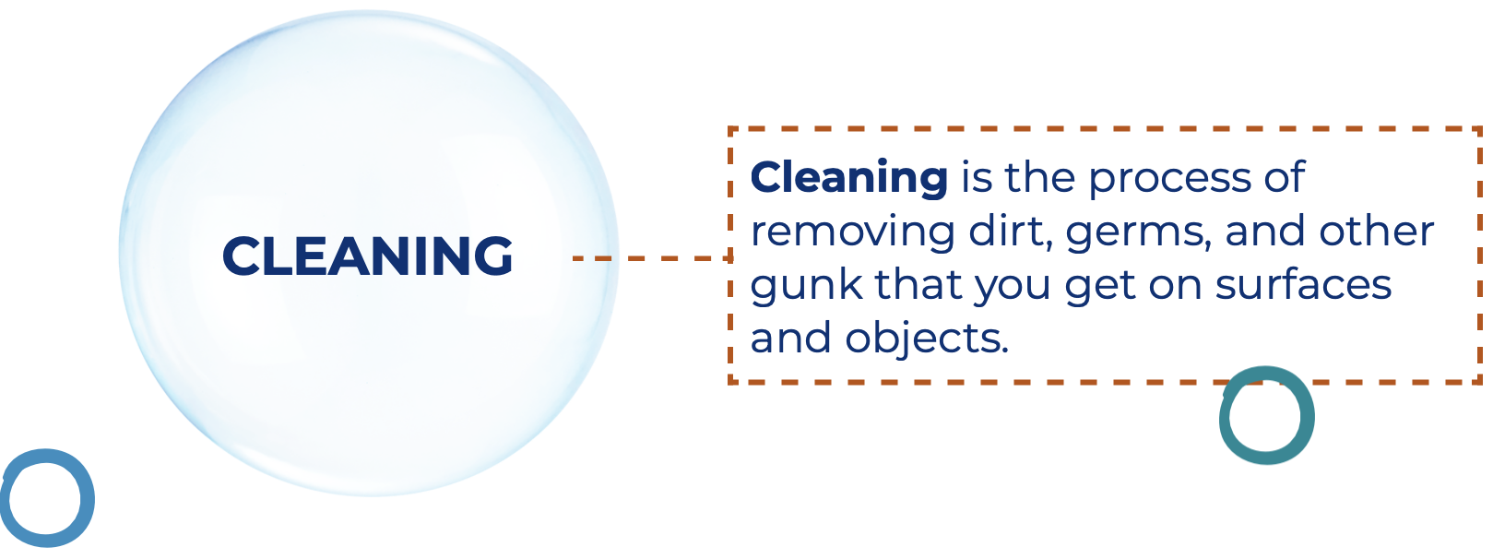
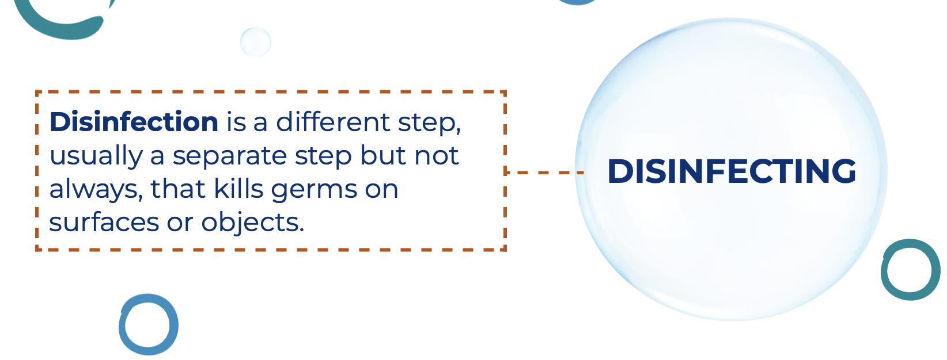
Cleaning & Disinfection
Infectious Agent
Cleaning is a process that removes things like dust, dirt and everyday messes from surfaces.
Susceptible Host
Reservoir
Portal of Entry
Portal of Exit
Disinfection is a process that kills germs.
Mode of Transmission
Notes:
Brett
As we discussed, germs can live everywhere in the healthcare environment. It’s important to keep the healthcare environment clean to stop germs from spreading. We do this by cleaning and disinfecting.
**Read definitions**
Cleaning is a process that removes things like dust, dirt, and everyday messes from surfaces.
Disinfection is a process that kills germs.
Cleaning and disinfection can interrupt our chain of infection by addressing where germs live (reservoir) and how they move or spread from one place to another (mode of transmission).
If a germ lives somewhere in the healthcare environment and we disinfect that environment, we are killing that germ and removing the risk for it spreading.
Additionally, lets say a surface becomes contaminated with germs from an infected resident. If we clean and disinfect that surface properly, we've killed the germs on that surface and removed the risk of them spreading to other areas of the environment or to other residents to staff.

Slide 25

Keeping the healthcare environment clean
How do you know if you are using your cleaning and disinfection products properly?
Notes:
Brett
Cleaning and disinfection is only as useful as using your products properly. If you are not using your products correctly, you are not killing the germs in the environment and and you are not removing the risk for the germs to spread further.
So, how do you if you are using your cleaning and disinfection products properly.
(give time for participants to respond)

Slide 26
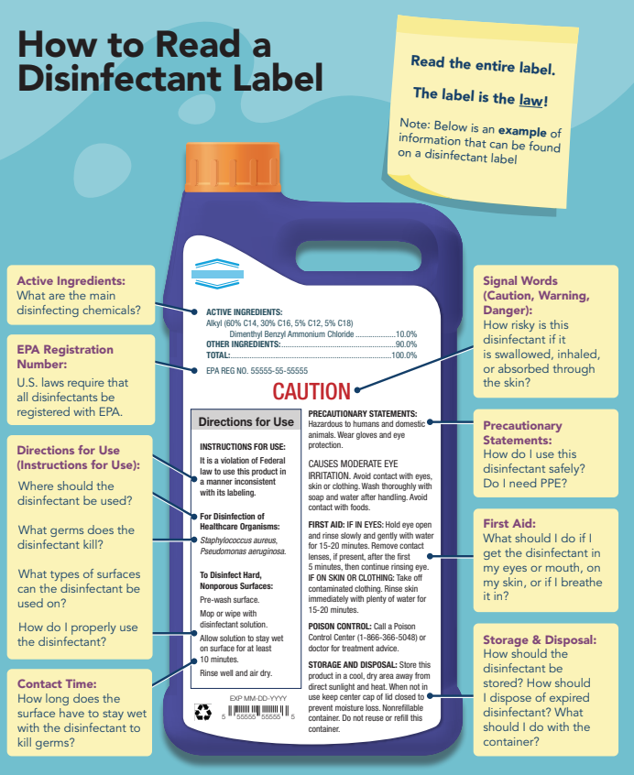
What information do you need from a disinfectant label?
Notes:
Brett
Reading the label is one of the best things you can do when it comes to proper cleaning and disinfection. Some specific points you should pay attention to
Directions for use
how do you use the product
does it need to be diluted
what surfaces can you use it on
what types of germs does it actually kill? Not all disinfectants kill all germs. For example, if you have norovirus spreading through your facility, only certain types of disinfectants are actually going to kill that germ. If you’re not using one of those disinfectants, you’re not going to be able to stop the spread.
Next is contact time
very important to know and we’ll talk about why in a few minutes
You should also see what type of PPE you need to protect yourself when using the product. Make sure you’re using the product in a safe way that doesn’t put you at risk.
Lastly, pay attention to the expiration date on your products to ensure you are not using a product that is already expired.
Your product labels contain a lot of useful information. Considering checking them or asking a supervisor if you have specific questions about a cleaning or disinfecting product!

Slide 27

Contact Time (AKA “dwell time” or “wet time”)
The amount of time a disinfectant needs to sit on a surface, without being wiped away or disturbed to effectively kill germs.
DO
Check your label - it is always product specific and may change based on what germ you are trying to kill
DON’T
Wipe the surface before it’s dry
Do anything to speed up the process like blow on the surface your use a fan
Notes:
Brett
Now before we get into the last activity of the day, let's discuss contact time – also called ‘dwell time’ or ‘wet time’. It is the amount of time a disinfectant needs to sit wet on a surface, without being wiped away or disturbed, to do its job of killing germs.
Contact time varies by product, but it is always specific to the product you’re using and it should be on the label. Sometimes it also varies based on the germ you’re trying to kill. Some germs may require a longer contact time than others so if you’re trying to kill something specific, make sure you’re using the correct contact time.
We never want to rush the disinfection process. The entire contact time has to finish before something that’s been disinfected can be used again. Don’t try to dry a surface that’s been disinfected more quickly by wiping with another cloth, or by blowing it with a fan and definitely never blow on it with your own breath.
If you are not following the contact time for the product you are using, you can consider that surface or whatever it was that you cleaned and disinfected to still be potentially contaminated or dirty.

Slide 28

Interactive Activity - Glo Germ
Notes:
Activity Overview:
Select a piece of shared equipment that is typically used in the facility and apply glo-germ gel to high touch spots on the equipment prior to the training.
Ask for a volunteer to clean the product with the appropriate cleaning wipes or detergent.
Other participants can assist by make suggestions of where to clean or letting the volunteer know if they have missed any areas.
Once the staff member is done, use the black light to identify any areas they have missed.
(Give participants 5 minutes for activity)

Slide 29
Thank You!
Christa Moor, MPH, RN, CIC
Public Health Nurse
Cmoor@twp.freehold.nj.us
Brett Nance, MPH, HO, CIC
Epidemiologist, Assistant Health Officer
Bnance@twp.freehold.nj.us

