Slide 1



STOP THE SPREAD:
Infection Control in Your Hands
Presented by

Slide 2
Agenda
Welcome!
Welcome and Introductions
Infection Control Presentation
Recognizing Risk
Personal Protective Equipment
Hand Hygiene
Cleaning and Disinfection
Notes:
Hello everyone! My name is ____. We are from the Freehold Area Health Department. We are the local health department that serves this facility.
We are very excited to bring you our new infection control training series; STOP THE SPREAD: Infection Control in Your Hands. This training is specifically geared towards non-clinical staff working in long term care or assisted living facilities.
There are two objectives for today’s presentation. The first is to learn where the risks exist for germs to spread. The second is to empower you to take the right infection prevention actions to remove or reduce those risks and keep everyone healthy.
The training is broken up into four sections and we will have three interactive activities. We encourage you to ask questions, share experiences, and actively participate.
Here is our agenda for the next hour. We will start by discussing recognizing risks in healthcare settings including where germs live and how they spread. We will then review three tools in our infection control toolbox: PPE, hand hygiene, and cleaning and disinfection.

Slide 3
Section 1
Recognizing Risk
Notes:
Before we talk about recognizing risk, let’s take a moment to talk about what a risk actually is. Can any of you think of a time when you spotted a risk at work or at home and took action to stop something bad from happening?
(Allow time for audience responses.)

Slide 4
Risk Recognition:
Seeing the potential for a problem to happen
Seeing a potential problem doesn’t mean the problem will definitely happen!
We take action to keep something bad from happening.
Notes:
A simple definition of risk recognition is ‘seeing the potential for a problem to happen.’ But seeing it doesn’t mean it has to happen. You all had examples of seeing a potential problem and doing something to stop it from becoming a real problem – and that’s important. You recognize risk, and you act on it!

Slide 5
Risks of Germs in Healthcare
Higher chance residents will have an infection
Residents likely to be more vulnerable to infection
Things we do as part of care can put people at risk of infection
The work we do presents many opportunities for germs to spread
Notes:
When we think about germs spreading in healthcare, it's helpful to remember what makes healthcare a unique setting for germs to spread.
Why do we think about germs and their risks differently in facilities like this than in other places like in our home or out in the community?
The residents in this facility are here to receive care, and there is a higher chance that they may already have an infection.
Many of the residents in long-term care facilities can be ill, weak, or elderly. They are going to be more vulnerable to or at risk for infection.
There are things done as part of resident care that can put people at risk of infection.
The work that we do in these types of facilities also bring opportunity for germs to spread. Examples include close interaction with residents, shared equipment, common areas and high touch surfaces.
This is why infection control is so important in these types of settings.

Slide 6
Where is the risk for germs to spread in healthcare?
Notes:
We’ve talked about recognizing risk in general, and about higher risks for germs to spread in healthcare. Now let’s work together to identify exactly where and why these risks exist in the healthcare setting.

Slide 7
Reservoirs
A place where germs live and thrive
2 Types
  Environment
  Body
Notes:
For us to be able to recognize the risk of germs spreading and be able to stop it, we first need to know where germs live.
Reservoirs are the places where germs can live and thrive. They are also the places that germs can spread from to cause infection. There are two types of reservoirs, or two general locations where germs can survive, in the environment or in the body. Body can refer to your residents as well as healthcare workers or anyone else in the facility.
Does anyone have any ideas of where germs might live in the healthcare environment or in the body?

Slide 8
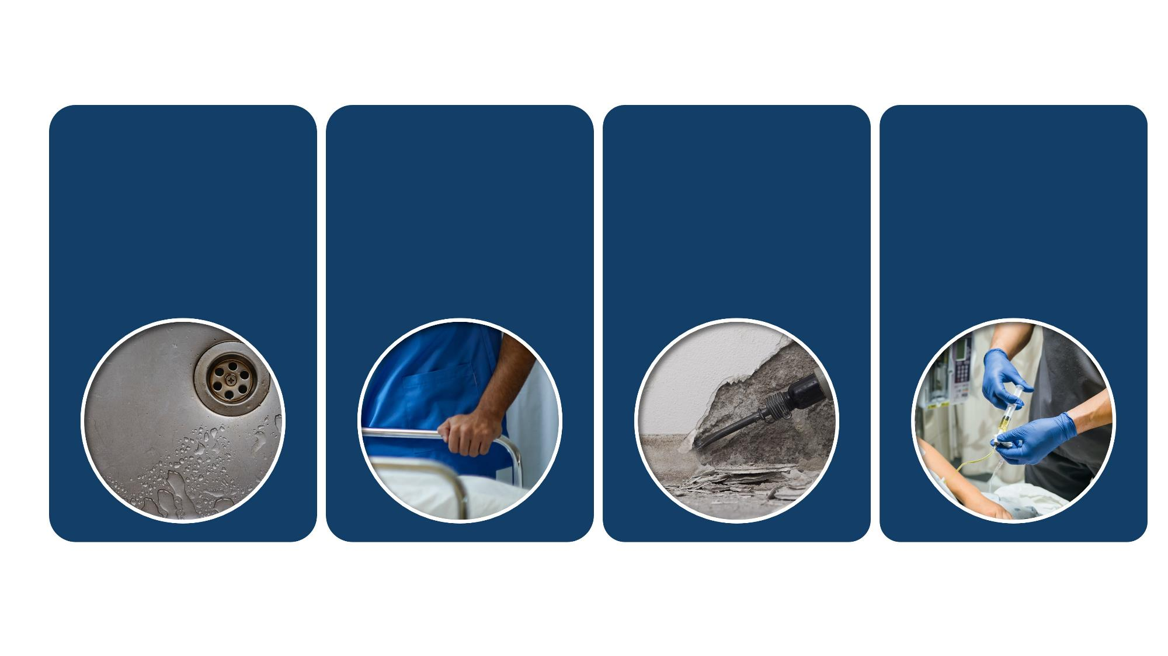
Reservoirs in the Healthcare Environment
Dry Surfaces
Bed rails
Door handles
Countertops
Bed curtains
Dirt and Dust
Construction
Maintenance
Repair
Renovation
Devices
Stethoscope
Blood pressure cuff
Glucometer
Pulse Oximeter
Water and
Wet Surfaces
Sinks and faucets
Drains
Ice machines
Pools
Notes:
There are four main reservoirs - or four main places where germs live in the environment of healthcare settings: water and wet surfaces; dry surfaces; dirt and dust, and devices
In terms of water and wet surfaces, germs can live in sinks and faucets, drains, ice machines, and pools. This also includes anywhere that water accumulates, like when water splashed around the sink after people use it.
Dry surfaces are all around us in the healthcare setting, and can include “high touch surfaces” like bed rails and door handles, or things that aren’t touched as often like countertops and bed curtains.
Germs can also live in dirt and dust from things like major construction, general maintenance, minor repairs, or renovation.
Last but not least, medical devices can harbor germs. Some common devices that you might see in this type of setting include stethoscopes, blood pressure cuffs, glucometers, and pulse oximeters.
Now, these are not the only places where you can find germs in the healthcare environment, but these some of the main areas that we will focus on today.

Slide 9
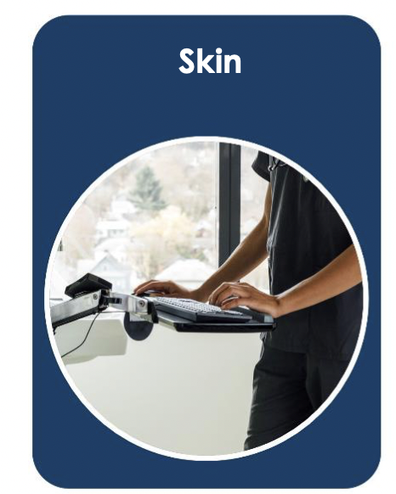
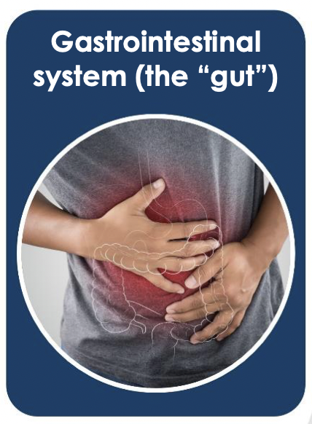
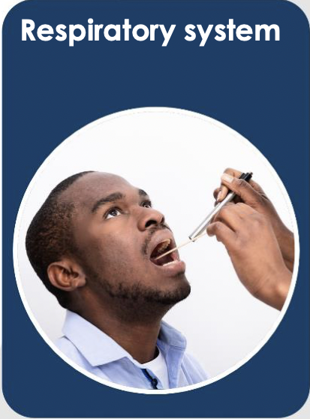
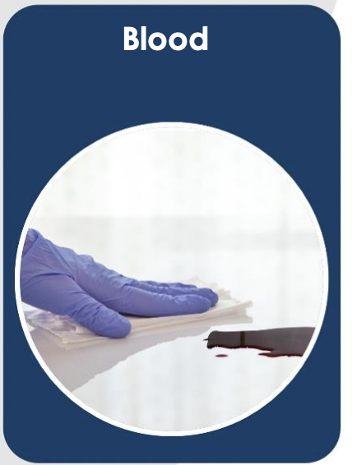
Reservoirs in the Body
Gastrointestinal
system (the “gut”)
Respiratory system
Blood
Notes:
In addition to germs living in the environment, they can also live in and on the body.
There are four main reservoirs - or four main places where germs live in and on the body: the skin, gut, respiratory system and blood.
Skin, especially hands, carry many germs and spread them easily.
Germs on skin can spread to other people, surfaces, and shared items.
This is why hand hygiene is such an important step of infection control, which we will discuss later.
The gut is filled with bacteria. Most germs in our gut do not cause problems in healthy people but can cause infection when spread among people with weak immune systems.
Germs found in residents stool (poop) can spread to our hands, surfaces, or other people during activities like direct patient care or cleaning a bathroom.
If proper hand hygiene or cleaning and disinfection is not done, these germs can spread further.
Germs can live in our respiratory system, like our nose, throat and lungs.
When an infected person talks, breaths, sneezes or coughs, their respiratory droplets can spread these germs
Germs can also live in our blood and spread when blood from an infected person gets onto a sharp item or device.
For example, reusing needles or not cleaning and disinfecting multi use medical devices like glucometers can cause germs to spread.
Knowing where germs live can help you recognize the risk for them to spread. It also helps you understand why infection control actions work to stop germs from spreading and making people sick.

Slide 10
How Germs Spread and Make People Sick
Notes:
Now that we know where germs live, let’s talk about how they spread and make people sick.

Slide 11
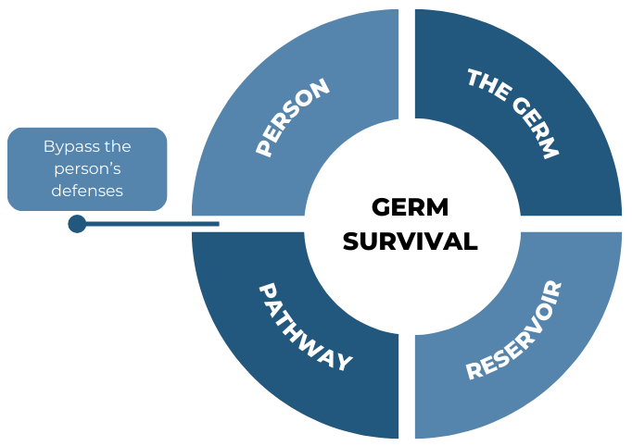
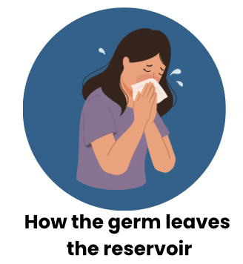
How Germs Make People Sick
Portal of Exit
Notes:
Germs are everywhere, but there are several things that have to happen for them to actually infect a person and cause illness.
Germs survive in reservoirs. Like we just learned, a reservoir can be in the body like in the respiratory tract or the blood. Or it can be in the environment, like in water or on a surface.
That germ needs a pathway- or a way to exit the reservoir it’s living in and travel to a person. In order to infect that person, the germ needs to bypass their natural defenses. For example, a germ on intact skin will be unable to infect a person. But if that person has a wound on their skin, that’s an entry point where the germ can get around the body’s normal defenses and cause infection. People who are older or have other health conditions are more at risk of infection because their body’s natural defenses are generally not as strong.
The common ways that a germ can spread include through touch, when they’re breathed in, through splashes or sprays, or through clinical care tasks that break down body’s defenses, such as putting an IV in which breaks the skin.
The good news is that because so many steps have to happen for that germ to infect someone else, it gives us lots of opportunities to stop the spread of germs and prevent infection.

Slide 12
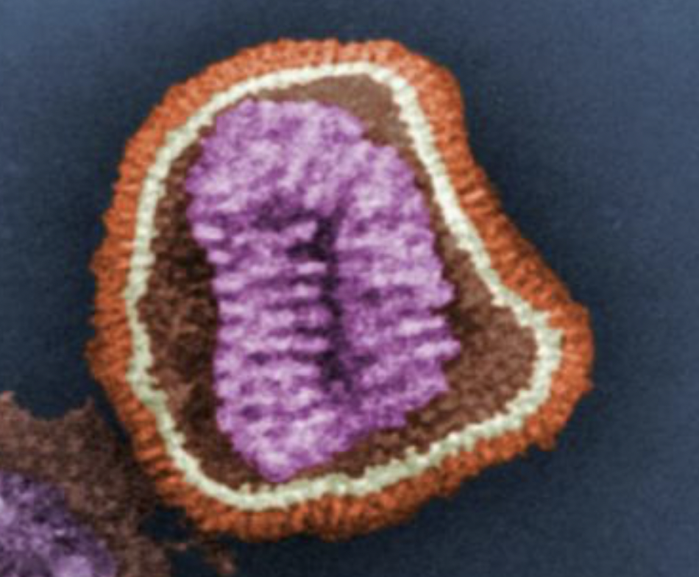
How Germs Spread and Make People Sick Example
Example Scenario - Flu virus
Germ
Reservoir
Pathway
Person & their body’s defenses
Respiratory system of the sick staff member
The sick staff member coughs or sneezes and the germs get onto the patient’s bed rail.
The patient touches the bed rail and then touches their eye, bypassing the body’s defenses.
Influenza
Notes:
Let’s go through an example of how a germ may actually spread in your facility. If we understand how a germ spreads, we can understand where the risk exists and take steps to prevent that spread from happening.
For this example, we’ll talk about the flu virus. Let’s imagine we have a healthcare worker who has the flu. Maybe their symptoms are very mild so they don’t realize they are sick. Or maybe they’re out of sick days so they chose to come to work when they were not feeling well.
In this example, the flu virus is our germ and the reservoir is the respiratory system of the sick staff member.
If that staff member coughs or sneezes, they have just created a pathway for those germs to exit their respiratory system in the form of respiratory droplets. Those droplets may land on something nearby, like the resident’s bed rail. If that resident touches the bed rail and then touches their eye, the germs bypass the body’s natural defenses and can make the resident sick with the flu.
In this example, what are some specific infection control steps that we could take to prevent the resident from getting sick? (allow audience to answer)
Potential answers-
Sick employee could have stayed home (review time off policies, staff education)
Sick employee could have worn a mask (PPE)
The bedrail could have been cleaned and disinfected prior to the resident touching it (cleaning and disinfection)
The resident could have washed their hands after touching the rail but before touching their eye (hand hygiene)
The employee could have gotten vaccinated and would have been less likely to get sick with flu (vaccination)

Slide 13
Key Takeaways
Risk recognition is seeing the potential for a problem to happen.
When you understand where germs live and how they spread to cause infection, you can recognize the risk for it to happen.
When you recognize the risks for germs to spread, you can choose the right infection control actions to keep it from happening.
Notes:
Great work. So we’ve reviewed how to recognize risks, how germs spread from the reservoirs where they live and thrive, and now we’ve started to talk about some of the infection prevention steps we take in our jobs to reduce the risk of spreading germs.
Now we’re going to take some time to dive deeper into a few of those infection prevention actions.
One important thing to remember as we talk about infection prevention actions is that they all have to happen together to truly protect you and your patients. Germs are sneaky. We want to stop the potential spread of germs at as many points as possible to make sure people don’t get sick.
We also want to make sure we’re taking these infection prevention actions all the time because the risk for infection always exists in the healthcare setting. These actions become even more important when there is an outbreak in your facility or someone is already sick. But, if we consistently engage in these practices everyday we can prevent illness from occurring and that really is our ultimate goal.

Slide 14
Section 2
Personal Protective Equipment (PPE)
Notes:
The first infection control topic we are going to highlight is Personal Protective Equipment or PPE.
We all wear PPE everyday throughout the course of our jobs because it reduces the risk of spreading germs. But let’s talk more about why we wear it and considerations we have to take into account to make sure it’s working the way it’s supposed to.

Slide 15
Personal Protective Equipment
PPE: equipment worn to minimize exposure to a variety of hazards
Protects you and your patient
PPE doesn’t have a brain!
Notes:
Personal protective equipment, or PPE, is equipment you wear to minimize your exposure to different risks. It offers protection to both the person who wears it and the people around you, specifically your residents.
PPE is actually one of the least effective infection control tools we have for a few reasons. First, it doesn’t actually remove the risk. It doesn’t remove the germ from the environment, it just provides a layer of protection between you and the germ. So the risk still exists, but PPE helps minimize risk. Second, it doesn’t have a brain. PPE only works when used correctly and that relies on you doing all of the right things.
PPE stops the spread of germs at multiple points. Let’s think about the flu germ. We can prevent flu germs from exiting a sick person’s respiratory tract by putting a mask on them. That removes the pathway for them to exit the reservoir. When a non-sick person wears a mask, it prevents germs from bypassing that person’s defenses and entering their nose or mouth.

Slide 16
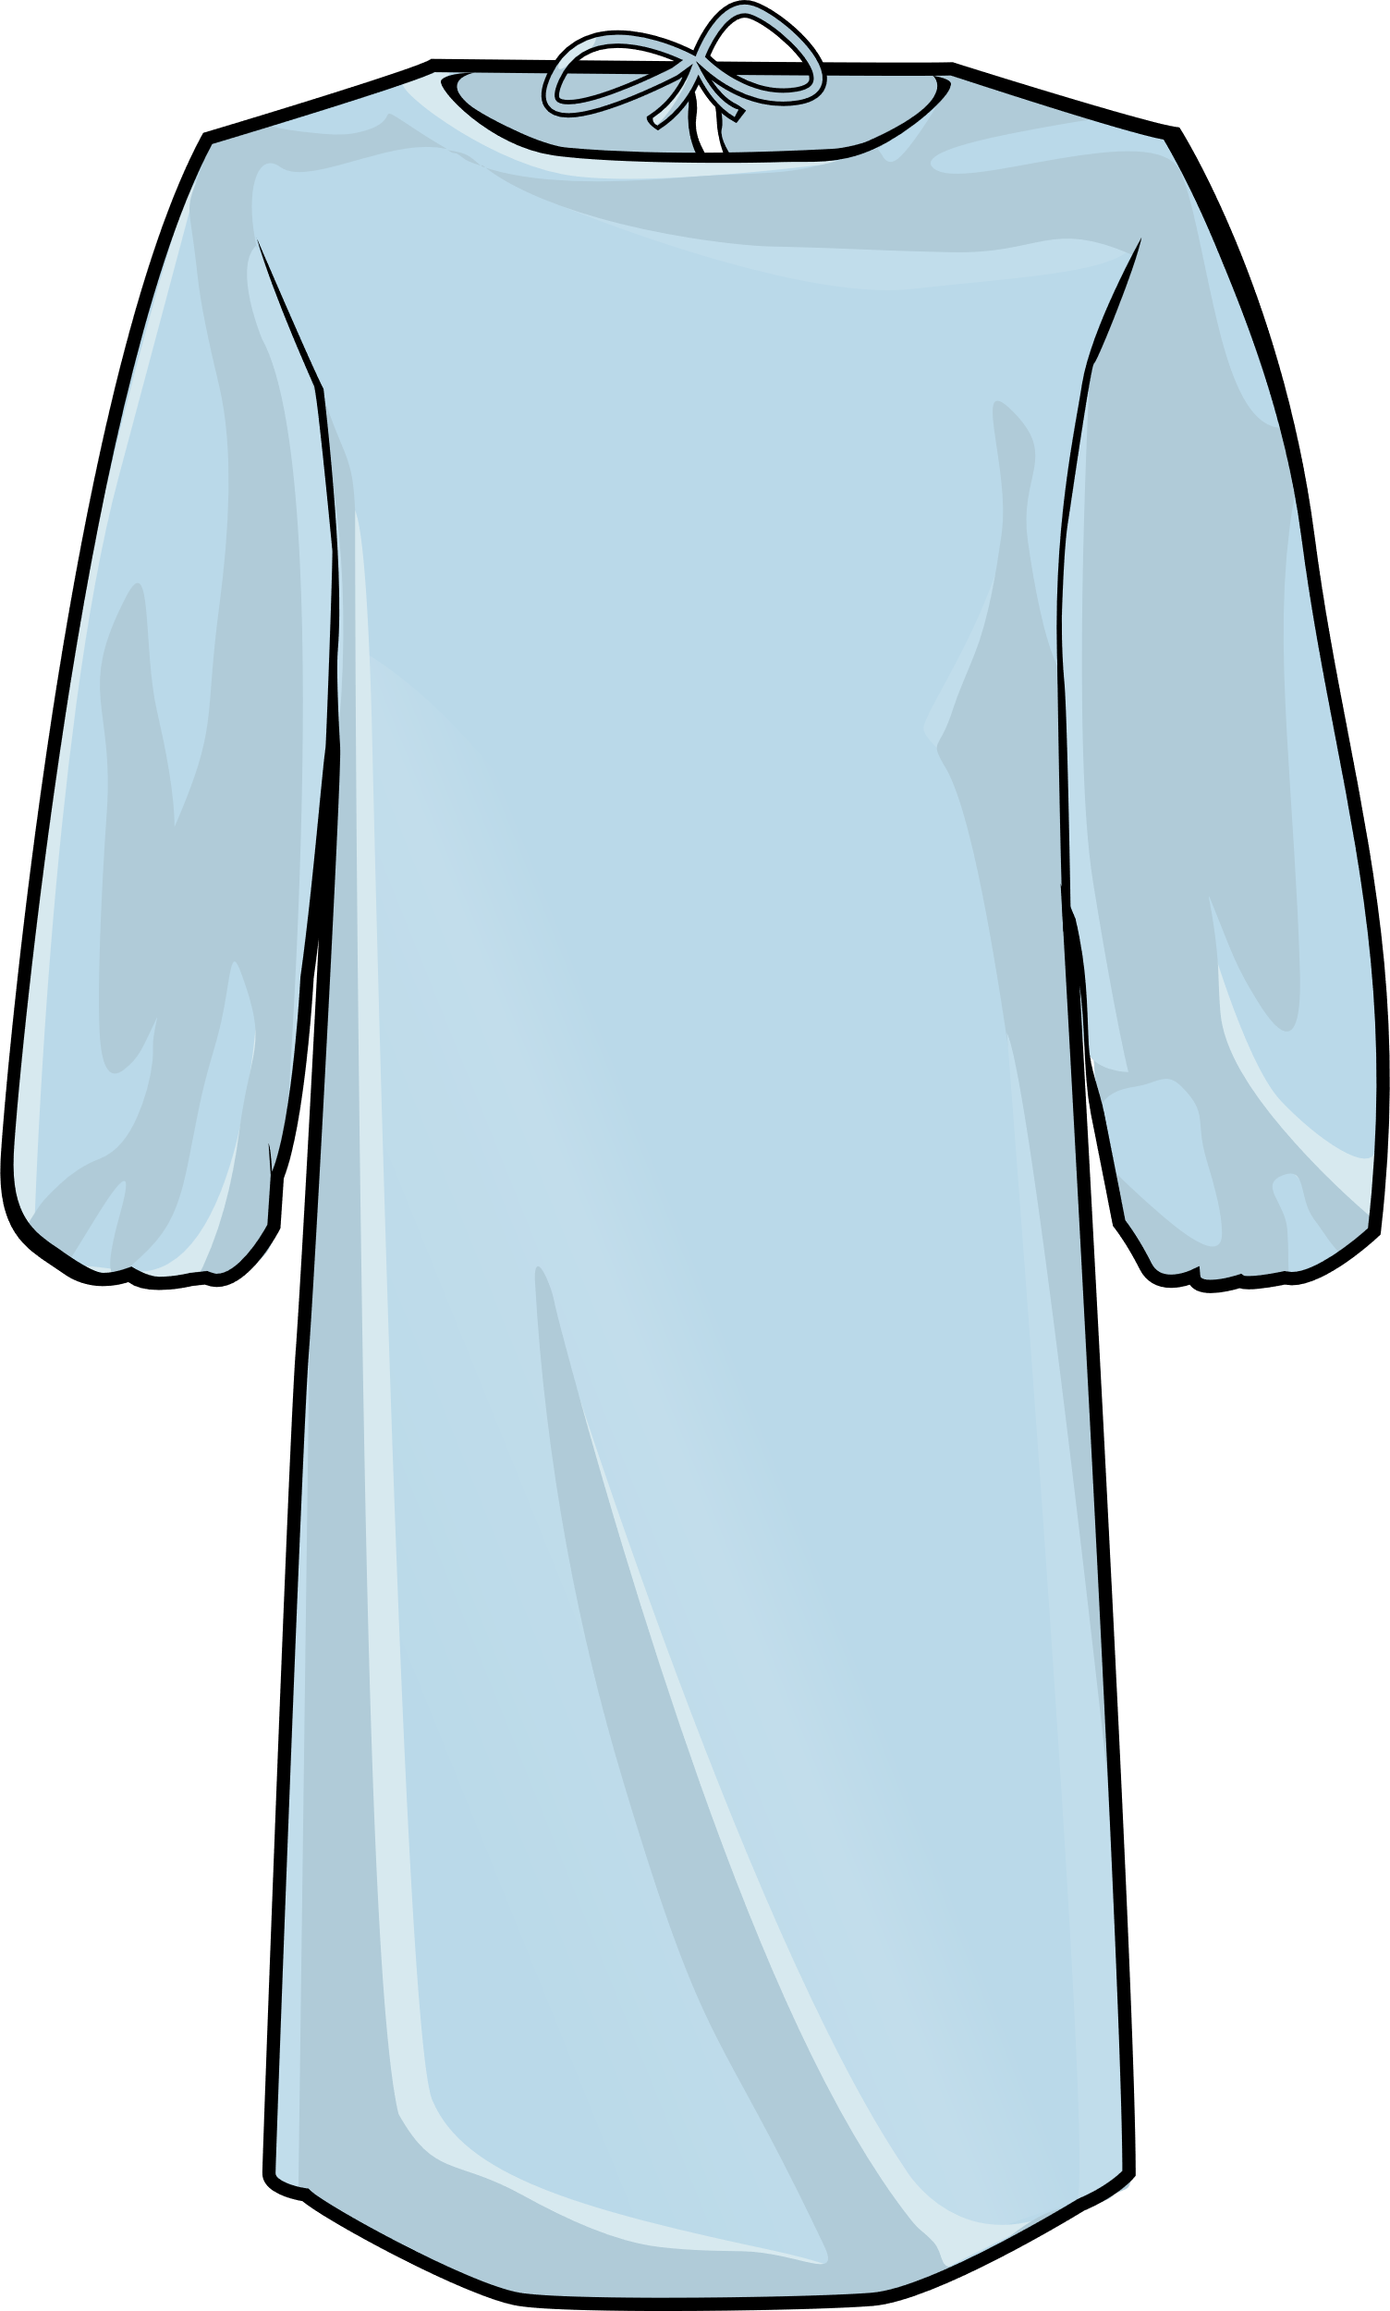

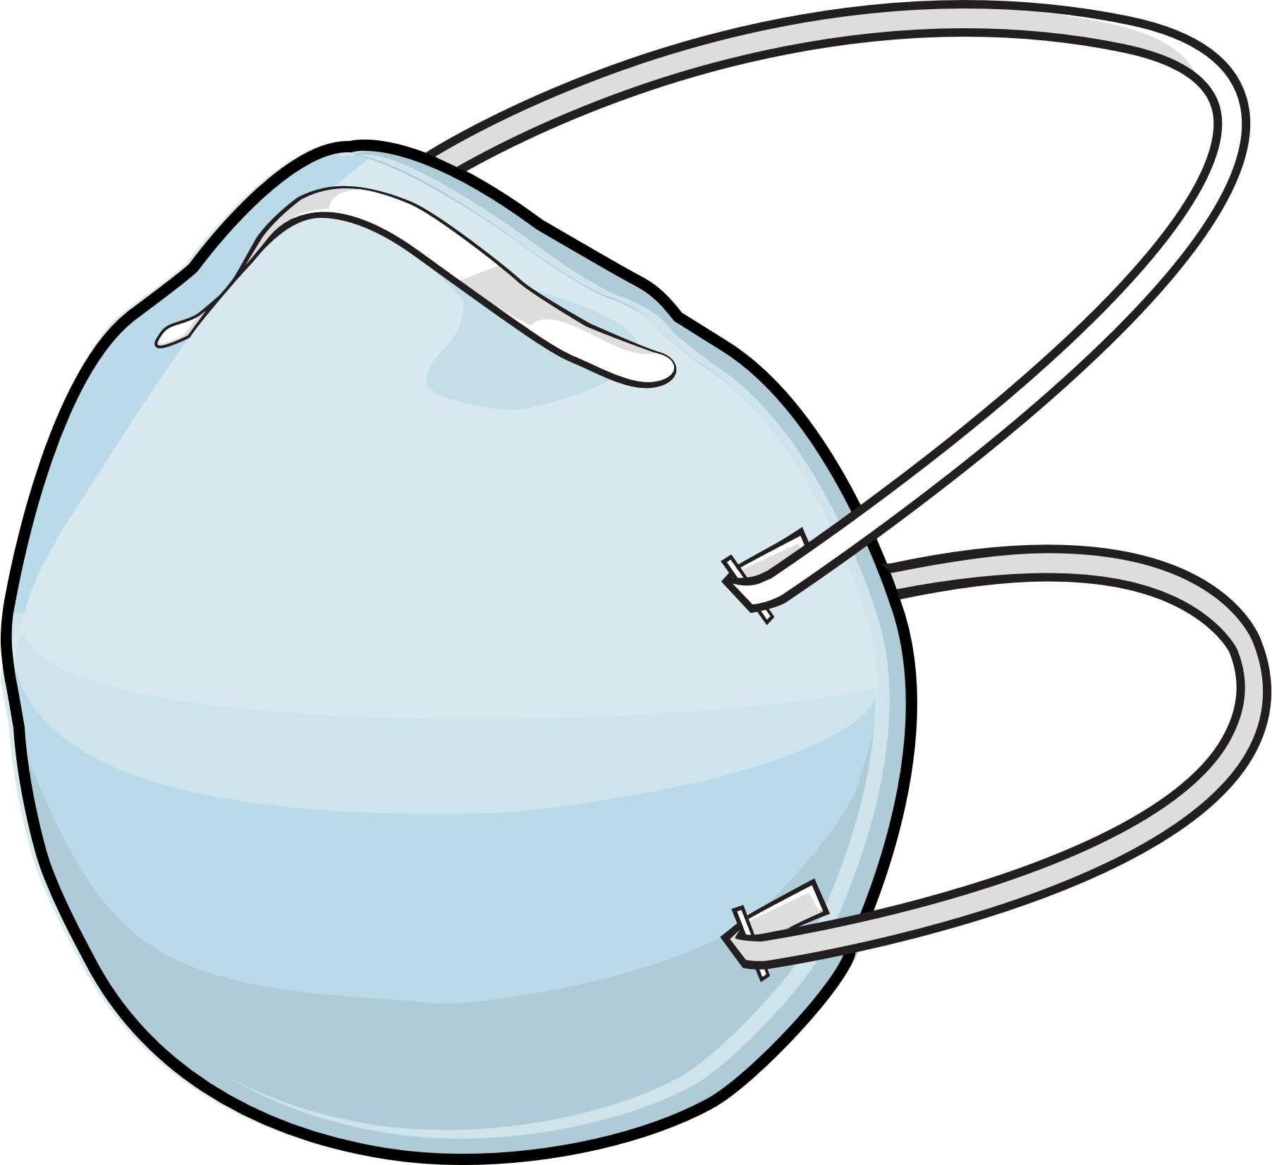
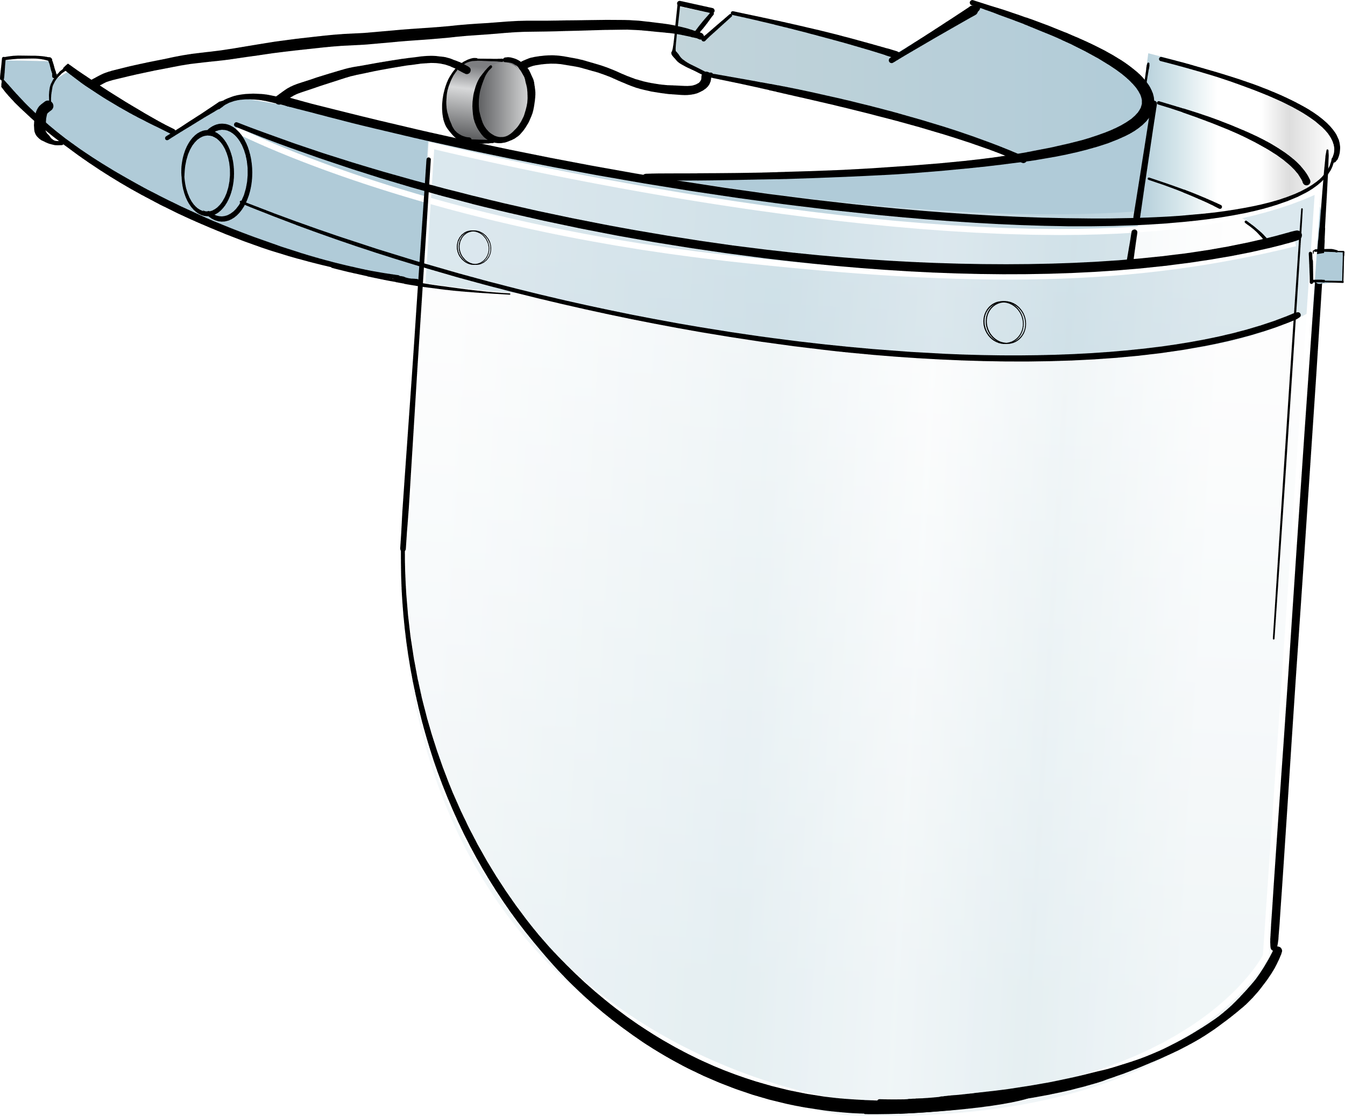

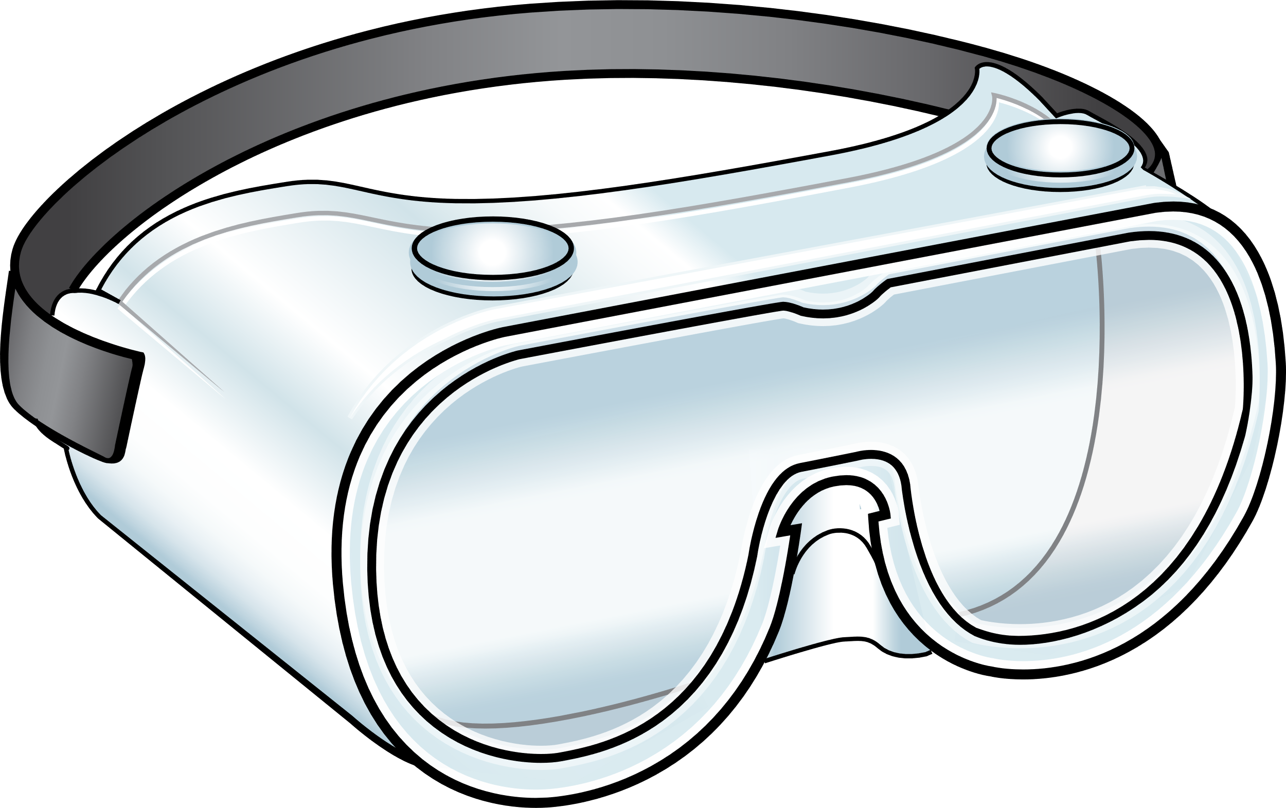
Type of PPE | How it Protects You | How it Protects the Patient
Gloves and Gowns | Prevents germs from getting on your hands, skin, or clothing | Get thrown out after use so the germs are not carried to the next patient
Mask or Respirator | Prevents you from breathing in germs | Prevents you from exhaling your own germs onto the patient
Eye Protection | Prevents germs from getting into your eyes (and potentially your respiratory tract) | Prevents you from touching your eye and spreading germs
Notes:
These are the most common types of PPE you’re going to use in a healthcare setting.
Gloves and gowns prevent germs from getting directly on your hands, skin or clothing. They protect the patient because when you dispose of those gloves and gowns before you leave the room, you leave those germs behind. That’s why they must be changed in between patients. We also need to change them when they become contaminated, even it we are still interacting with the same patient.
Masks or respirators like N95’s offer protection for your respiratory tract because they prevent you from breathing in germs. They also prevent you from exhaling your own germs onto the patient.
Just like the name implies, eye protection prevents germs from getting into your eyes. This is important because if germs get into your eyes they can cause an eye infection, but they can also get into your respiratory tract through your tear ducts and potentially cause a respiratory infection. This is why we wear eye protection for respiratory illnesses like flu and COVID. Eye protection also prevents you from touching your eyes while caring for a patient and potentially spreading your own germs.

Slide 17
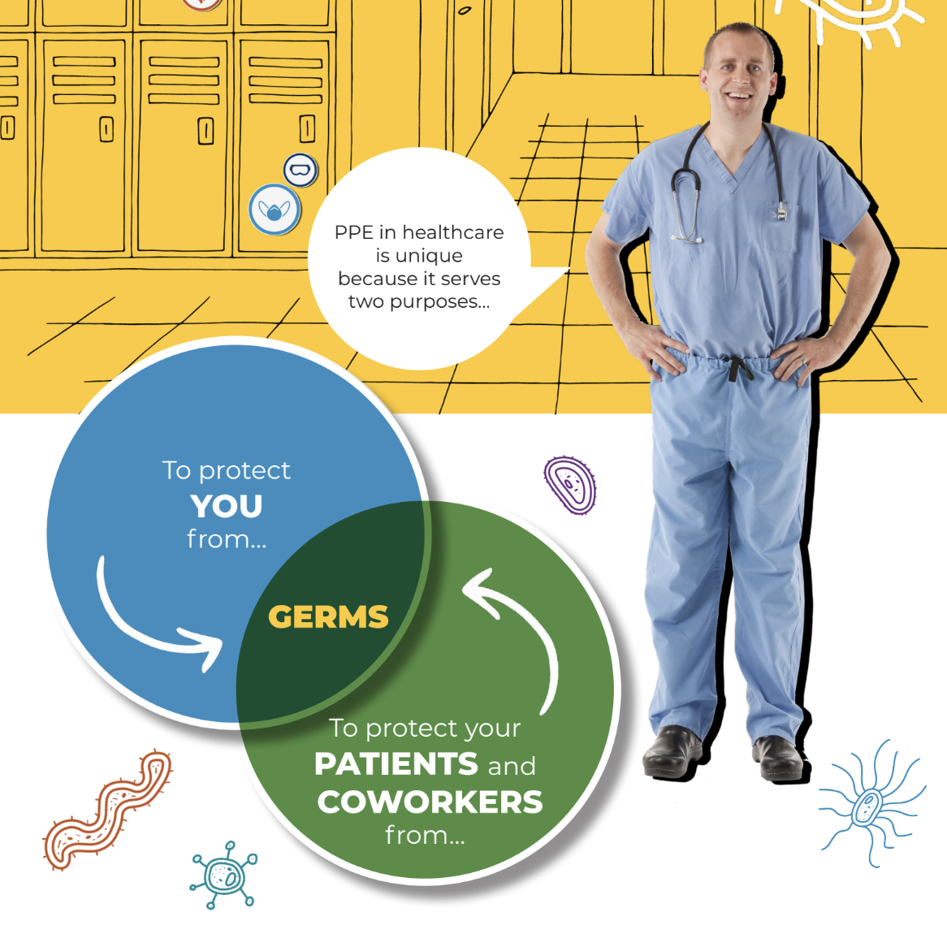
When do you wear PPE throughout the day and how do you choose what to wear?
Notes:
Ask question and allow time for responses.

Slide 18
Choosing the right PPE
Standard Precautions - assess the risk of the activity or task you are about to do
Based on what type of isolation the patient is on - check the signage on the door
Facility policy
When in doubt - ask your supervisor!
Notes:
Thank you for those answers. There’s a few in particular I want to highlight.
Even if you are not entering an isolation room, there may be times where you need to wear certain PPE based on the task you are about to perform. That’s why we always practice standard precautions. Standard Precautions is a common-sense, risk based approach to infection control. When we apply standard precautions to PPE use, it means we assess the risk of what we are about to do and select the right PPE for the task. For example, if you’re about to do an activity that may result in splashes, such as cleaning vomit, you should wear PPE that will protect you from those splashes. This could include a gown, gloves, and possibly eye protection.
We know that we need to wear certain PPE when a patient is on isolation. This is sometimes called transmission based precautions. The easiest way to identify what PPE to wear is to review the signage on the door. If your signage does not indicate which PPE to wear, make sure you know your facility policy. It is your responsibility to make sure you have the right PPE on before you enter the room.
Finally, always follow your facility policy and when in doubt, ask your supervisor.

Slide 19
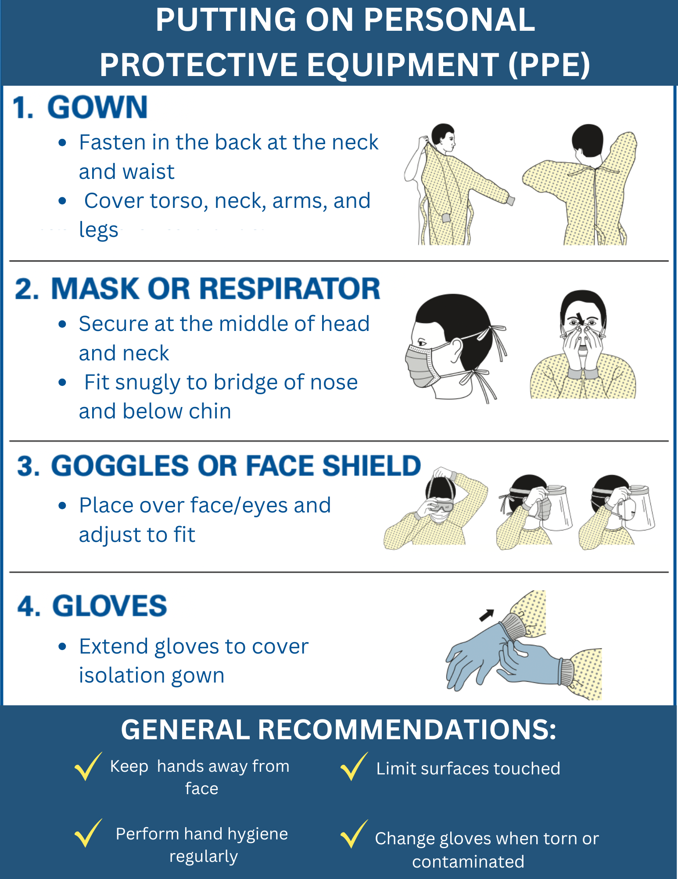
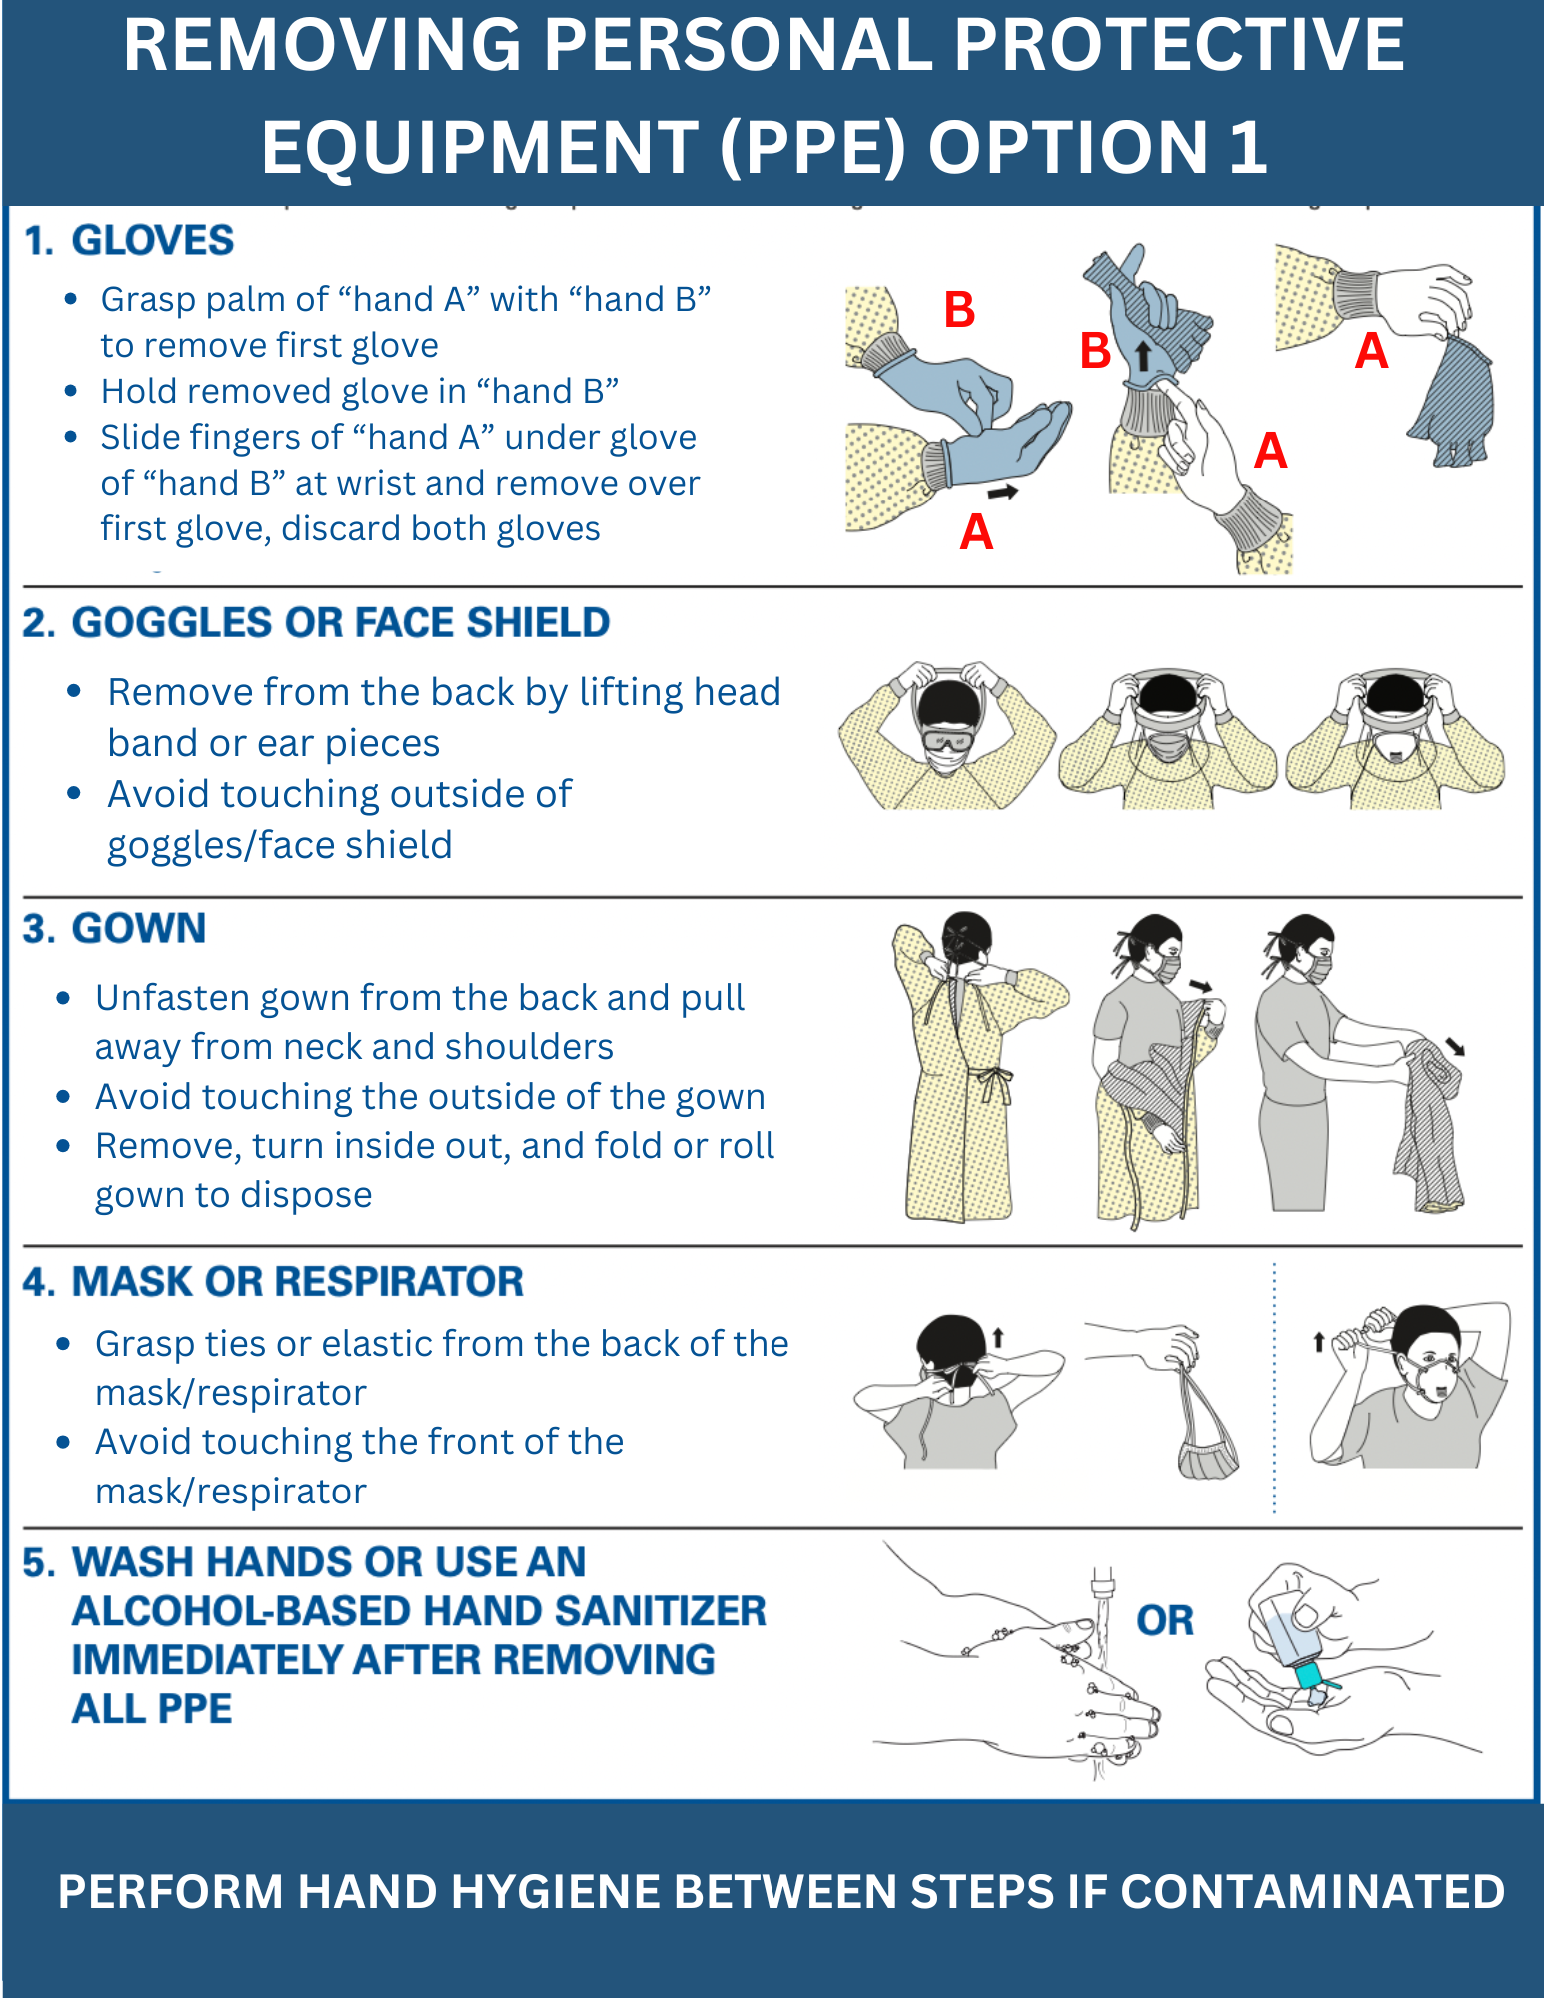
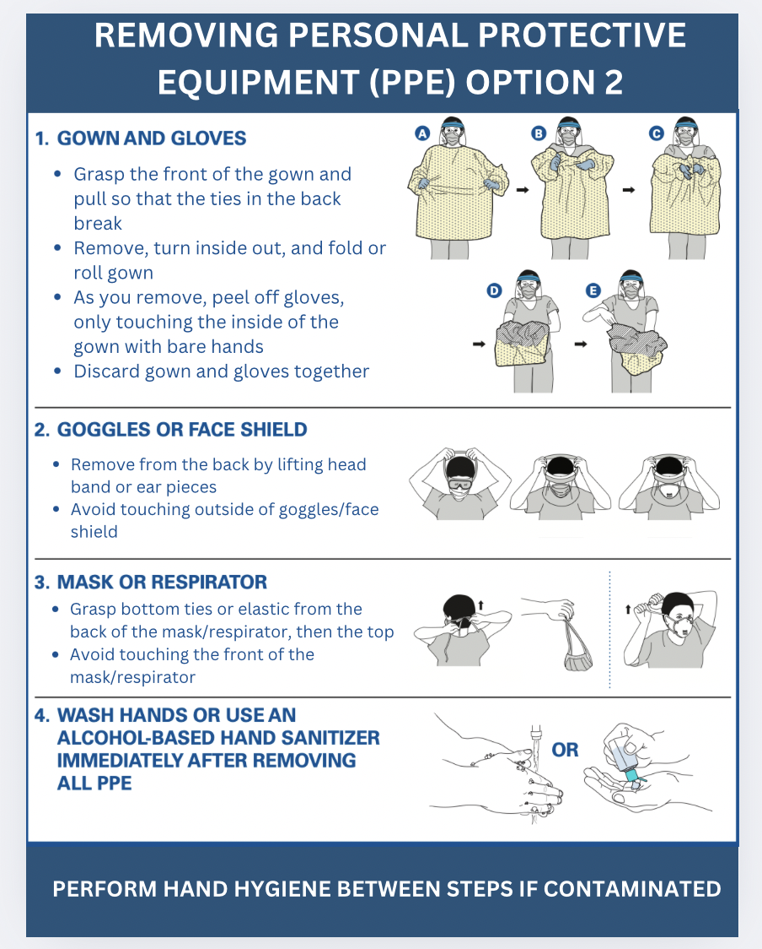
Interactive Activity: Donning and Doffing PPE
Notes:
Let’s put our PPE skills to the test.
Activity Overview:
Ask one staff member to come to the front of the room and practice properly donning and doffing all PPE.
The facilitator will guide the participant through each step and the rest of the students can offer feedback and advice.
Some key points to review during the activity:
PPE relies on you to do all the right things. Select the right PPE, put it on correctly, wear it correctly, take it off correctly, and perform the right actions when there’s a breach in your PPE.
Hand washing should occur both before putting on PPE and after removing it.
If at any point there is a breach in your PPE while doffing, stop and perform hand hygiene
When doffing PPE, remember that the front is contaminated. Once gloves are removed, only touch the non-contaminated portions of the PPE.
(Give participants 5 minutes for activity)

Slide 20
Section 3
Hand Hygiene

Slide 21
What is hand hygiene?
  Hand hygiene refers to the act of cleaning hands and includes the use of water, soaps, or alcohol-based hand sanitizer.
Reservoir
Germs can be found on the hands or gloves of staff members, on surfaces in the facility and on medical devices.
One of the main ways germs spread is by touching other people or surfaces and not properly washing cleaning your hands.
Notes:
The most common way for germs to spread in the healthcare setting is from hands. Germs can be found on the hands or gloves of staff members, on surfaces in the facility and on medical equipment. One of the main ways germs spread is by touching other people or surfaces and not properly cleaning your hands.
Hand hygiene is the act of cleaning hands and includes the use of water, soaps or alcohol-based hand sanitizer. Hand hygiene is a core infection control practice because it helps stop the spread at so many different points.
The skin on your hands can be a reservoir for germs. Performing hand hygiene can remove those germs from your skin and prevent those germs from spreading to surfaces, objects or other people.
Additionally, performing hand hygiene after touching an infected person or a contaminated surface or object can protect you by ensuring that those germs do not make their way into your eyes, nose, mouth, or breaks in your skin that would cause you to become infected.

Slide 22
When to clean your hands
When should I use soap and water to wash for 20 seconds?
Immediately before touching a patient
Before an aseptic task (e.g., handling an invasive medical device)
After contact with blood, body fluids, or contaminated surfaces
After touching a patient
After touching the patient environment
Before moving from work on a soiled body site to a clean body site on the same patient
Immediately after glove removal
If hands are visibly soiled
Before eating
After using the restroom
During the care of patients with known or suspected norovirus or C. difficile
ABHS is preferred over soap & water in most clinical situations
Notes:
Hand hygiene requires knowing when to perform it - your ability to recognize the risk for germs to spread - and requires that you perform it properly.
CLICK
So let’s break this down - this is a list of times when you should be cleaning your hands with alcohol based hand sanitizer.
Think about the tasks that you do throughout your entire workday. When are some specific times that you clean your hand throughout your day?
(give time for participants to respond)
After using the bathroom
After cleaning up bodily fluids including vomit, feces, etc
After coughing, sneezing, blowing your nose
Before preparing food or feeding someone
Before eating
After handling linens
In between cleaning (room to room)
After touching a high touch surface (door knobs, handrails, light switches, bathrooms)
Before and after cleaning a bathroom
Before and after handling raw foods like chicken, meat, or other poultry or preparing ready to eat foods like salad
It’s important to note that ABHS is preferred over soap and water in most situations. There are several situation in which hand washing with soap & water is preferred and we’ll talk about that on the next slide.

Slide 23
When to wash with soap & water
When should I use soap and water to wash for 20 seconds?
When hands are visibly soiled
Before eating
After using the restroom
During the care of patients with suspected or confirmed infection during outbreaks of C. difficile and norovirus
If hands are visibly soiled
Before eating
After using the restroom
Frequently missed areas during hand washing?
How long should you wash your hands for?
During the care of patients with known or suspected norovirus or C. difficile
Thumbs
Fingertips
Between fingers
20 seconds
Notes:
When to wash with soap and water…Does anyone want to share some times when washing with soap & water would be recommended over relying on alcohol based hand sanitizer?
(give participants time to respond)
And on the topic of washing hands properly - how long should we be washing our hands for?
Does anyone want to guess some commonly missed areas during hand washing? These are areas that we want to pay extra attention to.

Slide 24

Interactive Activity
Notes:
Activity overview:
Explain the objective of the activity- to demonstrate proper hand hygiene and review opportunities for improvement
Ask for at least one volunteer to come to the front of the room
Have them don gloves and apply a dollop of paint to their gloved hand
Have them close their eyes and pretend to wash their hands as if they were standing at a sink and the paint was soap
Time them for 20 seconds
After 20 seconds have them stop and open their eyes
Review where red paint is missing on their gloves, these are areas that they would have missed if actually hand washing
(Give participants 5 minutes for activity)
If using alcohol based sanitizer, the process is the same. You should put enough product on your hands and rub them together to cover all surfaces on your hands. This should take about 20 seconds.

Slide 25
Section 4
Environmental Cleaning
& Disinfection

Slide 26
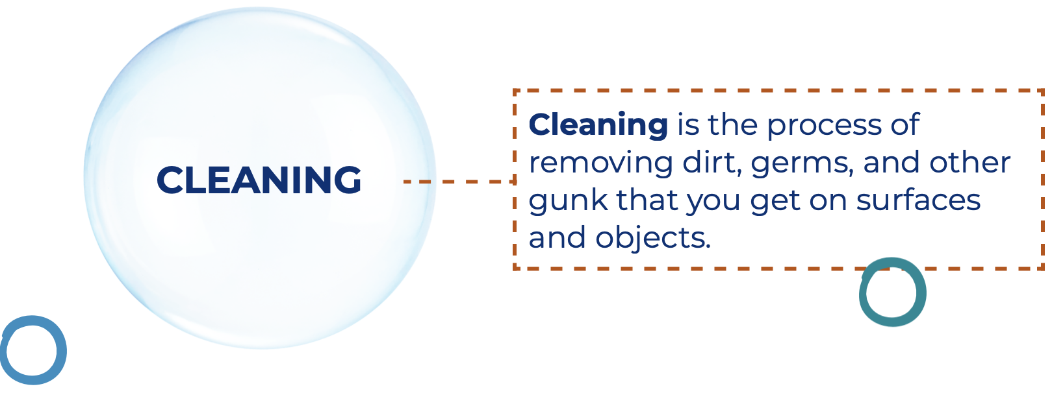
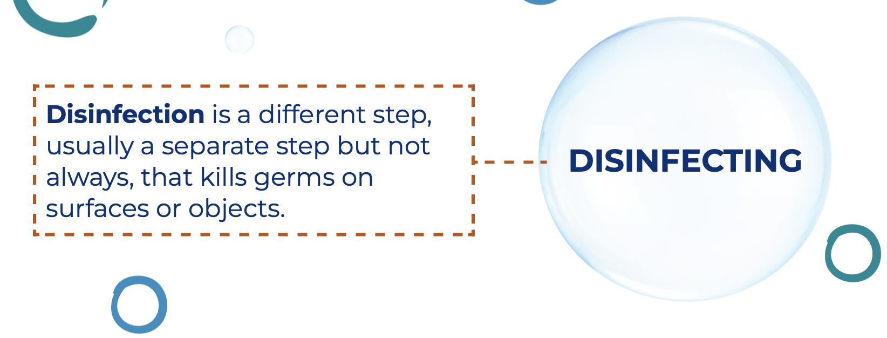
Cleaning & Disinfection
Cleaning is a process that removes things like dust, dirt and everyday messes from surfaces.
Susceptible Host
Disinfection is a process that kills germs.
Notes:
As we discussed, germs can live everywhere in the healthcare environment. It’s important to keep the healthcare environment clean to stop germs from spreading. We do this by cleaning and disinfecting.
Cleaning is a process that removes things like dust, dirt, and everyday messes from surfaces.
Disinfection is a process that kills germs.
Cleaning and disinfection can stop the spread by addressing where germs live (reservoir) and how they move or spread from one place to another (pathway)
If a germ lives somewhere in the healthcare environment and we disinfect that environment, we are killing that germ and removing the risk for it spreading.

Slide 27

Keeping the healthcare environment clean
How do you know if you are using your cleaning and disinfection products properly?
Notes:
Cleaning and disinfection is only as useful as using your products properly. If you are not using your products correctly, you are not killing the germs in the environment and and you are not removing the risk for the germs to spread further.
So, how do you if you are using your cleaning and disinfection products properly.
(give time for participants to respond)

Slide 28
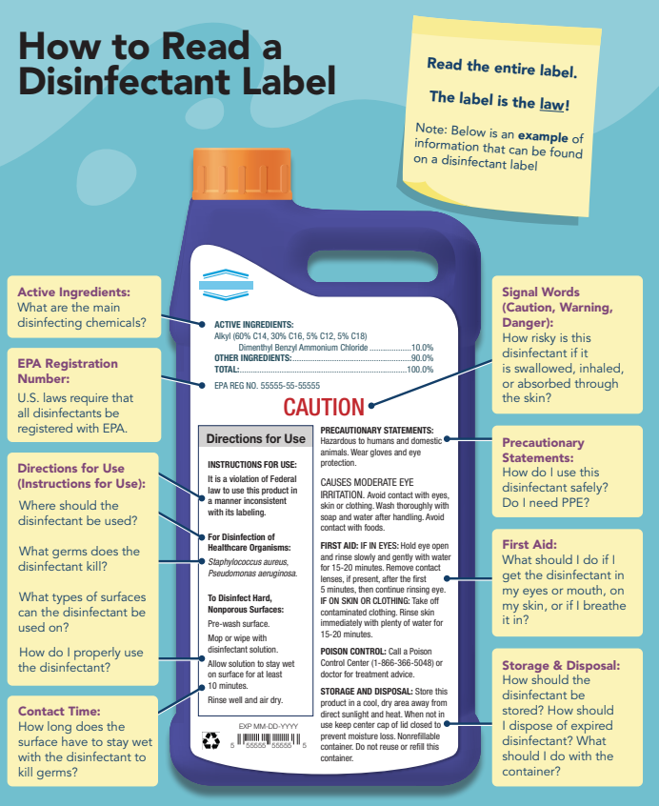
What information do you need from a disinfectant label?
Notes:
Reading the label is one of the best things you can do when it comes to proper cleaning and disinfection. Some specific points you should pay attention to
Directions for use including
does it need to be diluted
what surfaces can you use it on
what types of germs does it actually kill? Not all disinfectants kill all germs. For example, if you have norovirus spreading through your facility, only certain types of disinfectants are actually going to kill that germ. If you’re not using one of those disinfectants, you’re not going to be able to stop the spread.
You should also see what type of PPE you need to protect yourself when using the product. Make sure you’re using the product in a safe way that doesn’t put you at risk.
Pay attention to the expiration date on your products to ensure you are not using a product that is already expired.
Last is contact time
very important to know and we’ll talk about it on the next slide.

Slide 29

Contact Time (AKA “dwell time” or “wet time”)
The amount of time a disinfectant needs to sit on a surface, without being wiped away or disturbed to effectively kill germs.
DO
Check your label - it is always product specific and may change based on what germ you are trying to kill
DON’T
Wipe the surface before it’s dry
Do anything to speed up the process like blow on the surface your use a fan
Notes:
Now before we get into the last activity of the day, let's discuss contact time – also called ‘dwell time’ or ‘wet time’. It is the amount of time a disinfectant needs to sit wet on a surface, without being wiped away or disturbed, to do its job of killing germs.
Contact time varies by product, but it is always specific to the product you’re using and it should be on the label. Sometimes it also varies based on the germ you’re trying to kill. Some germs may require a longer contact time than others so if you’re trying to kill something specific, make sure you’re using the correct contact time.
We never want to rush the disinfection process. The entire contact time has to finish before something can be used again. Don’t try to dry a surface that’s been disinfected more quickly by wiping with another cloth, or by blowing it with a fan and definitely never blow on it with your own breath.
Lastly - on the topic of cleaning and disinfection. How do staff in this facility know what their are responsible for cleaning and disinfecting throughout the facility? How can you find out if you are not sure or don’t know?

Slide 30

Interactive Activity: Glo Germ
Notes:
Activity Overview:
Select a piece of shared equipment that is typically used in the facility and apply glo-germ gel to high touch spots on the equipment prior to the training.
Ask for a volunteer to clean the product with the appropriate cleaning wipes or detergent.
Other participants can assist by make suggestions of where to clean or letting the volunteer know if they have missed any areas.
Once the staff member is done, use the black light to identify any areas they have missed.
(Give participants 5 minutes for activity)

Slide 31
Thank You!
Questions?

