Slide 1

Body Reservoirs
Introduction to Reservoirs:
Where Germs Live
Session 1
Notes:
Facilitator Notes:
Participants log in and get settled.

Slide 2
Agenda
Welcome
Welcome and Introductions
Four Body Reservoirs
  Discussion
Environmental Reservoirs
  Discussion
Reservoirs Synthesis
  Bringing It Together
Conclusion

Slide 3
Reservoir Definition
The places where germs live are called “reservoirs.”
There are reservoirs in the human body and in the environment.

Slide 4

The Body Reservoirs
Skin
Gastrointestinal
system (the “gut”)
Respiratory system
Blood

Slide 5

Skin

Slide 6
Key Takeaways about the Skin Reservoir
Skin, especially hands, interacts with the environment daily.
Pathways:
  Touch
  Breaking down or bypassing the body’s defenses

Slide 7

GI System

Slide 8
Key Takeaways about the GI System Reservoir
The “gut” usually refers to most of the intestines, rectum, and anus.
Gut germs travel easily in stool.
Pathways:
  Touch
  Breaking down or bypassing the body’s defenses

Slide 9

Respiratory System

Slide 10
Key Takeaways about the Respiratory System Reservoir
Upper airway: Nose, mouth, throat, windpipe
Lower airway: Lungs
Pathways:
  Breathing in
  Splashes and sprays
  Touch
Notes:
Facilitator Notes:
Stop screensharing the word cloud and return to slide 13 of the PowerPoint.
Note key points about the respiratory system reservoir shown on the slide. Point out whether they were identified in the word cloud and reiterate additional points that were included in the word cloud.
Reinforce connections between the respiratory system reservoir and how germs can spread and cause harm. Invite a volunteer from a different reservoir group to share verbally or in the chat their ideas about why the respiratory system reservoir is important for infection control.
Time permitting and as appropriate, you may choose to incorporate infection control actions that are relevant to the respiratory system reservoir into this discussion.
Sample Script:
“Thank you! There are several pathways for germs to be spread from the respiratory system. Breathing is an important pathway, of course, because germs can be spread through respiratory droplets. We also have to remember that respiratory droplets can spread by splashes and sprays to the eyes, nose, and mouth. Touch is also important, because germs in the respiratory system spread easily to the skin and hands, and from there can be spread to other people and surfaces.
“I’d like to hear from someone who reviewed one of the other reservoirs – based on what we saw in the word cloud and other points of discussion, what stands out for you as important about the respiratory system for infection control in your profession? Please feel free to unmute yourself!”
(Pause for responses. Acknowledge and affirm as appropriate.)

Slide 11
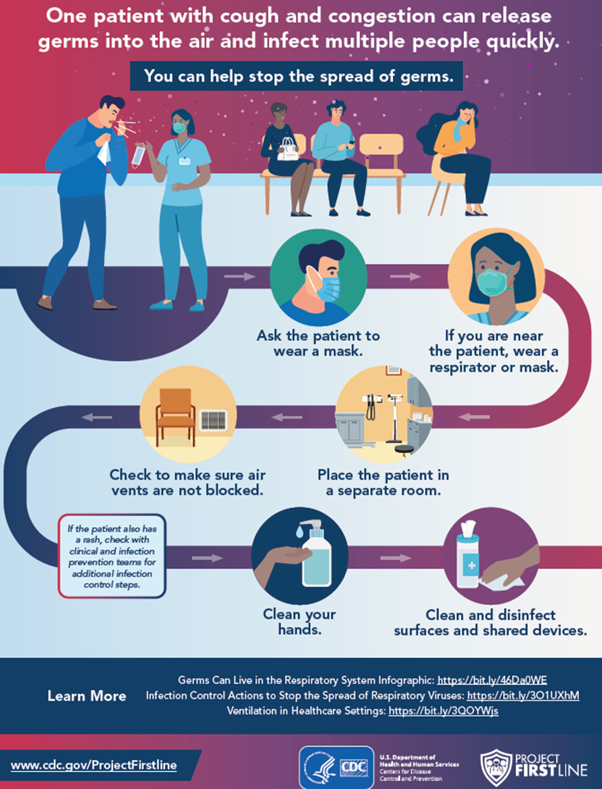
Additional PFL Resource

Slide 12
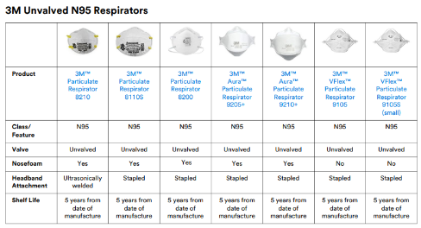
Respiratory Plan (OSHA) / N95 Respirator Use
1910.134 Regulation
In any workplace where respirators are necessary to protect the health of the employee or whenever respirators are required by the employer, the employer shall establish and implement a written respiratory protection program with worksite-specific procedures.
https://www.osha.gov/laws-regs/regulations/standardnumber/1910/1910.134
Notes:
TB, measles, Chickenpox – all airborne, can also protect against droplet- pertussis, influenza,

Slide 13

Blood
Notes:
“

Slide 14
Key Takeaways about the Blood Reservoir
Blood is not supposed to have germs in it.
Some viruses cause infections that release virus into the blood. If a person is infected and untreated, blood can then spread the virus to other people.
Pathways:
  Breaking down or bypassing the body’s defenses
  Splashes and sprays
  Touch

Slide 15
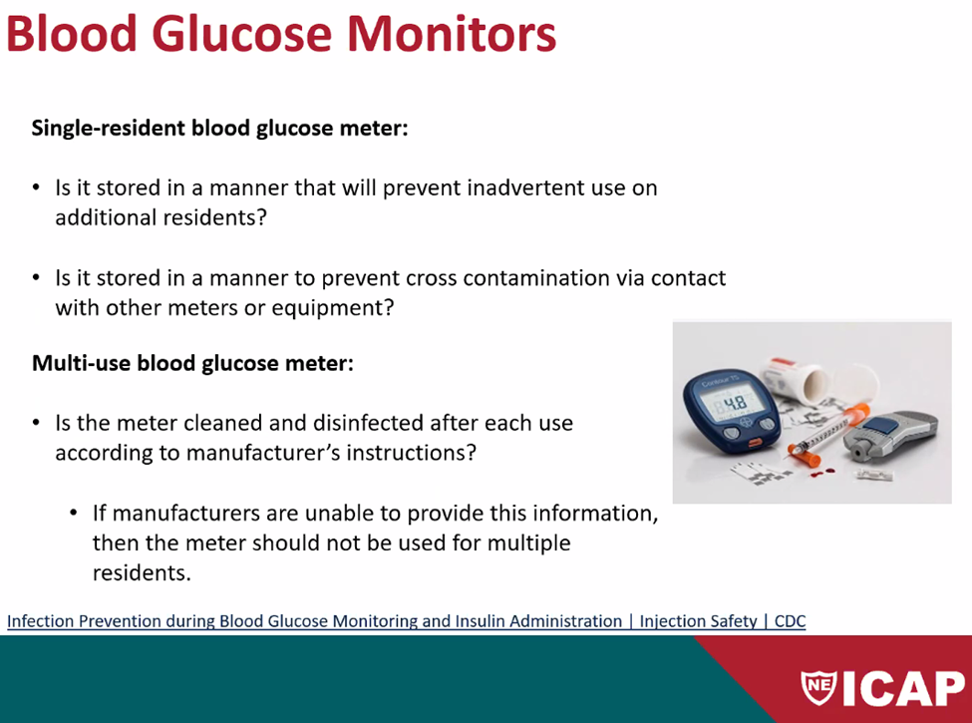
Additional ICAP Notes (BBP)

Slide 16
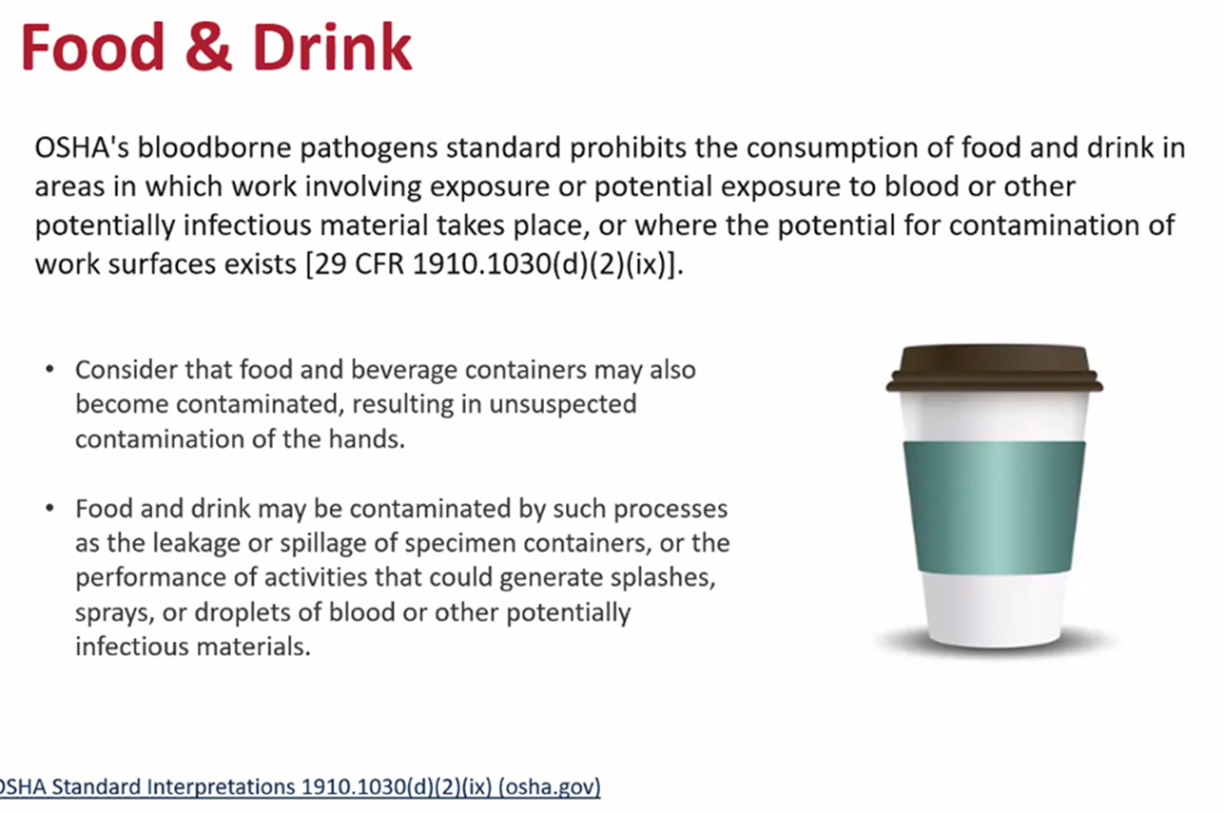
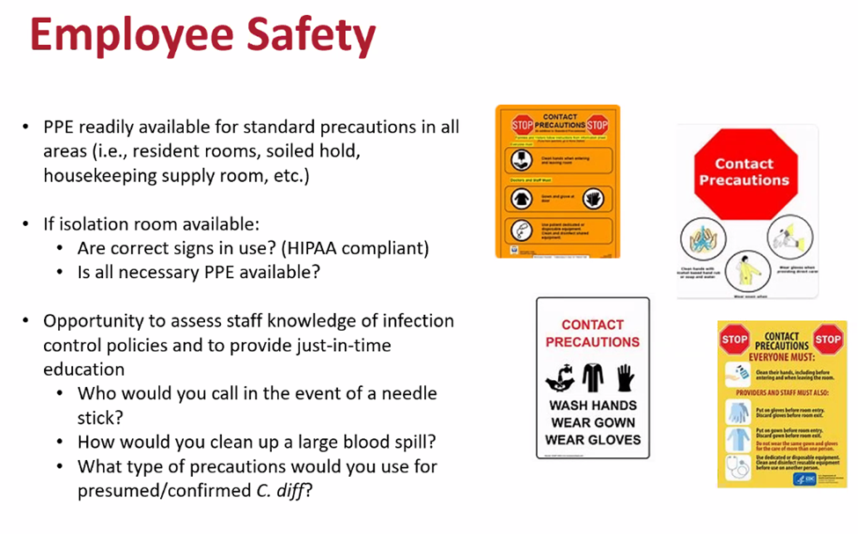
Additional ICAP Notes (BBP)

Slide 17
Key Takeaways
”Reservoirs” are the places on and in our bodies and in the environment where germs live. Germs frequently spread between and among these reservoirs.
Four reservoirs in the human body that are important for infection control are the skin; the gastrointestinal (GI) system or “gut”; the respiratory system; and blood.
Understanding where germs live helps us recognize where there is risk for them to be spread, and why infection control actions work to stop them from spreading and making people sick.

Slide 18
Discussion
What is one important thing about EACH reservoir that a new colleague should know to prevent the spread of germs? Why?

Slide 19
Questions

Slide 20
Healthcare Environment Reservoirs
Introduction to Reservoirs:
Where Germs Live
Session 2

Slide 21
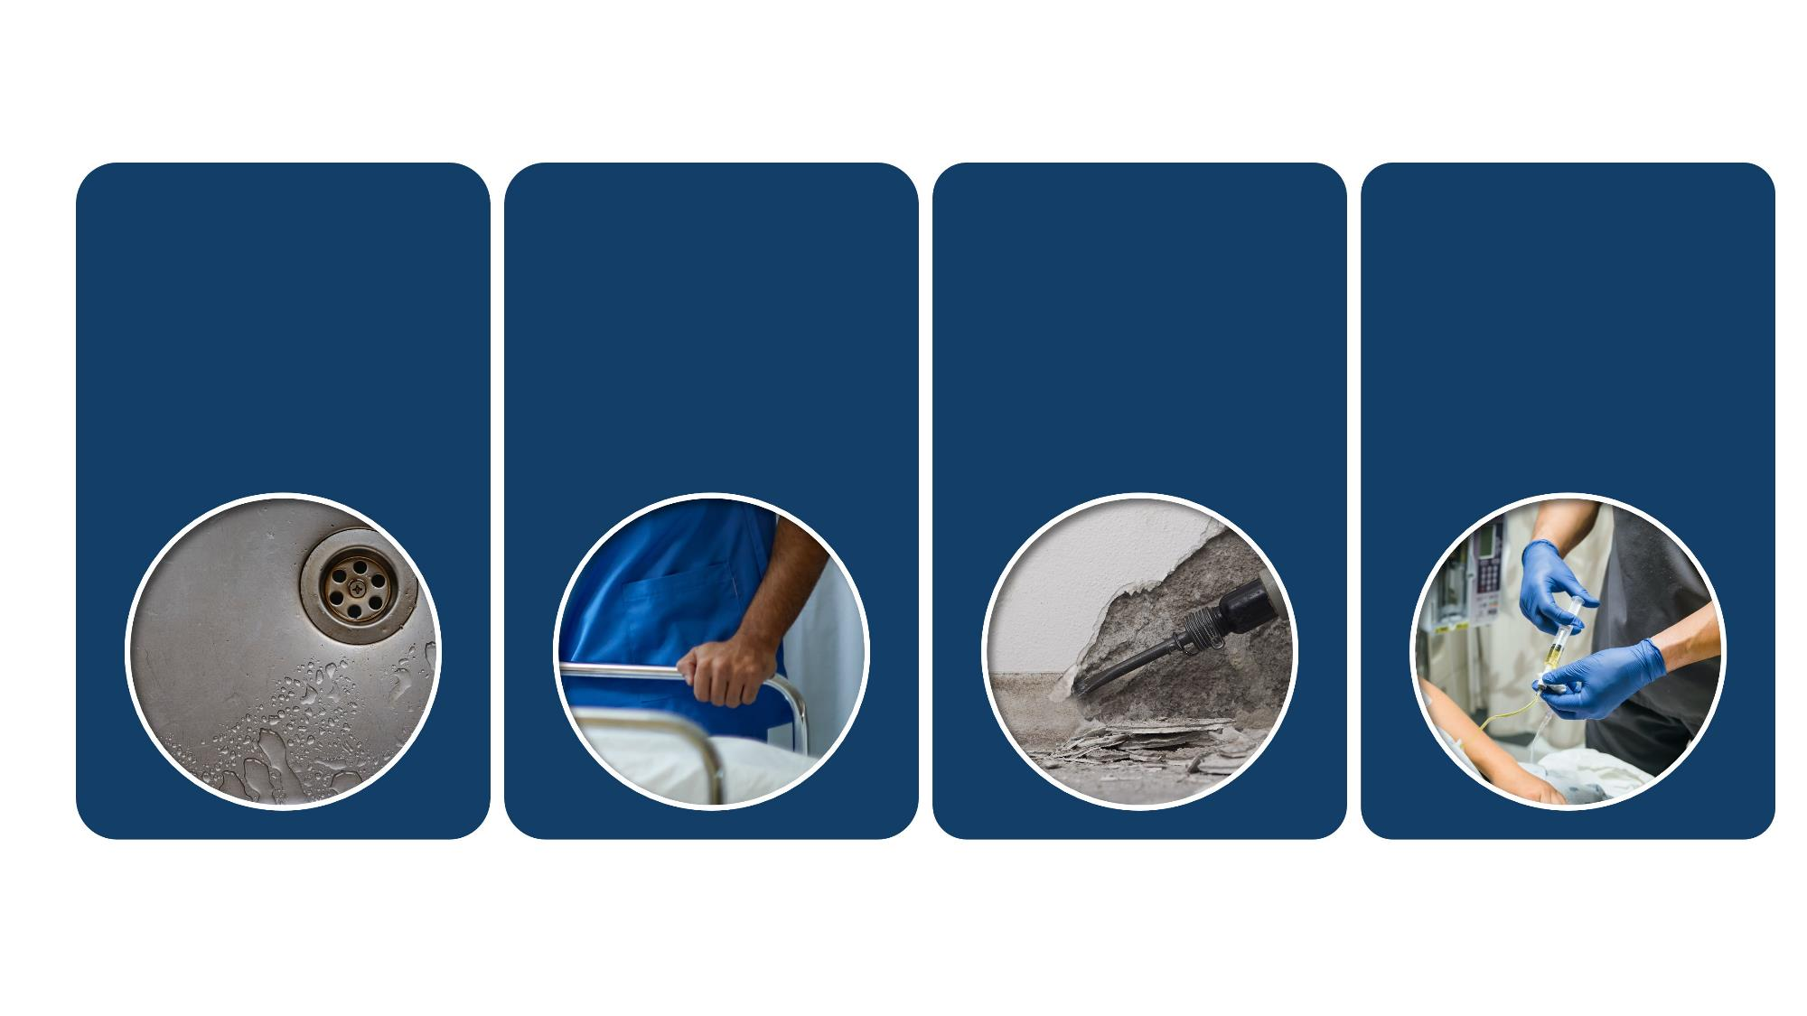
Reservoirs in the Healthcare Environment
Water and
Wet Surfaces
Sinks and faucets
Drains
Ice machines
Therapy pools
Dry Surfaces
Bed rails
Door handles
Countertops
Bed curtains
Dirt and Dust
Construction
Maintenance
Repair
Renovation
Devices
Stethoscope
Blood pressure cuff
Endoscope
Artificial hip

Slide 22
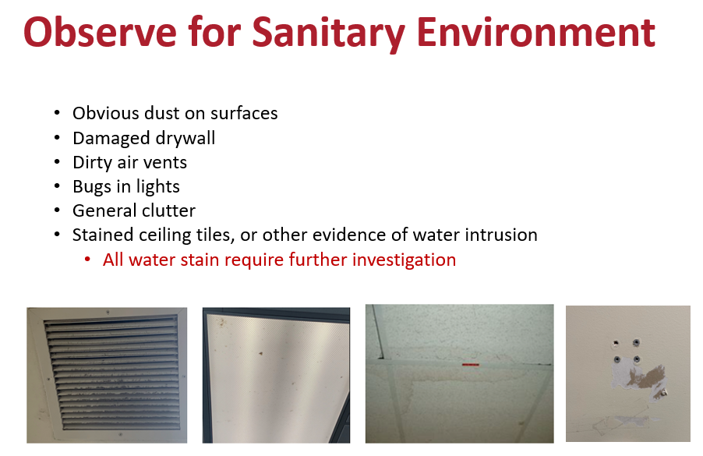
Additional ICAP Notes

Slide 23

Water and Wet Surfaces: Taking Action

Slide 24

Water and Wet Surfaces Reservoir
Water is used in many ways in healthcare.
Tap water is safe to drink, but it is not sterile.
Water and wet surfaces can be good places for germs to grow.
Pathways:
Touch
Splashes and sprays
Breathing in

Slide 25
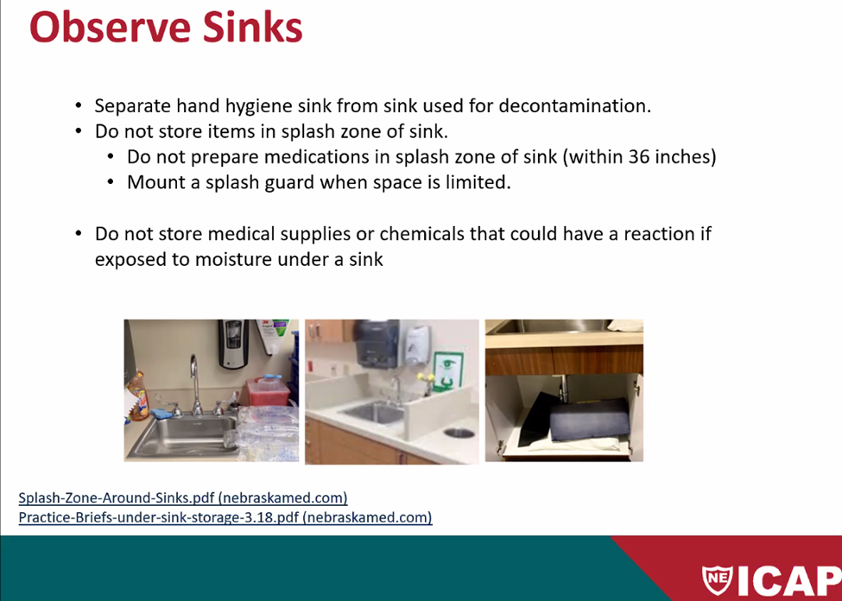
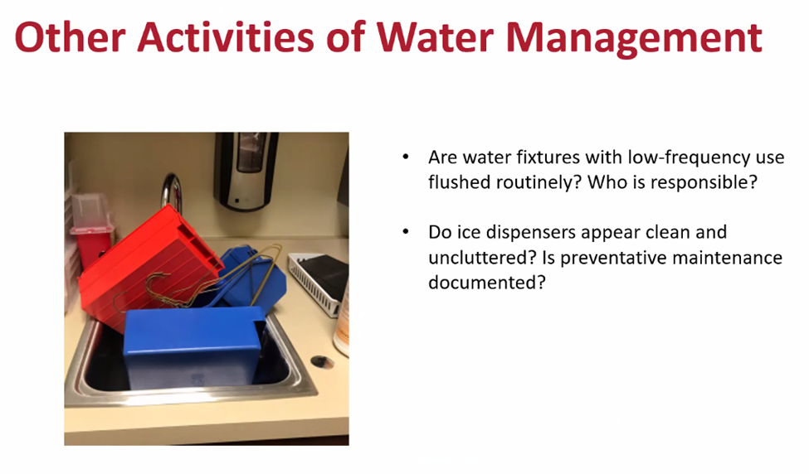
Additional ICAP Notes

Slide 26

Dry Surfaces:
Taking Action

Slide 27

Dry Surfaces Reservoir
Germs found on the body, in the air, and in stool can also be found on dry surfaces
Includes “high-touch” surfaces: bed rails, door handles, light switches
Pathways:
Touch
Breaking down or bypassing the body’s defenses

Slide 28
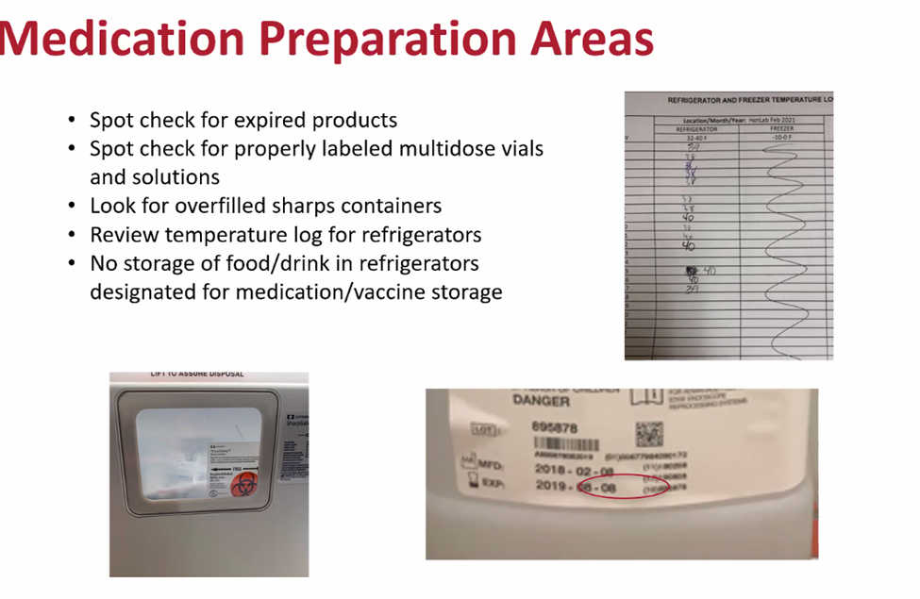
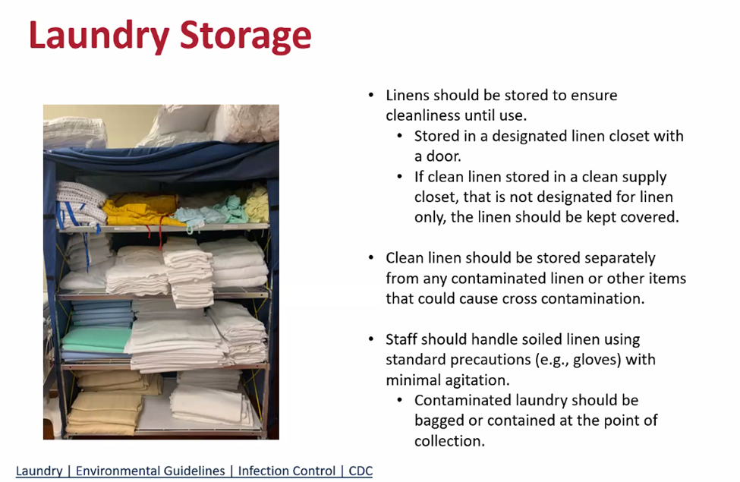
Additional ICAP Notes

Slide 29
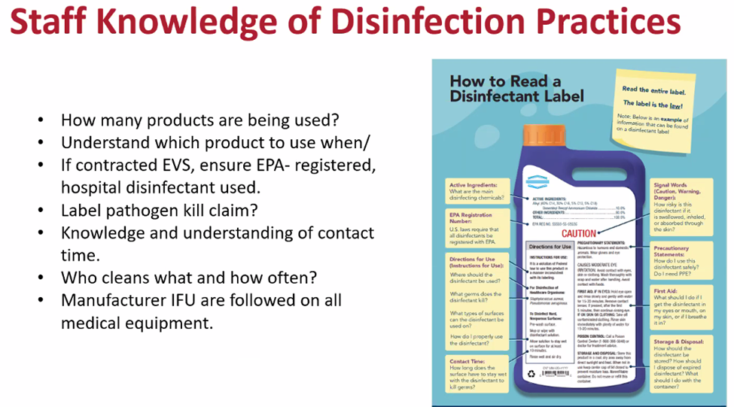
Additional PFL Resources

Slide 30
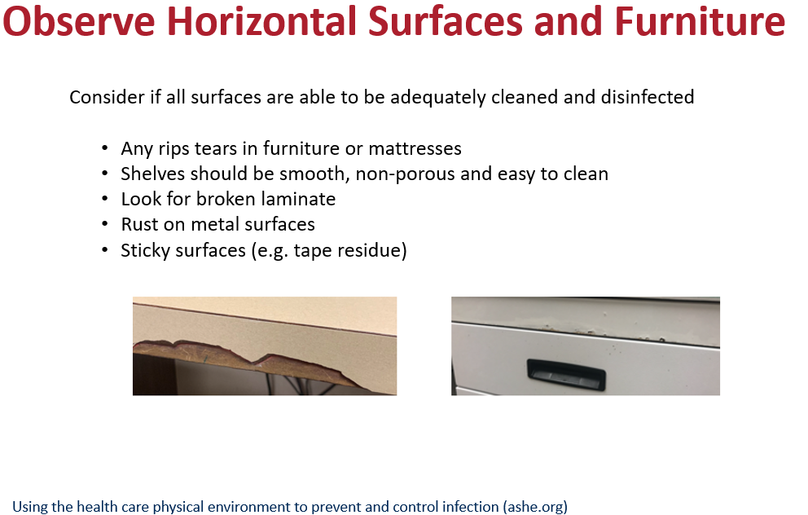
Additional ICAP Notes

Slide 31

Dirt and Dust:
Taking Action

Slide 32

Dirt and Dust Reservoir
Dirt, soil, and dust from both outdoors and indoors have germs in them that can be carried through the air.
Germs in dirt and dust can harm certain patients.
Pathways:
Breathing in
Touch

Slide 33
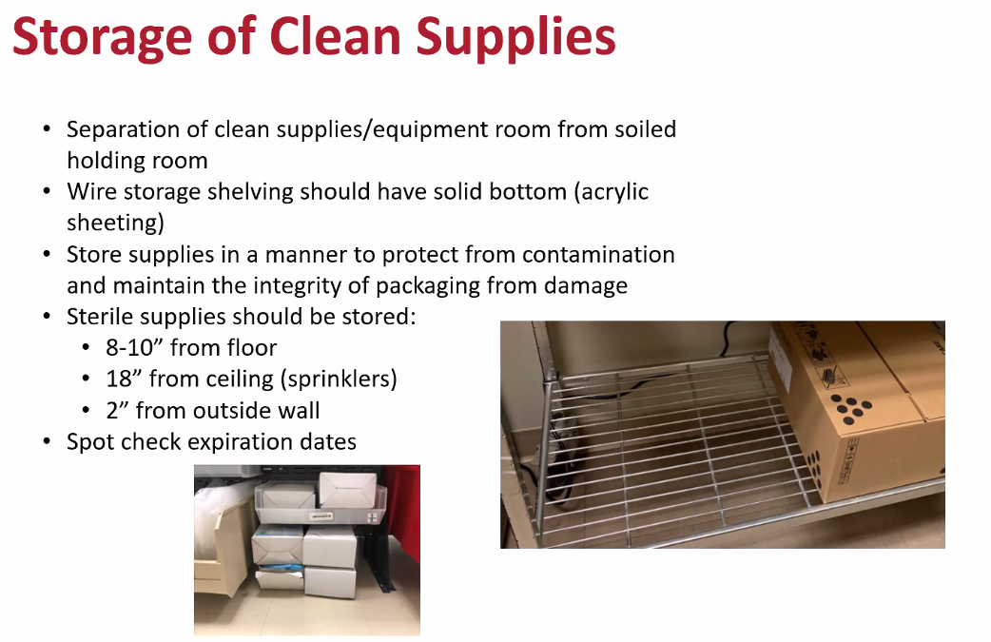
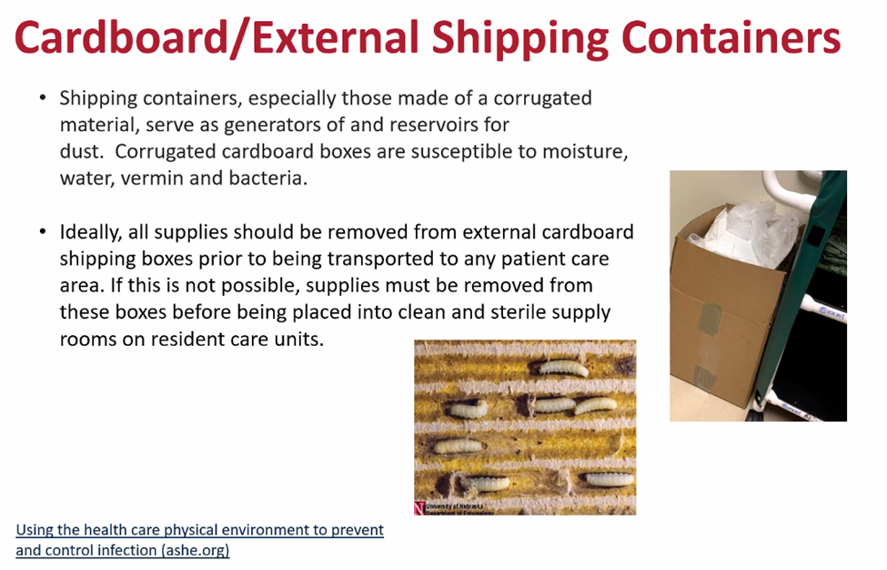
Additional ICAP Notes

Slide 34

Devices:
Taking Action

Slide 35

Devices Reservoir
Often in contact with multiple surfaces and people
Used on a patient’s body (stethoscope, blood pressure cuff)
Used in a patient’s body
(IV needle, endoscope,
artificial hip)
Pathways:
Breaking
down or bypassing the body’s defenses
Touch

Slide 36
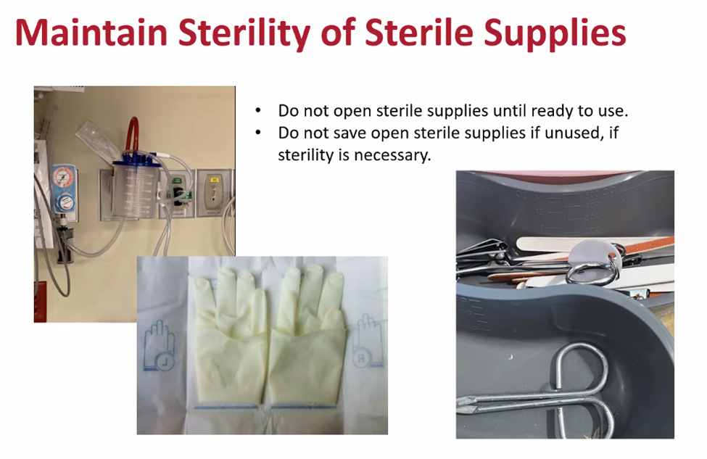
Additional ICAP Notes

Slide 37

Key Takeaways
”Reservoirs” are the places on and in our bodies and in the environment where germs live. Germs frequently spread between and among these reservoirs.
Four reservoirs in the healthcare environment that are important for infection control are water and wet surfaces; dry surfaces; dirt and dust; and devices.
Understanding where germs live helps us recognize where there is risk for them to be spread and why infection control actions work to stop them from spreading and making people sick.

Slide 38
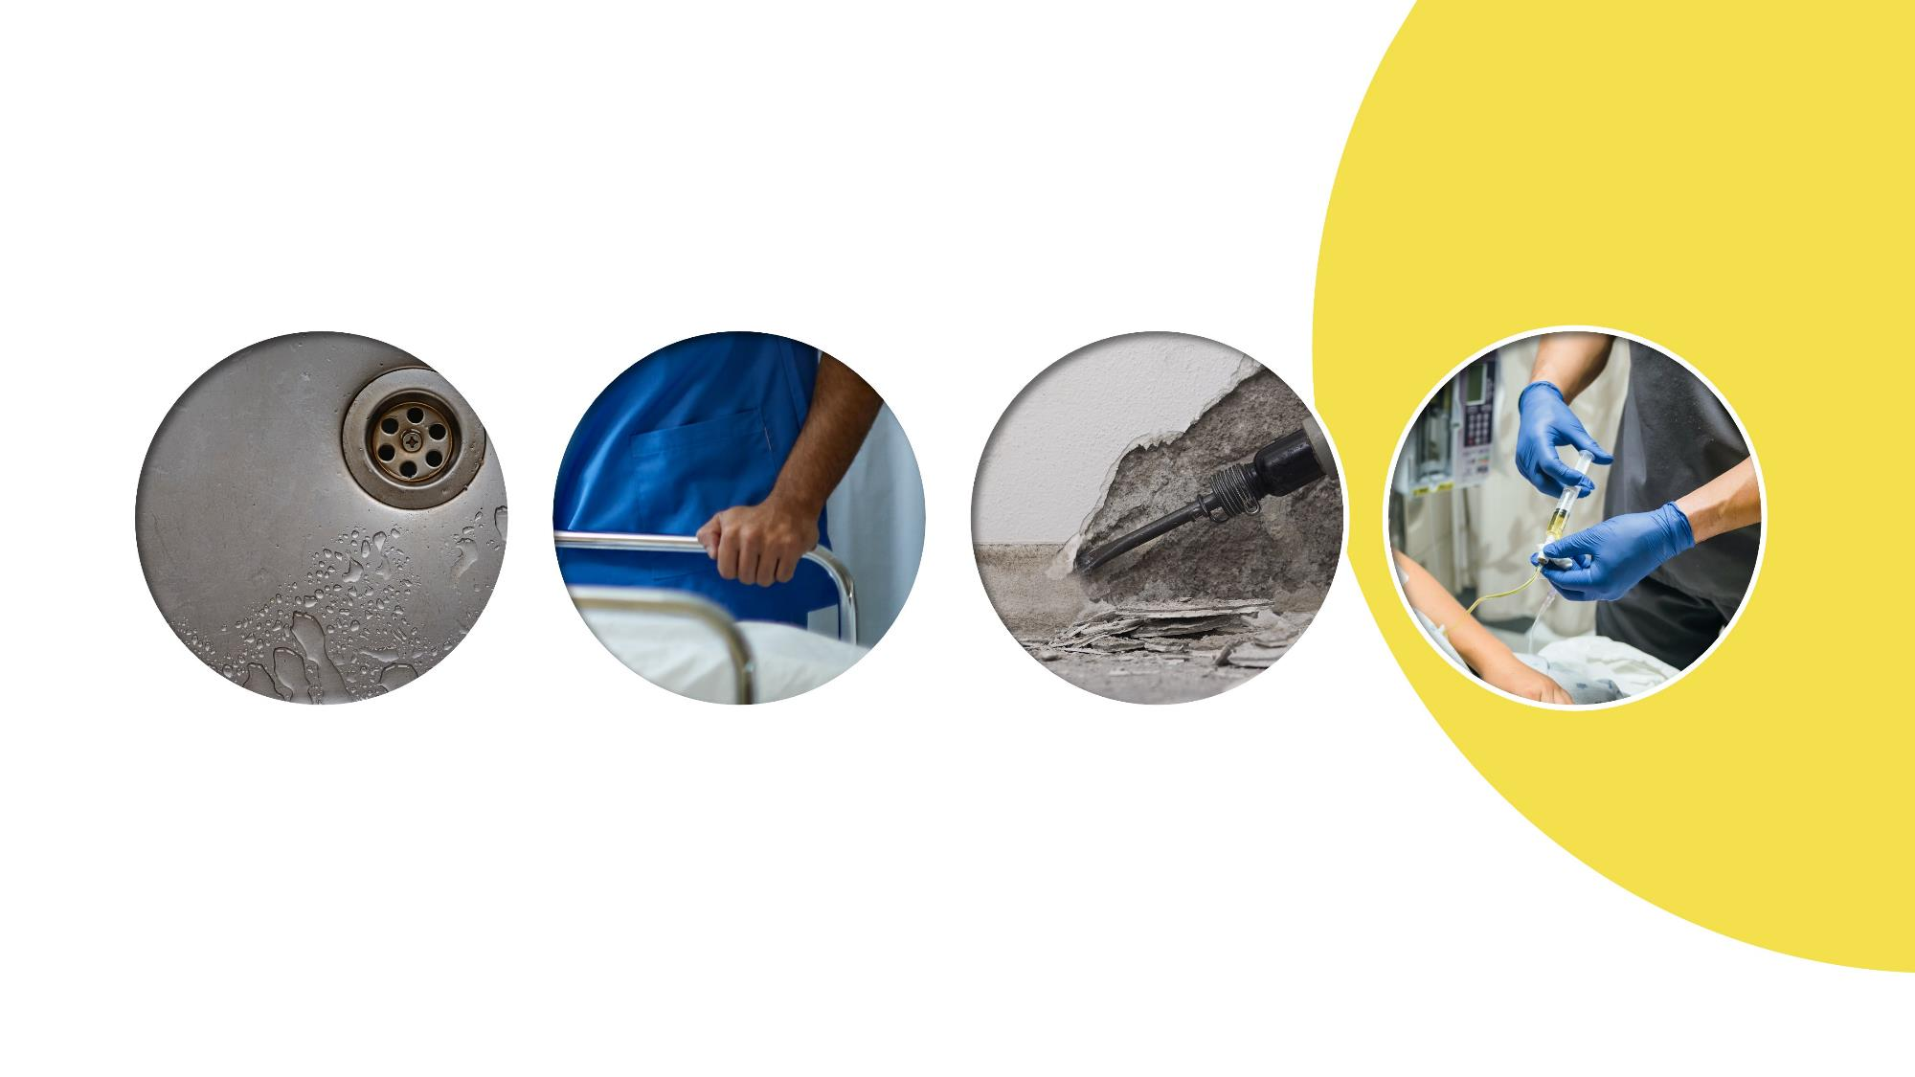
Question
Water and
Wet Surfaces
Dry Surfaces
Dirt and Dust
Devices

Slide 39
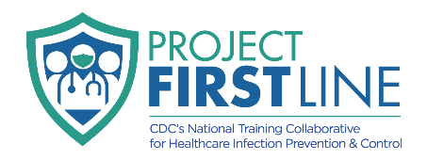
Body and Healthcare Environment Reservoirs: Synthesis
Introduction to Reservoirs:
Where Germs Live
Session 3
Notes:
Facilitator Notes:
Participants log in and get settled.

Slide 40

Reservoirs Review
Body
Environment
Skin
GI
system or “gut”
Respiratory system
Blood
Water and
wet surfaces
Dry surfaces
Dirt and dust
Devices

Slide 41
Reservoir Tables
I Know | I Think I Know | I Want to Know

Slide 42
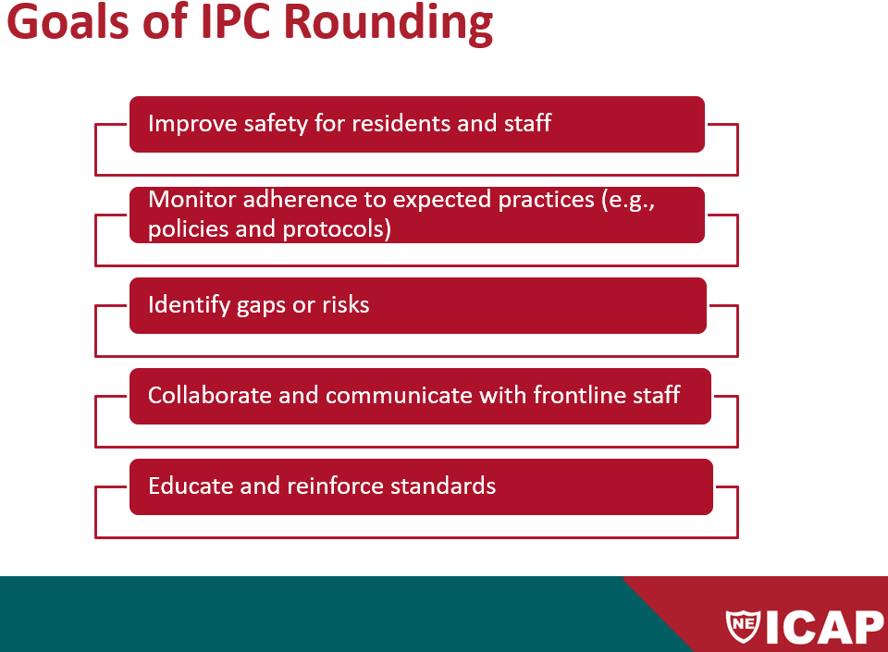
Additional ICAP Notes

Slide 43
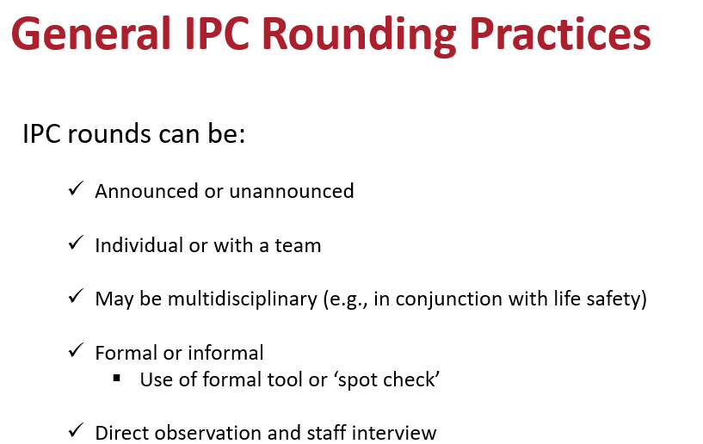
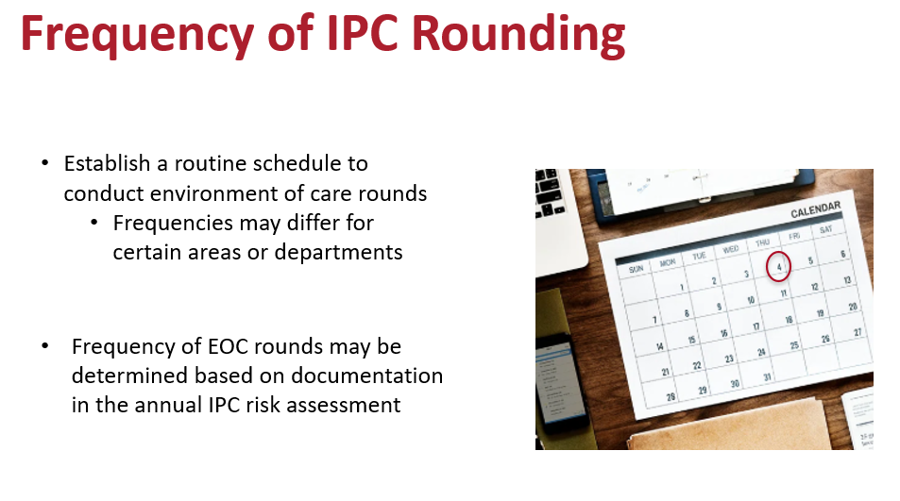
Additional ICAP Notes

Slide 44
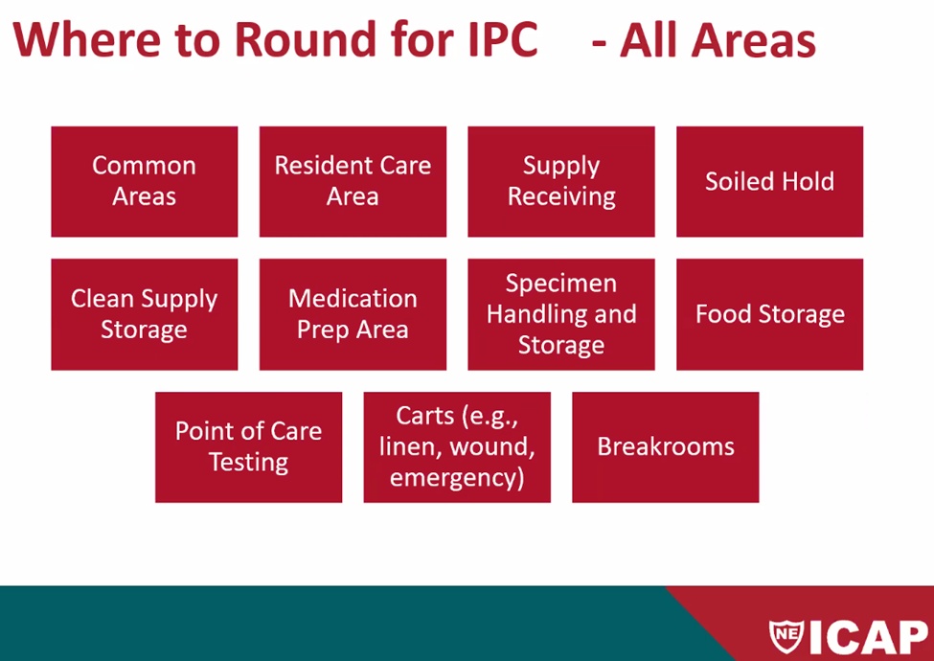

Slide 45
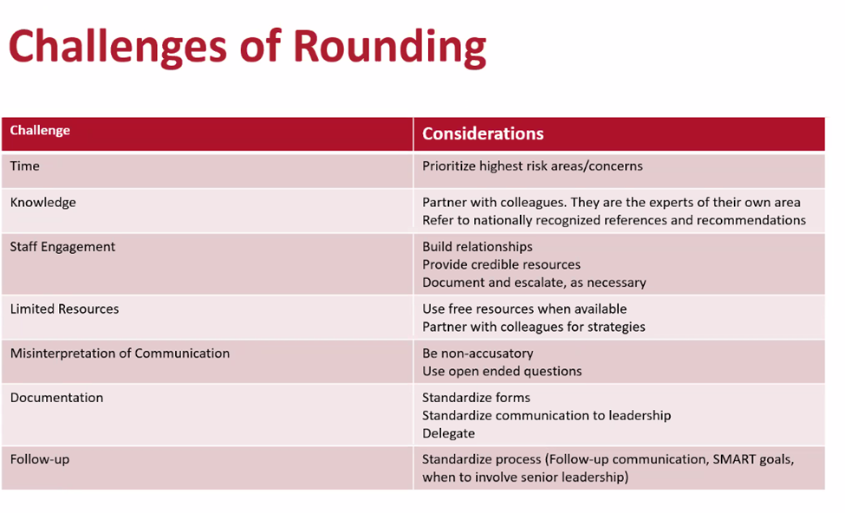

Slide 46
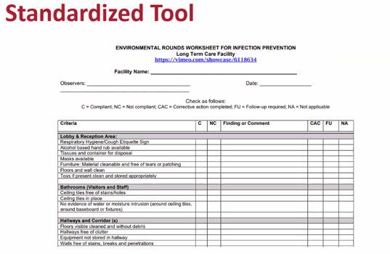

Slide 47
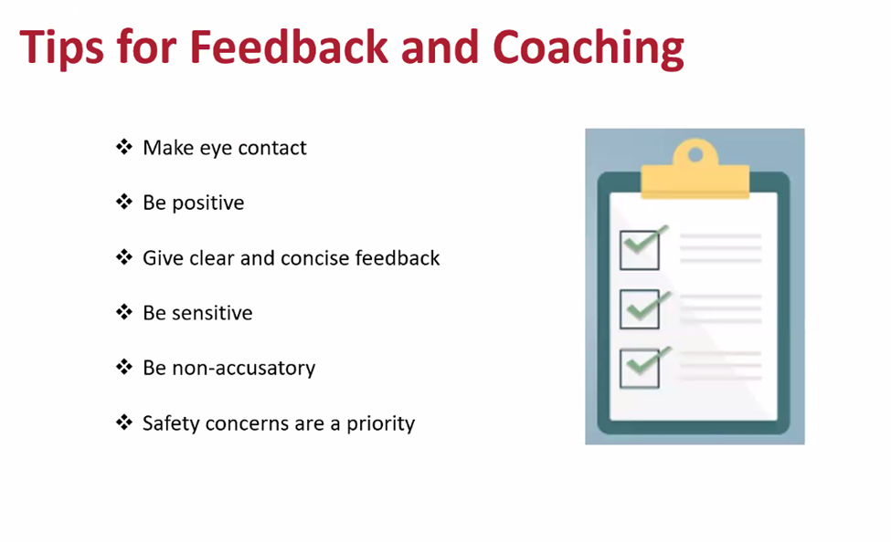
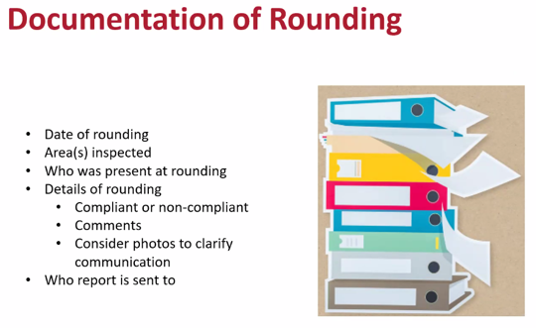
Additional ICAP Notes

Slide 48
Reflection
What do I still want to know?

Slide 49
Conclusion

Slide 50

How to Get Involved and Feedback
Project Firstline on CDC.gov:
https://www.cdc.gov/infection control/projectfirstline/index.html
CDC’s Project Firstline on Facebook:
https://www.facebook.com/CDCProjectFirstline
CDC’s Project Firstline on Twitter:
https://twitter.com/CDC_Firstline
Project Firstline Inside Infection Control on YouTube:
https://www.youtube.com/playlist?list=PLvrp9iOILTQZQGtDnSDGViKDdRtIc13VX
To sign up for Project Firstline e-mails, click here: https://tools.cdc.gov/campaignproxyservice/subscriptions.aspx?topic_id=USCDC_2104
Project Firstline feedback form: https://www.cdc.gov/infectioncontrol/pdf/projectfirstline/TTK-ParticipantFeedback-508.pdf
Placeholder for partners to add their own links

Slide 51
Additional ICAP Resources
Rounding Tools:
ICAP. Environmental Rounds Worksheet for Infection Prevention
  https://icap.nebraskamed.com/wp-content/uploads/sites/2/2017/09/Environment_Checklist.pdf
NACCHO. Environmental Rounds Worksheet for Infection Prevention Long Term Care Facility
  https://www.naccho.org/uploads/downloadable-resources/Programs/Community-Health/Project-Firstline/Environmental-Rounds-Worksheet-for-IPC-in-LTCF.pdf
Innovate IPC. Environment of Care Rounding Tool
  https://innovateipc.org/wp-content/uploads/2024/01/EOC-tool.ae_.fillable.pdf
Resources:
CDC. Guidelines for Environmental Infection Control in Health-Care Facilities
https://www.cdc.gov/infectioncontrol/pdf/guidelines/environmental-guidelines-P.pdf
CDC. Best Practices for Environmental Infection Control in Healthcare Facilities: in Resource-Limited Settings
https://www.cdc.gov/hai/pdfs/resource-limited/environmental-cleaning-RLS-H.pdf
CDC. Options for Evaluating Environmental Cleaning
https://www.cdc.gov/hai/toolkits/appendices-evaluating-environ-cleaning.html
ASHE. Using the Health Care Physical Environment to Prevent and Control Infection
https://www.ashe.org/sites/default/files/ashe/CDCfullbookDIGITAL.pdf

