Slide 1
“Education Stations” for Long-Term Care Staff
Allie Lawrence, MPH, RN
Janet Allen, BSN, RN

Slide 2
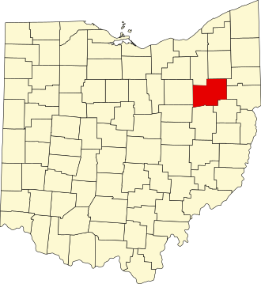
Background
Stark County is located in the northeastern part of Ohio.
As of the last census, there were almost 375,000 people living in Stark County.*
21% of the population is age 65 or older.*
*U.S. Census Bureau

Slide 3
Long-Term Care in Stark County
37 Long-term care facilities in our jurisdiction.
Includes skilled nursing, assisted living, independent living, and residential facilities for individuals with intellectual and/or developmental disabilities.

Slide 4
NACCHO and Our IP Journey
Past NACCHO grants gave us tools to build and grow relationships with IPs and administrators.
Conducting ICARs in LTCFs revealed common infection control gaps and educational needs. Education was offered based on these findings.
During this grant cycle, LTCF IPs were surveyed about their IP program and learning needs for themselves and their staff.

Slide 5
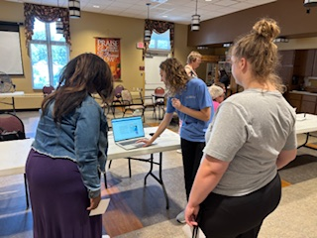
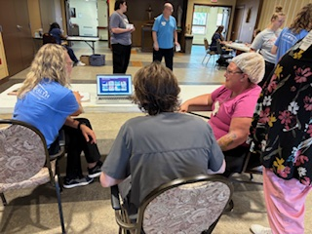
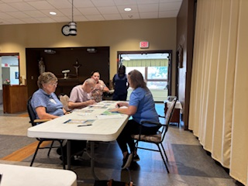
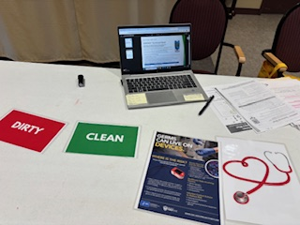
Education Stations

Slide 6
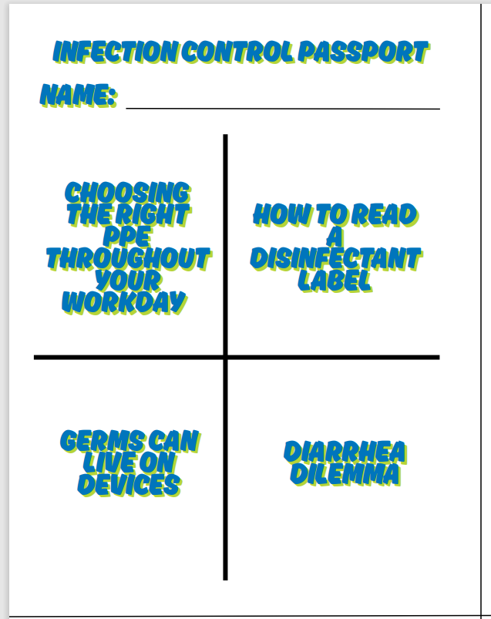
The Stations

Slide 7

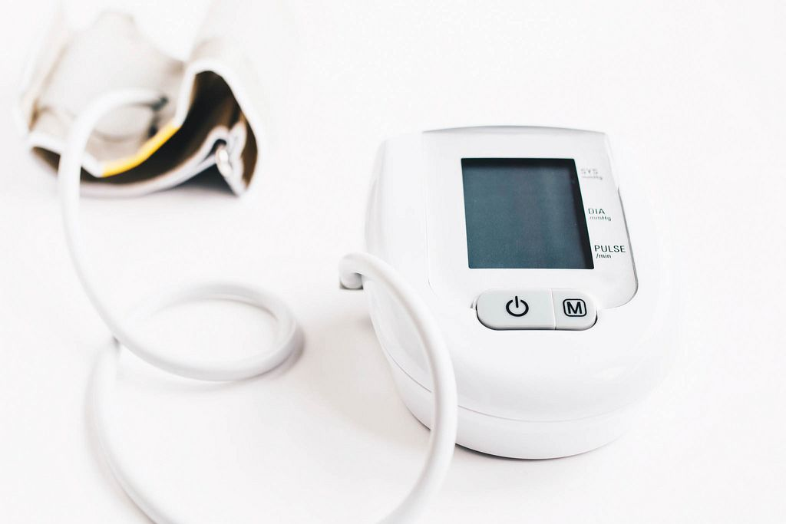
Environmental Cleaning and Disinfection
How to Read a Disinfectant Label
Germs Can Live on Devices

Slide 8
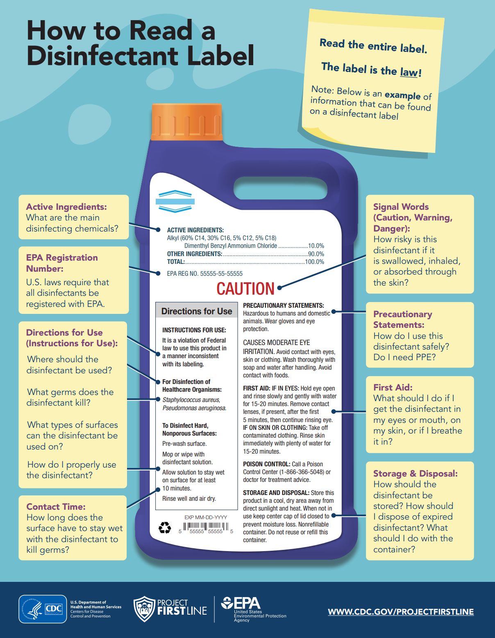
How to Read a Disinfectant Label

Slide 9
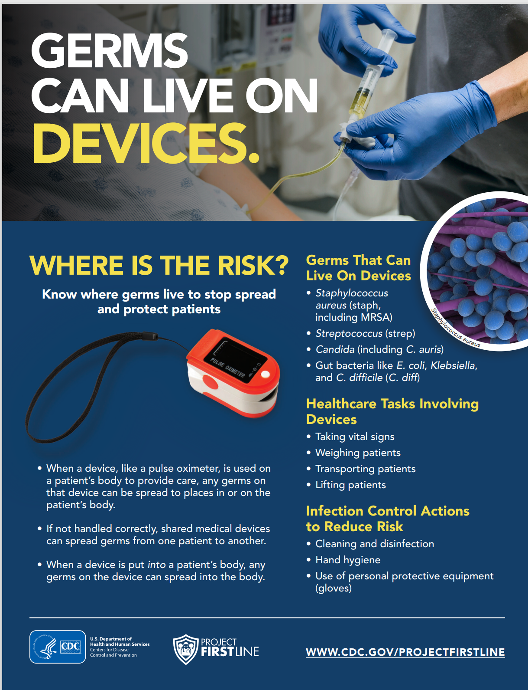
Germs Can Live on Devices

Slide 10
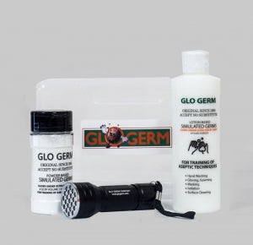

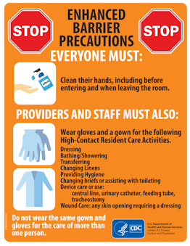
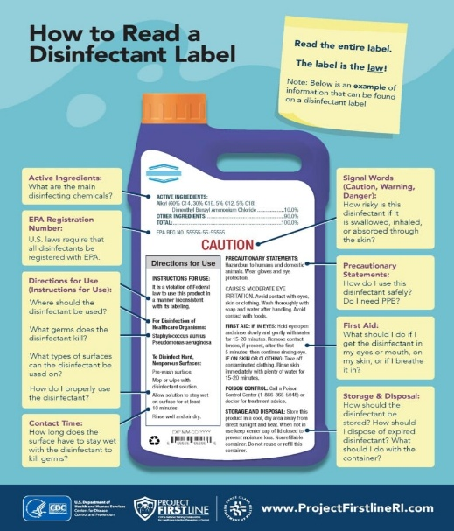


Resources for Facilities

Slide 11
Feedback and Lessons Learned
More engagement from staff with stations versus traditional lecture format.
Less time from work duties-each station took 10 minutes or less.
PFL resources are multi-functional and can be used for both in-person learning and reference documents after training.
Active participation and highlighted knowledge gaps and facilitated lively discussion.
Management and non-clinical staff also participated.
Will need to adjust times or offer more times for those working different shifts.
Addition of new stations to include Glo-germ and PPE foamboard.

Slide 12


