Slide 1

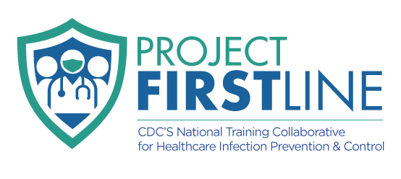
The Basic Science of Viruses & How Viruses Spread From Surfaces to People
CDC Project Firstline
Hancock Public Health

Slide 2
Agenda
1.
Introduction
4.
How Viruses Spread From Surfaces to People
2.
Pre-test
5.
Post-test
3.
The Basic Science of Viruses

Slide 3

Introduction: What is Project Firstline?
A training and education nation training collaborative initiative that was designed by the CDC to help frontline healthcare workers understand and apply infection control principles.
The goal of Project Firstline is to make sure you have the infection control knowledge that you need and deserve to keep yourself, your patients, your colleagues, and your family safe.

Slide 4
Pre-test Questions:
What is a virus?
  A living organism that reproduces independently
  A type of bacteria
  A microscopic infectious agent that needs a host to reproduce
  A harmless particle in the air
Which of the following is a primary way viruses spread from surfaces to people?
  Through direct blood transfusion
  Through touching contaminated surfaces and then touching the face
  Through listening to loud sounds
  Through exercising outdoors
True or False: The Eyes, nose, and/or mouth is most often the entry point for surface-transmitted viruses?

Slide 5
Pre-test Questions:
4. True or False: Viruses can reproduce on surfaces like tables and doorknobs.
5. Which of the following best describes how long viruses can survive on surfaces?
Only a few seconds
Forever
Varies depending on the surface and virus type
Only in wet environments

Slide 6
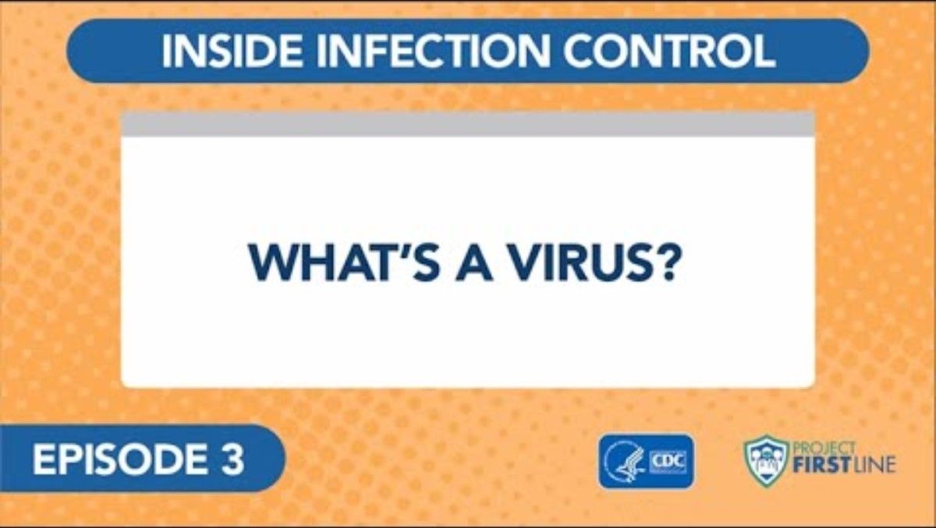
The Basic Science of Viruses: What is a virus?
Notes:
https://www.cdc.gov/infectioncontrol/projectfirstline/videos/Ep3-Virus-LowRes-New.mp4

Slide 7
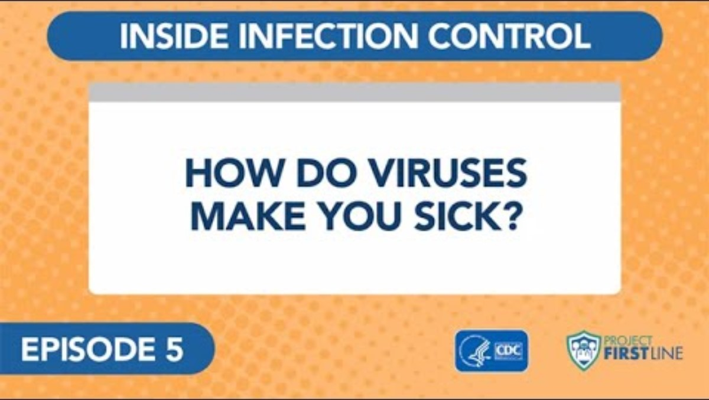
The Basic Science of Viruses: How do viruses make you sick?
Notes:
https://www.cdc.gov/infectioncontrol/projectfirstline/videos/Ep5-How-LowRes-New.mp4

Slide 8
The Basic Science of Viruses: Key Points
All viruses have two parts:
  Genes: that contain all the info needed to make more virus copies
  Proteins: that protect the genes and help the virus spread
  SOME VIRUSES- contain a third part: an envelope made of special fats that protects genes and proteins
Viruses are able to use cells in the body to make copies of themselves. It is how viruses spread within the body, and from person to person.
When enough virus has been able to get into our cells and make copies of themselves, the body recognizes that there's an infection, and our immune system revs up to fight off the virus.
It's the activity of our immune system fighting the virus that makes us feel sick.

Slide 9
How Viruses Spread From Surfaces to People: Definitions
Fomite transmission:
  Infection spread through direct contact with an article or surface (e.g., from a stethoscope) that has become contaminated with infectious material.
    Fomite: nonliving object contaminated with microorganisms that can spread the microorganisms to other persons.
Contact transmission:
  Infection spread through direct contact with an infectious person (e.g., touching during a handshake or taking a pulse) or with an article or surface that has infectious material on it.

Slide 10
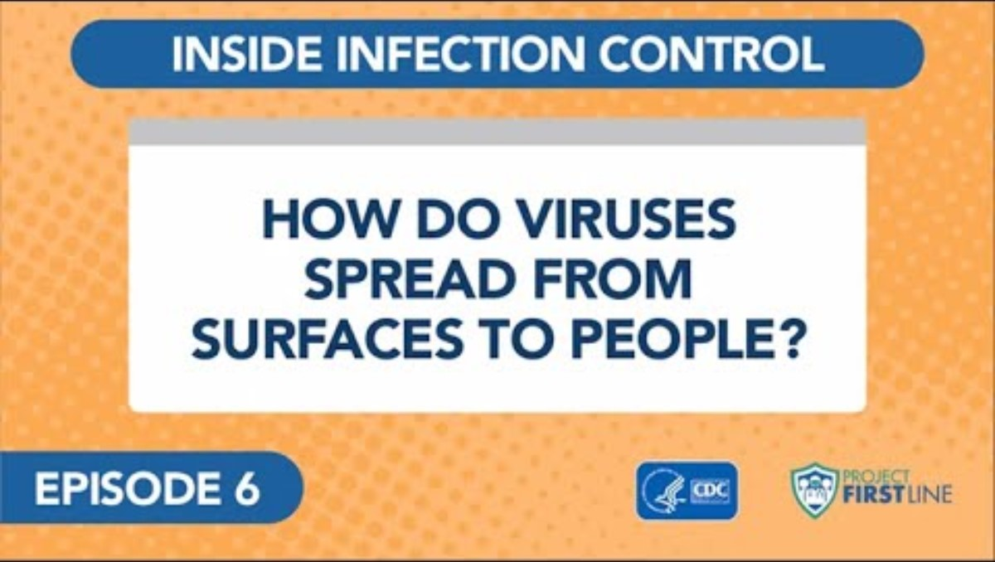
How Viruses Spread From Surfaces to People: Video
Notes:
https://www.cdc.gov/infectioncontrol/projectfirstline/videos/Ep6-Spread-LowRes-New.mp4

Slide 11
How Viruses Spread From Surfaces to People: Key Points
Although many viruses are spread through respiratory droplets, they can also spread by touching something that has live virus on it and then touching your face without cleaning your hands first.
Virus can get on surfaces when respiratory droplets land on those surfaces.
Virus can also get on surfaces when body fluids from an infected person – like spit and snot – get onto things nearby.
Notes:
Some viruses can stay suspended in the air for quite some time. The measles virus can stay suspended in the air up to 2 hours after the infected person leaves.

Slide 12
Post-test Questions:
How do viruses replicate inside the human body?
  By dividing like bacteria
  By using host cells to produce viral copies
  By growing from spores
  By photosynthesis
What is the most effective way to prevent viral spread from surfaces to people?
  Wearing a mask indoors
  Taking antibiotics
  Regular hand hygiene and not touching the face
  Using mosquito nets
True or False: Proper handwashing with soap and water can remove viruses on your hands.

Slide 13
Post-test Questions:
4. Which statement is TRUE about high-touch surfaces?
They are rarely involves in virus transmission
  They include items like doorknobs, phones, and railings
  Only medical equipment can be high-touch surfaces
  Viruses die immediately on these surfaces.
5. Why is understanding the basic science of viruses important for preventing outbreaks?
So people can self-diagnose viral infections
To ensure everyone becomes immune
To improve personal and public health practices
To avoid all physical activity

Slide 14
Resources and Future Training Sessions:
Project Firstline on CDC: https://www.cdc.gov/infectioncontrol/projectfirstline/index.html
Project Firstline on Facebook:
https://www.facebook.com/CDCProjectFirstline/
Twitter:
https://twitter.com/CDC_Firstline
Youtube: https://www.youtube.com/playlist?list=PLvrp9iOILTQZQGtDnSDGViKDdRtIc13VX
To sign up for Project Firstline e-mails, click here: https://tools.cdc.gov/campaignproxyservice/subscriptions.aspx?topic_id=USCDC_2104

Slide 15



Thank you to our partners:

Slide 16
Questions?
Thank you for your time!
Your feedback is important! Please complete a feedback form prior to leaving.
Presenter: Elise Mancini, BS
Additional Questions or Comments can be referred to:
Hannah Plumley, MPH, CIC
Epidemiologist
Hancock Public Health
hplumley@hancockph.com
567-250-5185

