Slide 1

Clean Hands, Safe Residents: The Importance of Hand Hygiene
Faith Gandy, MPH
Alyssa Reed
Cabell-Huntington Health Department

Slide 2
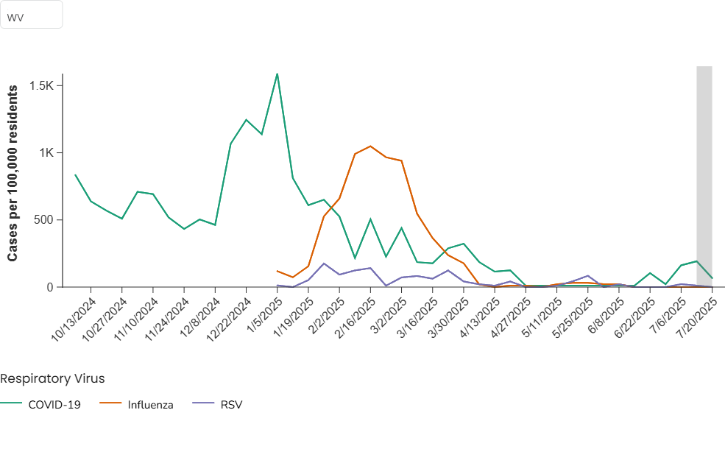
How is this Relevant to WV?
Notes:
This chart shows COVID, influenza, and RSV cases in residents of WV over the age of 60

Slide 3
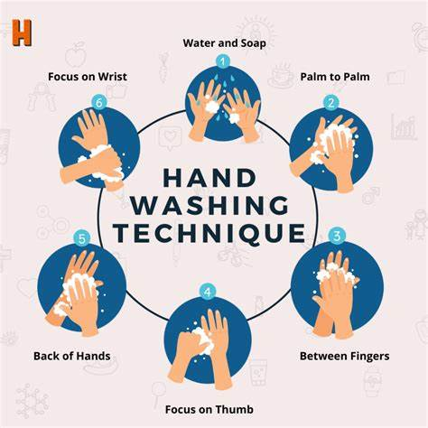
When Should You Wash Your Hands?
Before and after eating
After using the restroom
After changing diapers or assisting with the restroom
After touching high-contact surface
After contact with bodily fluids (blood, urine, saliva)

Slide 4
The 5 Steps to Proper Handwashing
Wet your hands with clean, running water (warm or cold), turn off the tap, and apply soap
1
Lather your hands by rubbing them together with the soap. Lather the back of your hands, between your fingers, and under you nails
2
Scrub your hands for at least 20 seconds. Need a timer? Hum the “Happy Birthday” song from beginning to end twice
3
Rinse your hands well under clean, running water
4
Dry your hands using a clean towel or an air dryer
5

Slide 5
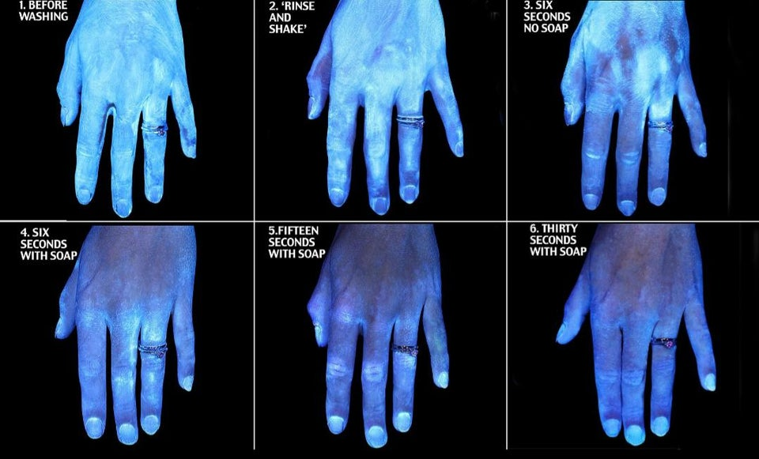
5 Common Handwashing Mistakes to Avoid
Not scrubbing long enough
Skipping fingertips/nails
Using too little soap or water
Not drying hands thoroughly
Missing key areas like thumbs of between fingers

Slide 6
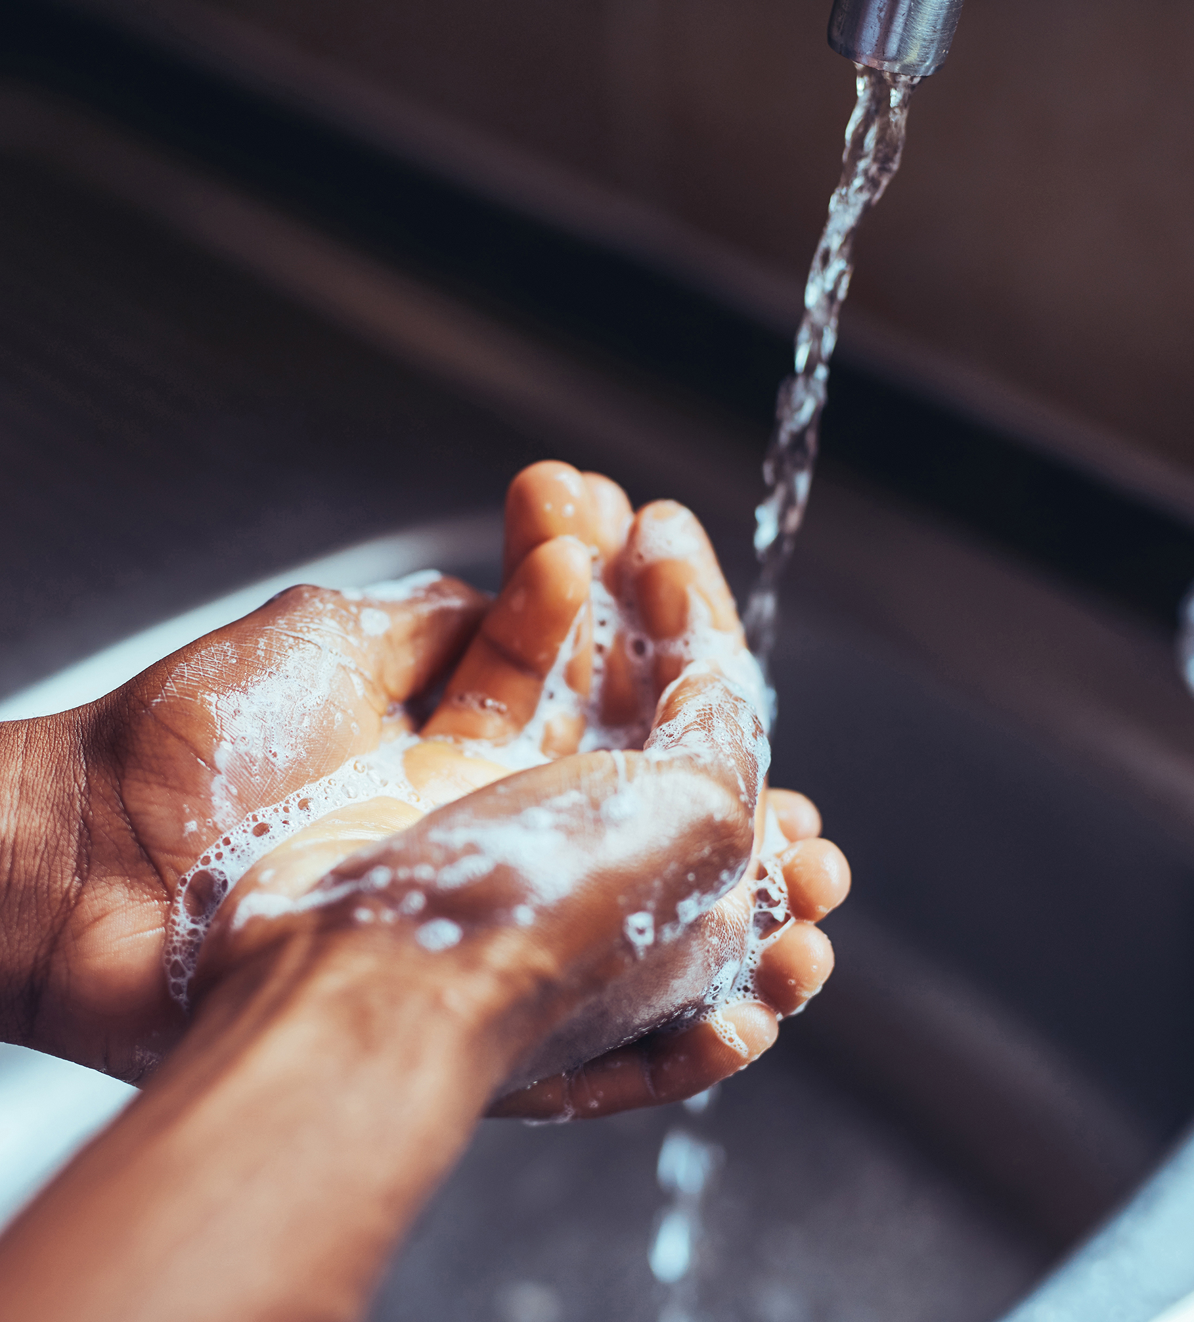
Knowledge Check
What is the most missed area when washing hands?
Palms
Fingertips
Wrists
Thumbs

Slide 7
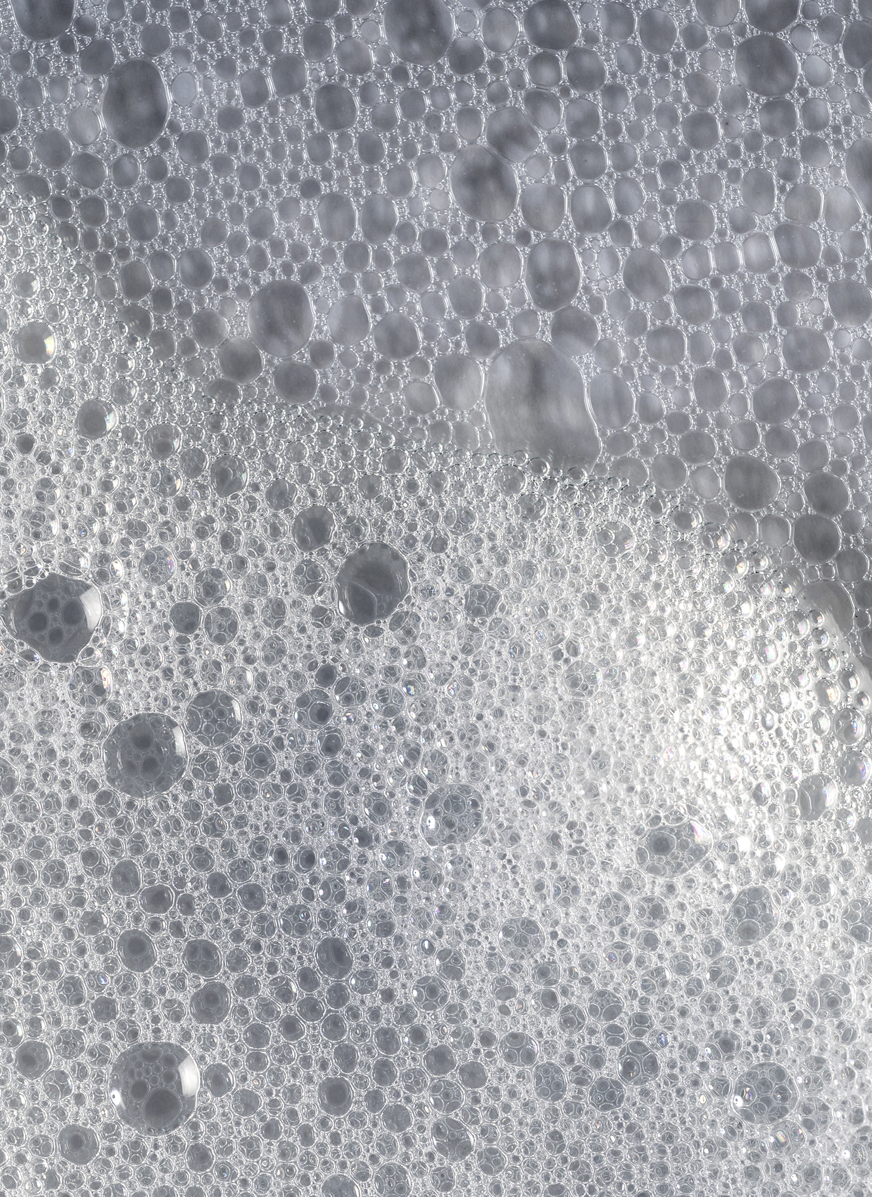
Correct Answer is D
Here’s Why:
  People tend to focus on the palms and fingers, and may forget to rotate and clean around thumbs
  The standard hygiene washing motion (rubbing palms together) doesn’t naturally include the thumbs unless you consciously clean them
  WHO’s recommended hand hygiene technique include a specific step for the thumbs: “rotational rubbing of left thumb clasped in right palm and vice versa.”

Slide 8
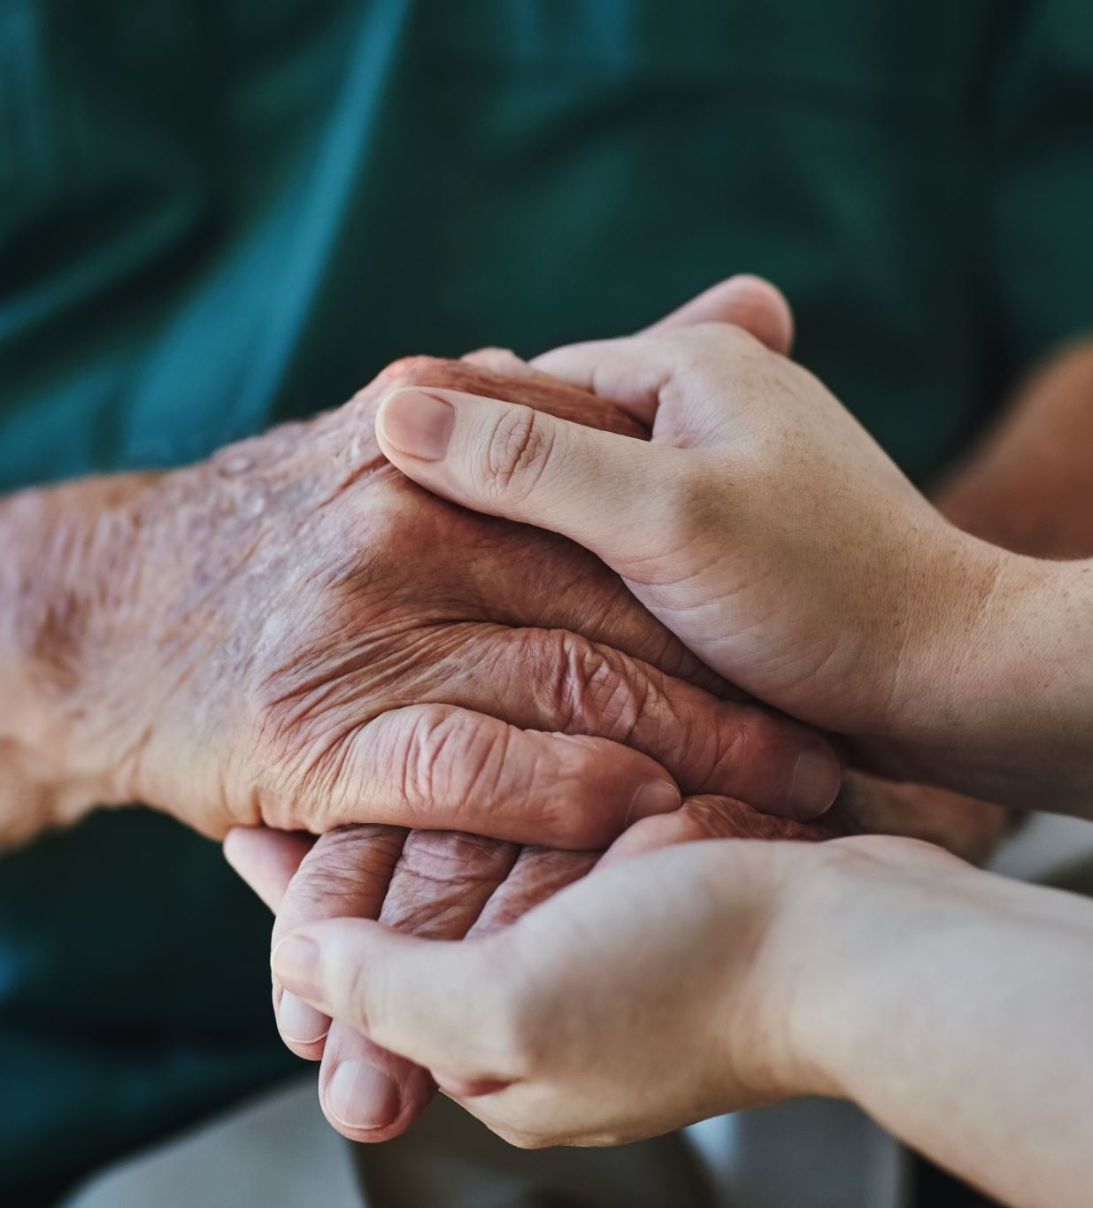
What diseases does Handwashing Prevent?
Respiratory Infections (COVID-19, Influenza, Pneumonia)
Diarrheal Diseases (Salmonella, E. Coli and Norovirus)
Reducing the number of these infections by washing hands frequently helps prevent the overuse of antibiotics- the single most important factor leading to antibiotic resistance around the world
  Handwashing can also prevent people from getting sick with germs that are already resistant to antibiotics and that can be difficult to treat
Notes:
Elderly individuals have compromised immune systems, making it easier for respiratory pathogens to take hold
The close living quarters make these viruses spread quickly. For individuals with weakened immune systems, handwashing benefits are even more significant, reducing diarrheal illness by 58%. A single gram of human feces, about the weight of a paper clip, can obtain one trillion germs.

Slide 9
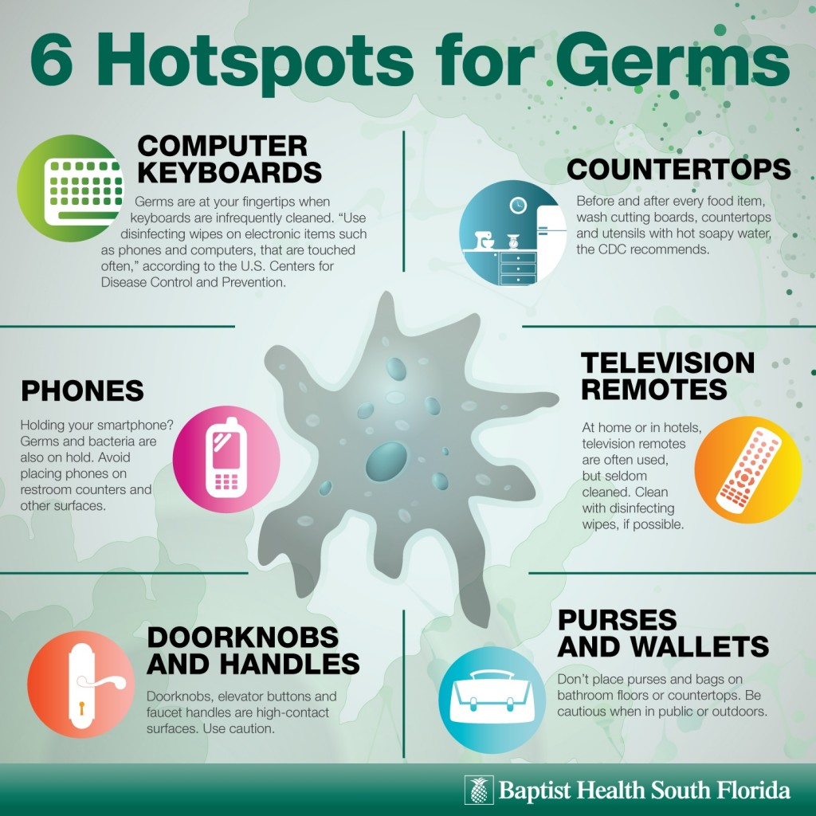
Germs aren’t just on hands!
Germs can live on bedrails, doorknobs, light switches, light switches, call buttons, wheelchairs/mobility aids and shared medical equipment
Germs can survive on these surfaces for extended periods of time even up to 48 hours

Slide 10
Reservoirs: Where Germs Live
Water and Wet Surfaces: Moist environments provide ideal conditions for bacteria to grow. Germs from these surfaces can enter the body through splashes, sprays, or direct contact.
Dry Surfaces: Germs from the air, human body, and stool can survive on surfaces for days or even weeks. Common high-touch surfaces like bed rails, light switches, doorknobs, and keyboards are especially likely to harbor these germs.
Dust and Dirt: Germs that live in soil or dust are generally not harmful to healthy individuals but can pose serious risks to those with weakened immune systems.
Medical Devices: Germs on medical equipment can spread through direct contact or when the device is used during procedures that introduce bacteria into the bloodstream or other parts of the body.

Slide 11
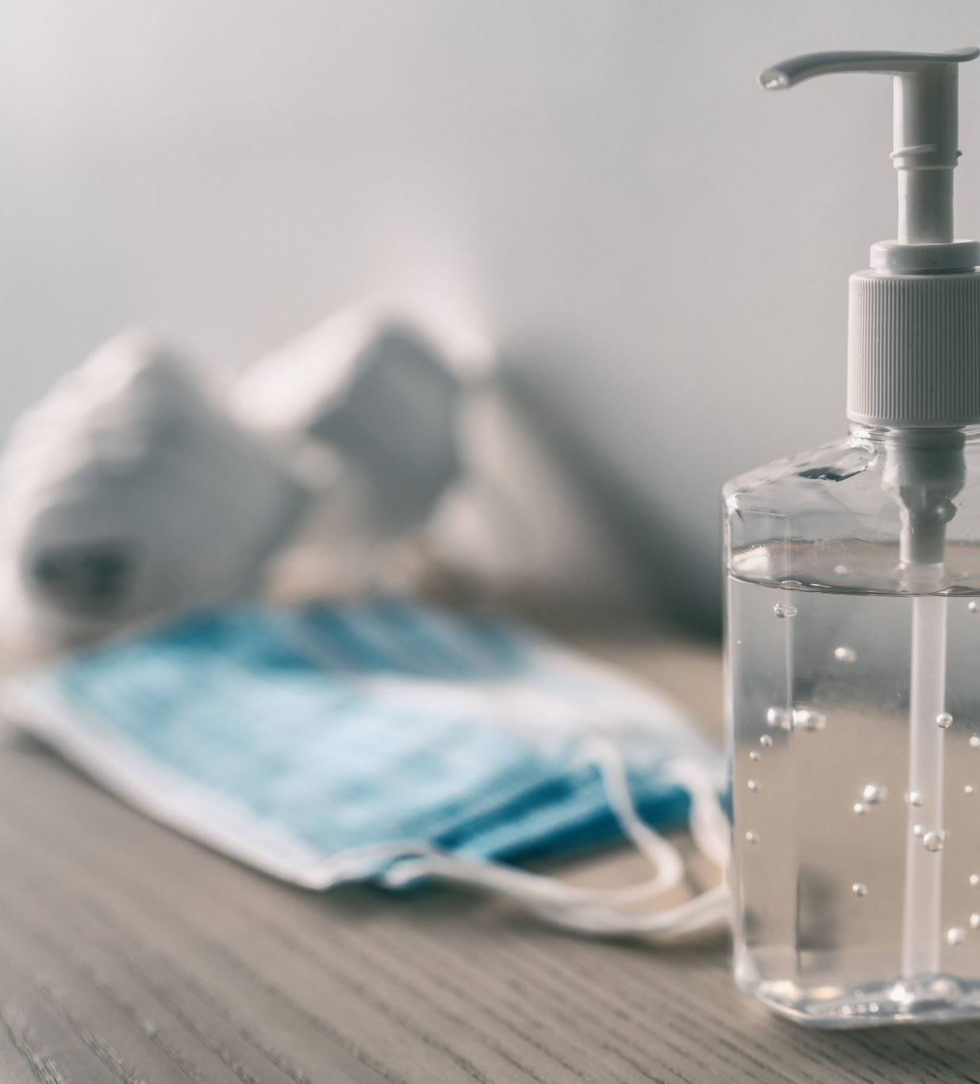
When to use Hand Sanitizer instead of Soap and Water
Use Hand Sanitizer (60%+ alcohol when)
  Hands are not visibly dirty or soiled
  After touching shared surfaces or equipment
  When moving between clean and contaminated tasks
  When soap and water is not available

Slide 12
When to use Soap and Water, NOT Hand Sanitizer
  Use Soap and Water:
  Hands are visibly dirty or soiled
  After contacts with patients or surfaces with the following pathogens:
    C. diff, Norovirus, Anthrax
  After using the restroom
  Before eating or handling food
  After cleaning bathrooms or dealing with fecal contamination
  If hands feel sticky or have chemical residue
Notes:
Pathogens form spores that are not likely killed by alcohol-based hand sanitizers

Slide 13
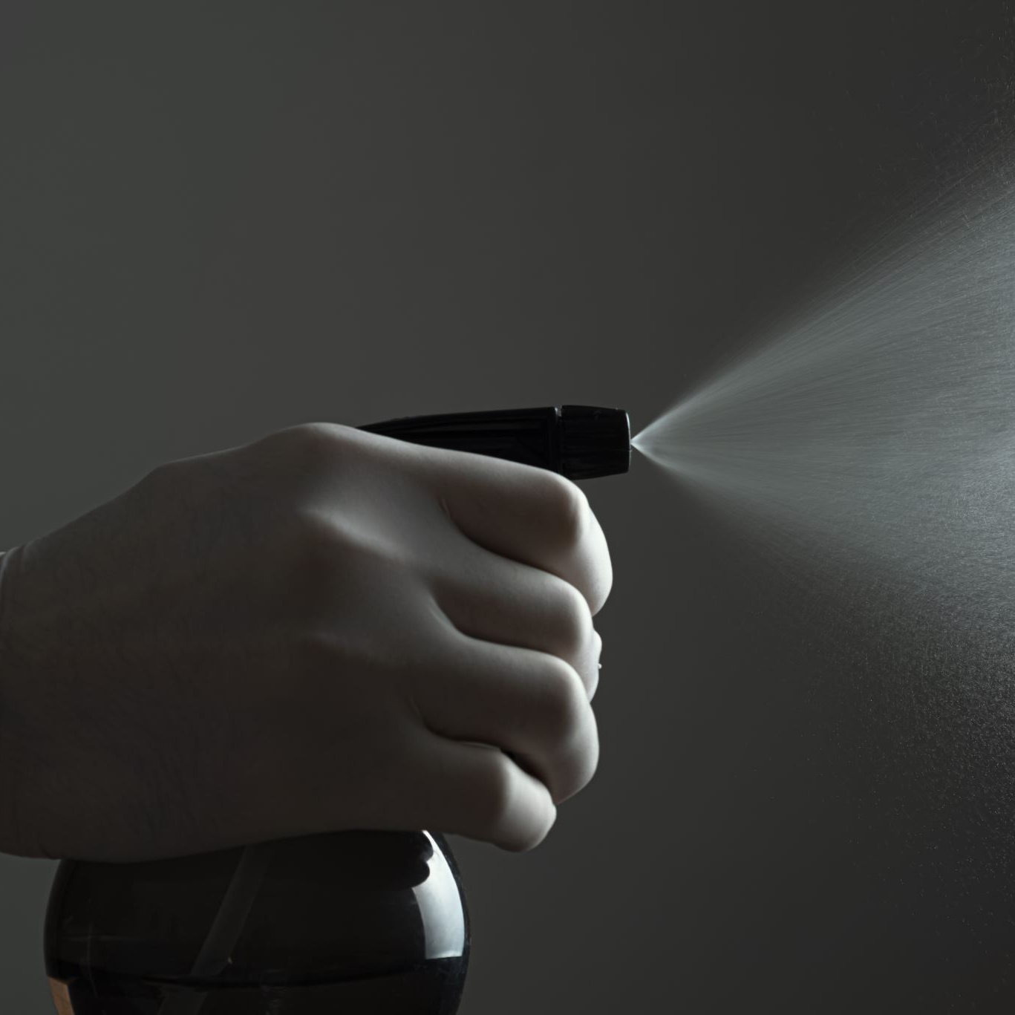
Remember: It isn’t just all about handwashing!
It’s important to clean and sanitize shared surfaces to break the chain of infection
Hand hygiene remains essential in preventing the spread of germs, but cleaning high-touch surfaces also plays a vital role

Slide 14
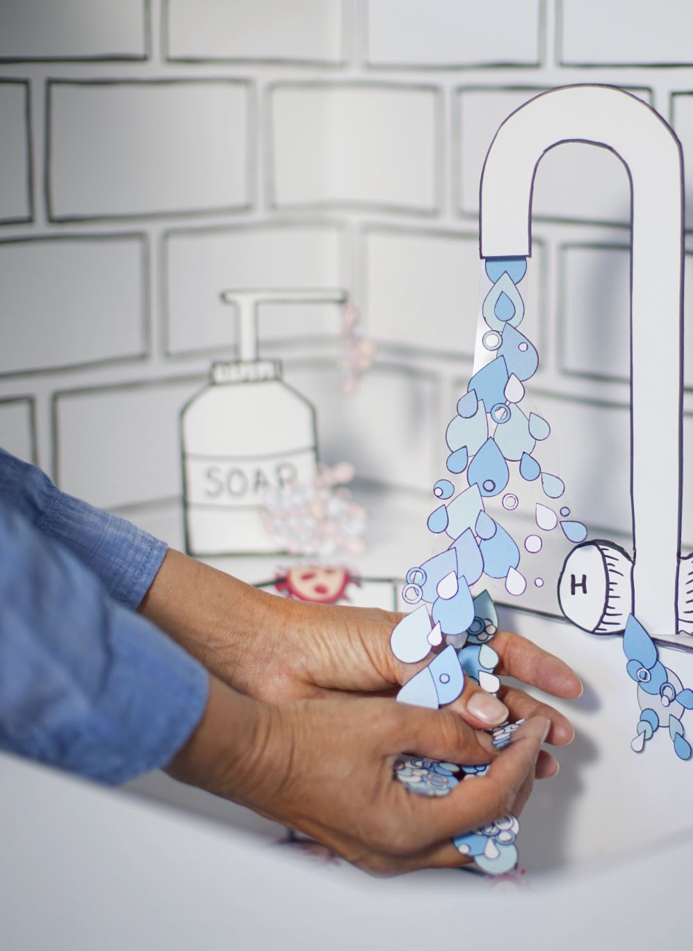
Conclusion
Hand hygiene is the most effective method of breaking the chain of infection from the hands, which are major vehicles for transmission in healthcare settings
By practicing proper handwashing, both staff and residents can significantly reduce the spread of infections, ensuring a safer, healthier environment for everyone

Slide 15
Resources
https://pmc.ncbi.nlm.nih.gov/articles/PMC8754384/
https://www.who.int/teams/integrated-health-services/infection-prevention-control/hand-hygiene
https://www.cdc.gov/Clean-Hands/About/Hand-Hygiene-for-Healthcare.html
https://www.cdc.gov/clean-hands/hcp/clinical-safety/?CDC_AAref_Val=https://www.cdc.gov/handhygiene/providers/index.html

Slide 16
Questions?

