Slide 1
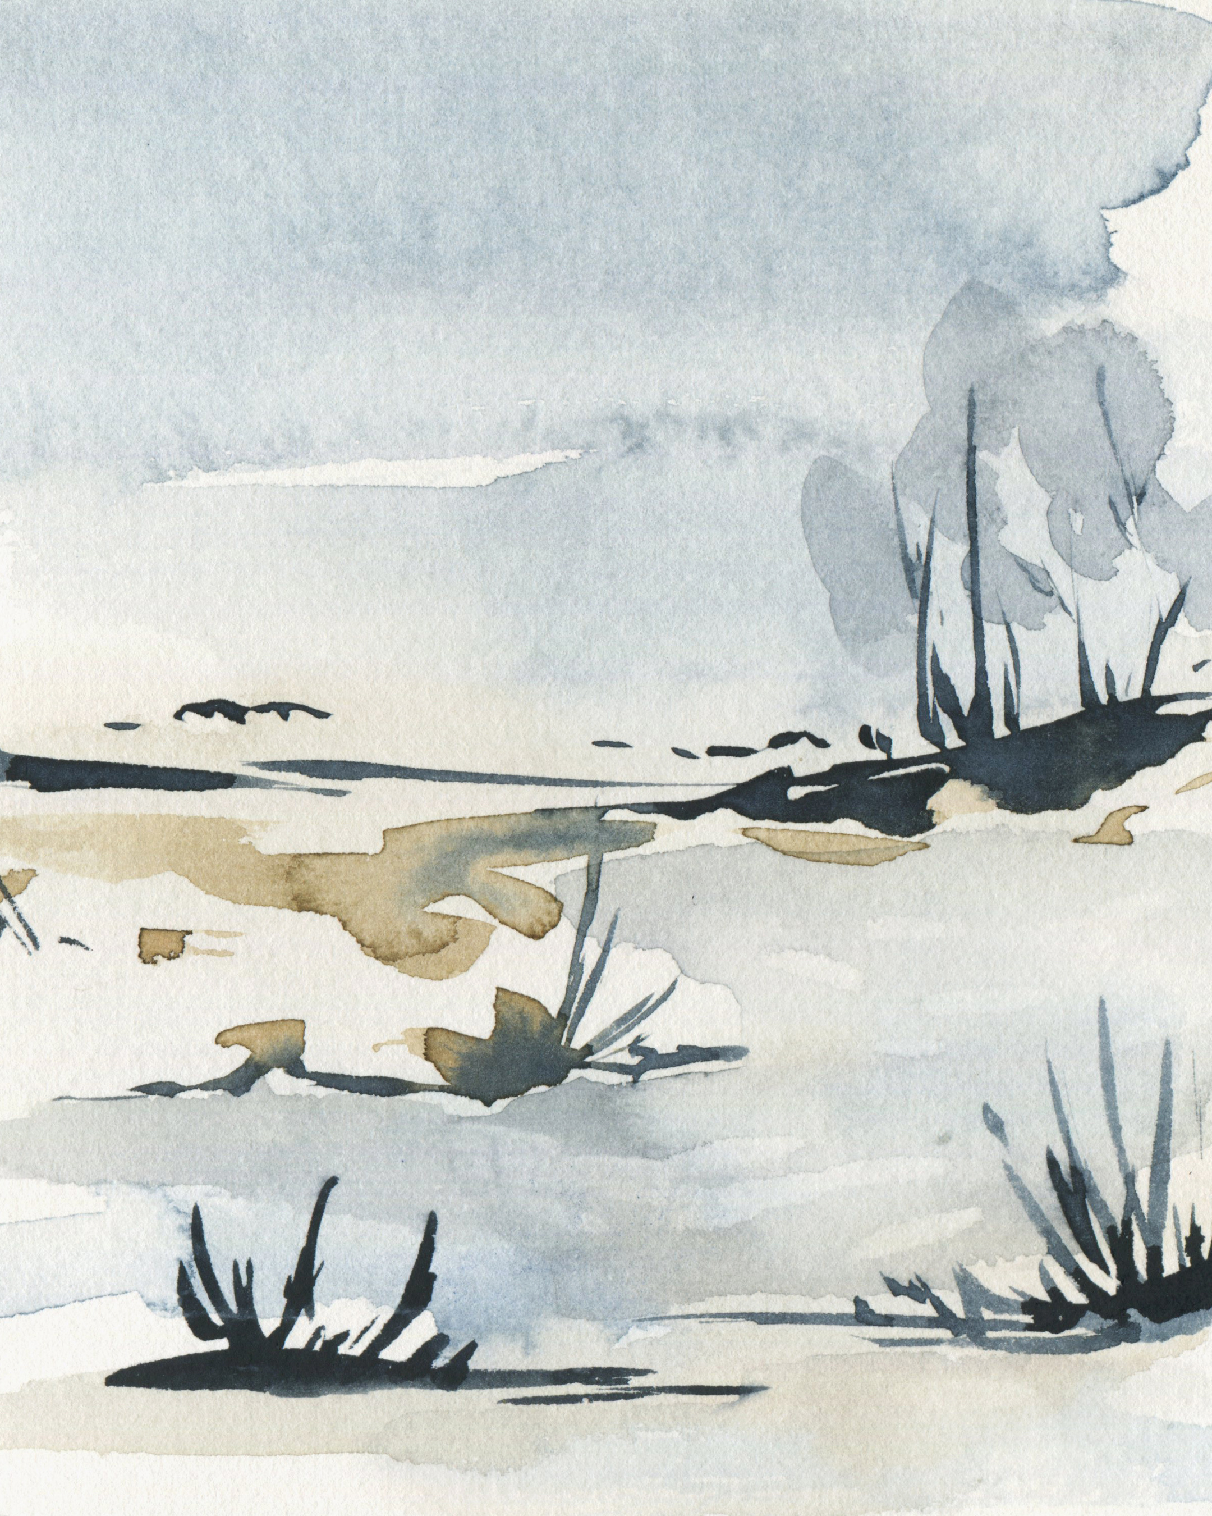



2026
SUN | MON | TUE | WED | THU | FRI | SAT
 |  |  |  | 1 | 2 | 3
4 | 5 | 6 | 7 | 8 | 9 | 10
11 | 12 | 13 | 14 | 15 | 16 | 17
18 | 19 | 20 | 21 | 22 | 23 | 24
25 | 26 | 27 | 28 | 29 | 30 | 31
National Radon Action Month
National One Health Awareness Month
Thank Your Mentor Day
International Day of Clean Energy
Radon Awareness Week
MORE RELEVANT OBSERVANCES
National Mentoring Month
Family Fit Lifestyle Month
National Birth Defects Awareness Month

Slide 2


2026
SUN | MON | TUE | WED | THU | FRI | SAT
1 | 2 | 3 | 4 | 5 | 6 | 7
8 | 9 | 10 | 11 | 12 | 13 | 14
15 | 16 | 17 | 18 | 19 | 20 | 21
22 | 23 | 24 | 25 | 26 | 27 | 28
Earthquake Awareness Month
World Wetlands Day
MORE RELEVANT OBSERVANCES
American Heart Month

Slide 3
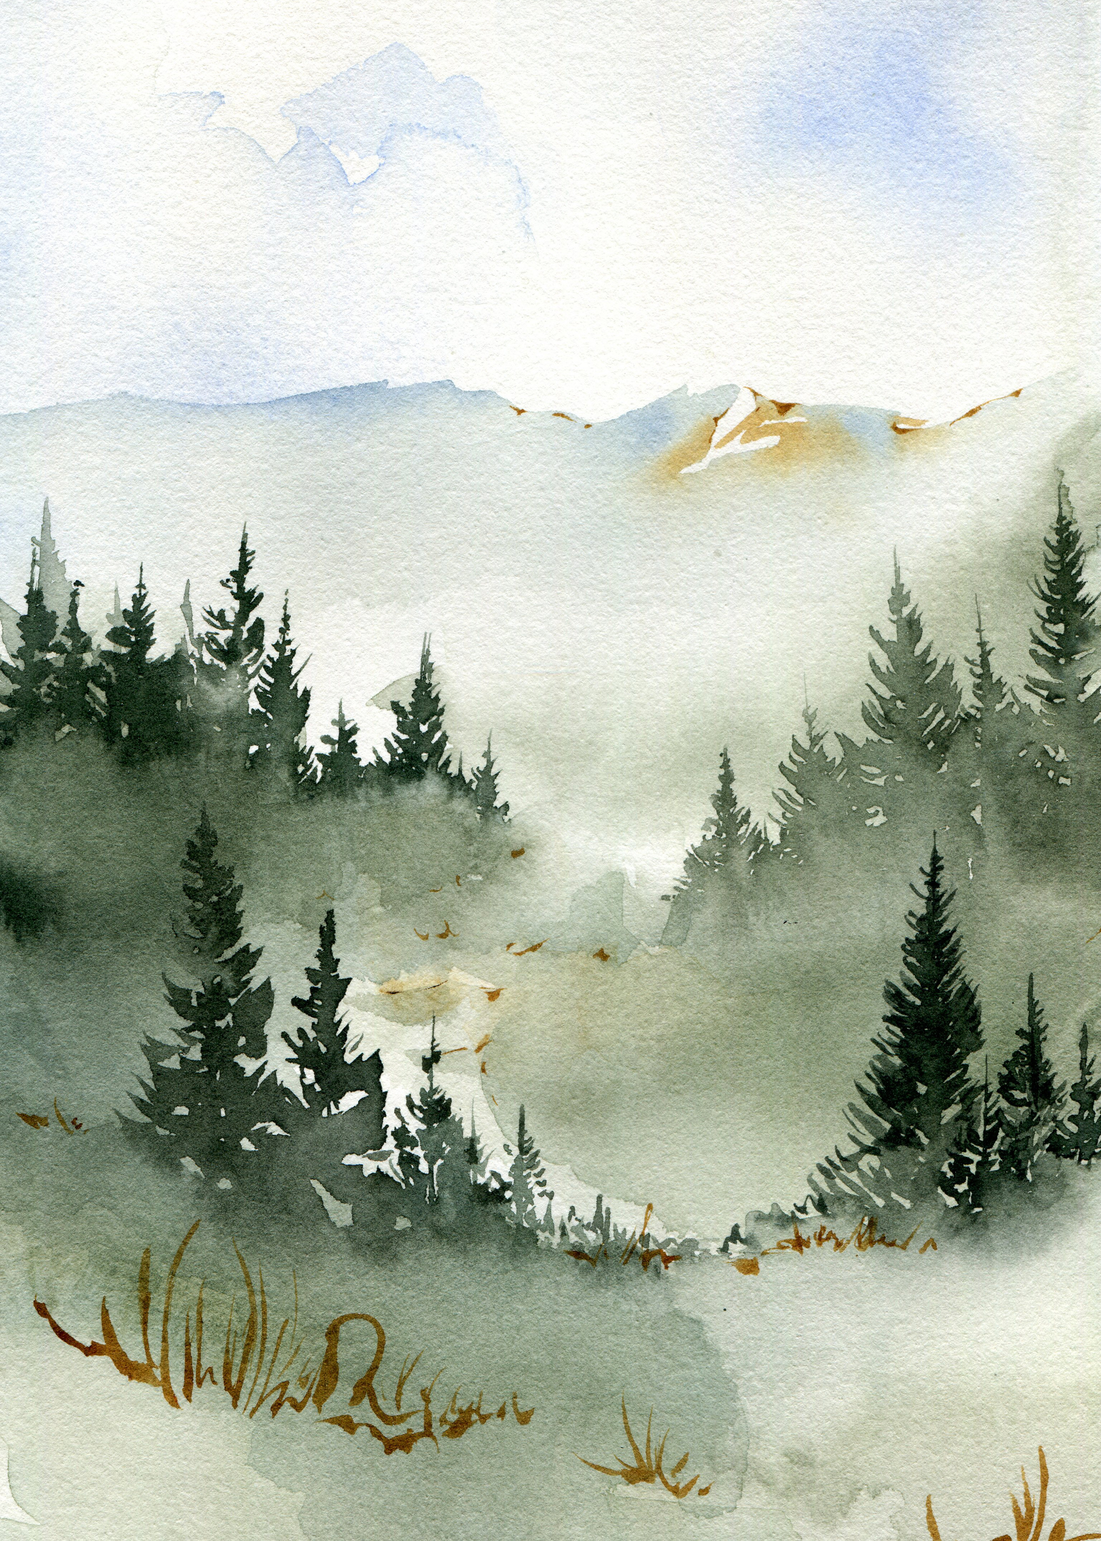

2026
SUN | MON | TUE | WED | THU | FRI | SAT
1 | 2 | 3 | 4 | 5 | 6 | 7
8 | 9 | 10 | 11 | 12 | 13 | 14
15 | 16 | 17 | 18 | 19 | 20 | 21
22 | 23 | 24 | 25 | 26 | 27 | 28
29 | 30 | 31
World Seagrass Day
World Wildlife Day
National Groundwater Awareness Week
International Day of Action for Rivers
World Day for Glaciers
International Day of Forests
World Water Day
World Meteorological Day
MORE RELEVANT OBSERVANCES
Women’s History Month
National Tsunami Awareness Week

Slide 4


2026
SUN | MON | TUE | WED | THU | FRI | SAT
 |  |  | 1 | 2 | 3 | 4
5 | 6 | 7 | 8 | 9 | 10 | 11
12 | 13 | 14 | 15 | 16 | 17 | 18
19 | 20 | 21 | 22 | 23 | 24 | 25
26 | 27 | 28 | 29 | 30
National Healthy Homes Month
Citizen Science Month
National Public Health Week
World Health Day
2026 Preparedness Summit
Earth Day
World Malaria Day
MORE RELEVANT OBSERVANCES
National Park Week
National ParkRx Day
National Minority Health Month

Slide 5
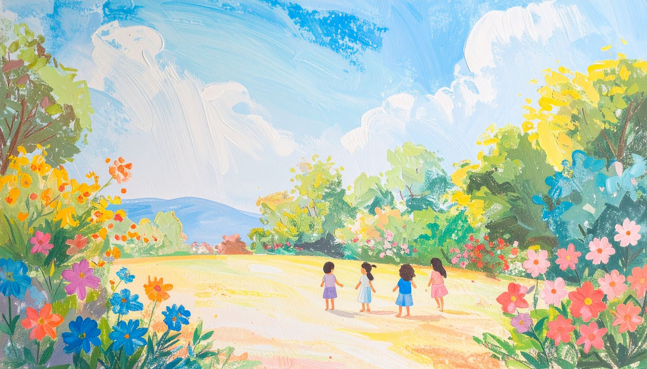

2026
SUN | MON | TUE | WED | THU | FRI | SAT
 |  |  |  |  | 1 | 2
3 | 4 | 5 | 6 | 7 | 8 | 9
10 | 11 | 12 | 13 | 14 | 15 | 16
17 | 18 | 19 | 20 | 21 | 22 | 23
24 | 25 | 26 | 27 | 28 | 29 | 30
31
Lyme Disease Awareness Month
Wildfire Awareness Month
Drinking Water Week
World Asthma Day
Provider Appreciation Day
World Hand Hygiene Day
Food Allergy Awareness Week
Heat Safety Week
MORE RELEVANT OBSERVANCES
National Water Safety Month
Healthy and Safe Swimming Week
National Asthma and Allergy Awareness Month
Air Quality Awareness Week
National Hurricane Preparedness Week

Slide 6


2026
SUN | MON | TUE | WED | THU | FRI | SAT
 | 1 | 2 | 3 | 4 | 5 | 6
7 | 8 | 9 | 10 | 11 | 12 | 13
14 | 15 | 16 | 17 | 18 | 19 | 20
21 | 22 | 23 | 24 | 25 | 26 | 27
28 | 29 | 30
National Safety Month
World Environment Day
Heat Action Day
World Food Safety Day
World Day to Combat Desertification and Drought
United Nations Public Service Day
MORE RELEVANT OBSERVANCES
National Mosquito Control Awareness Week

Slide 7


2026
MID-YEAR CHECK-IN:
YOU’RE DOING BETTER THAN YOU THINK.
SUN | MON | TUE | WED | THU | FRI | SAT
 |  |  | 1 | 2 | 3 | 4
5 | 6 | 7 | 8 | 9 | 10 | 11
12 | 13 | 14 | 15 | 16 | 17 | 18
19 | 20 | 21 | 22 | 23 | 24 | 25
26 | 27 | 28 | 29 | 30 | 31
UV Safety Month
Lakes Appreciation Month
NACCHO360 Annual Conference
World Drowning Prevention Day
MORE RELEVANT OBSERVANCES
National Environmental Public Health Tracking Awareness Week

Slide 8
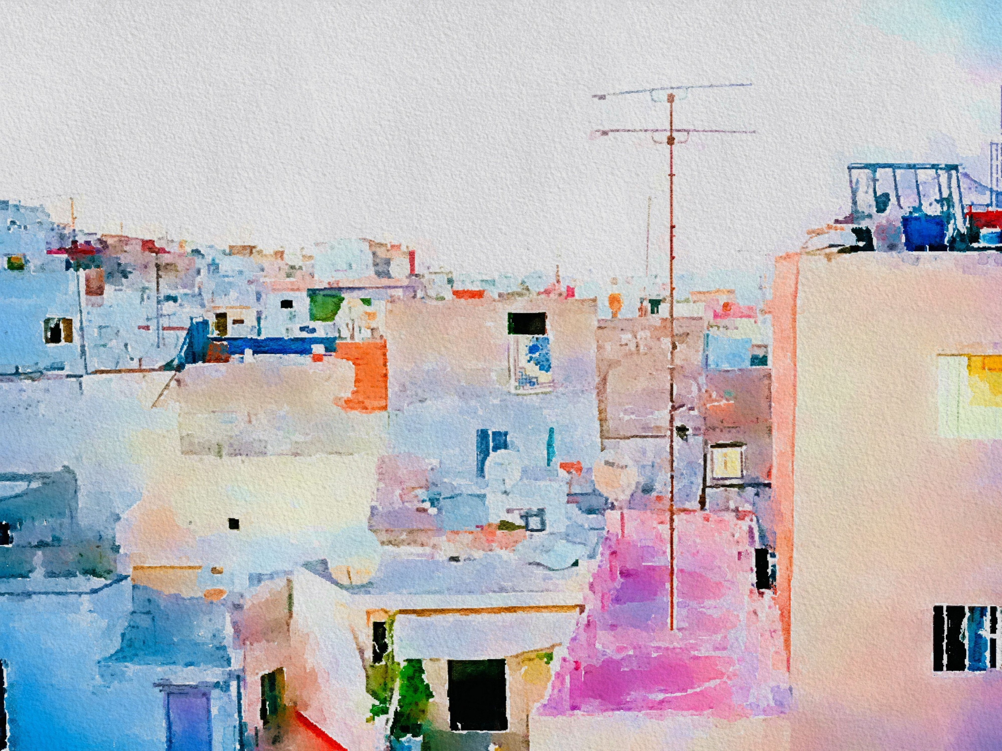

2026
SUN | MON | TUE | WED | THU | FRI | SAT
 |  |  |  |  |  | 1
2 | 3 | 4 | 5 | 6 | 7 | 8
9 | 10 | 11 | 12 | 13 | 14 | 15
16 | 17 | 18 | 19 | 20 | 21 | 22
23 | 24 | 25 | 26 | 27 | 28 | 29
30 | 31
National Water Quality Month
World Mosquito Day
World Lake Day

Slide 9


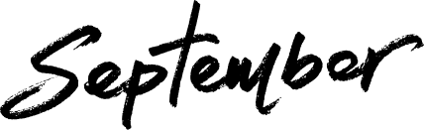
2026
SUN | MON | TUE | WED | THU | FRI | SAT
 |  | 1 | 2 | 3 | 4 | 5
6 | 7 | 8 | 9 | 10 | 11 | 12
13 | 14 | 15 | 16 | 17 | 18 | 19
20 | 21 | 22 | 23 | 24 | 25 | 26
27 | 28 | 29 | 30
National Food Safety Education Month
National Preparedness Month
International Day of Clean Air for Blue Skies
Septic Smart Week
National Public Lands Day
World Environmental Health Day
World Rivers Day
MORE RELEVANT OBSERVANCES
Protect Your Groundwater Day
Mesothelioma Awareness Day

Slide 10
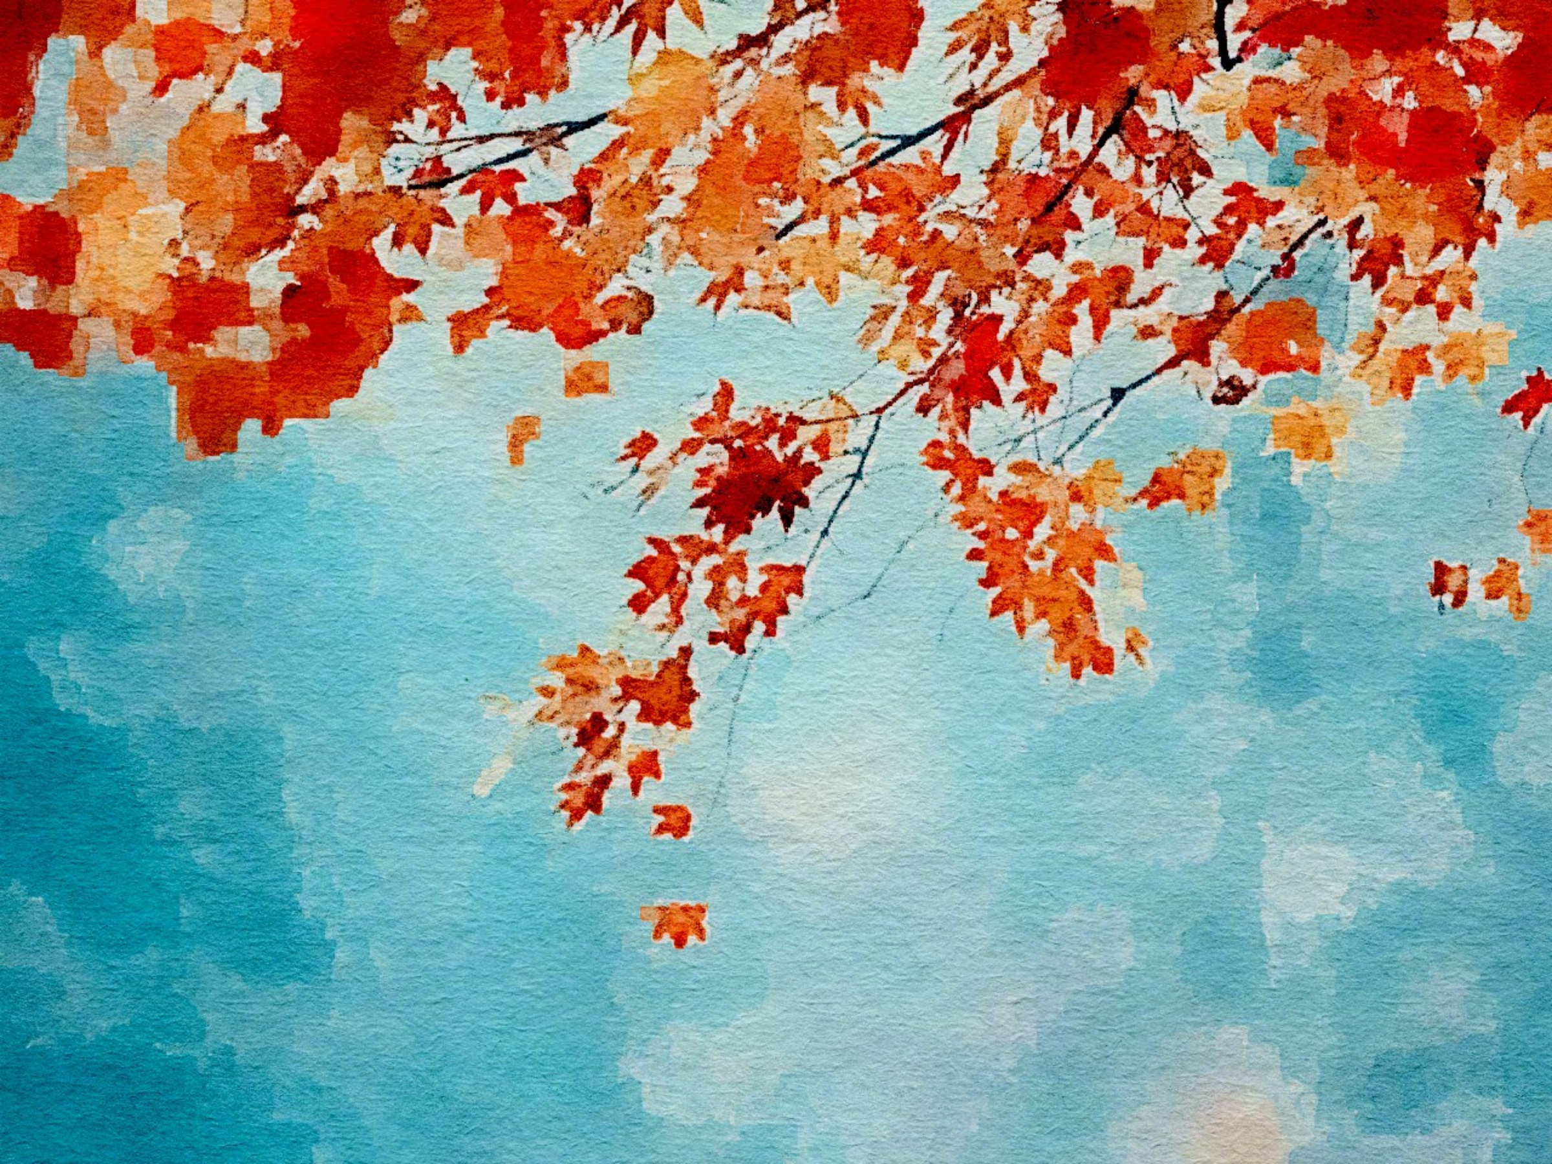

2026
SUN | MON | TUE | WED | THU | FRI | SAT
 |  |  |  | 1 | 2 | 3
4 | 5 | 6 | 7 | 8 | 9 | 10
11 | 12 | 13 | 14 | 15 | 16 | 17
18 | 19 | 20 | 21 | 22 | 23 | 24
25 | 26 | 27 | 28 | 29 | 30 | 31
Healthy Lung Month
International Day of Older Persons
National Fire Prevention Week
Children’s Environmental Health Day
World Mental Health Day
World Habitat Day
International Day for Disaster Risk Reduction
Global Handwashing Day
World Food Day
World Cities Day
MORE RELEVANT OBSERVANCES
International ShakeOut Day
National Lead Poisoning Prevention Week
National Health Education Week

Slide 11
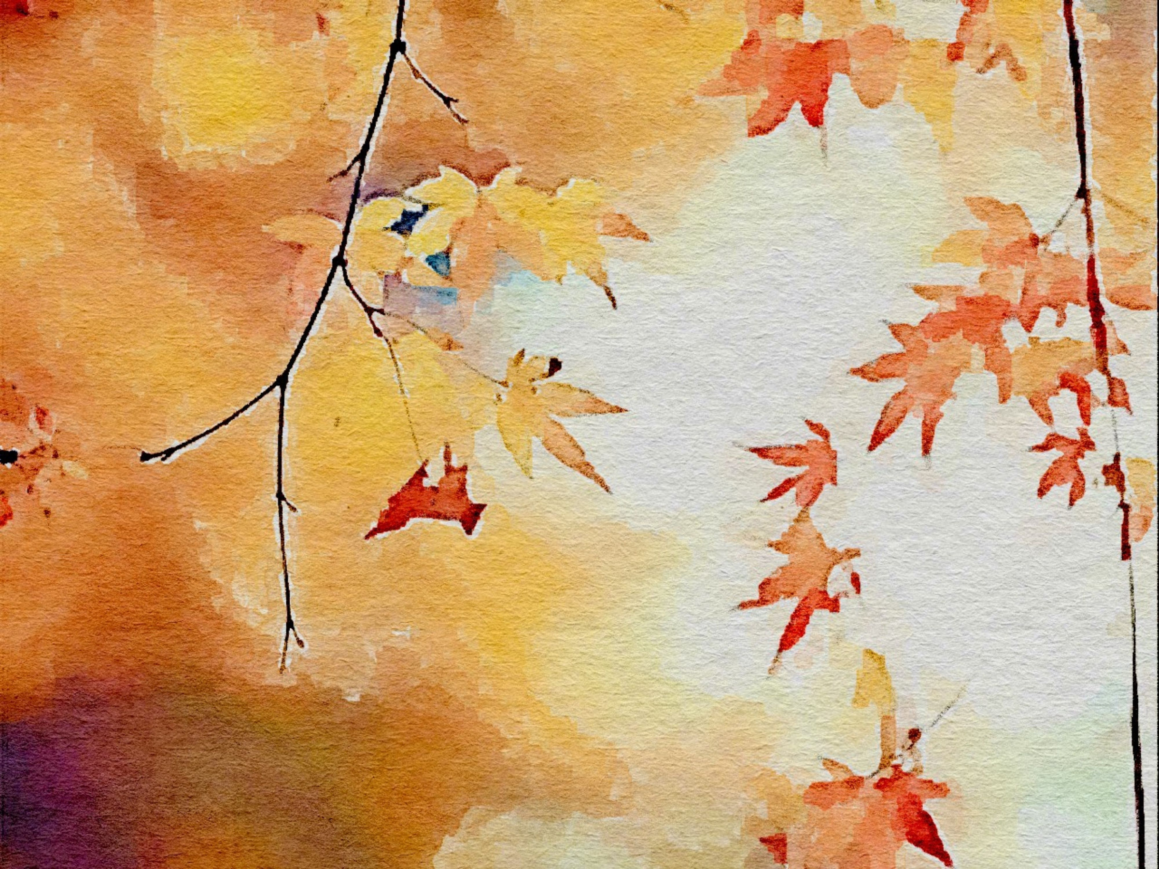

2026
SUN | MON | TUE | WED | THU | FRI | SAT
1 | 2 | 3 | 4 | 5 | 6 | 7
8 | 9 | 10 | 11 | 12 | 13 | 14
15 | 16 | 17 | 18 | 19 | 20 | 21
22 | 23 | 24 | 25 | 26 | 27 | 28
29 | 30
One Health Day
World Tsunami Awareness Day
National Rural Health Day
Public Health Thank You Day

Slide 12
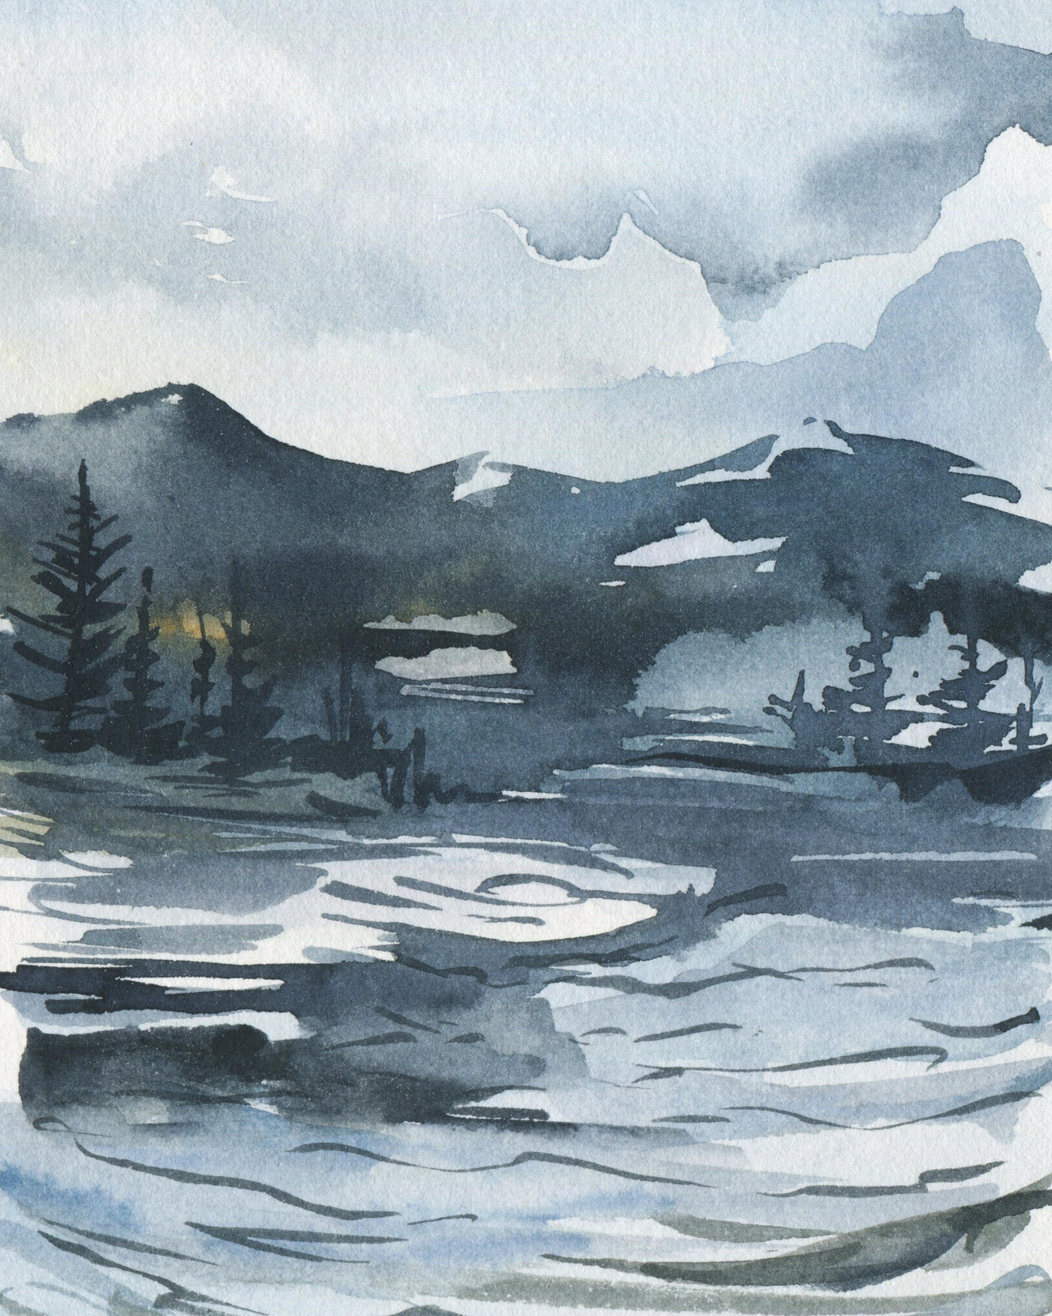

2026
SUN | MON | TUE | WED | THU | FRI | SAT
 |  | 1 | 2 | 3 | 4 | 5
6 | 7 | 8 | 9 | 10 | 11 | 12
13 | 14 | 15 | 16 | 17 | 18 | 19
20 | 21 | 22 | 23 | 24 | 25 | 26
27 | 28 | 29 | 30 | 31
Safe Toys and Gifts Month
International Mountain Day
MORE RELEVANT OBSERVANCES
#WinterReady

Slide 13












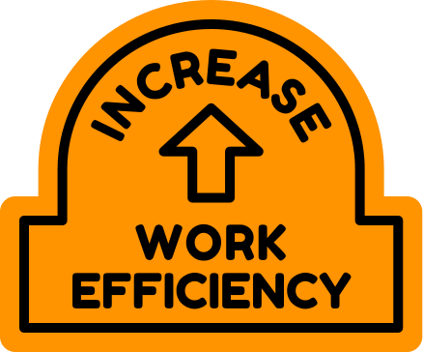














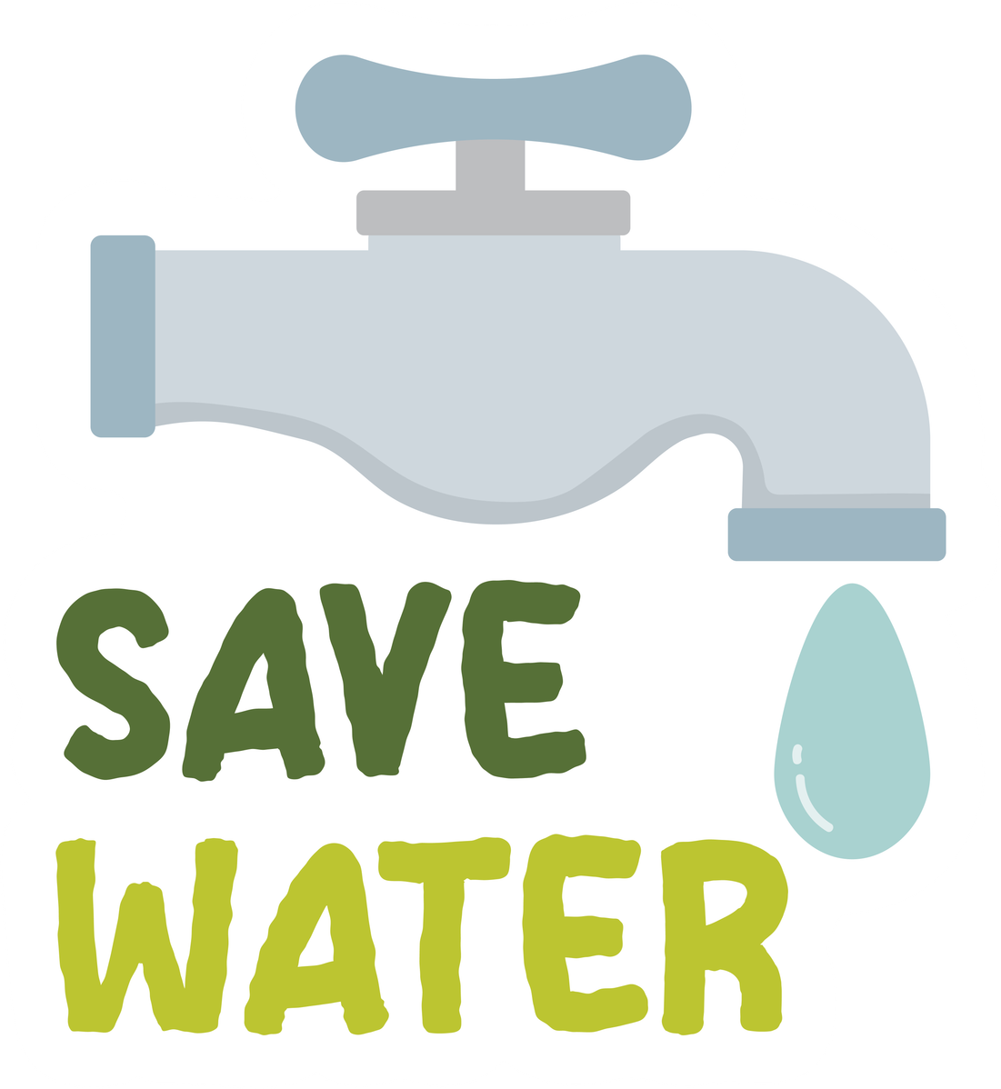



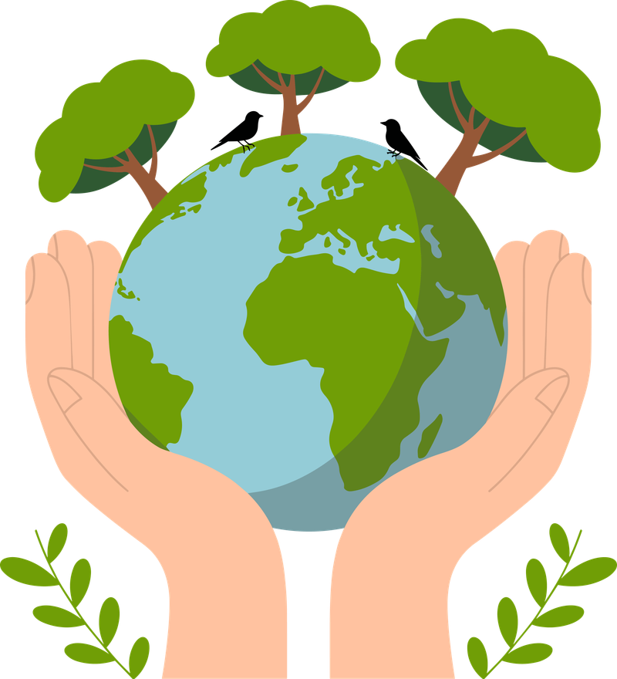


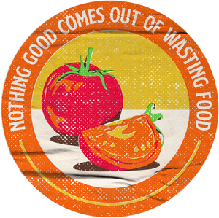





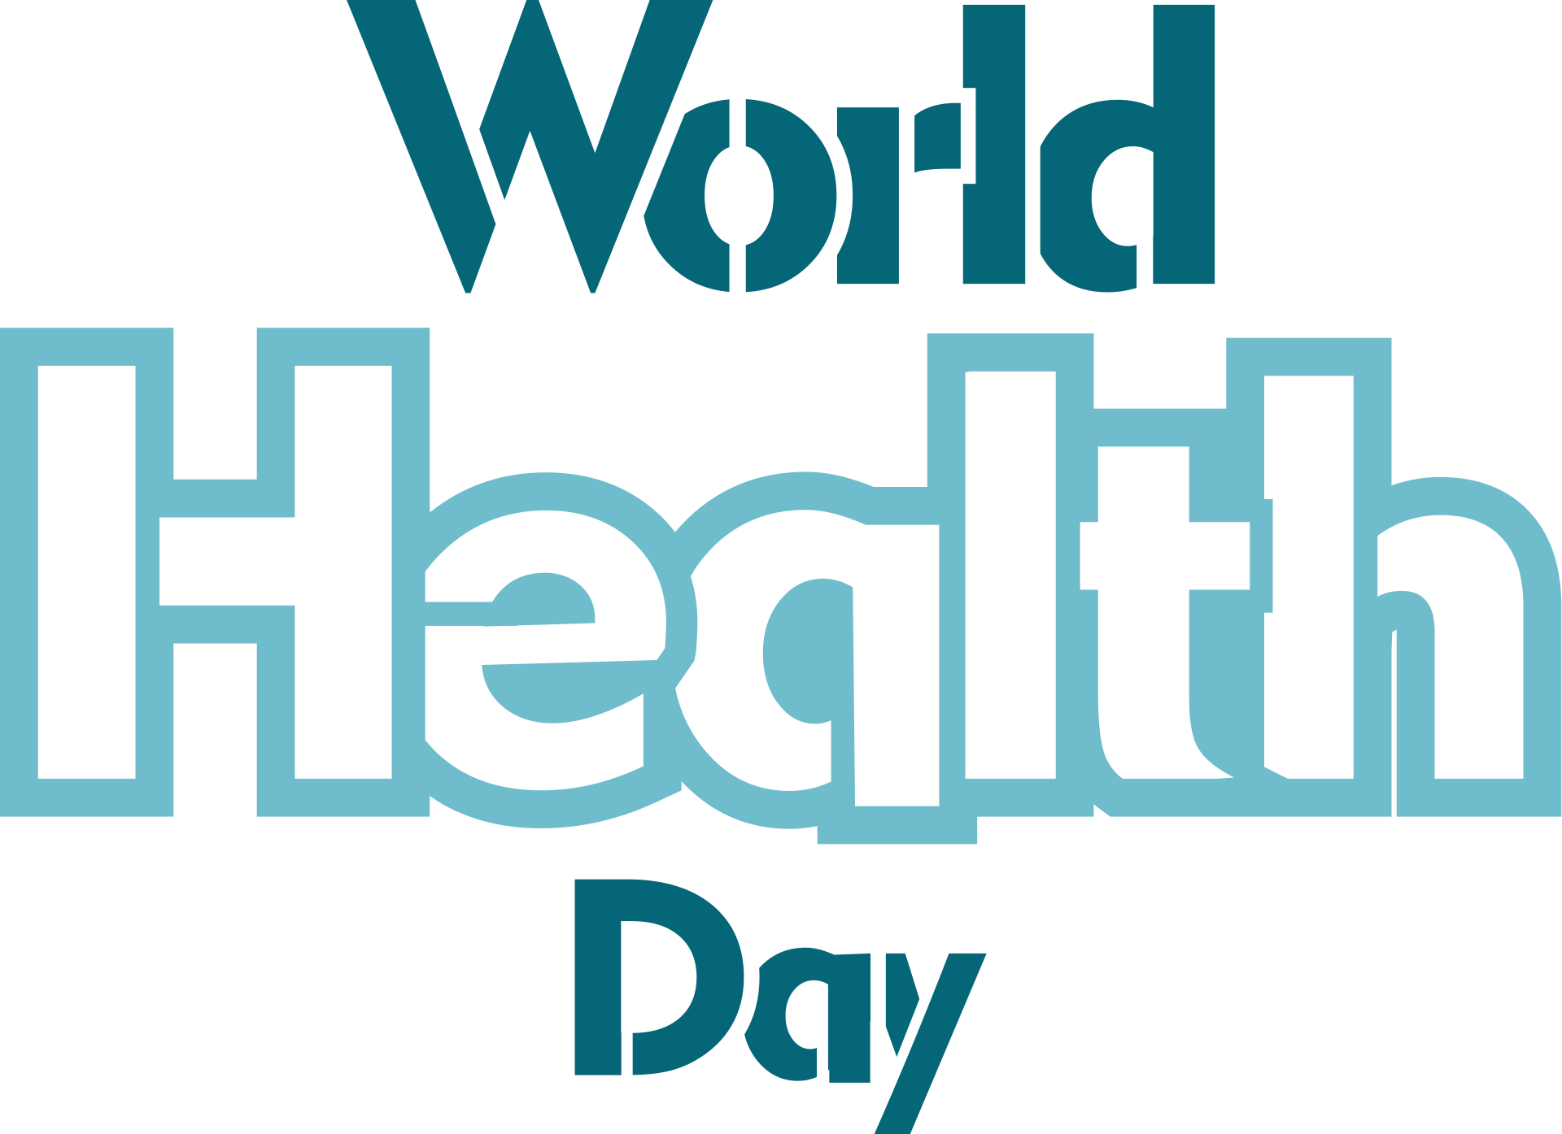






















TEAM MEETING
TOWN HALL MEETING
workgroup call
in the field
CONFERENCE CALLL
WORLD MOSQUIT DAY
World Environmental Health Day
NACCHO CONFERENCE
NATIONAL PARK WEEK

