Slide 1
Emergency Mosquito Control After Hurricanes
National Center for Emerging and Zoonotic Infectious Diseases
Janet McAllister, PhD, BCE
Division of Vector Borne-Diseases
Arboviral Diseases Branch
Fort Collins, CO

Slide 2
Disclaimers
“
“The findings and conclusions in this presentation are written by authors serving in their capacity as CDC employees and do not necessarily represent an official view of the Centers for Disease Control and Prevention.”
Material for this presentation comes from the FEMA website and article co-written with a FEMA employee, Stephanie Madson.
  Federal Assistance for Mosquito Abatement Postdisaster or during disease outbreaks. J Am Mosq Control Assoc. 36(2S):74-77, 2020
  https://www.fema.gov

Slide 3
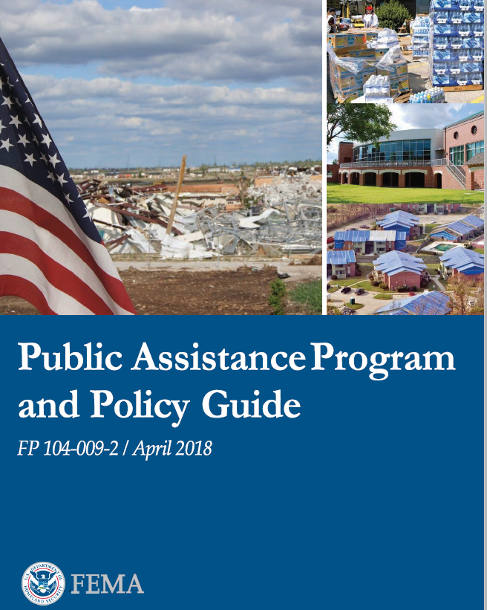
FP 104-009-2 Eligibility of Vector Control (Mosquito Abatement)
PURPOSE: This policy describes the criteria the Federal Emergency Management Agency will use to determine eligibility for vector control (mosquito abatement) measures.
AUTHORITY: Section 403 of the Robert T. Stafford Disaster Relief and Emergency Assistance Act, 42 U.S.C. 5121-5206, and 44 CFR §206.225(a)(3)(i).
https://www.fema.gov/media-library/assets/documents/111781

Slide 4


Types of Aid
Public Assistance – Work that can be done by State, Territory, Tribe or Local Government (STTL)
Direct Federal Assistance – When impact is so severe the STTL lacks capability to perform or contract work, STTL may ask Federal Government to aid directly

Slide 5
Cost Eligibility
Directly ties to performance of eligible work
Adequately documented
Authorized and not prohibited by Law
Consistent with applicants' internal policies
Necessary and reasonable to accomplish the work properly and efficiently

Slide 6
Eligible work
Mosquito abatement measures may be eligible when a State, Territorial, Tribal, or local government public health official validates in writing that a mosquito population poses a specific health threat as discussed further in Appendix G: Mosquito Abatement. FEMA consults with the CDC to determine the eligibility of mosquito abatement activities. FEMA only provides PA funding for the increased cost of mosquito abatement. This is the amount that exceeds the average amount based on the last 3 years of expenses for the same period.

Slide 7
What’s Covered?
Personnel – overtime, and in some cases straight time
Supplies – purchased and taken from stock
Equipment and Purchased Equipment
  Example – vehicle mileage, flight time, sprayer time
Mutual Aid
Contracts
  Fixed price, cost-reimbursement and time and materials (T&M)

Slide 8
Adequately documented
Keep your records for a minimum of 3 years
Records needed:
  Personnel time
  Equipment logs
  Amount of supplies
  Contracts activated or executed specific to the even
  Surveillance

Slide 9
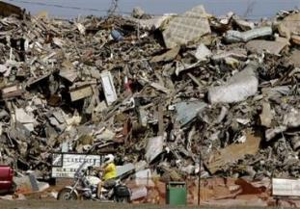
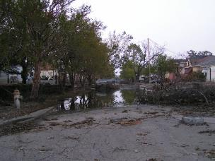
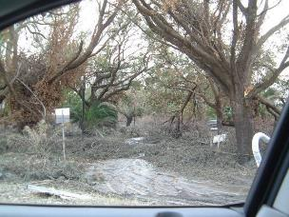
Control
Unusual conditions exist after storms
  Disruption of navigation/communication
  Drivers/pilots unfamiliar with area
  Training issues
  Canyon effect
  Safety – unlit streets and towers
  Impassible streets
Assoc. Press

Slide 10
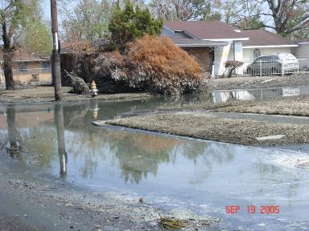
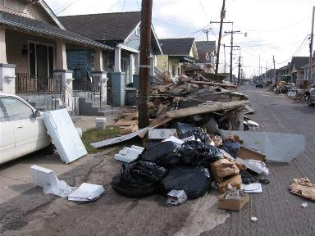
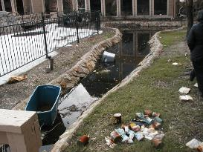
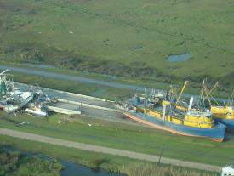
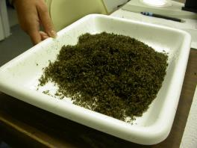
Common problems

Slide 11
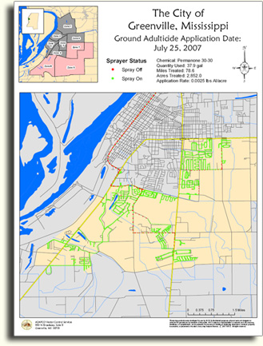
Properly and efficiently
Effectiveness is dependent on infrastructure landscaping and environmental conditions
Coverage is limited in scope – 1 truck can only cover a small number of miles in a night, about 1000 acres
Greenville is ~17,728 acres

Slide 12
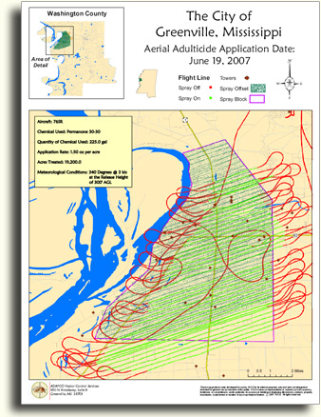
Properly and efficiently
Single plane can treat ~40,000 -60,000 acres in a night
Not dependent on road systems so less gapping in treatment area

Slide 13
Properly and efficiently
Greenville: 17,728 acres (27.7 mi²)
Truck:
~ 17 nights
Aircraft:
< 1 night

Slide 14
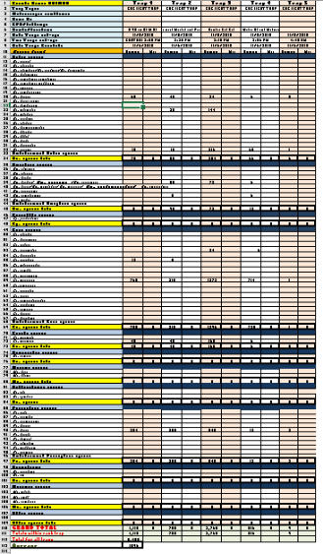
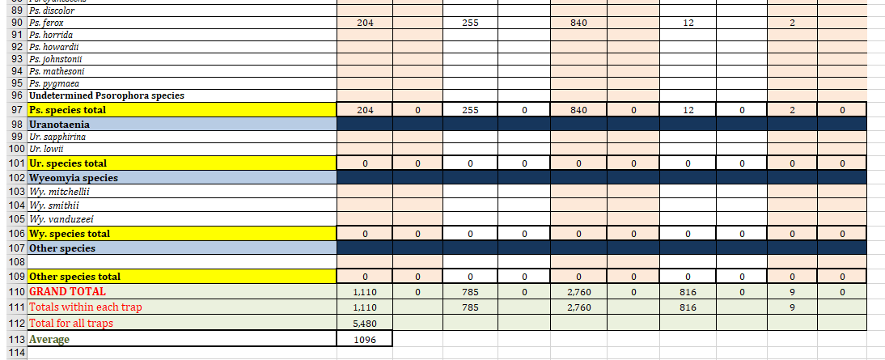
Example of surveillance data:

Slide 15
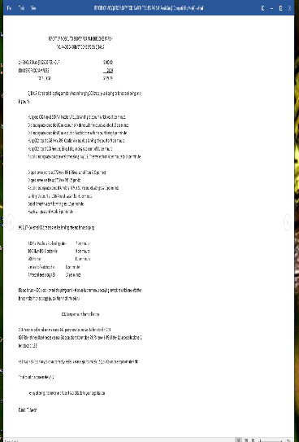
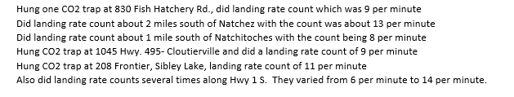

Examples of surveillance data:

Slide 16
Relevant surveillance data
FEMA only provides PA funding for the increased cost of mosquito abatement due to increased mosquito/disease
Data should cover the relative time, i.e. same epiweeks as the event and reimbursement period
To the extent possible, data should come from same collection sites in the impacted area
Clean data is appreciated!!

Slide 17
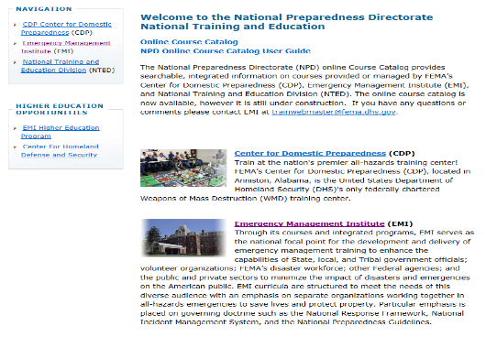
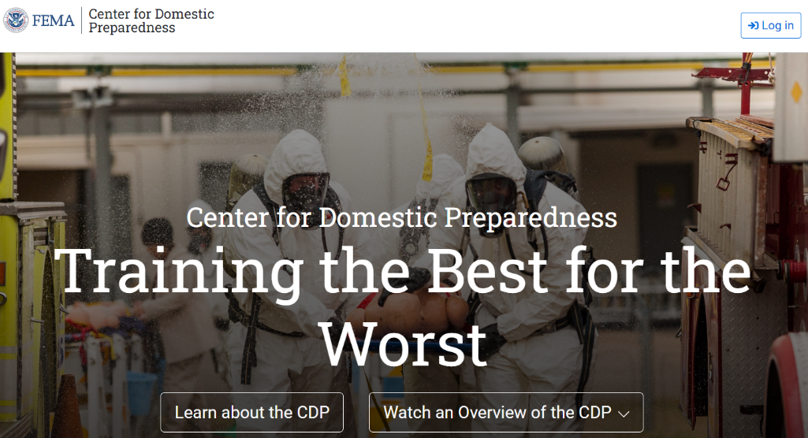
Training Opportunities
FEMA
www.training.fema.gov
Center for Domestic Preparedness in Anniston, AL
https://cdp.dhs.gov

Slide 18
Questions?

