Slide 1
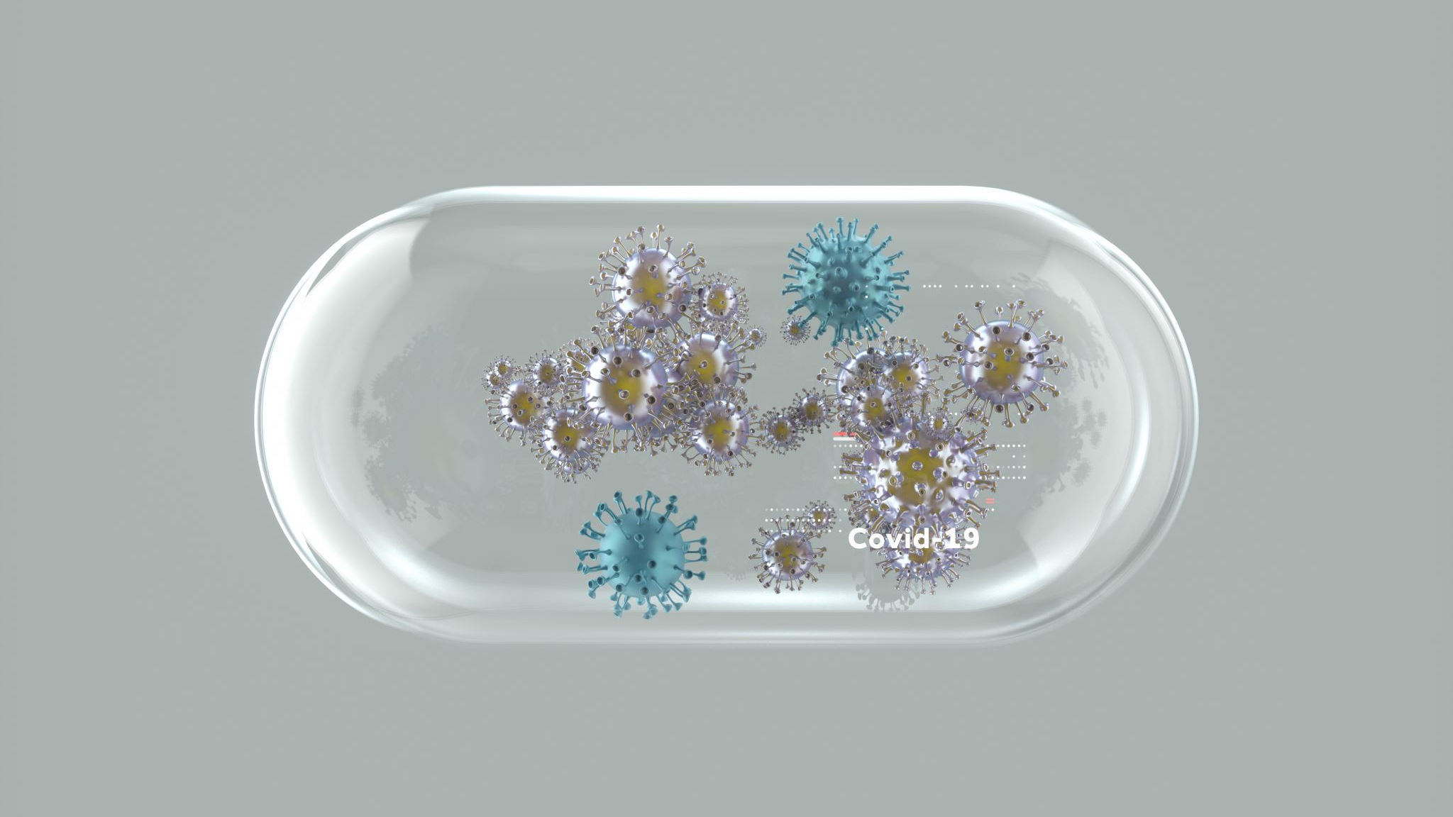
Infection Prevention & Control
Faith Gandy and Alyssa Reed
Infection Prevention Educator Epidemiologists
Cabell-Huntington Health Department

Slide 2

Purpose
Reduce the risk of infections spreading between residents/patients and staff
Ensure that residents, who are more susceptible to infections, are protected from preventable diseases
Promote a healthy living environment where both residents and staff are safeguarded from contagious infections

Slide 3
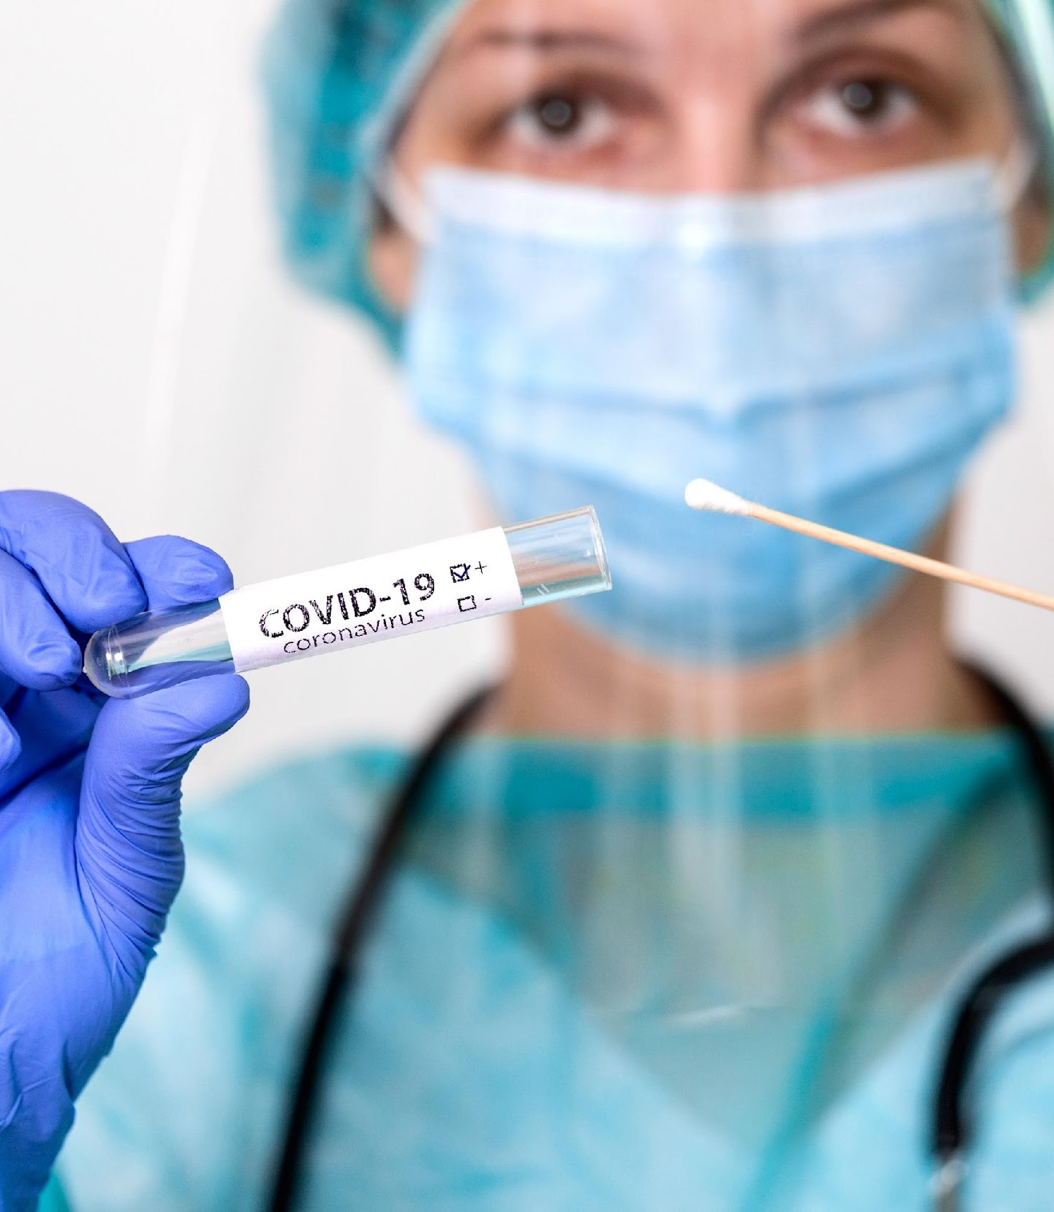
What is Infection Prevention and Control?
Infection Prevention and Control refers to a set of practices, guidelines, and protocols designed to prevent the spread of infections among residents, staff, and visitors
Understanding where germs thrive and how they spread is essential for recognizing potential risks and taking effective steps to prevent infection.
IPC effects all aspects of healthcare

Slide 4

Immunocompromised
Individuals with underlying health conditions or weakened immune systems may have a harder time fighting off infections.
Infections in these individuals can be more severe and potentially life threatening.
Recovery often takes longer compared to those with healthy immune systems.

Slide 5
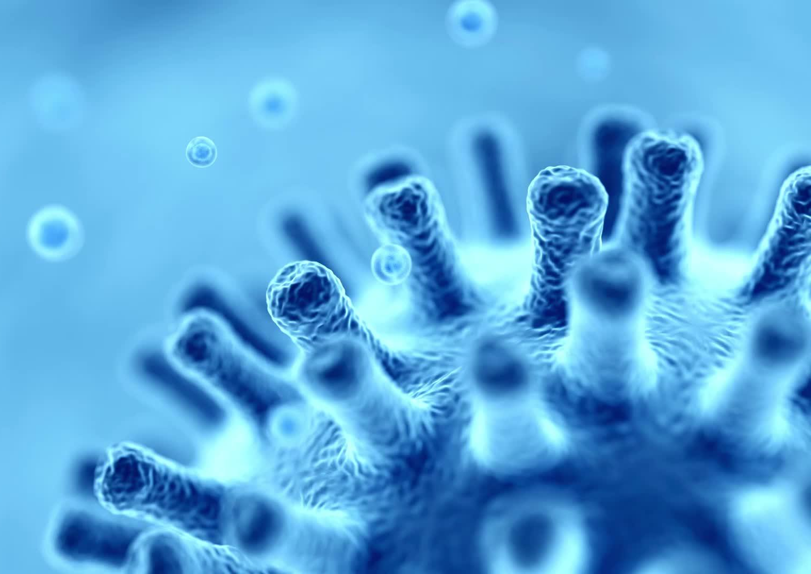
Germs
Not all germs are harmful, but pathogens are the ones that cause infections in humans
Spread through person-to-person, indirect contact, droplet transmission, airborne transmission, or fecal-oral route
Common germs in healthcare settings:
  Bacteria (E. Coli, Staph infections, MRSA)
  Viruses (Influenza, Norovirus, COVID-19)
  Fungi (Yeast infection)

Slide 6

Where Germs Live
Water and Wet Surfaces: Moist environments provide ideal conditions for bacteria to grow. Germs from these surfaces can enter the body through splashes, sprays, or direct contact.
Dry Surfaces: Germs from the air, human body, and stool can survive on surfaces for days or even weeks. Common high-touch surfaces like bed rails, light switches, doorknobs, and keyboards are especially likely to harbor these germs.
Dust and Dirt: Germs that live in soil or dust are generally not harmful to healthy individuals but can pose serious risks to those with weakened immune systems.
Medical devices: Germs on medical equipment can spread through direct contact or when the device is used during procedures that introduce bacteria into the bloodstream or other parts of the body.

Slide 7
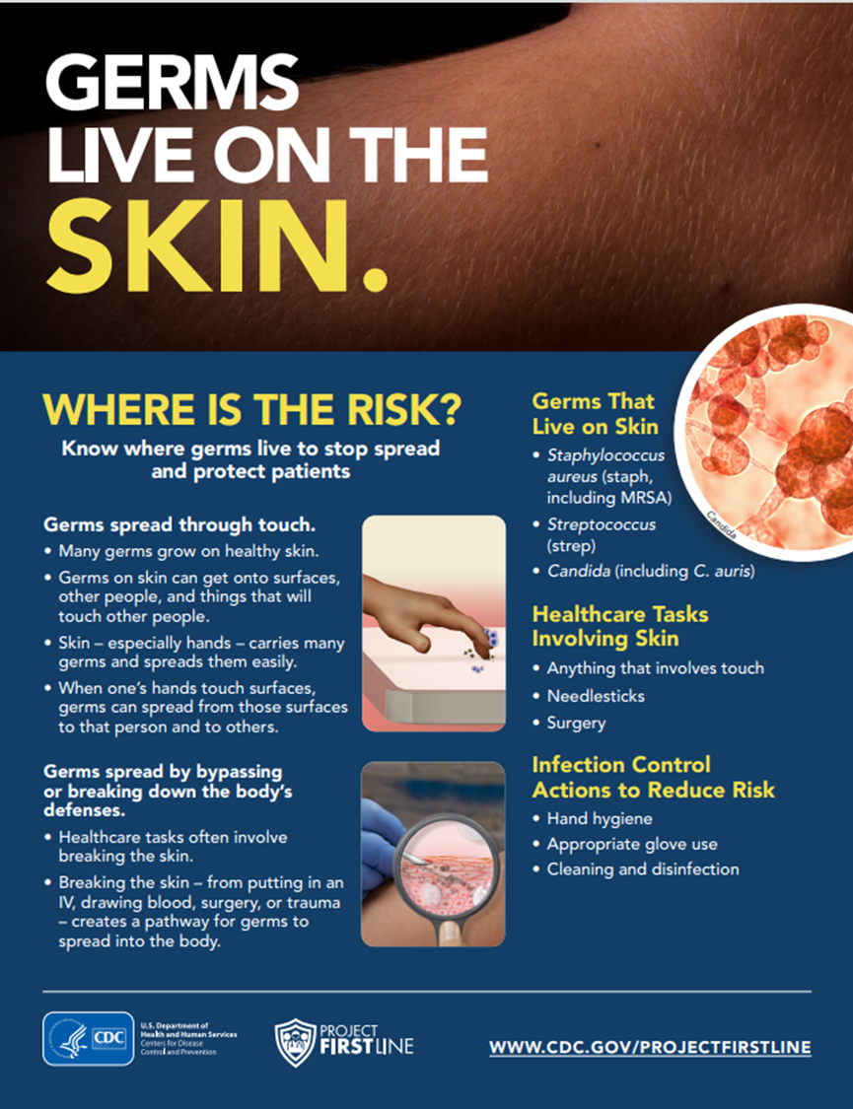
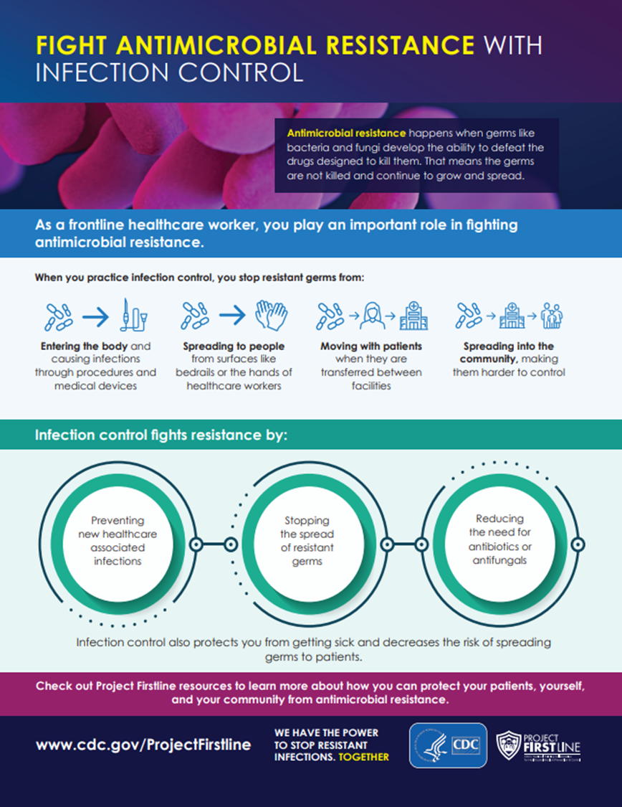
Notes:
MRSA lives on the skin and can be spread through direct contact. Hand washing is critical to reduce the risk. This is a poster from CDC project firstline if anyone is interested on getting themselves a copy.

Slide 8
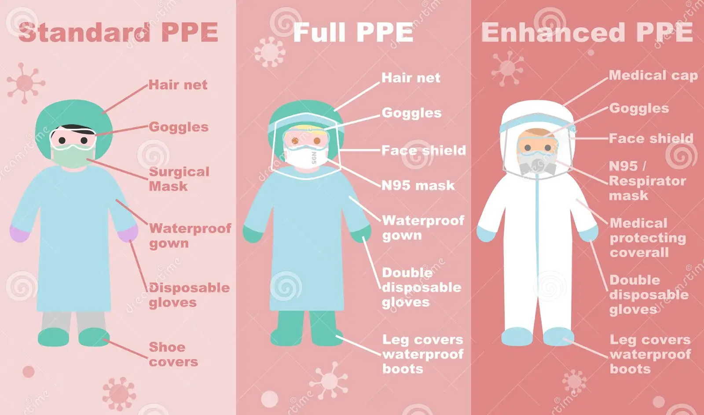
Personal Protective Equipment
Ensure correct donning and doffing of PPE to avoid contamination
Ensure appropriate disposal of PPE after use to prevent cross-contamination

Slide 9
What is the correct order for donning/ doffing PPE for environmental staff?
Gloves
Mask
Hand Hygiene
Eye protection
Gown
Notes:
Don: hand hygiene, gown, mask, eye protection, gloves
Doff: Remove gloves, gown, perform hand hygiene, remove eye protection, remove mask, hand hygiene again

Slide 10
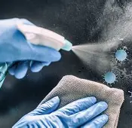
Environmental Cleaning
Regular cleaning
Clean and disinfect high-touch surfaces (doorknobs, bed rails, light switches, remote controls)
Special focus on common areas
Ensure that communal areas like dining rooms, activity rooms, and restrooms, are cleaned to regularly to prevent the spread of germs
Notes:
The EPA has a list of registered antimicrobial products used for norovirus and other infectious diseases. It is important to know that norovirus can not be killed with handsanitizer. You have to wash your hands to kill it.

Slide 11
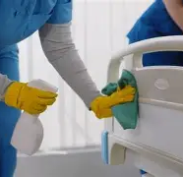
Environmental Disinfection
Use hospital-grade disinfectants and ensure appropriate contact for disinfectants to be effective
Follow a schedule for deep cleaning of the environment (weekly, biweekly)
  How often should the following be cleaned:
    Patient rooms (daily cleaning)
    Restrooms (general cleaning)
    High touch surfaces (common areas)
Notes:
For example, Clean and disinfect surfaces starting from the areas with a lower likelihood of norovirus contamination (e.g., tray tables, counter tops) to areas with highly contaminated surfaces (e.g., toilets, bathroom fixtures). Change mop heads when new solutions are prepared, or after cleaning large spills of emesis or fecal material.

Slide 12

Sinks: A Mode of Infection Transmission
Biofilm can build up in handwashing sink drains. This can allow organism that live in pipes/drain to contaminate the environment when the sink is being used
DO NOT:
  Empty body fluids down the drain
  Empty IV bags, antibiotics, or medications down the drain
  Pour liquid enteral food supplements down the drain
  Store resident care items by the sink
Notes:
Splashes may occur when flowing water hits the drain or when a toilet is flushed. Splashes can lead to spread of multidrug-resistant organisms containing droplets, which in turn may contaminate
the environment, equipment, and skin or clothing of healthcare personnel and patients/residents

Slide 13
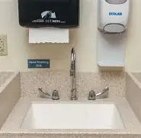
Sink Hygiene in Patient Care Areas
Are there clear three-foot splash zone or splash guards in place?
Review things stored around/below sink
Are the faucets offset from the drain?
  This is preferred because it leaves space to place items and doesn’t block drain
Make sure sinks are draining properly

Slide 14
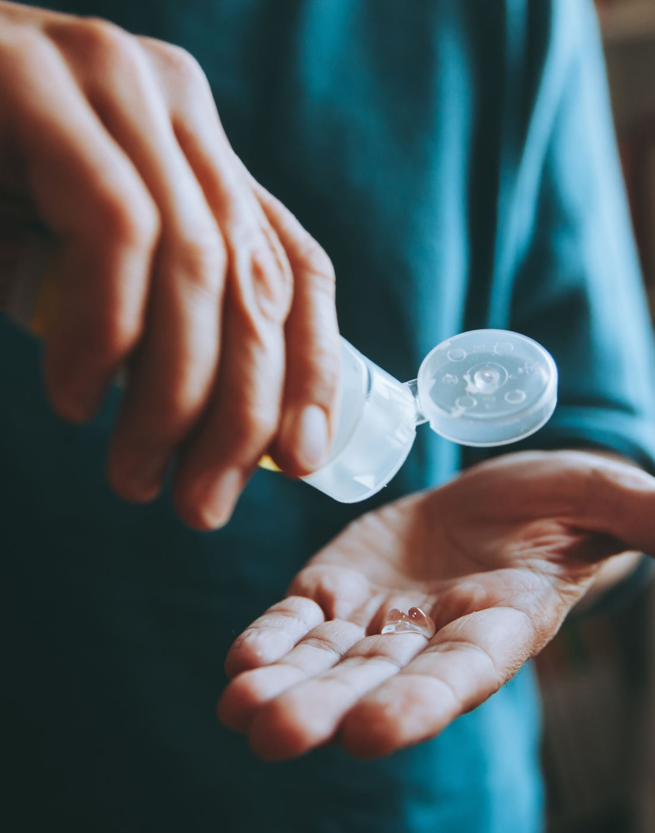
Hand Hygiene
Importance: Proper hand hygiene is the most effective way to prevent the transmission of infections
Notes:
The World Health Organization (WHO) estimates that hand washing can prevent up to 50% of all infections. This statistic highlights the significance of proper hand wash techniques in preventing the spread of illnesses. Hand washing is considered the single most important measure for preventing the spread of infections, and it is a powerful tool that can significantly reduce the risk of contracting and spreading diseases.

Slide 15
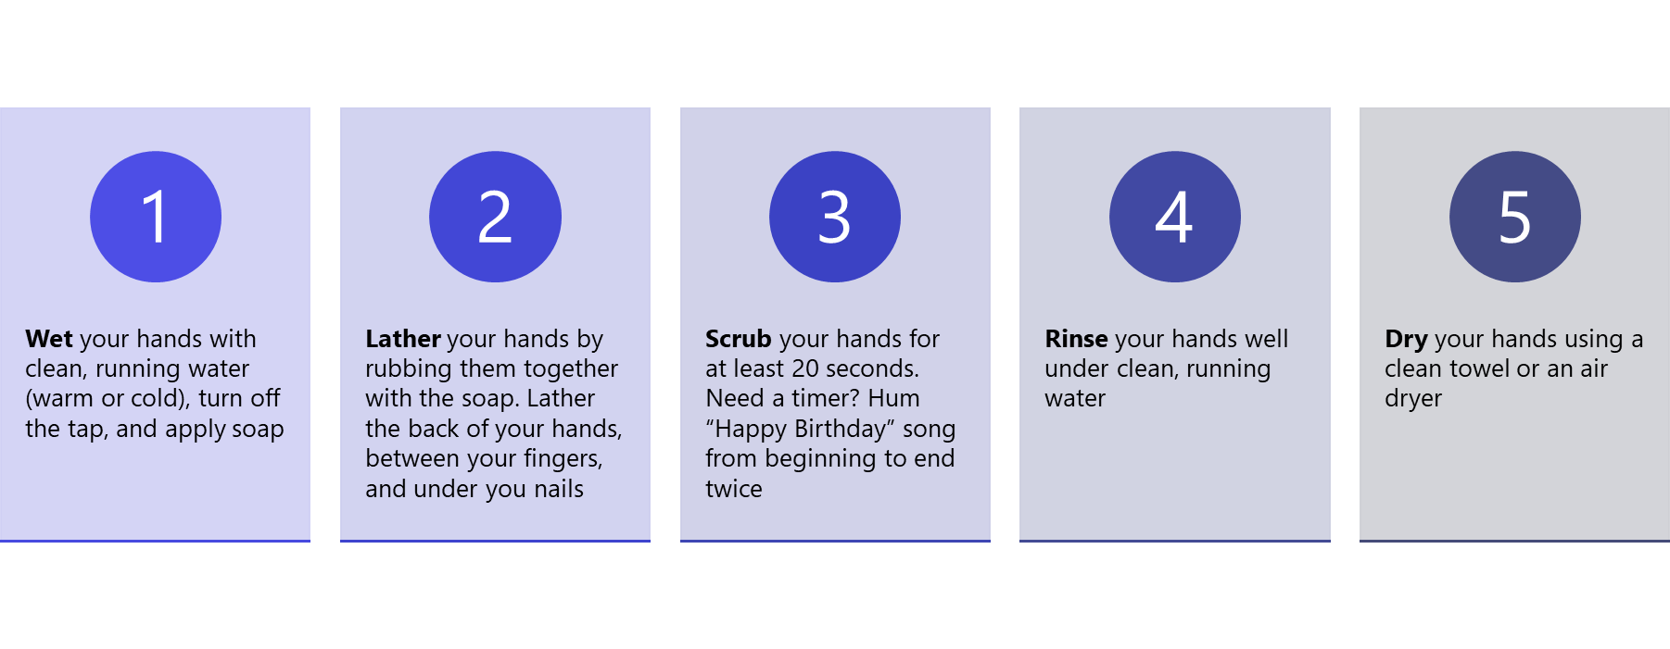
The 5 Steps to Proper Handwashing
r

Slide 16
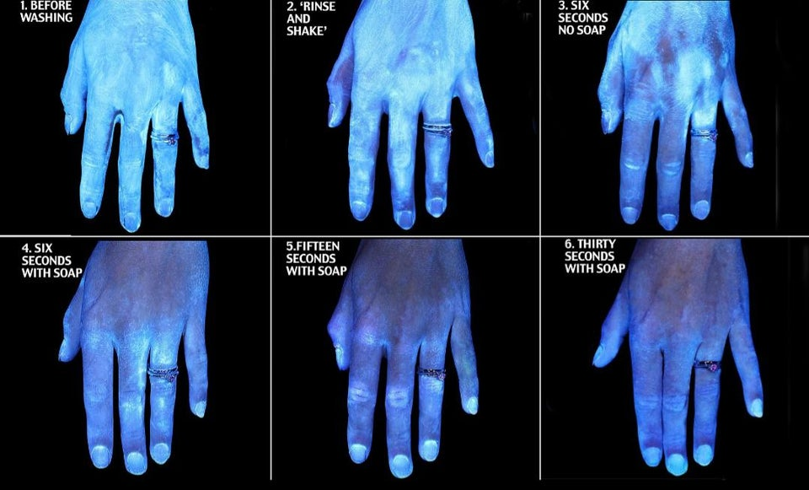
5 Common Hand Washing Mistakes
Not scrubbing long enough
Skipping areas
Using too little soap or water
Not drying hands properly

Slide 17
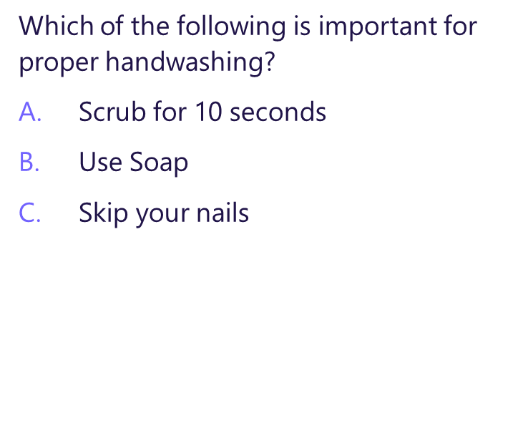

Quiz

Slide 18
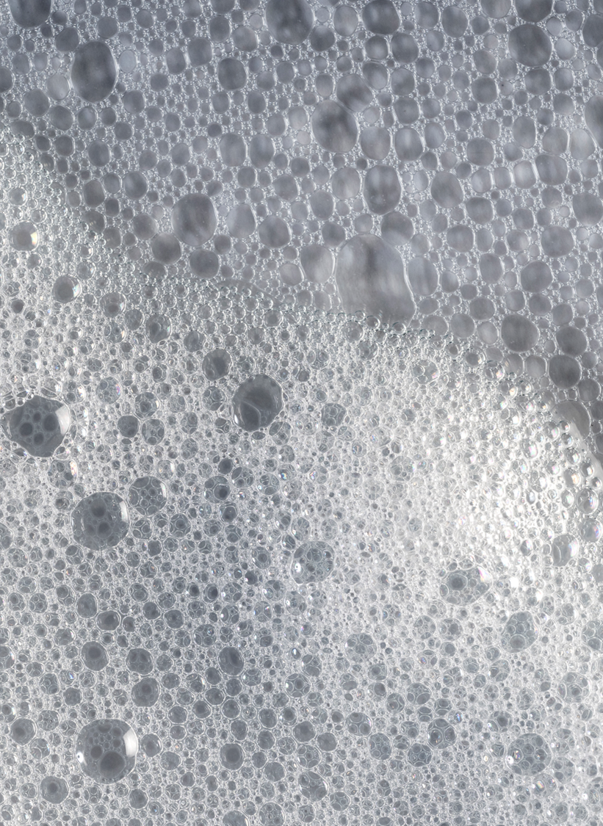
Correct Answer is B
Here’s Why:
+A. Scrub for 10 seconds: this is incorrect. The recommended time for scrubbing hands is at least 20 seconds to effectively remove germs
+B. Use Soap: This is correct. Soap is essential for removing dirt and germs from hands. It helps break down oils and dirt, making it easier to wash away bacteria and viruses
+C. Skip your nails: This is incorrect. You should wash all areas of your hands, including your nails, to prevent germs from staying trapped in those areas

Slide 19
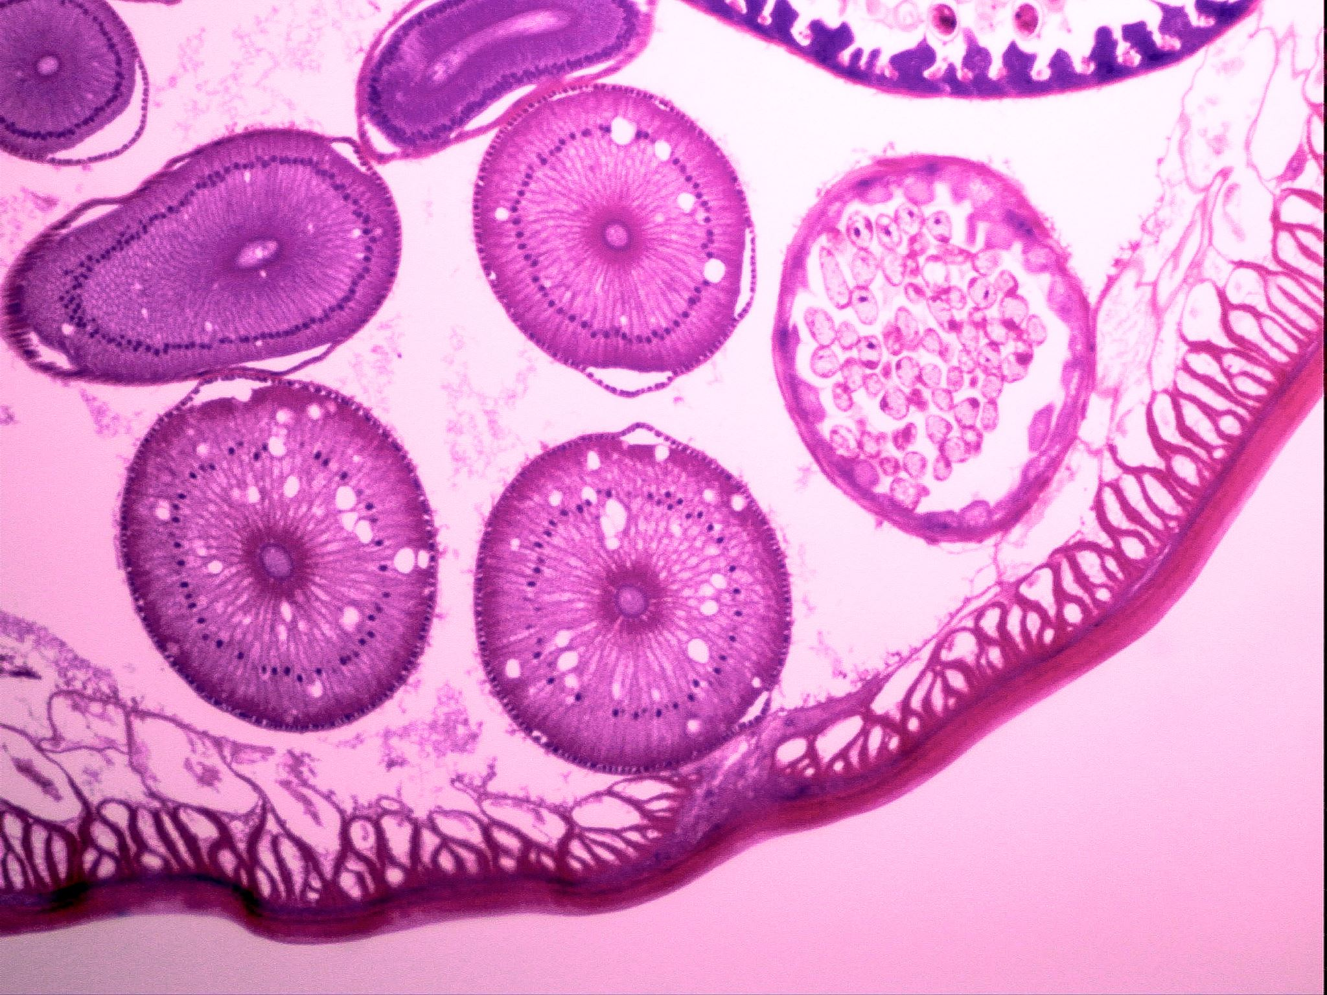
What Diseases Does Handwashing Prevent?
Respiratory Infections (COVID-19, Influenza, Pneumonia)
  Elderly individuals have compromised immune systems, making it easier for respiratory pathogens to take hold
  The close living quarters make these viruses spread quickly
Gastrointestinal Infections (Norovirus, Clostridium difficile, and E. Coli)
  Frequent contact with contaminated surfaces such as bed rails, doorknobs, and shared bathrooms can be contaminated with these pathogens
  Elderly are more vulnerable as they after have reduced stomach acid or digestive issues

Slide 20
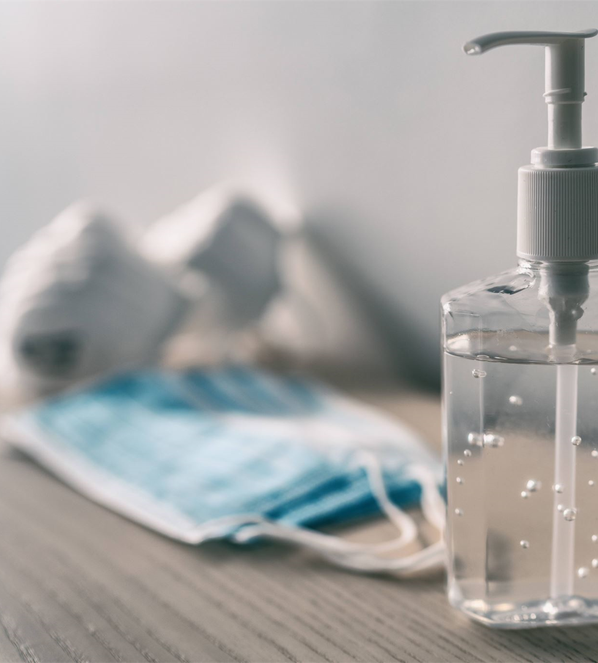
When to use Soap and Water, NOT Hand Sanitizer
Use Soap and Water:
  Hands are visibly dirty or soiled
  After contacts with patients or surfaces with the following pathogens:
    C. diff, Norovirus, Anthrax
  After using the restroom
  Before eating or handling food
  After cleaning bathrooms or dealing with fecal contamination
  If hands feel sticky or have chemical residue
Notes:
pathogens form spores that are not likely killed by alcohol based hand sanitizers

Slide 21
When can you use Hand Sanitizer instead of Soap and Water
Use Hand Sanitizer (60% + alcohol when)
  Hands are not visibly dirty
  In between cleaning rooms or surfaces
  After removing gloves
  During routine cleaning in non-spore forming pathogen areas

Slide 22
Hand Sanitizer or Soap??
After glove removal?
After patient room terminal cleaning?
After touching high-touch surfaces?
After restroom or bodily fluid exposure?
Before eating or taking a break?
Notes:
hand sanitizer or soap
soap and water
hand sanitizer
soap and water
soap and water

Slide 23
Hand Washing Conclusion:
By practicing proper handwashing, both staff and residents can significantly reduce the spread of infections, ensuring a safer, healthier environment for everyone
Hand hygiene is the most effective method of breaking the chain of infection from the hands, which are major vehicles for transmission in healthcare settings

Slide 24


Other Presentations CHHD Offers
Isolation Precautions
Enhanced Barrier Precautions
Outbreak Information

Slide 25

Contact Info for Cabell-Huntington Health Department
Health Department Number: (304) 523-6483
Mikaela Earl (Director of Epidemiology): Ext. 284
Faith Gandy (Epidemiology Educator): Ext. 399
Alyssa Reed (Epidemiology Educator): Ext. 398

Slide 26
Resources
https://www.cdc.gov/healthcare-associated-infections/media/pdfs/PHS-ReduceWaterRisk-ChecklistTool-508.pdf
https://www.cdc.gov/healthcare-associated-infections/php/toolkit/water-management.html?CDC_AAref_Val=https://www.cdc.gov/hai/prevent/environment/water.html
https://www.cdc.gov/infection-control/hcp/core-practices/index.html
https://www.cdc.gov/projectfirstline/hcp/training/index.html

