Slide 1
Infection Prevention and Control:
Traveling to a Home Near You
Table Talk with (Insert LHD Name)
Notes:
UPDATE TITLE WITH LHD NAME
**CONSIDER UPDATING MASTER TEMPLATE TO ADD LHD LOGO**
1
1

Slide 2
Agenda
Welcome and introductions
Home care setting
Recognizing risk
Portability of care
Cleaning and disinfection
Conclusion

Slide 3
Infection Prevention and Control:
Traveling to a Home Near You
Notes:
3

Slide 4

Learning Objectives
Understand the concepts of risk recognition, reservoirs, and pathways in home care.
Apply the concept of portable care to the home care bag and vehicle that is important for infection control.
Describe the difference between cleaning and disinfection.
Discuss why it is important to follow the label instructions on a disinfectant product.
Notes:
4

Slide 5
Home Care: A Unique Setting
A home is anywhere a person lives. That can be a house, apartment, assisted living, group home, camper, tent, or no shelter at all. (Dommaraju, 2021)
Homes are not designed for health care, and differences in home environments can pose unique challenges and barriers for home care providers. (Olsen, 2010)
Home care providers must be flexible, resourceful, and sometimes creative to provide care for people living in many different types of environments. (McGoldrick, 2016)
Notes:
References
Dommaraju, S. R., Raguveer, V., Ryan, C., Ceh, J., Galanter, W. L., & Figueroa, E. (2021). Home Health Care for Patients Without Shelter. AMA Journal of Ethics, 23(11), E887–E892. https://doi.org/10.1001/amajethics.2021.887
McGoldrick M. (2016). Core and supplementary contents in the home care nursing bag. Home Healthcare Now, 34(8), 457. https://doi:10.1097/NHH.0000000000000431
Olsen, S. (2010). The role of human factors in home health care. [electronic resource] : workshop summary. National Academies Press.
5

Slide 6
Discussion
What are some current challenges or barriers that impact daily home care work?
Notes:
6

Slide 7
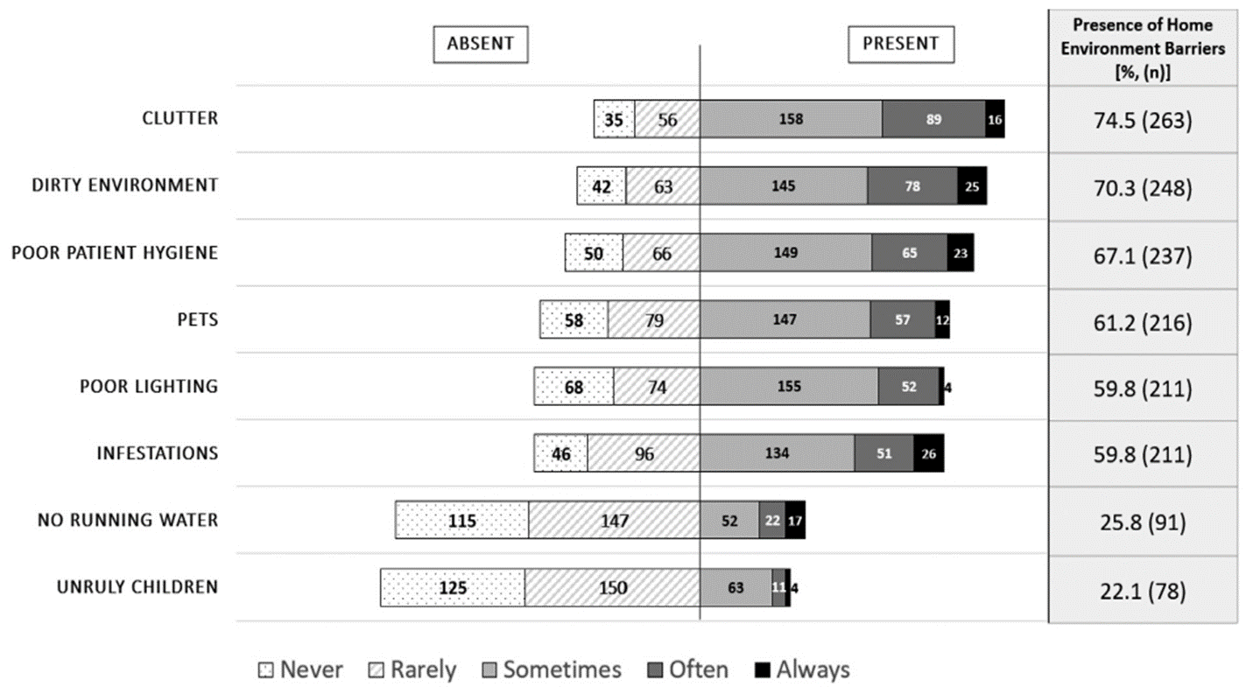
Environmental Barriers in the Home
Science Direct: Infection prevention and control practices in the home environment (https://doi.org/10.1016/j.ajic.2020.10.021)
Notes:
Environmental barriers in the home that may impact cares
Self reported survey to 353 Home Care nurse (2 agencies)
Reference
Adams, V., Song, J., Shang, J., McDonald, M., Dowding, D., Ojo, M., & Russell, D. (2021). Infection prevention and control practices in the home environment: Examining enablers and barriers to adherence among home health care nurses. American journal of infection control, 49(6), 721–726. https://doi.org/10.1016/j.ajic.2020.10.021
7

Slide 8
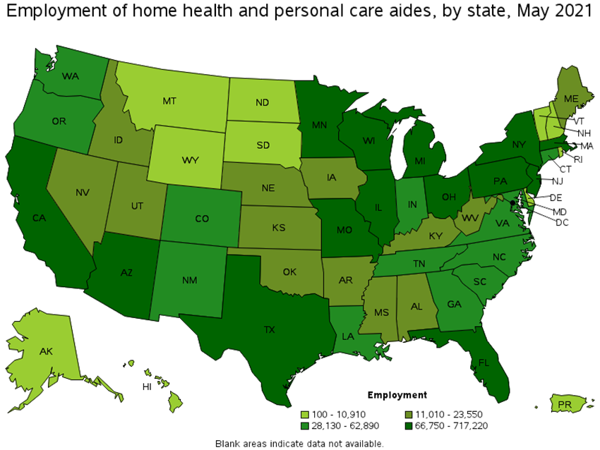
Industry Statistics
From 2002 to 2018, the number of Home Health Care (HHC) users has increased by 35% (Adams, 2021)
In 2018, 3.4 million people were visited by HHC providers from 11,556 agencies (Adams, 2021)
Employment of home health and personal care aides is projected to grow 33 percent from 2020 to 2030, much faster than the average for all occupations
(U.S. Bureau of Labor and Statistics, 2022)
U.S. Bureau of Labor and Statistics: Occupational Employment and Wage Statistics (www.bls.gov/oes/current/oes311120.htm#st)
Notes:
References
Adams, V., Song, J., Shang, J., McDonald, M., Dowding, D., Ojo, M., & Russell, D. (2021). Infection prevention and control practices in the home environment: Examining enablers and barriers to adherence among home health care nurses. American journal of infection control, 49(6), 721–726. https://doi.org/10.1016/j.ajic.2020.10.021
U.S. Bureau of Labor and Statistics. Occupational Employment and Wage Statistics (2022). https://www.bls.gov/oes/current/oes311120.htm#st
8

Slide 9
Recognizing Risk
Infection Prevention and Control: Traveling to a Home Near You
Notes:
9

Slide 10
Recognizing Risk
Risk Recognition: Seeing the potential for a problem to happen.
Seeing a potential problem doesn’t mean the problem will definitely happen! We take action to keep something bad from happening.
Reservoir: A place where germs live and thrive.
Pathway: A way for germs to be spread from their reservoir to another reservoir, or to a person to infect.
Notes:
10

Slide 11
How Germs Spread in Health Care: Four Main Pathways
1
Through touch
2
When they’re breathed in
3
Through splashes or sprays
4
Through clinical care tasks that bypass or break down the body’s natural defenses
Notes:
11

Slide 12

Reservoirs Review
Body Reservoirs
Environment Reservoirs
Skin
GI
system or “gut”
Respiratory system
Blood
Water and
wet surfaces
Dry surfaces
Dirt and dust
Devices
Notes:
12

Slide 13
What do you know about reservoirs in home care?
What do you know about pathways in homecare?
Notes:
13

Slide 14
Portability of Care
Infection Prevention and Control: Traveling to a Home Near You

Slide 15
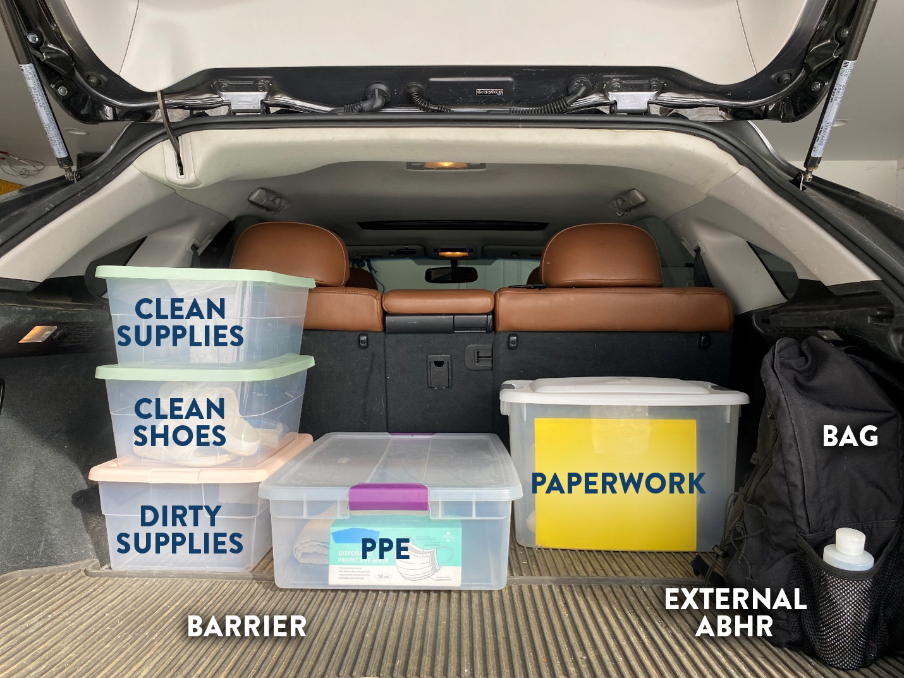
Vehicle Considerations
Dedicated space in the vehicle
Clearly separated clean and dirty areas
Closeable containers with high sides
Nonporous surface (leather/vinyl)
Barrier on porous (fabric) surfaces in trunks or seats of vehicle
Prevent contamination from external environments and cross contamination inside vehicle (McGoldrick, 2015)
Consider placement and covered supplies to provide safety from other passengers, pets, and children
Notes:
Reference
McGoldrick M. (2015). Best Practices for Managing Medical Equipment and Supplies Stored in a Vehicle. Home healthcare now, 33(7), 368–374. https://doi.org/10.1097/NHH.0000000000000270
15

Slide 16
Discussion
How is your vehicle organized?
Notes:
16

Slide 17

History of the Home Care Bag
Notes:
17

Slide 18
Home Care Bag: Environmental Assessment
Initial Assessment
  Consider bringing documentation tools/essentials only, rather than the whole bag
  Assess risk – home environment, water availability, necessary equipment (McGoldrick, 2016)
  Plan what will be needed on the next trip
Identify dedicated space in the home for bag placement
  Define clean and dirty areas – consider bag and reusable items (blood pressure cuff, stethoscope, etc.) that will need disinfection
  Barrier on porous (fabric) and nonporous surfaces (McGoldrick, 2017)
  Prevent contamination from external environments and cross-contamination (Bakunas-Kenneley & Madigan, 2009)
Notes:
References
Bakunas-Kenneley, I., & Madigan, E. A. (2009). Infection prevention and control in home health care: The nurse's bag. American journal of infection control, 37(8), 687-688.
McGoldrick M. (2016). Core and supplementary contents in the home care nursing bag. Home Healthcare Now, 34(8), 457. https://doi:10.1097/NHH.0000000000000431
McGoldrick M. (2017). Best Practices for Home Care "Bag Technique" and the Use of Surface Barriers. Home healthcare now, 35(9), 478–484. https://doi.org/10.1097/NHH.0000000000000611
18

Slide 19
Discussion
When would you consider not taking the bag inside?
Notes:
19

Slide 20
Home Care Bag Considerations
Consider only bringing in necessary equipment when client is:
In Transmission-Based Precautions
Known to be colonized or infected with a multidrug-resistant organism (MDRO), C. difficile, or diarrhea of unknown etiology (McGoldrick, 2017)
  MDROs may include Methicillin-resistant Staphylococcus aureus (MRSA), Carbapenem-resistant Enterobacteriaceae (CRE), and Candida Auris
Home environment is experiencing infestation(s)
Environment is contaminated with excrements from humans, pests, and/or pets (McGoldrick, 2015)
Use your best judgement
Notes:
References
McGoldrick M. (2015). Best Practices for Managing Medical Equipment and Supplies Stored in a Vehicle. Home healthcare now, 33(7), 368–374. https://doi.org/10.1097/NHH.0000000000000270
McGoldrick M. (2017). Best Practices for Home Care "Bag Technique" and the Use of Surface Barriers. Home healthcare now, 35(9), 478–484. https://doi.org/10.1097/NHH.0000000000000611
20

Slide 21

Ok, ready to proceed…

Slide 22
Bringing the Bag into the Home
Best Bag Practices:
Plan supplies needed to limit trips to vehicle (McGoldrick, 2016)
Identify area for bag placement
  Cleanable, hard surface
  Consider barrier placement on surface
Hand hygiene
  Before entering the bag, before donning PPE, after doffing PPE, and between tasks
Keep bag closed when not obtaining items for care
Think of the bag as a clean utility room
Notes:
Reference
McGoldrick M. (2016). Core and supplementary contents in the home care nursing bag. Home Healthcare Now, 34(8), 457. https://doi:10.1097/NHH.0000000000000431
22

Slide 23
Selecting a Bag
Bag material
  Wipeable inside and outside
  Clean and disinfect bag, working inside to outside
  Consider proper laundering frequency due to environment and when visibly soiled (McGoldrick, 2017)
Product placement
  Clean and disinfect devices BEFORE placing in bag
    Includes computer, mouse, tablet, cell phone, and equipment such as stethoscope and blood pressure cuff (McGoldrick, 2016)
  Dedicate an external location on the bag for hand sanitizer
Transportation of other supplies outside of bag (e.g., sharps)
Notes:
References
McGoldrick M. (2016). Core and supplementary contents in the home care nursing bag. Home Healthcare Now, 34(8), 457. https://doi:10.1097/NHH.0000000000000431
McGoldrick M. (2017). Best Practices for Home Care "Bag Technique" and the Use of Surface Barriers. Home healthcare now, 35(9), 478–484. https://doi.org/10.1097/NHH.0000000000000611
23

Slide 24
Cleaning and Disinfection
Infection Prevention and Control: Traveling to a Home Near You

Slide 25
Poll
Cleaning is killing germs. Disinfecting is removing dirt and some germs.
Disinfecting is a type of cleaning (cleaning with chemicals).
Cleaning is a type of disinfecting (disinfecting with soap or detergent).
Disinfecting is killing germs. Cleaning is removing dirt and some germs.
Notes:
Correct answer is D. Disinfecting is killing germs. Cleaning is removing dirt and some germs.
25

Slide 26
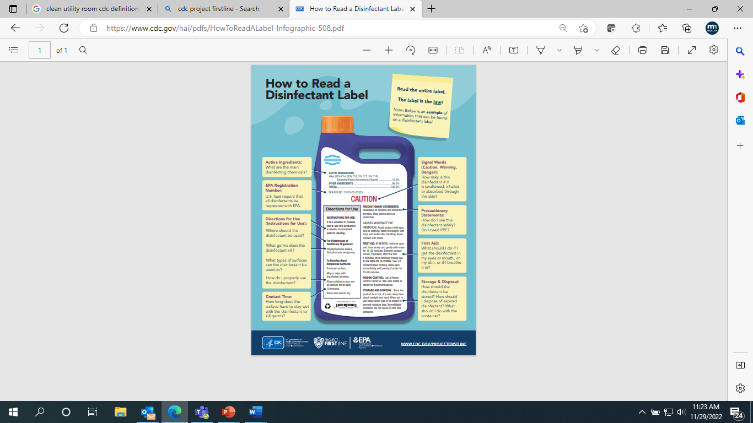
Cleaning and Disinfection
There is a difference between cleaning and disinfecting – cleaning can remove visible grime and some germs, while disinfecting kills germs.
Clean before disinfecting
Follow product label instructions
  Contact time
  Consider other factors such as temperature that can change how well a product works
Consider products that both clean and disinfect
  EPA list of disinfectants
CDC: How to Read a Disinfectant Label (www.cdc.gov/hai/pdfs/HowToReadALabel-Infographic-508.pdf)
Notes:
26

Slide 27
Conclusion

Slide 28

Key Takeaways
Help control infections in health care by recognizing the risks, the reservoirs, and the pathways for germs to spread.
Understanding elements of infection control in portability of care for the vehicle and home care bag to stop the spread of infection.
Cleaning removes visible dirt and disinfecting kill germs on surfaces or objects.
It is important to keep the health care environment clean to stop the spread of germs.
Follow the instructions on the disinfectant label – especially instructions for contact time.
Notes:
28

Slide 29
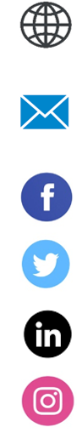
Resources and Feedback Poll
LHD Name
Subscribe to LHD Project Firstline emails
LHD on Facebook
LHD on Twitter
LHD on LinkedIn
LHD on Instagram
CDC’s Project Firstline
(www.cdc.gov/infection control/projectfirstline/index.html)
CDC’s Project Firstline on Facebook (www.facebook.com/CDCProjectFirstline)
CDC’s Project Firstline on Twitter (www.twitter.com/CDC_Firstline)
Project Firstline Inside Infection Control on YouTube
(www.youtube.com/playlist?list=PLvrp9iOILTQZQGtDnSDGViKDdRtIc13VX)
Sign up for CDC’s Project Firstline emails (https://tools.cdc.gov/campaignproxyservice/subscriptions.aspx?topic_id=USCDC_2104)
Notes:
UPDATE FOR LHD INFO
29

Slide 30
Funny Minute
Why did the germ cross the microscope?
To get to the other slide.
Notes:
30

Slide 31
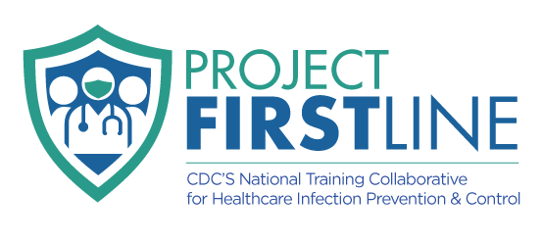

Questions
Insert Local Health Department information here
Logo
Contact info
Reporting instructions
Local outbreak policies
Include QR codes or links to LHD specific online resources, videos, or interactive checklists if applicable
**Option to add LHD logo to bottom of master template**
Notes:
UPDATE FOR LHD INFO
31

Slide 32

Acknowledgements
Presentation was adapted by the National Association of County and City Health Officials and [LHD] with permission from the Minnesota Department of Health Project Firstline Team.

